Slide 1
MICROBIOLOGIA GENERALE
Viruses of prokaryotes

Slide 2
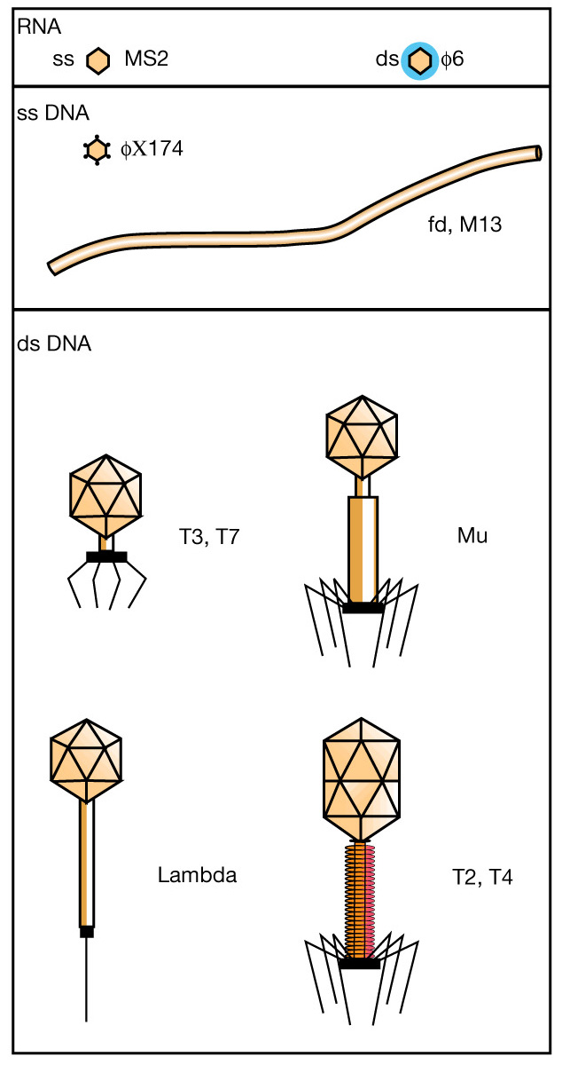
The main types of
bacterial viruses

Slide 3
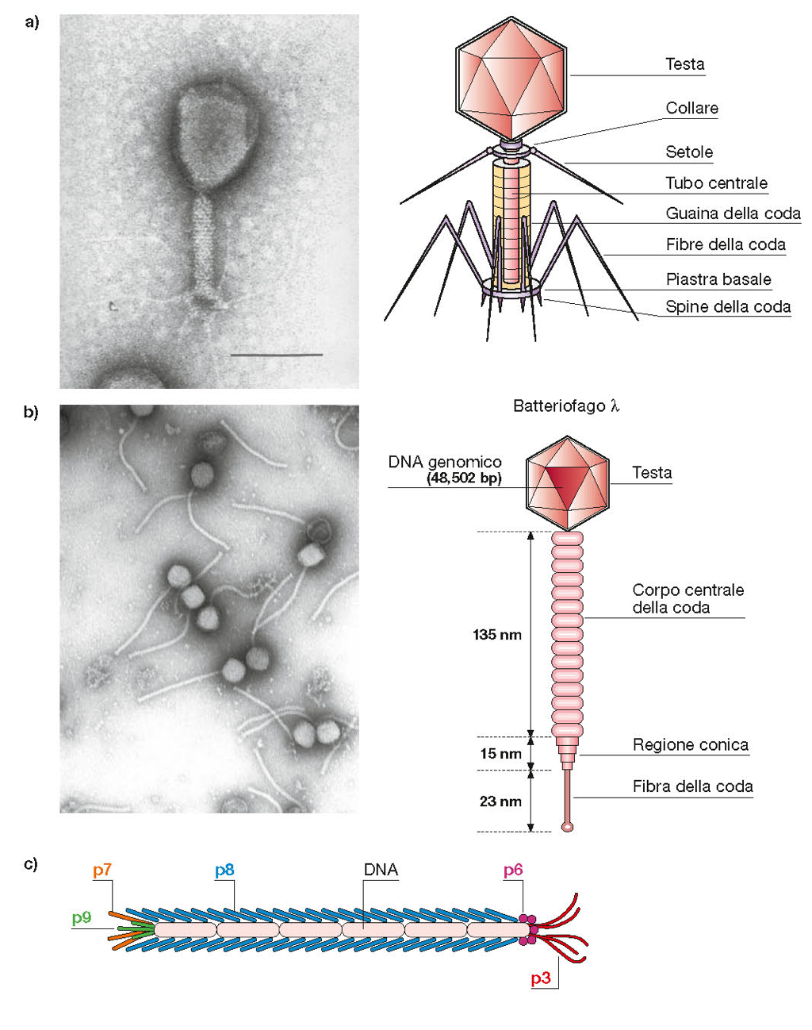

Slide 4
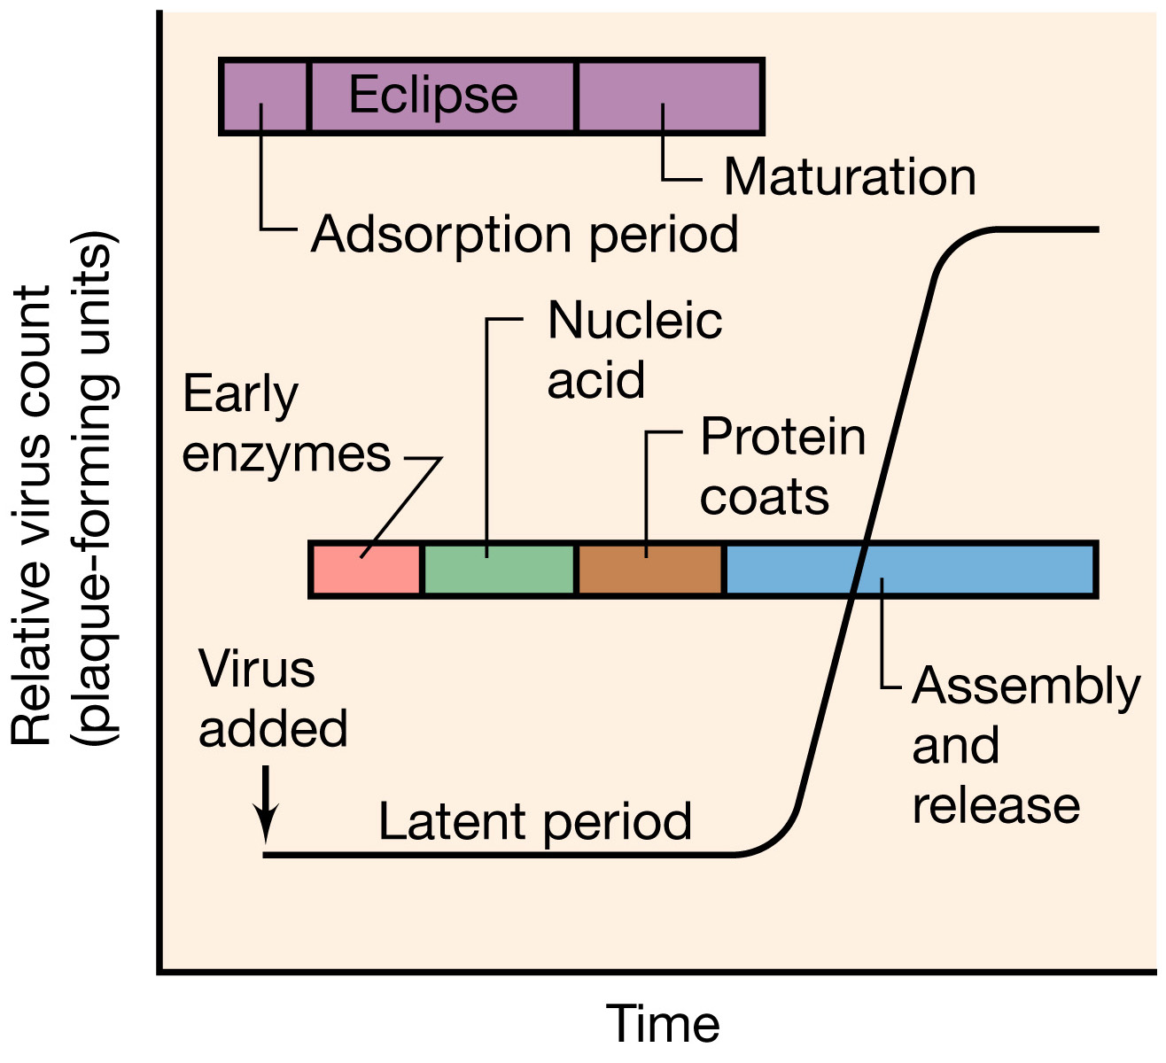
The one-step growth curve of virus replication

Slide 5
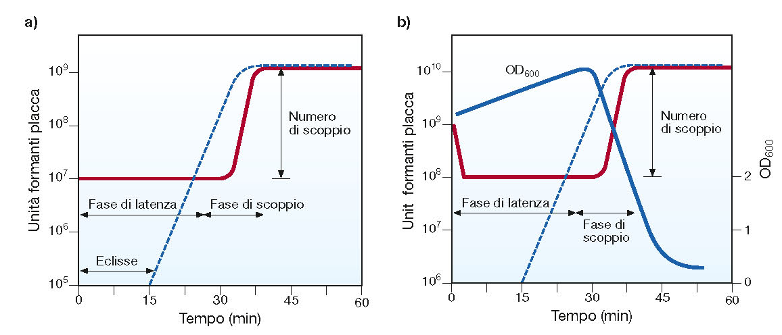
The one-step growth curve of virus replication

Slide 6
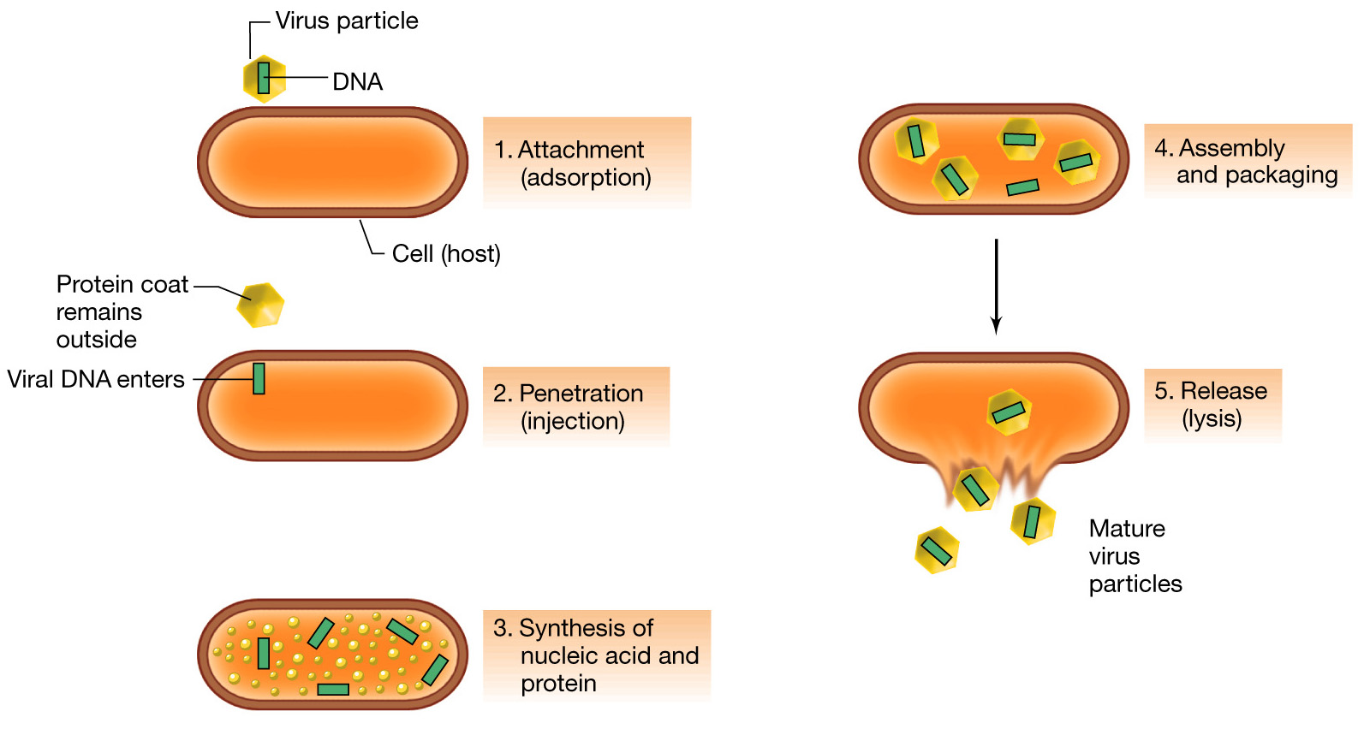
The replication cycle of a bacterial virus

Slide 7
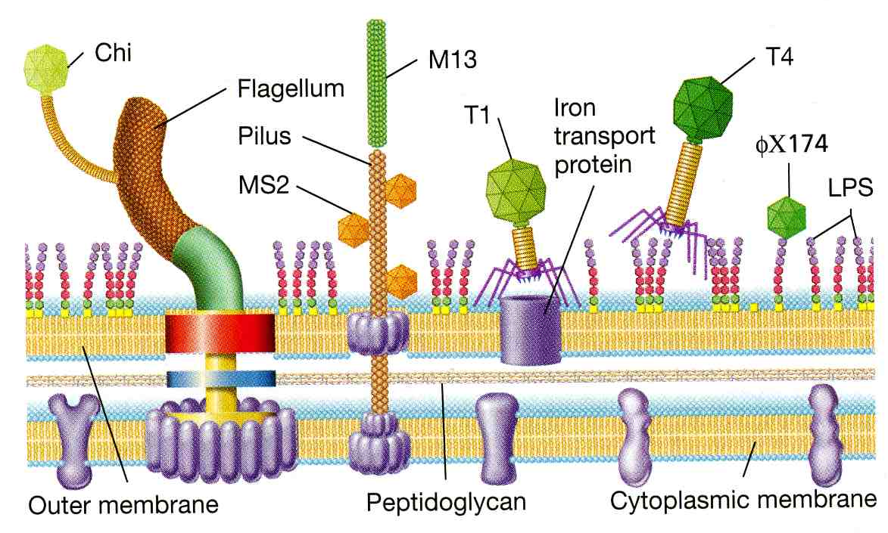
Bacteriophage receptors

Slide 8
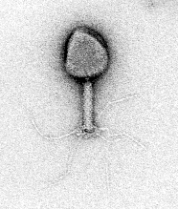
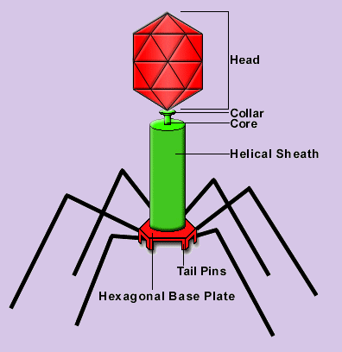
The Escherichia coli bacteriophage T4

Slide 9
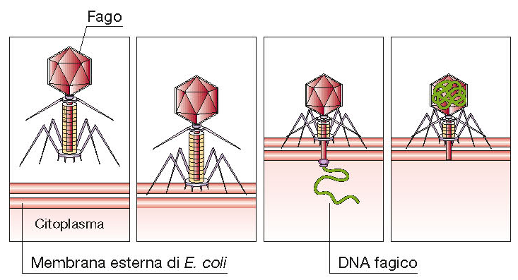
Attachment of T4 phage virion to the cell wall of
E. coli and injection of DNA

Slide 10
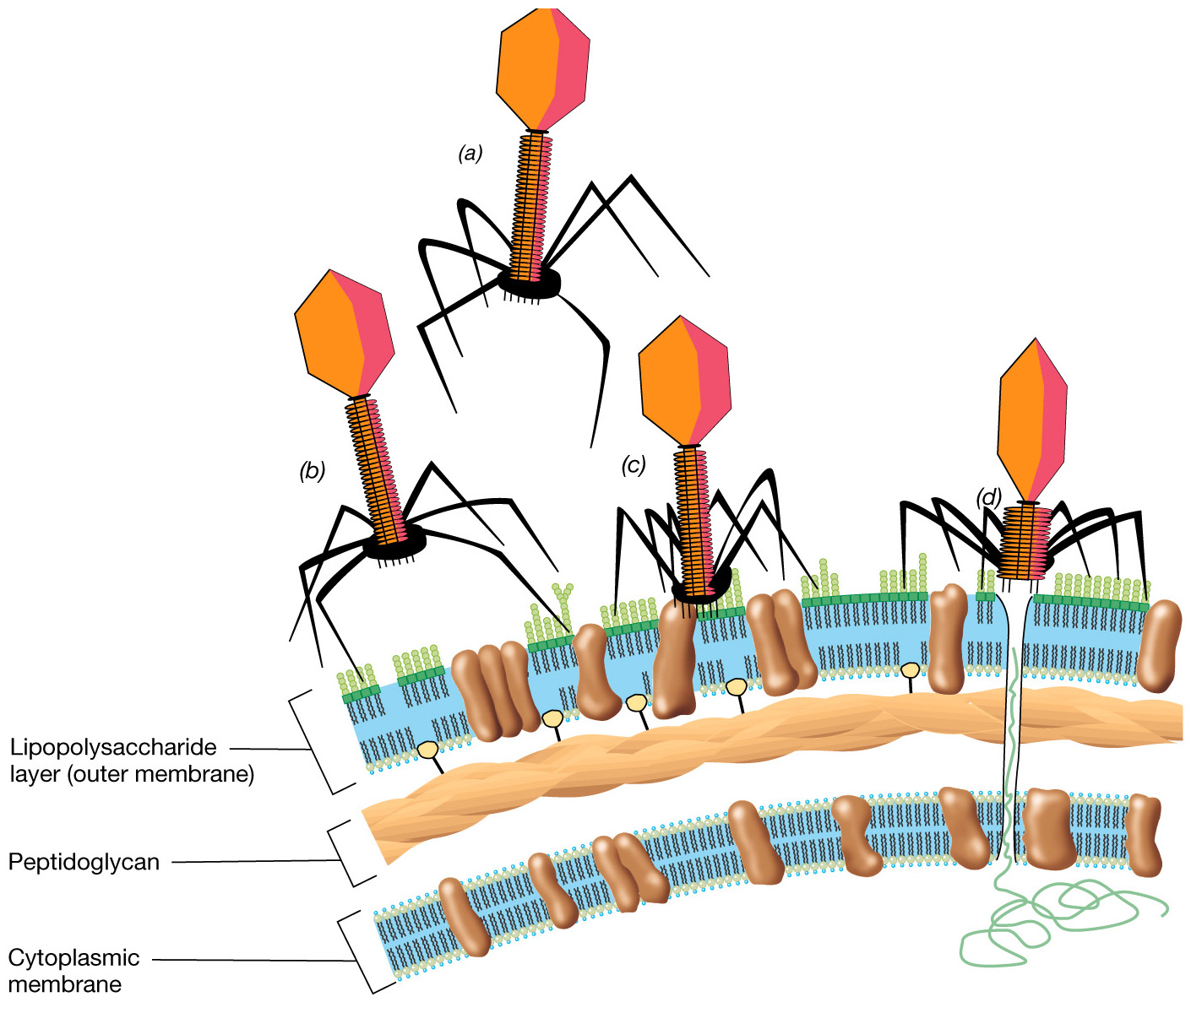
Attachment of T4 phage
virion to the cell wall of
E. coli and injection of DNA

Slide 11
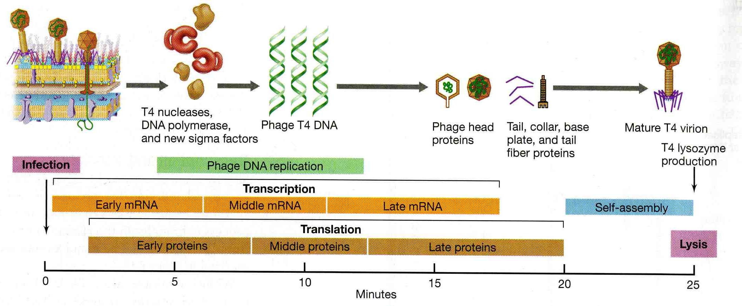
Time course of events in phage T4 infection

Slide 12
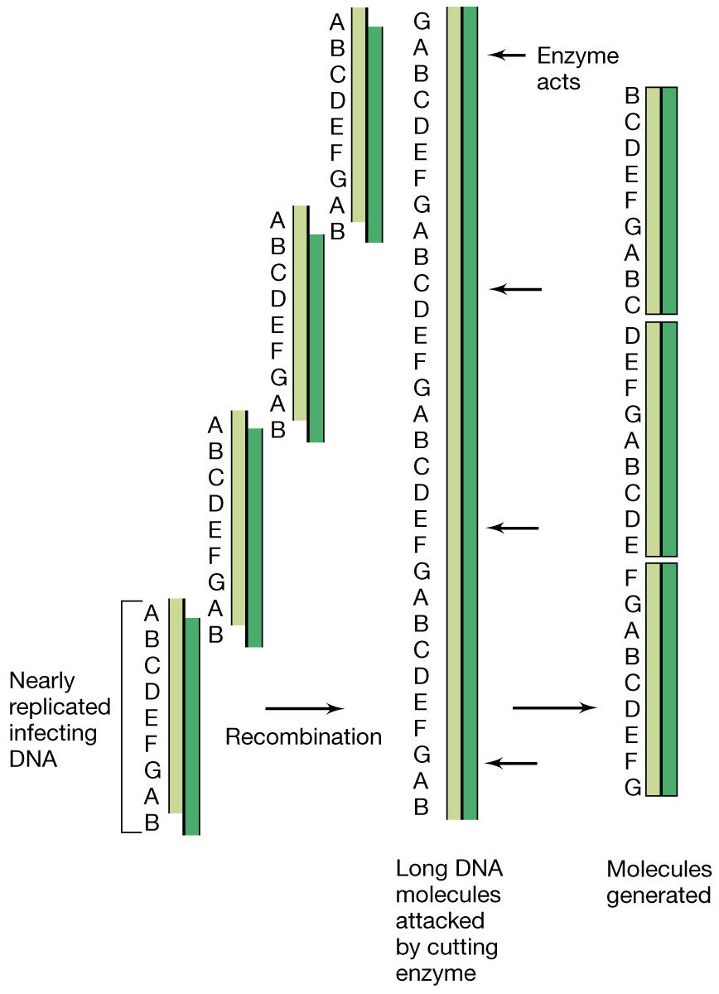
Generation in T4 of virus length DNA
molecules with permuted sequences

Slide 13
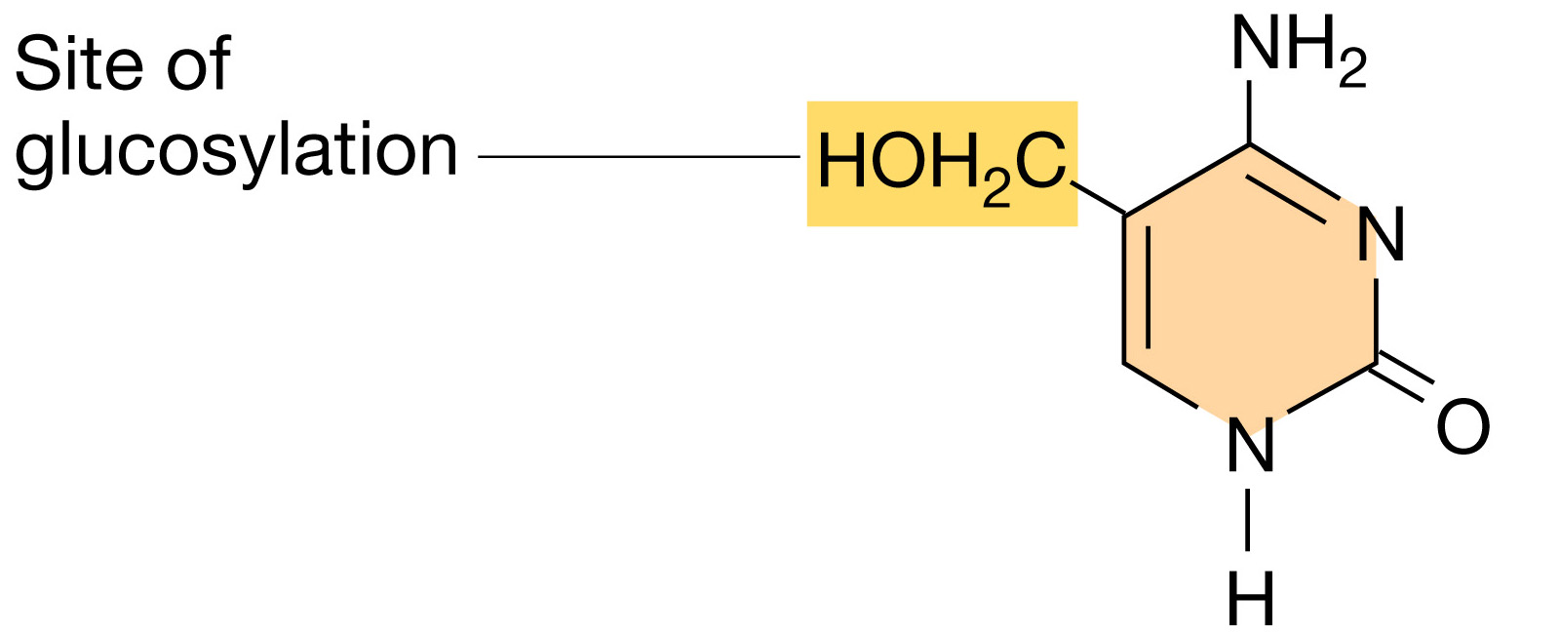
The unique base in the DNA of the T-even bacteriophages, 5-hydroxymethylcytosine

Slide 14
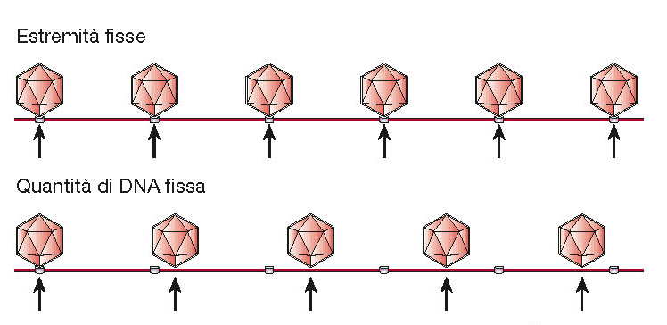
Packaging of phage genomes
λ
T4

Slide 15
Packaging of DNA into a T4 phage head

Slide 16
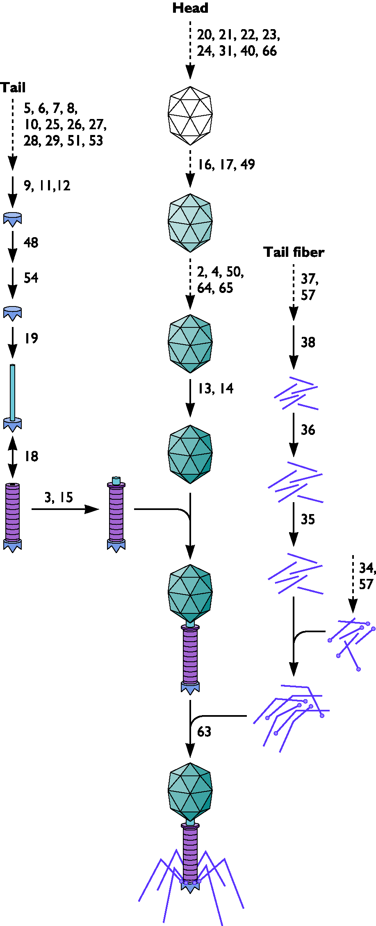
Assembly of T4 phage

Slide 17
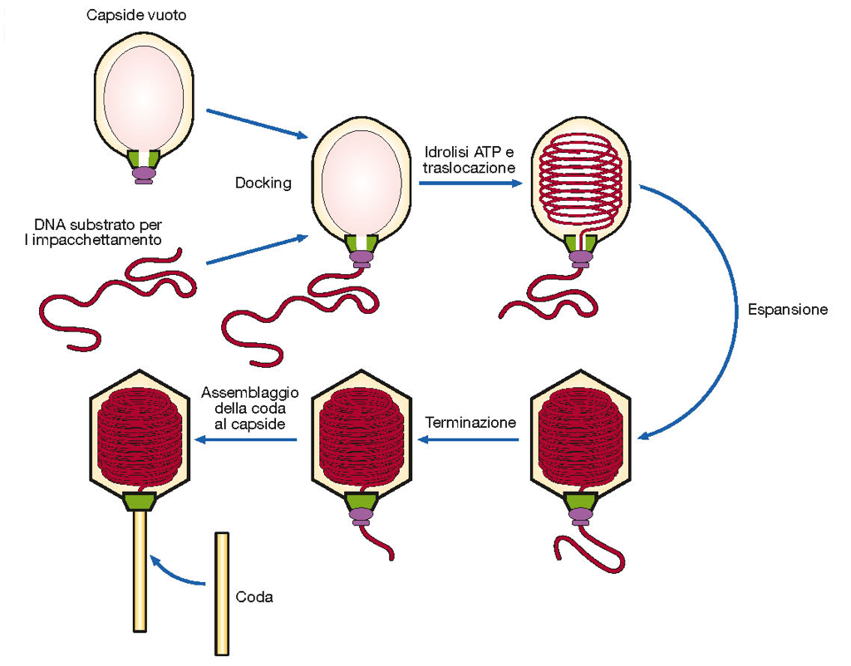
Assembly of T4 phage

Slide 18
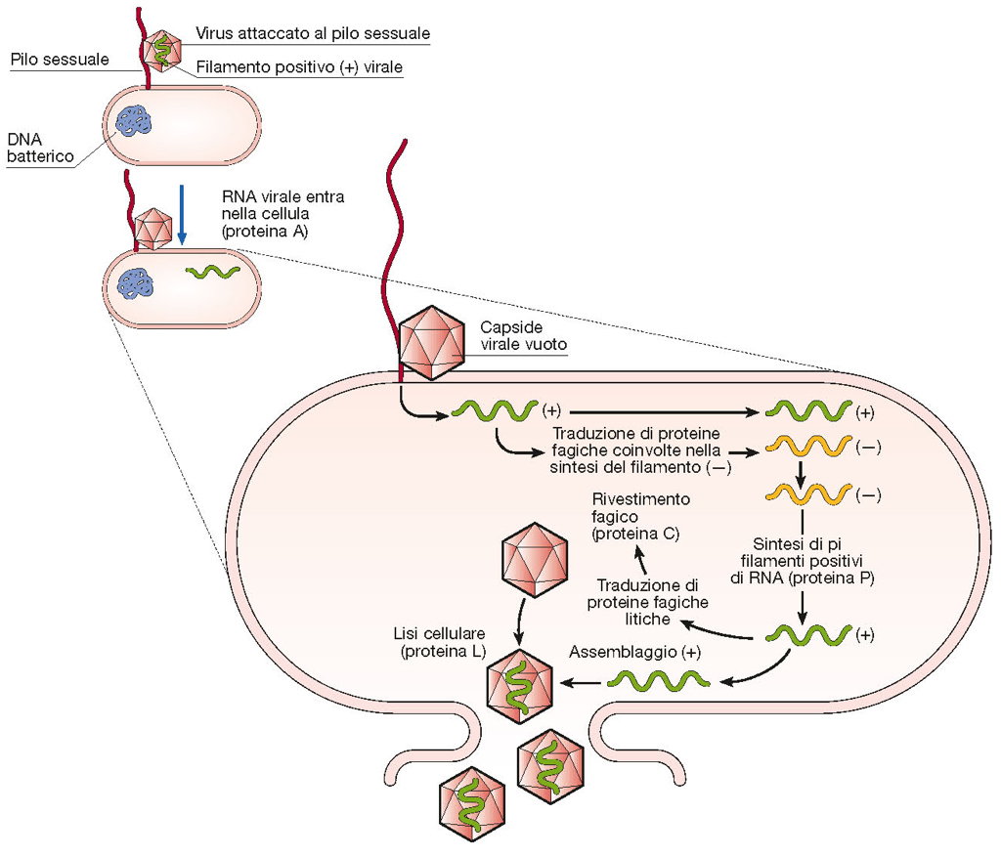
The RNA phage MS2 and flow of events during its multiplication.

Slide 19
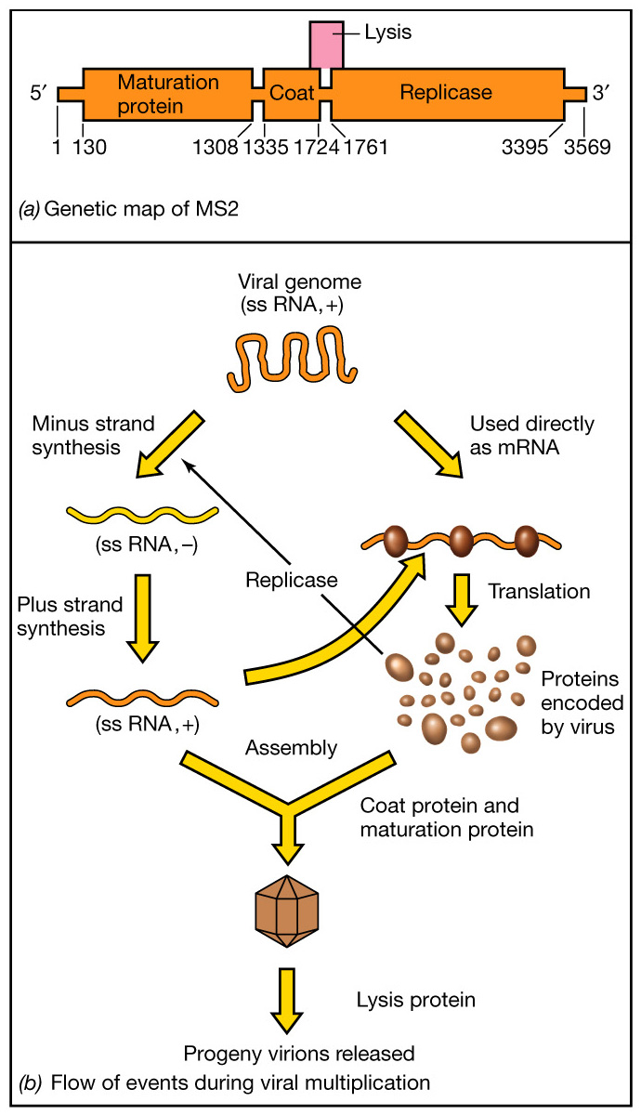
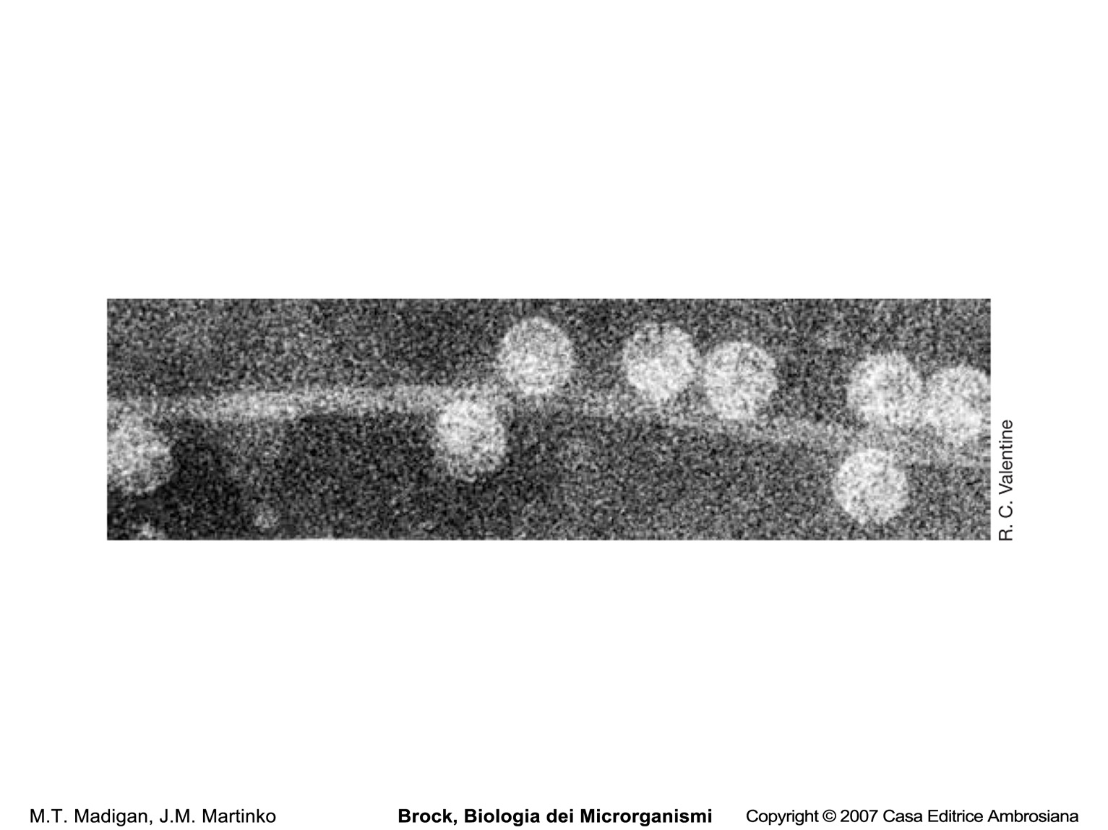
Genetic map of the RNA phage MS2 and flow of events during its multiplication.

Slide 20
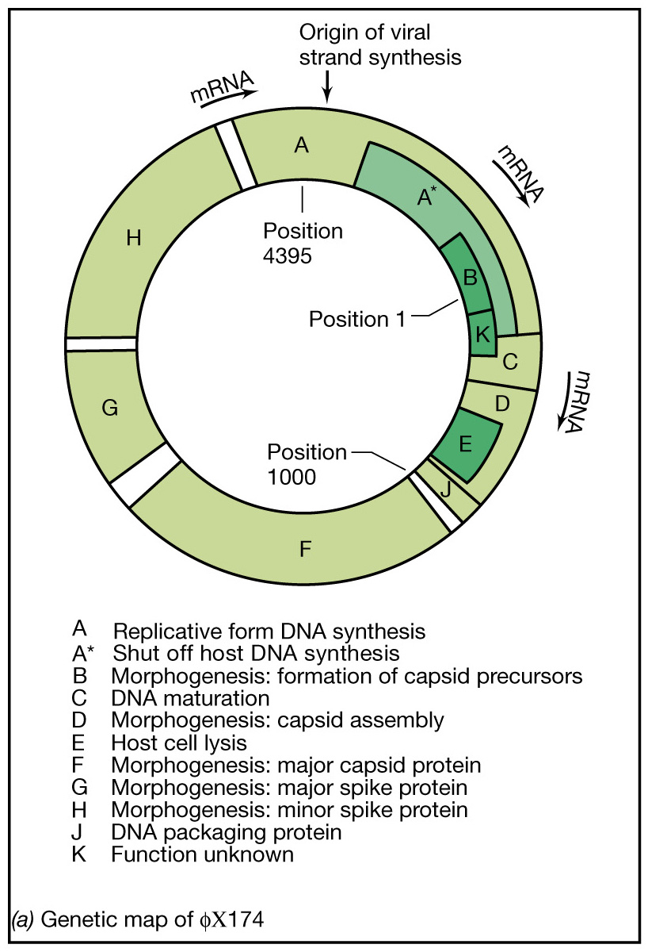
Genetic map of φX174, a single-stranded DNA phage
(5386 bp)
Notes:
Figure: 16-03a
Caption:
Bacteriophage θX174, a single-stranded DNA phage. (a) Genetic map. Note the regions of gene overlap (A/B, K/B, K/C, K/A, A/C, and D/E). Intergenic regions are not colored. Protein A* is formed using only part of the coding sequence of gene A by reinitiation of translation (see text). (b). The production of progeny ss DNA from replicative form ds DNA involves rolling circle replication and is shown in more detail in Figure 16.4.

Slide 21
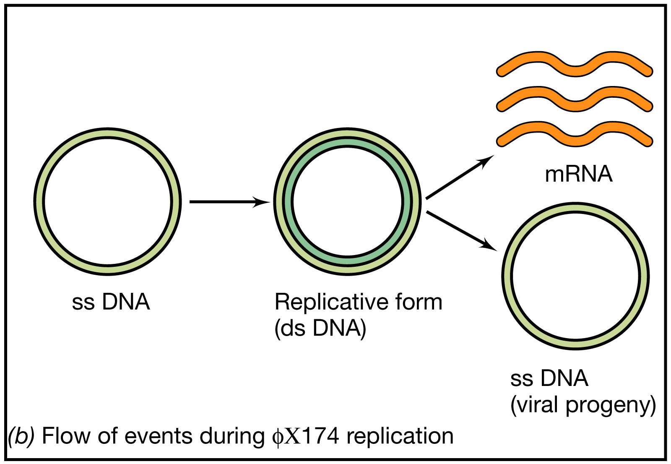

Slide 22
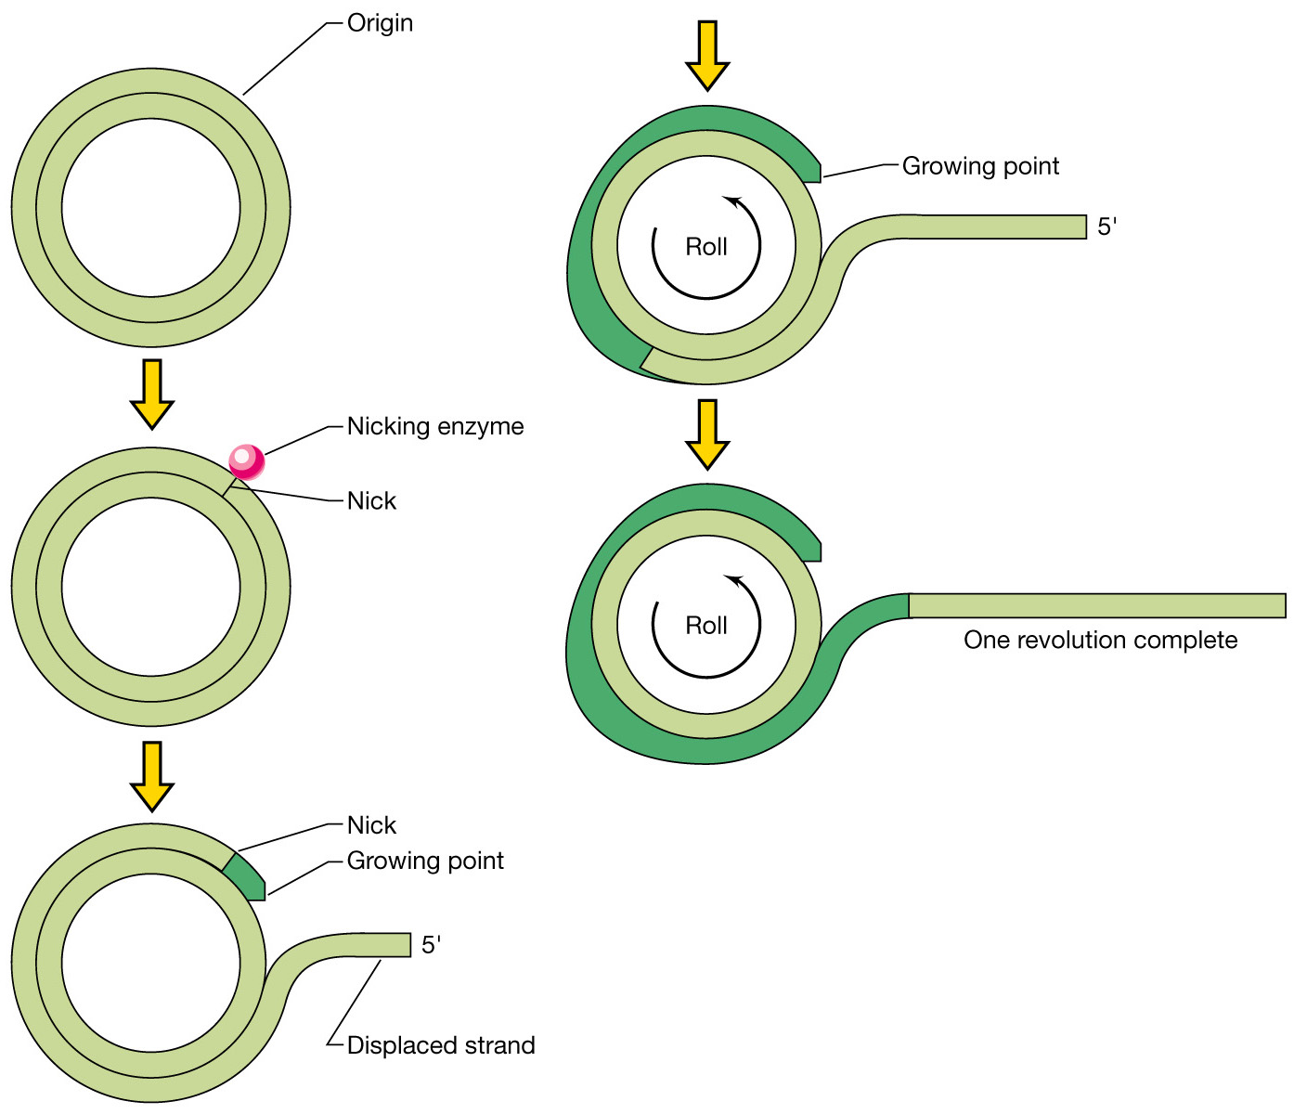
Rolling circle replication

Slide 23
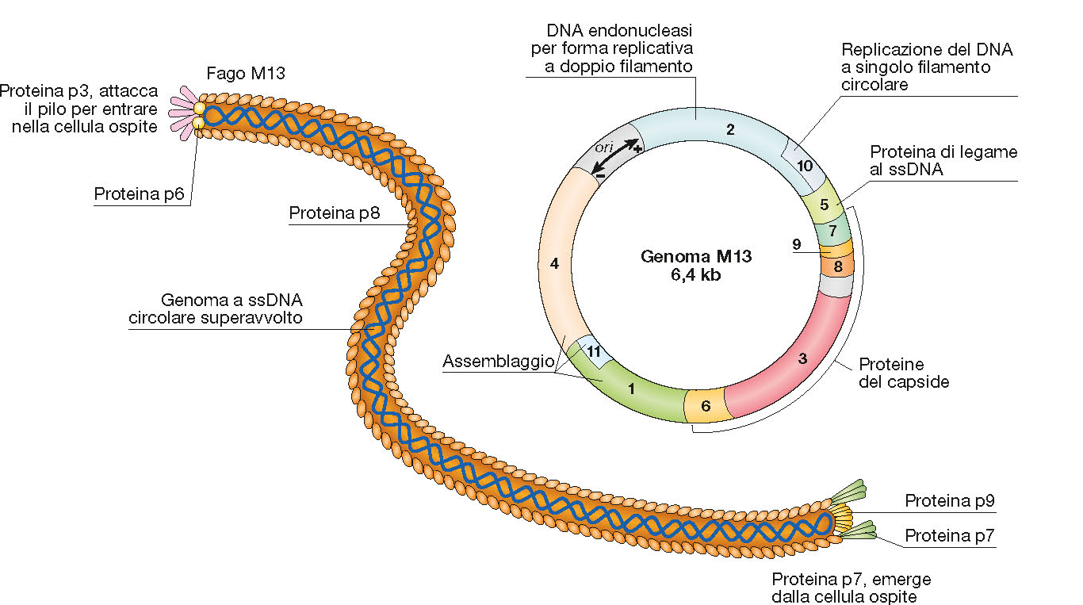
The filamentous M13 phage

Slide 24
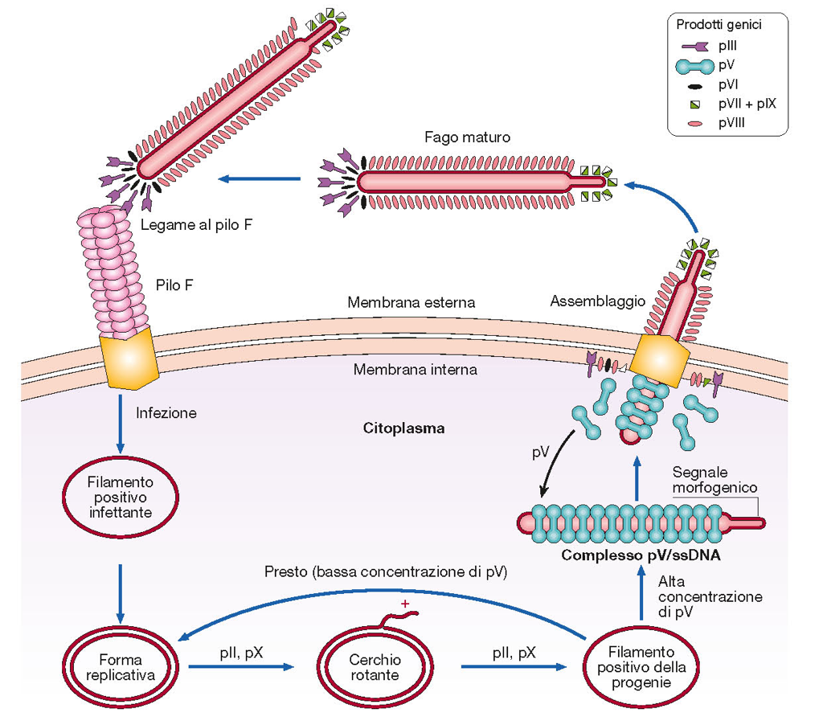
The replicative cycle of the filamentous M13 phage

Slide 25
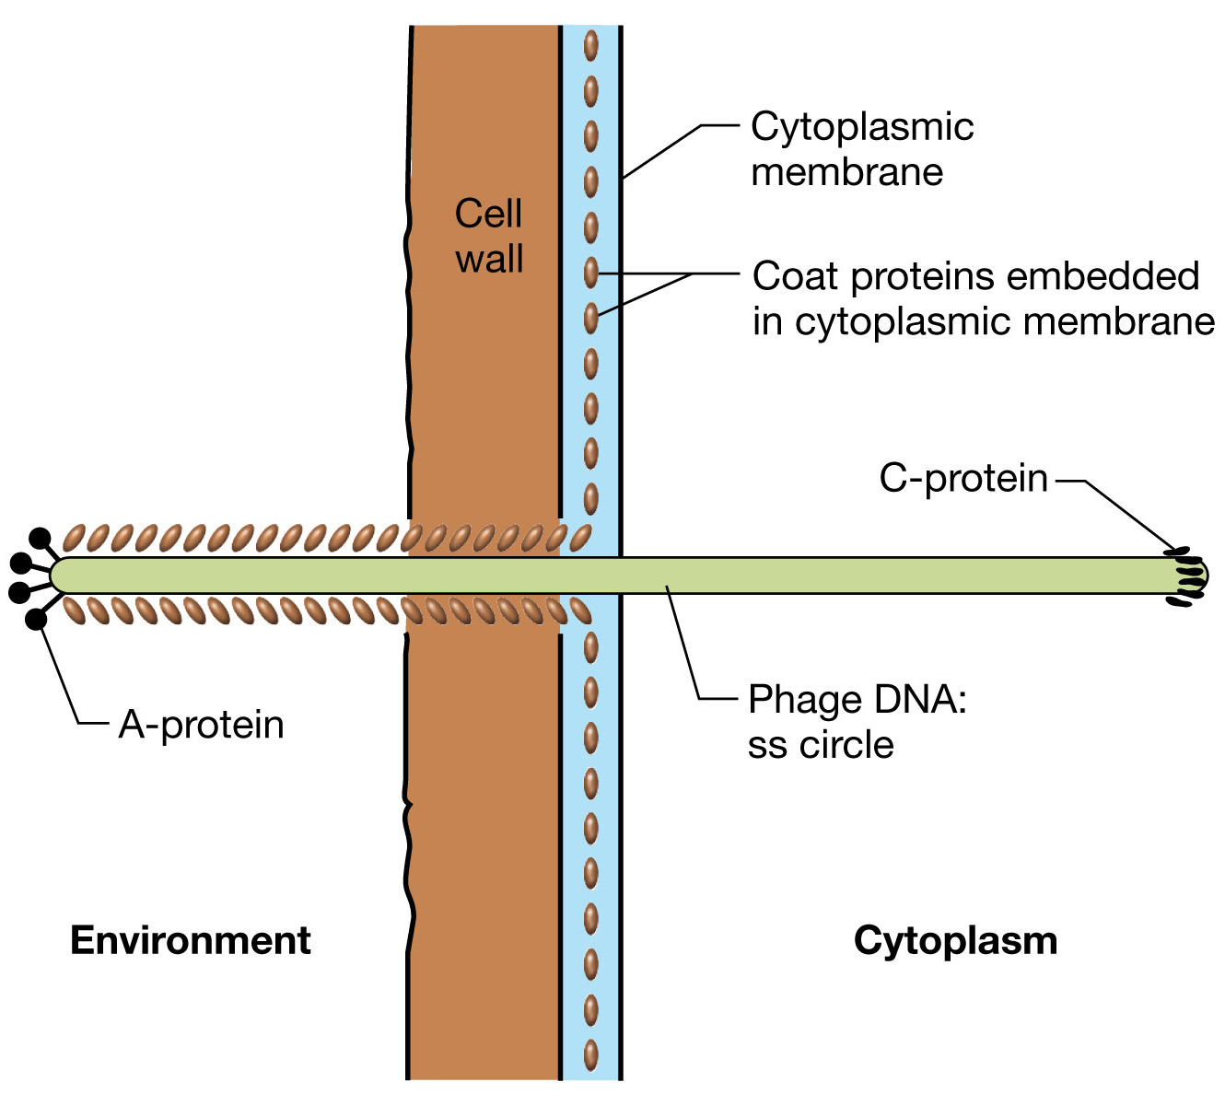
Assembly of filamentous
single-stranded phage
M13 and exit from the infected cell without lysis

Slide 26
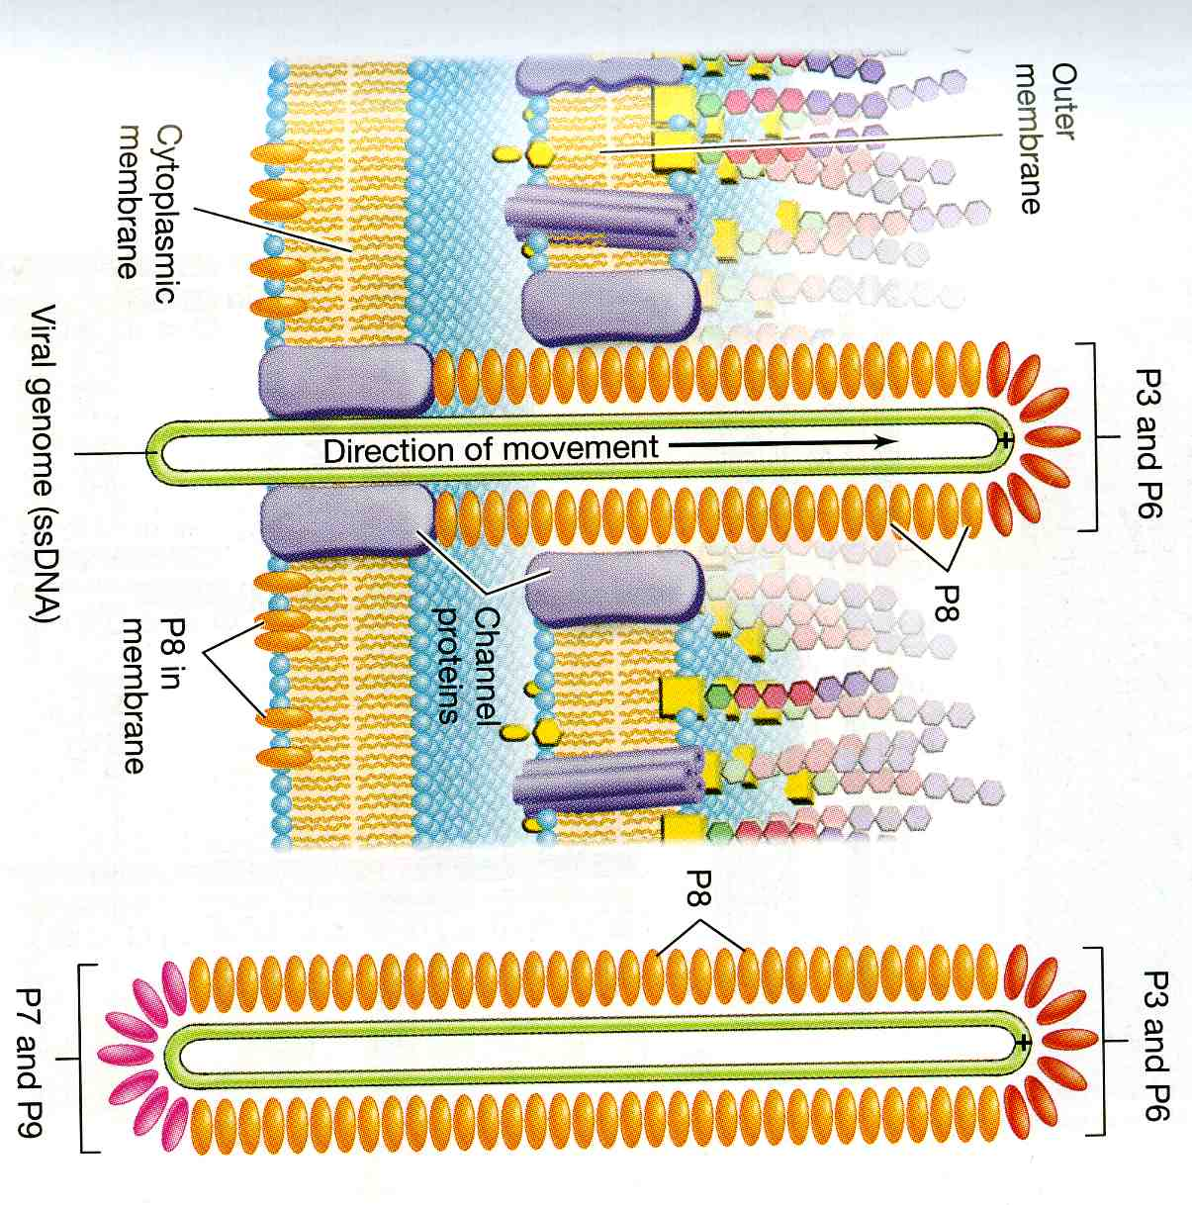
Assembly of filamentous single-stranded phage M13 and exit from the infected cell without lysis

Slide 27
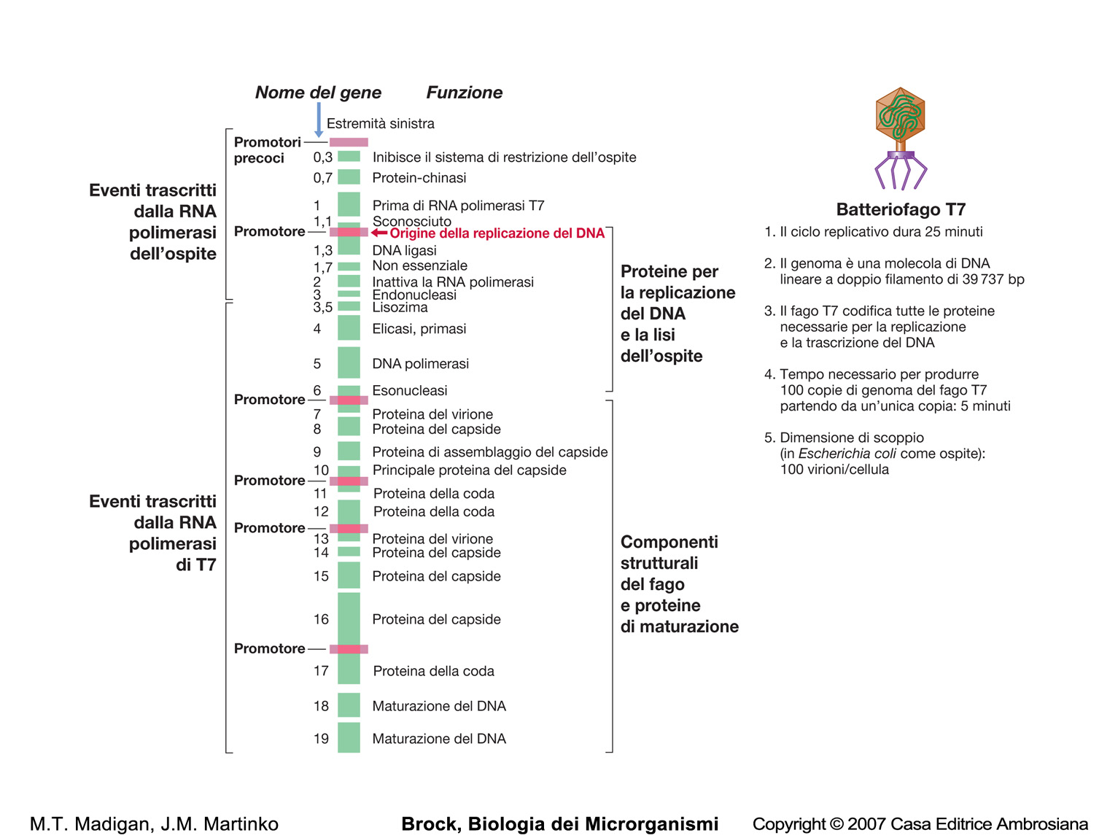
The bacteriophage T7

Slide 28
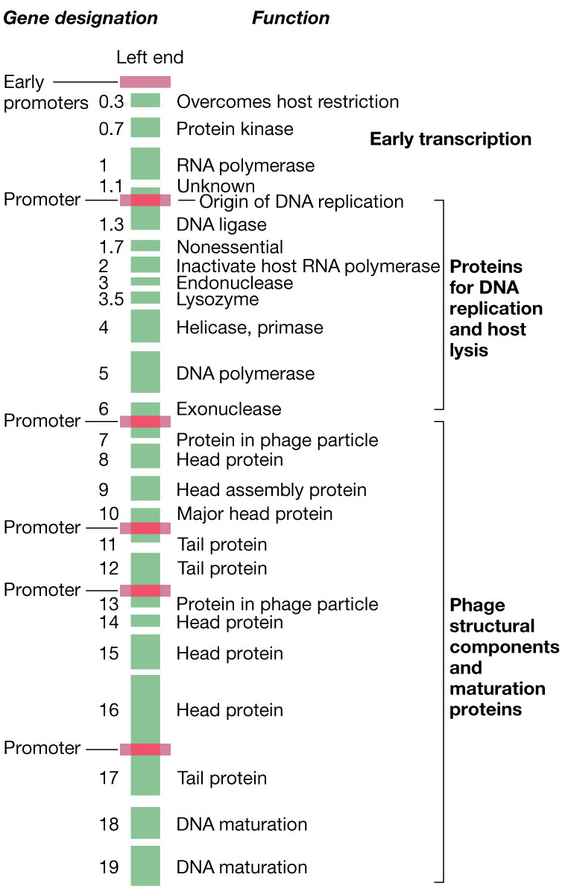
Genetic map of phage T7
RNA polymerase
Inactivation host RNA pol
Digestion host DNA
Inactivation host restriction

Slide 29
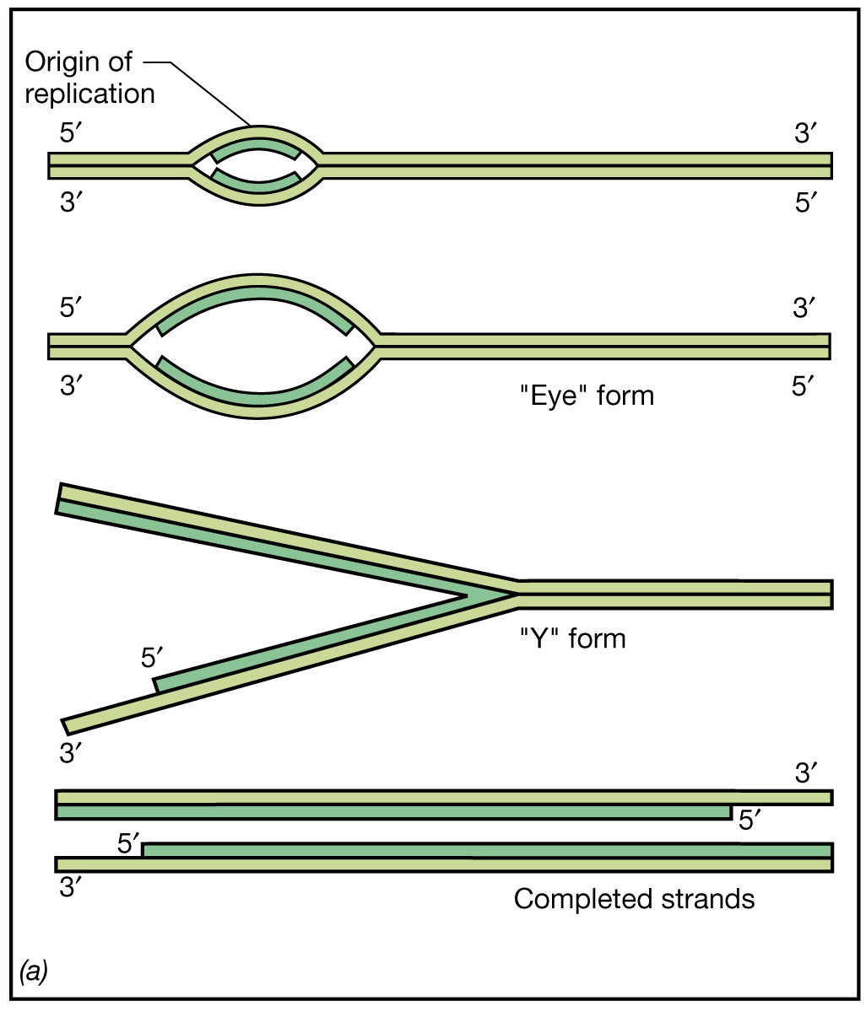
Replication of the linear, double-stranded DNA genome of bacteriophage T7

Slide 30
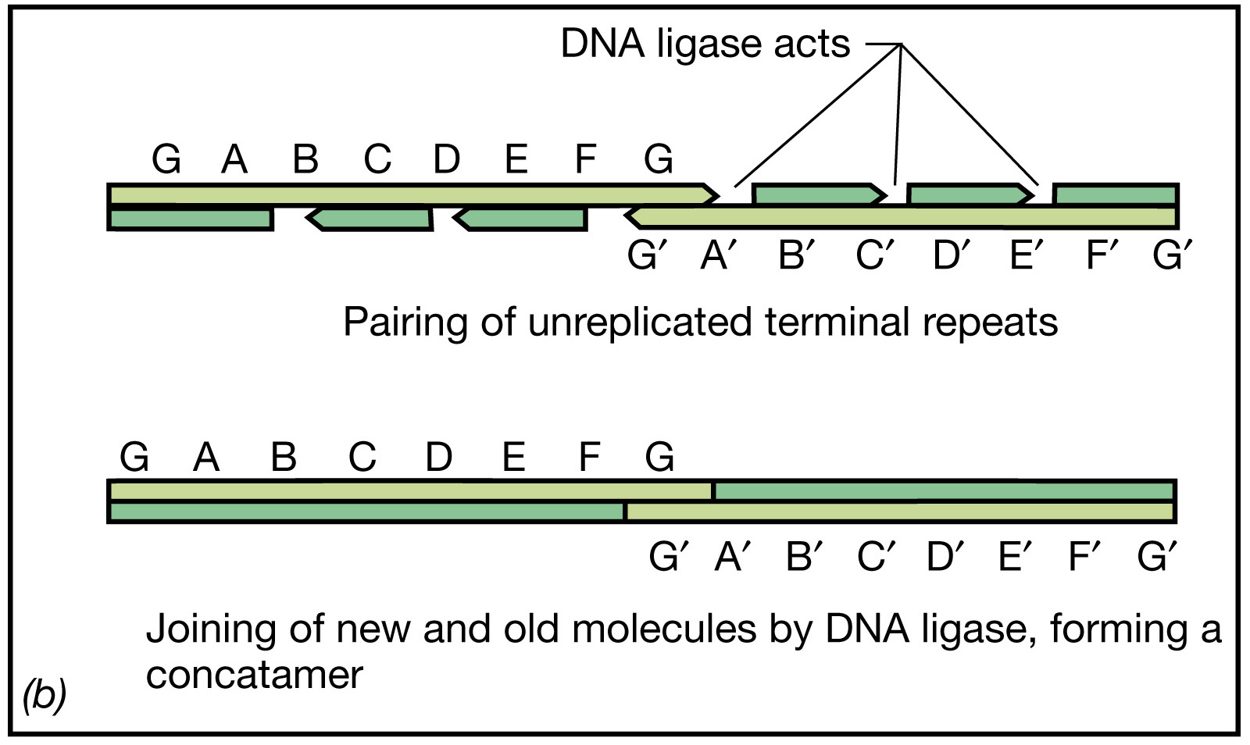
Replication of the linear, double-stranded DNA genome of bacteriophage T7

Slide 31
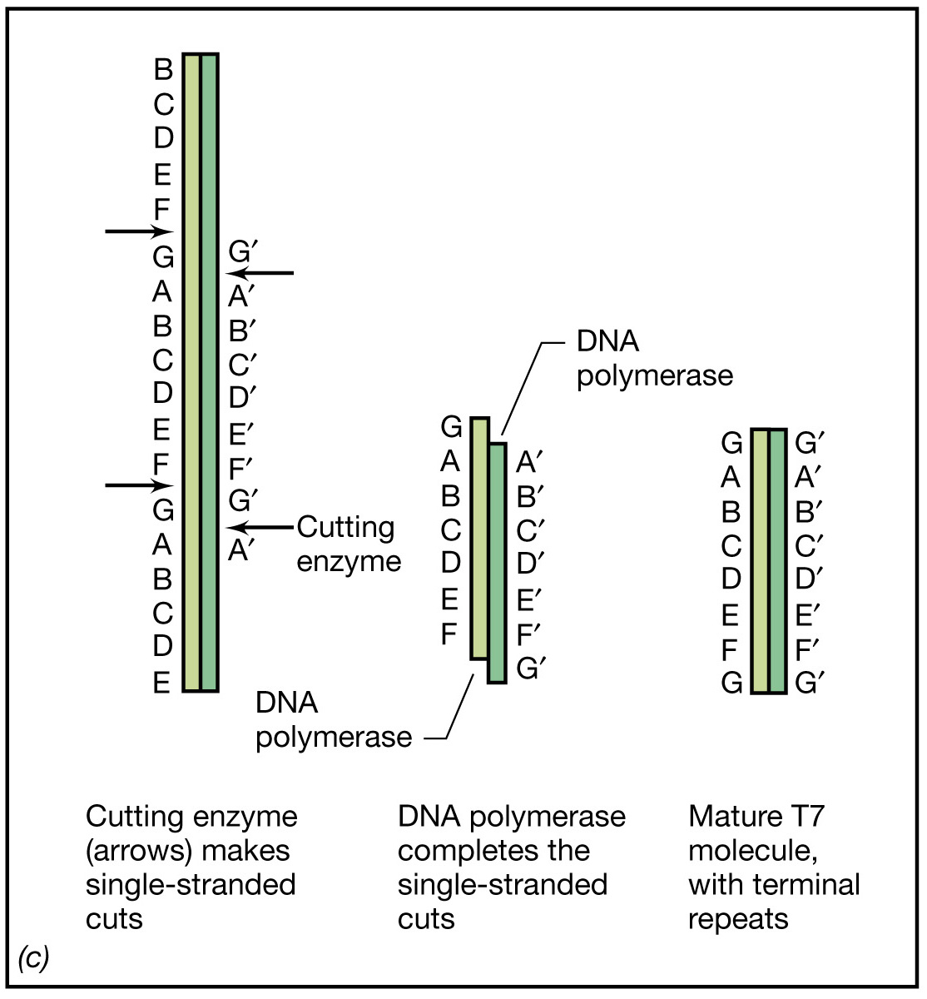
Replication of the linear, double-stranded DNA genome of bacteriophage T7

Slide 32
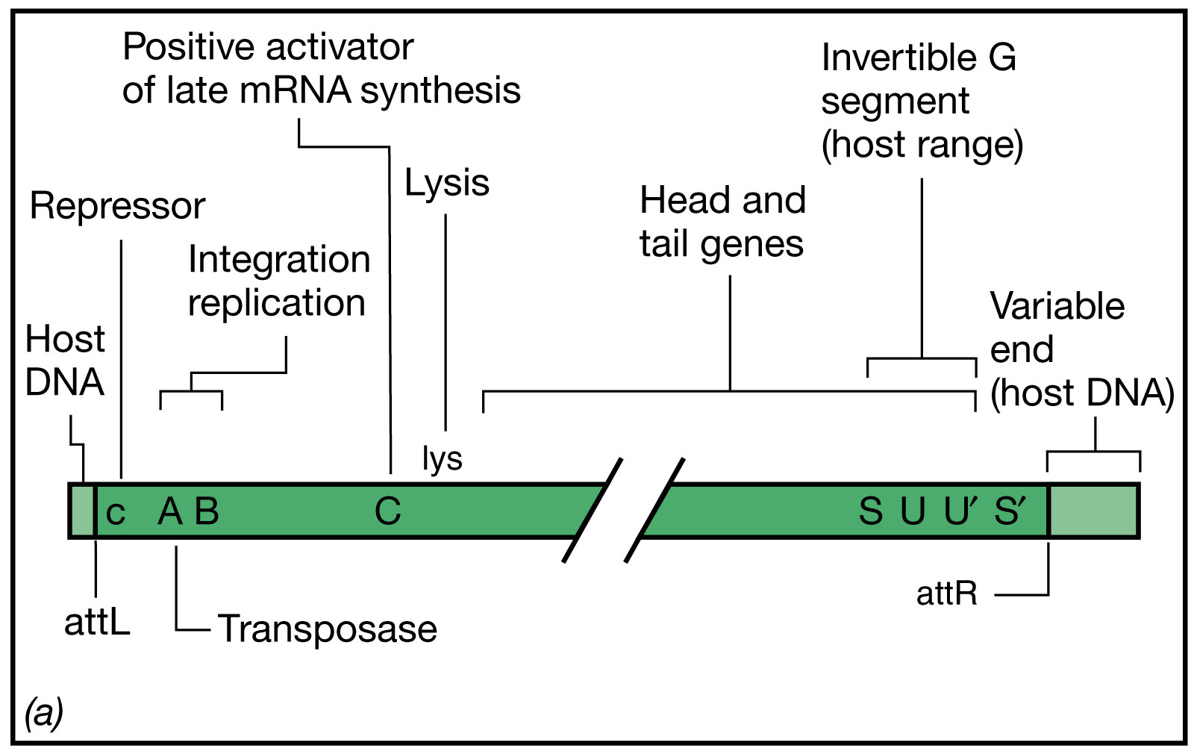
Genetic map of bacteriophage Mu

Slide 33
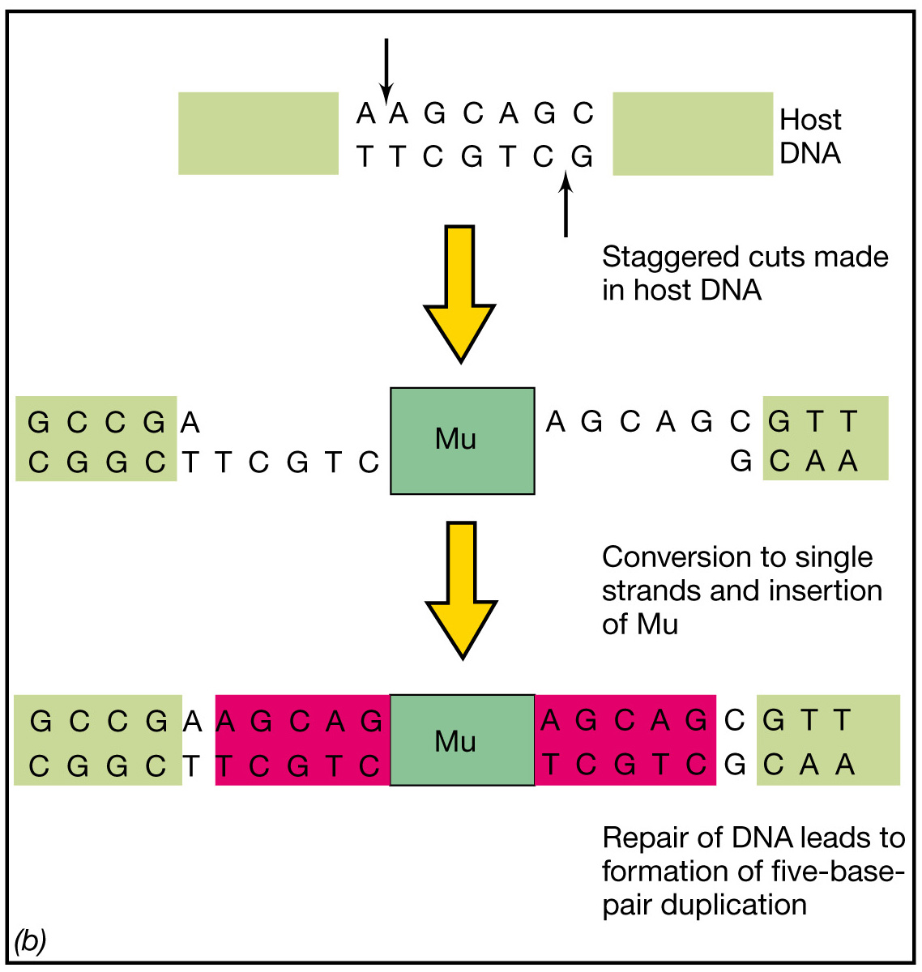
Integration of Mu
into the host DNA

Slide 34
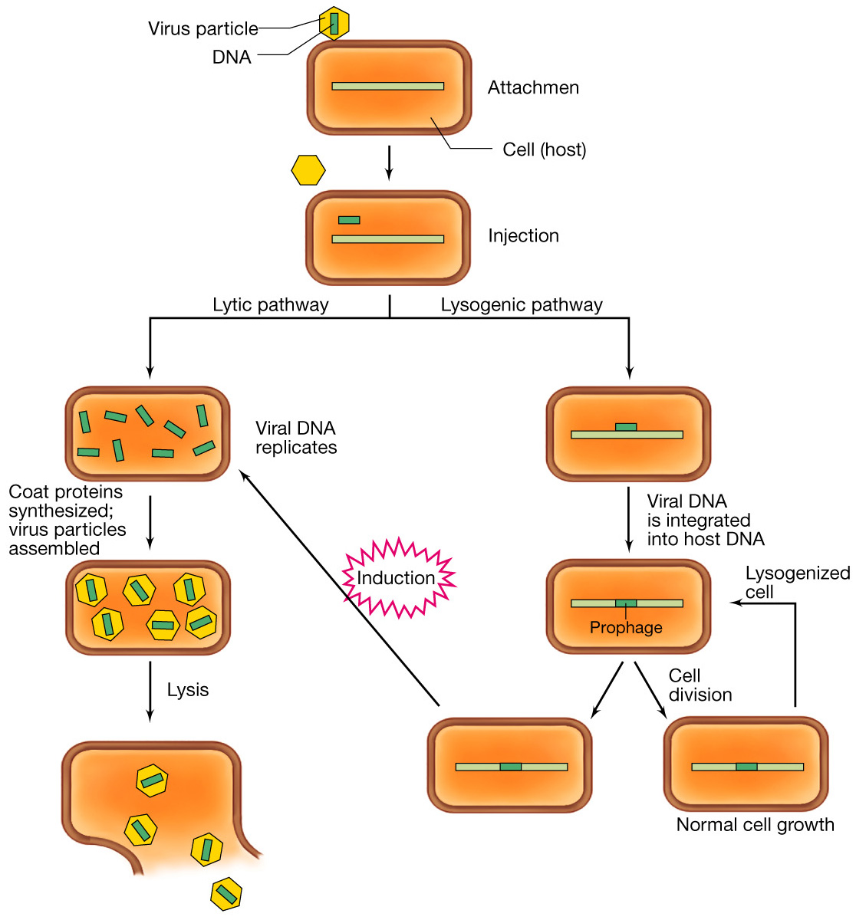
Temperate phage
infection cycle

Slide 35
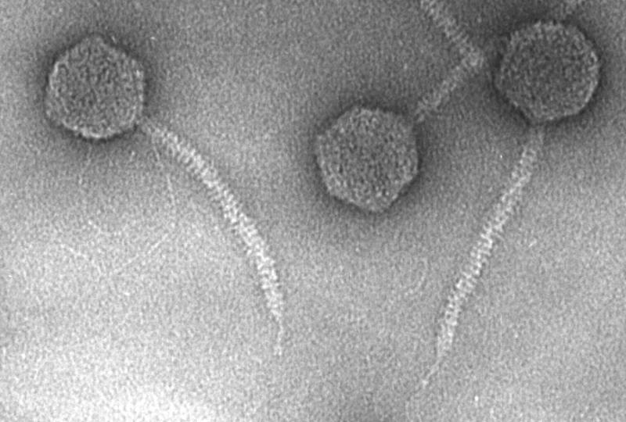
The Escherichia coli temperate bacteriophage λ

Slide 36
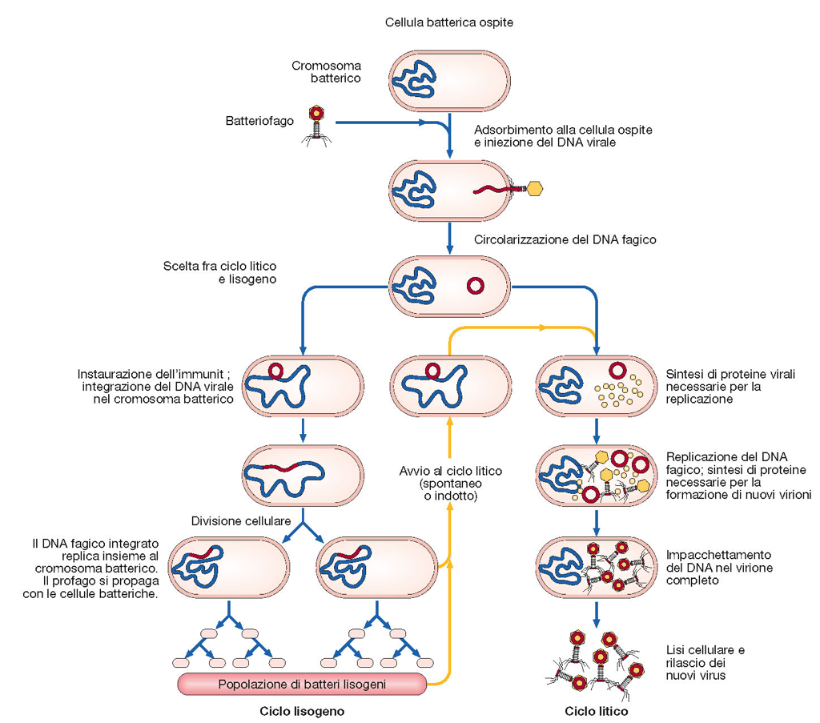
The replication cycle of bacteriophage λ

Slide 37
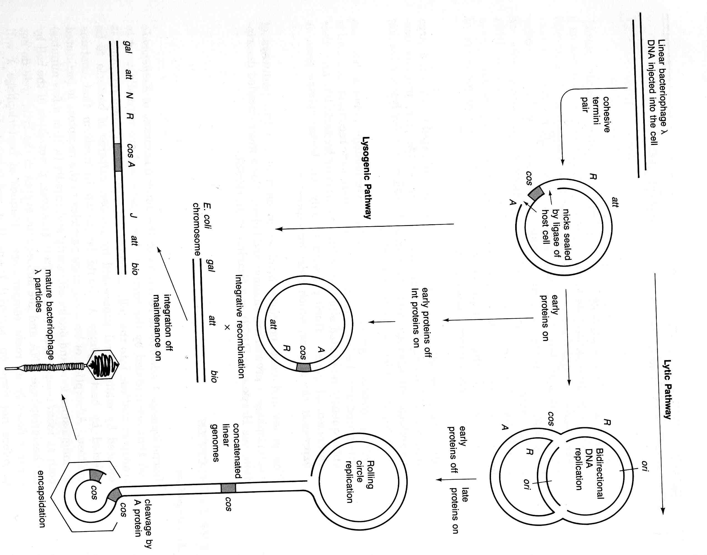
The bacteriophage λ
life cycle

Slide 38
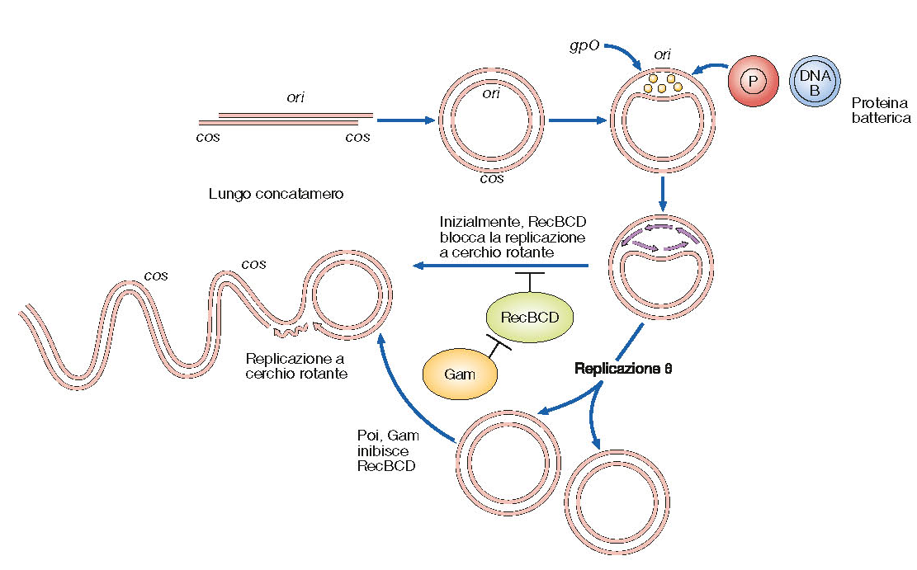
Genome DNA replication of bacteriophage λ

Slide 39
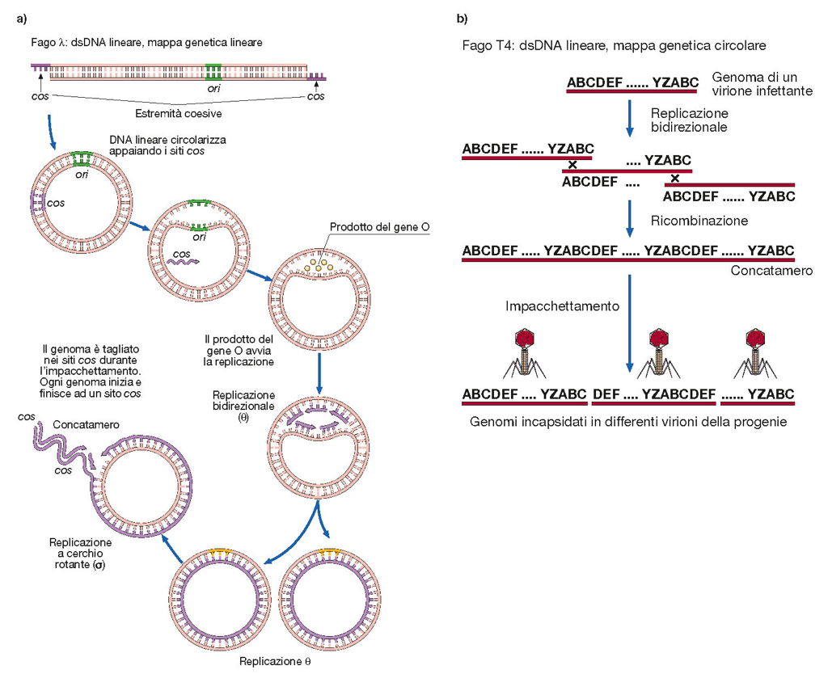

Slide 40
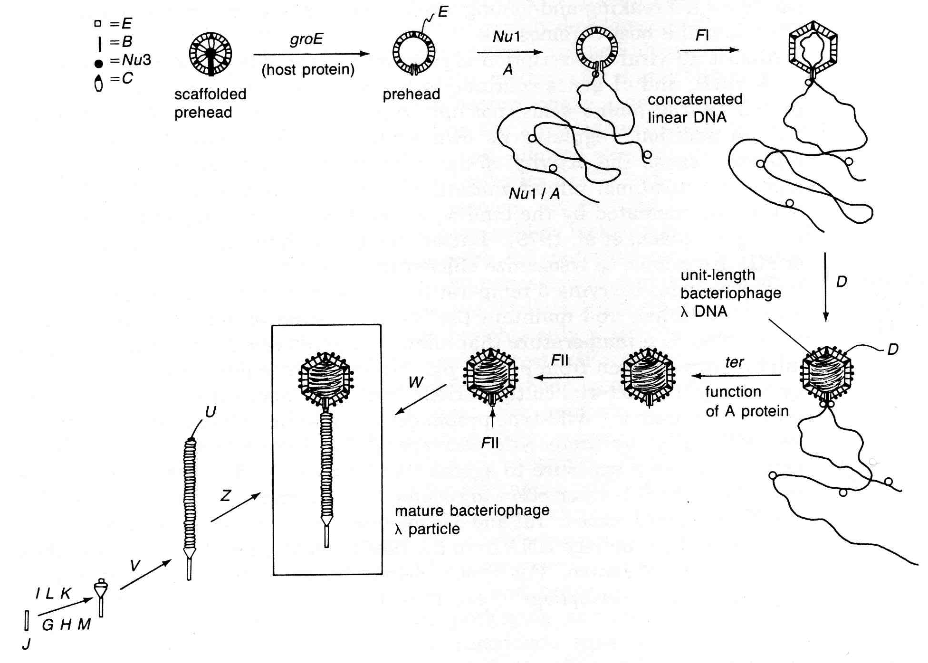
The assembly pahtway of bacteriophage λ

Slide 41
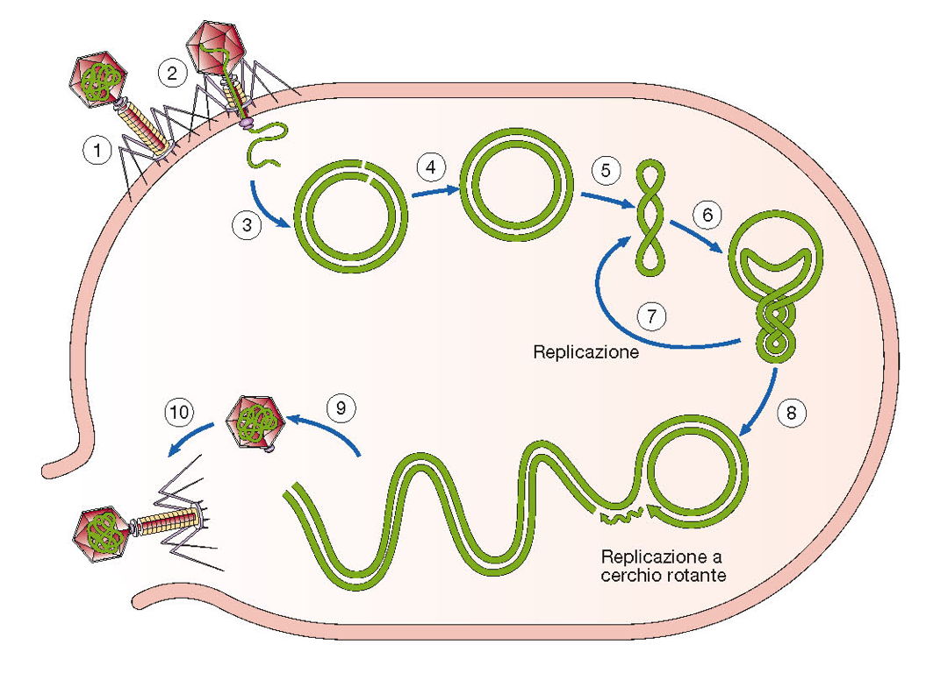
The lytic pahtway of bacteriophage λ

Slide 42
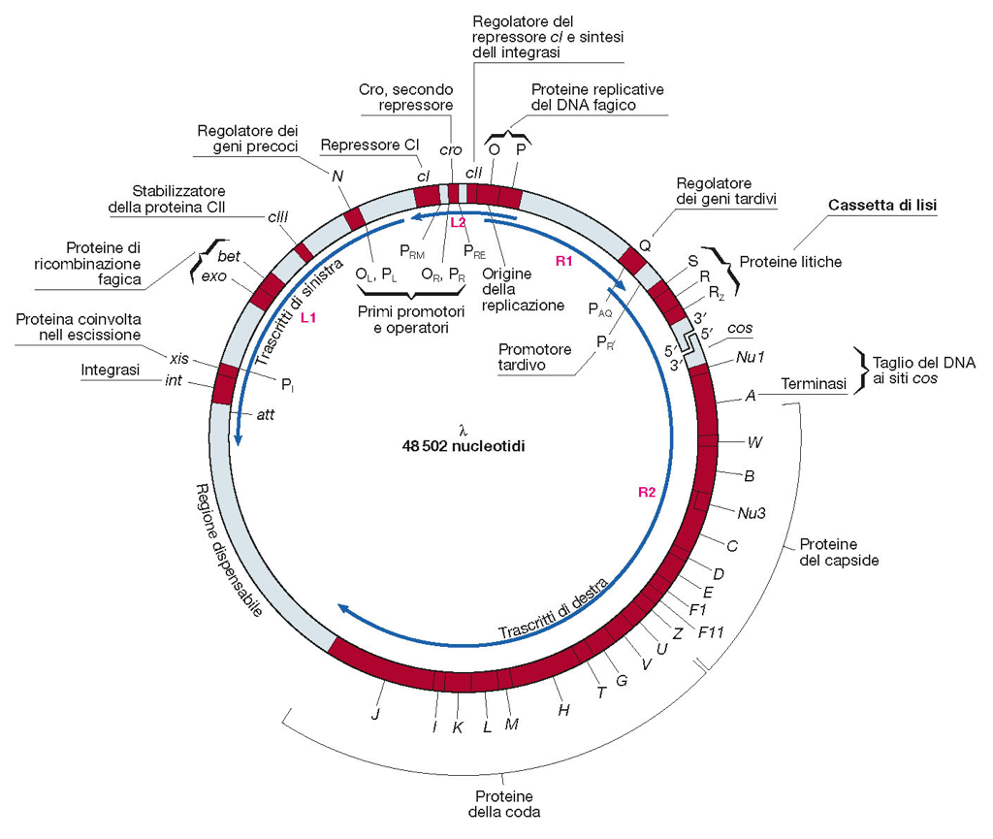
Genetic and molecular
map of lambda

Slide 43
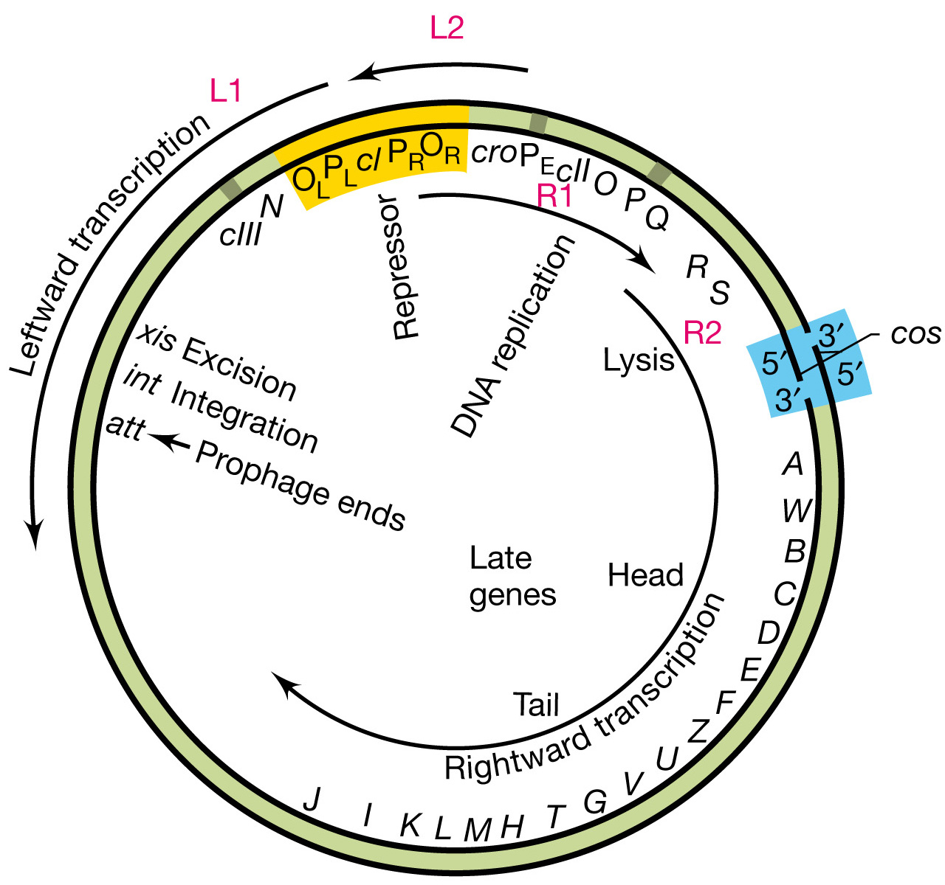
Genetic and molecular
map of lambda

Slide 44
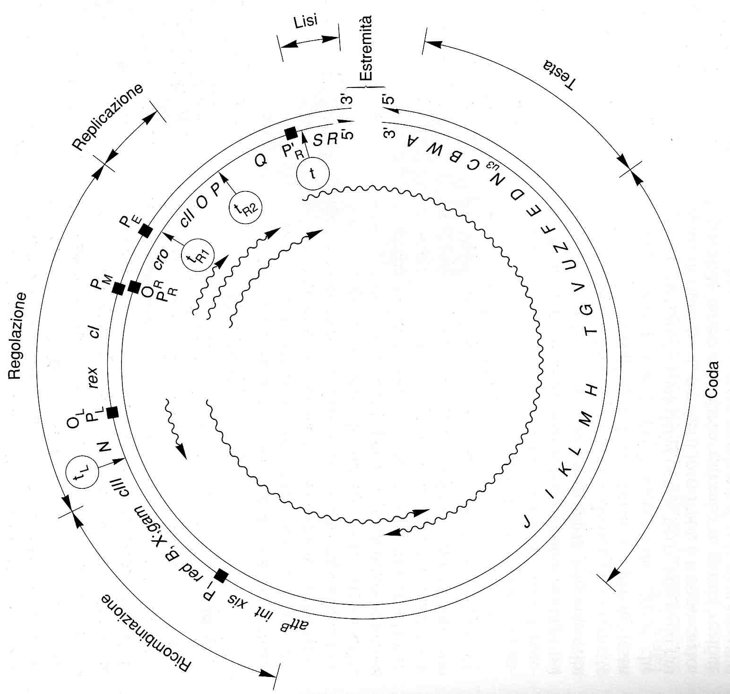
Genetic and molecular map of lambda: the promoters

Slide 45
λ phage infection: immediate-early gene expression
1< 3-5 min

Slide 46
λ phage infection: delayed-early gene expression
> 3-5 min

Slide 47
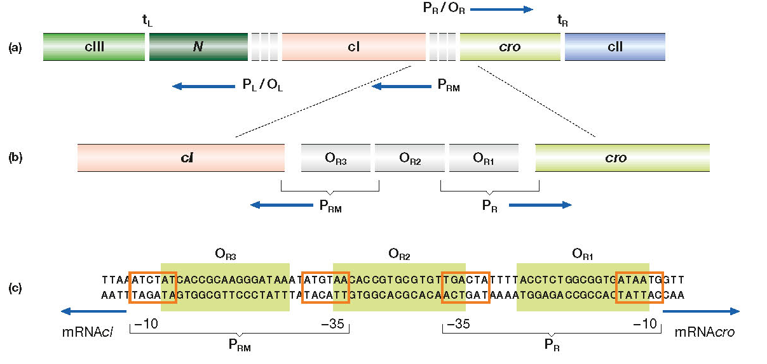
Structure of the operator right (OR) on the lambda genome

Slide 48
Structure of the operator right (OR) on the lambda genome
CI O_{R1}>O_{R2}>O_{R3}
Cro O_{R3}>O_{R2}>O_{R1}

Slide 49
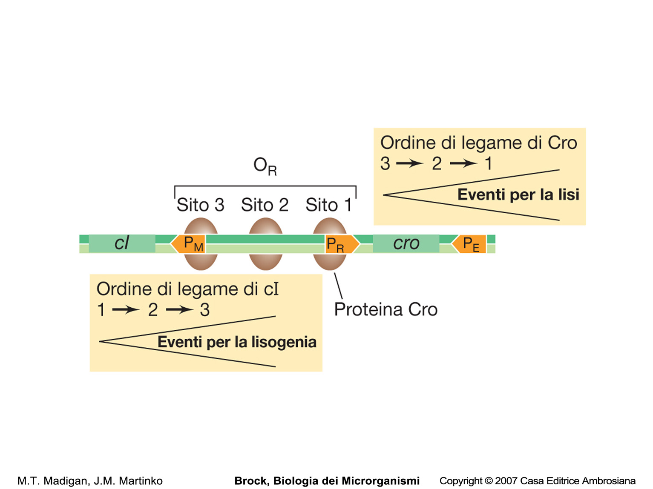
Regulation of cI and cro expression

Slide 50
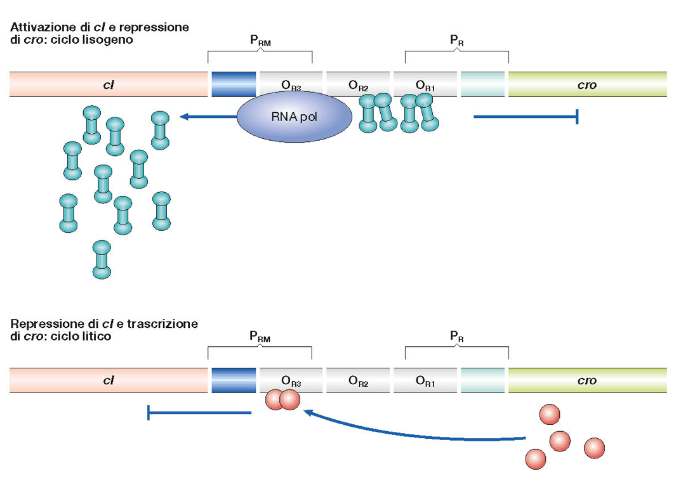

Slide 51
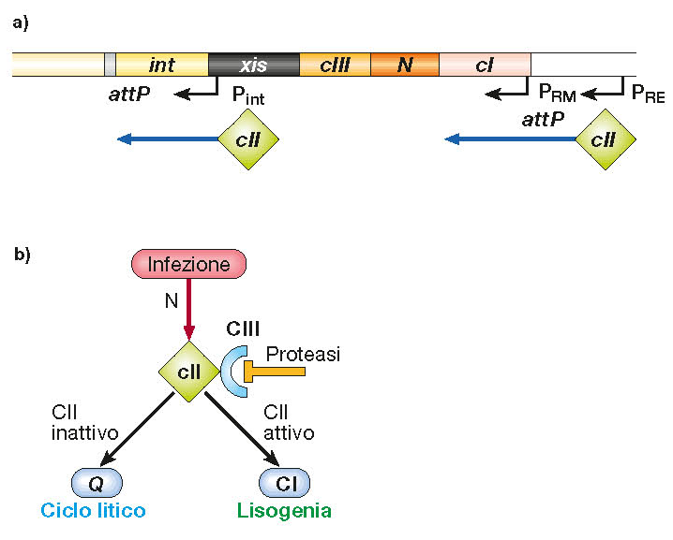
λ phage gene expression: regulation of P_{RE} activation
High MOIs
Poor growth conditions

Slide 52
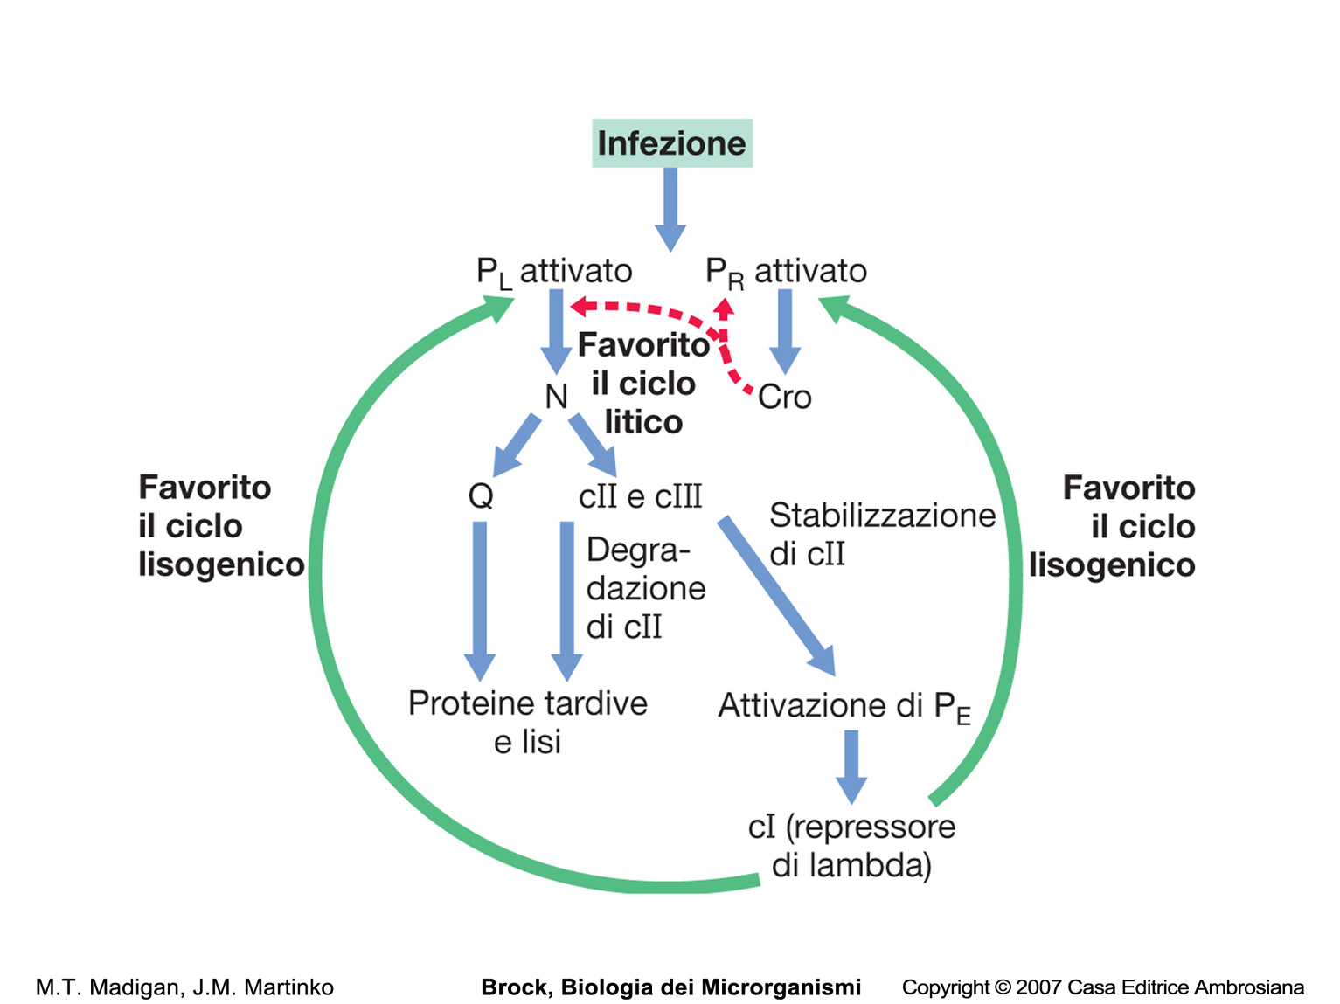

Slide 53
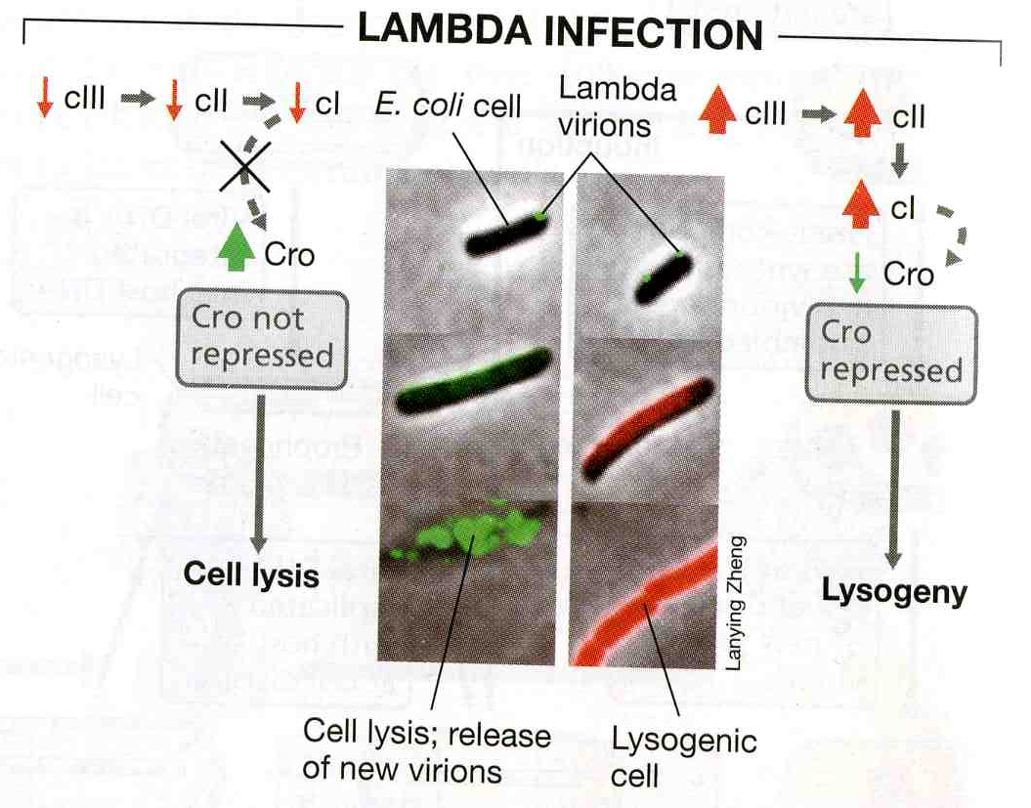
Regulation of lytic and lysogenic events in phage λ

Slide 54
Integration of lambda
DNA into the host

Slide 55
In a lysogenized cell, the cI
protein represses transcription
of lytic genes in a superinfecting
λ virion, thereby protecting the
cell from lysis

Slide 56
Mechanism of the SOS response. DNA damage results in conversion of RecA protein into a protease that cleaves LexA protein. LexA protein normally represses the activities of the recA gene and the DNA repair genes uvrA and umuD. With LexA inactivated, these genes become active.
As a protease, the RecA protein also cleaves the lambda repressor protein.
Notes:
Figure: 10-07
Caption:

