Slide 1
MICROBIOLOGIA GENERALE
Structure and function of prokaryotic cells 3

Slide 2
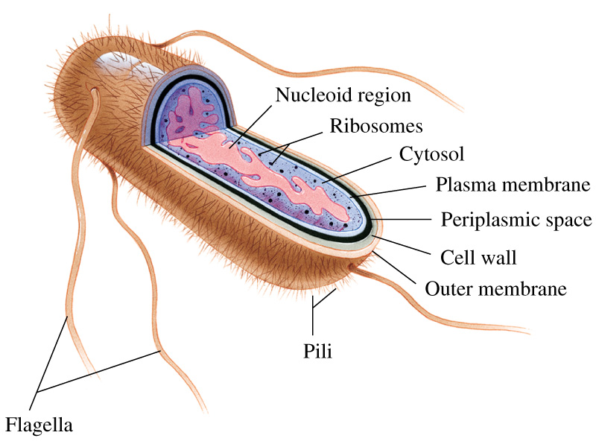
The prototype of a prokaryotic cell

Slide 3
Structure and function of prokaryotic cells:
in the cytosol

Slide 4
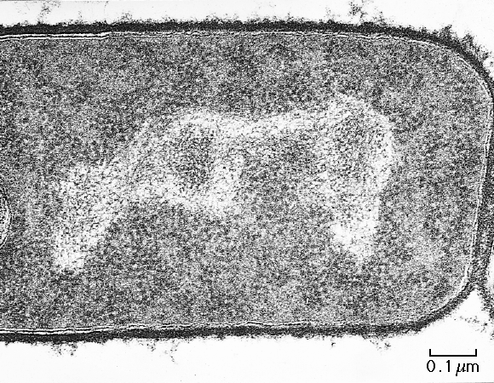
Escherichia coli

Slide 5
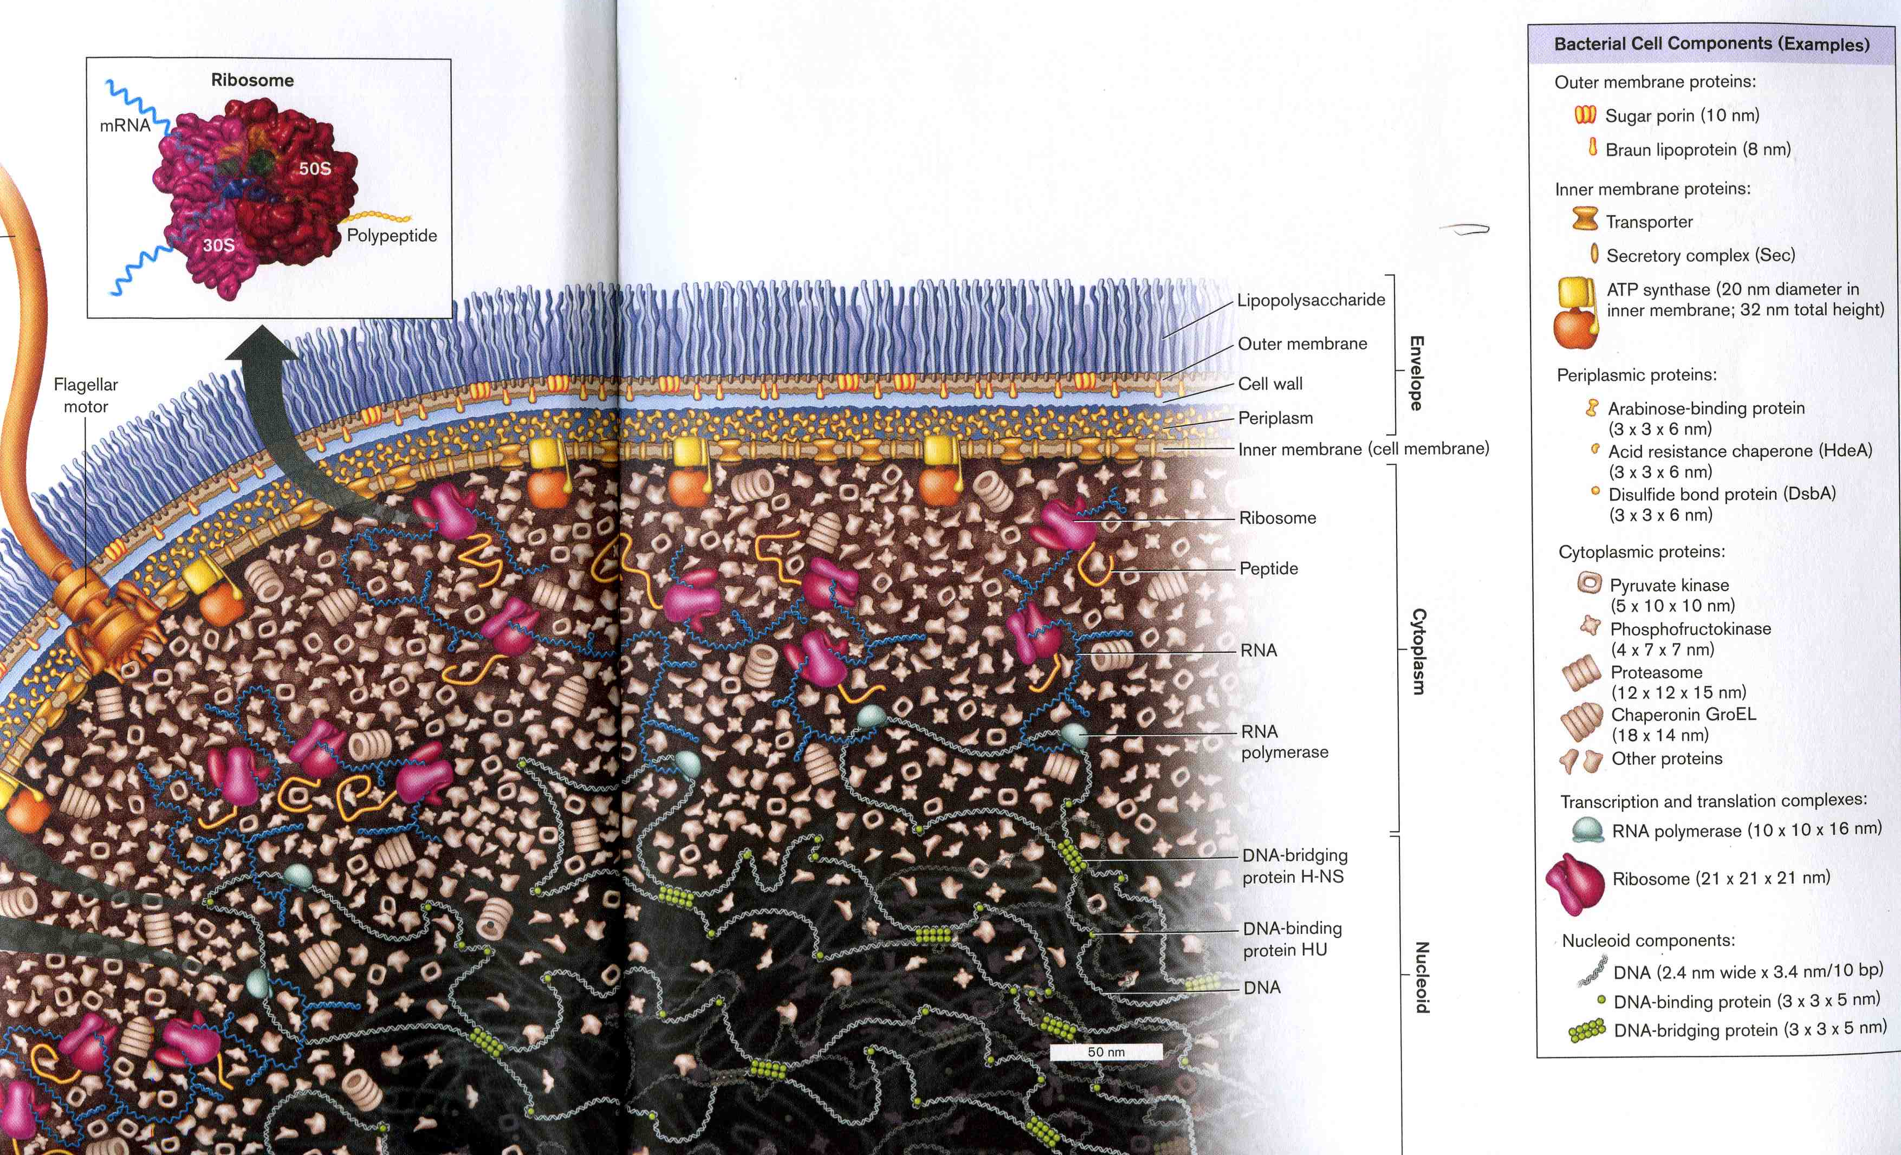
Model of a bacterial cell: Escherichia coli

Slide 6
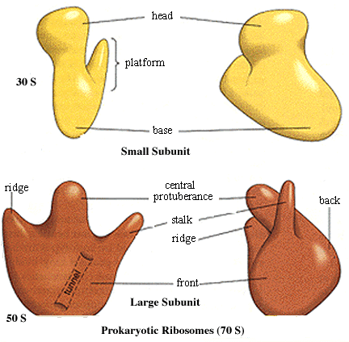
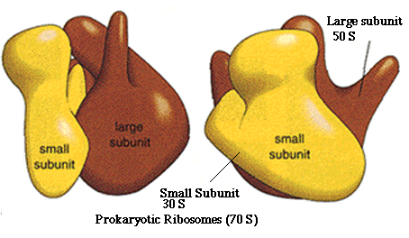
The ribosomes of procaryotes
30 S
Type of rRNA | Nt | Subunit location
16 S | 1542 | 30 S
5 S | 120 | 50 S
23 S | 2904 | 50 S
50 S

Slide 7
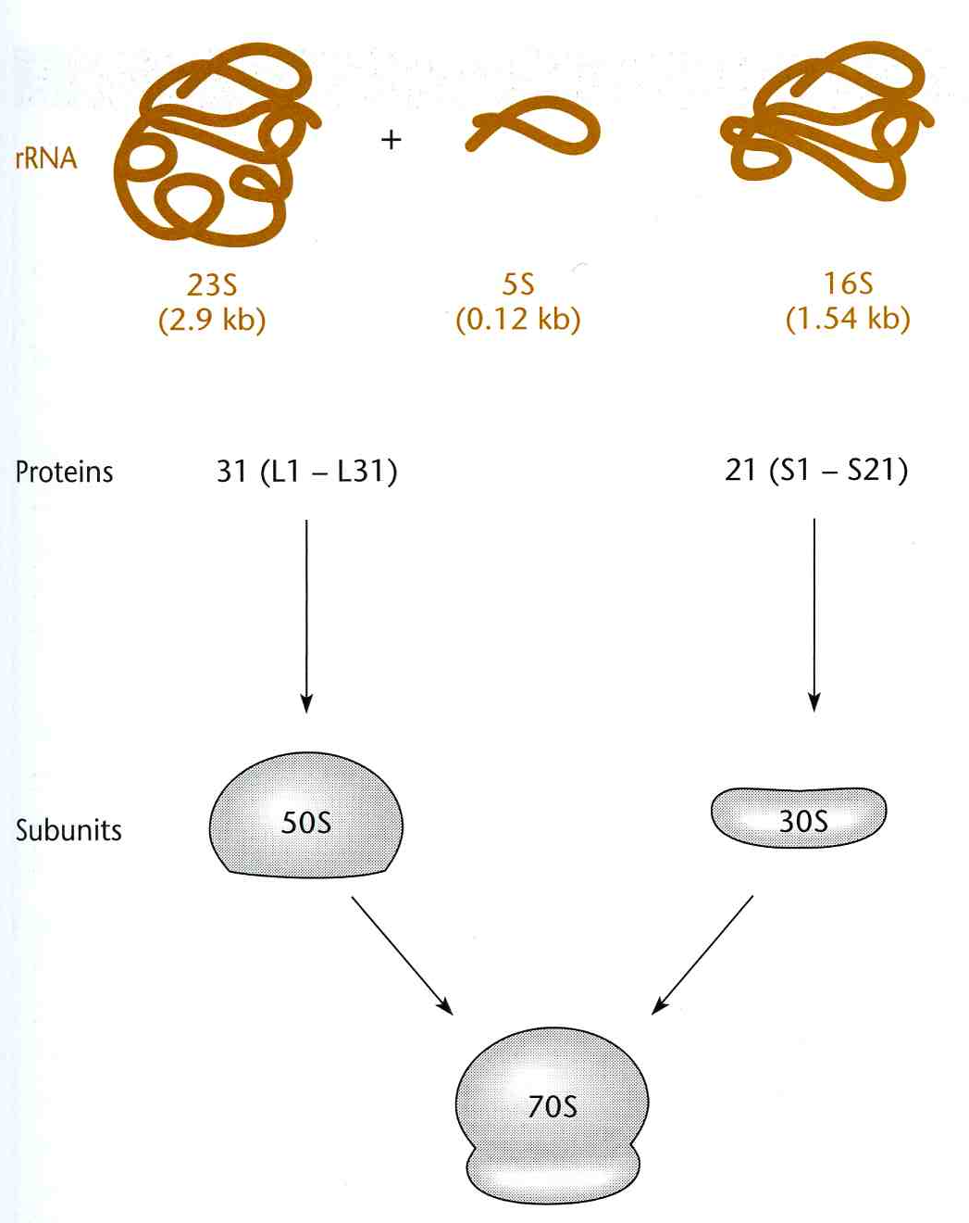
The composition of a bacterial ribosome

Slide 8
The bacterial inclusions
Inclusions | Where found | Composition | Function
Glycogen | Escherichia | polyglucose | reserve C and E
PHB | Pseudomonas | polyhydroxy butyrate | reserve C and E
Polyphosphate | Corynebacterium | PO₄ polymers | reserve P
Sulfur globes | sulfur bacteria | S | reserve e⁻ and E
Gas vesicles | aquatic bacteria | shell with gas | floatation
Magnetosomes | aquatic bacteria | Magnetite Fe₃O₄ | orienting
Carboxysomes | autotrophic bacteria | enzymes for CO₂ fixation | site of CO₂ fixation
Phycobilisome | cyanobacteria | phycobiliproteins | light-harvesting pigments
Chlorosomes | green bacteria | Lipid, protein, bchl | light-harvesting pigments

Slide 9
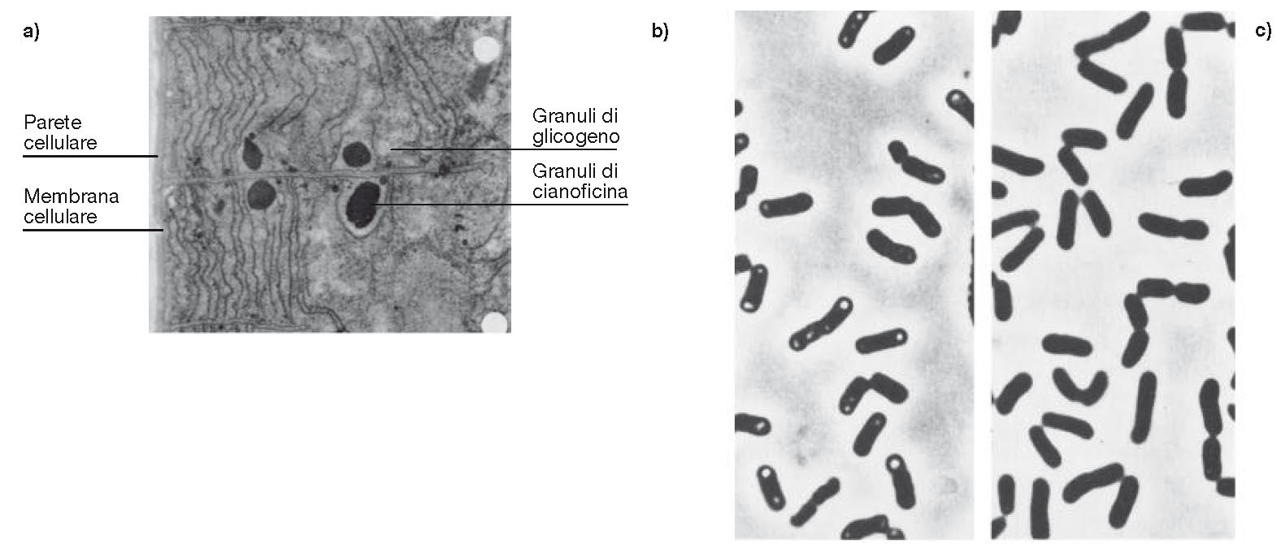
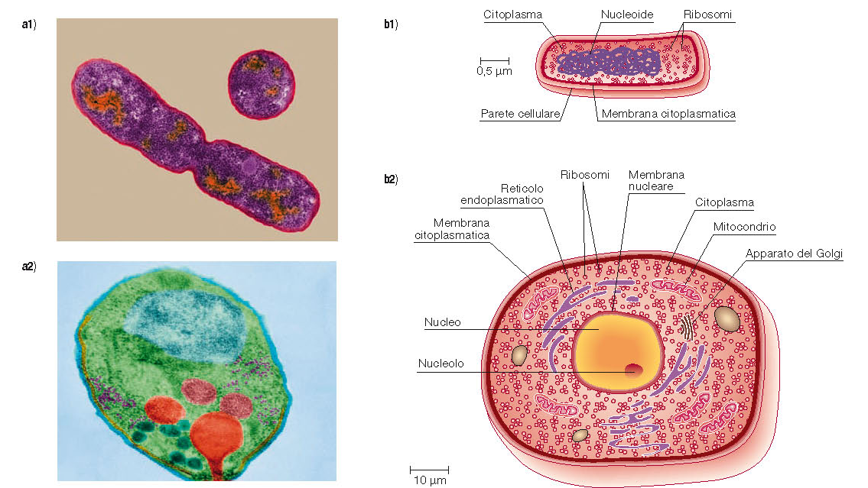

Slide 10
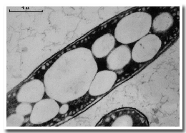
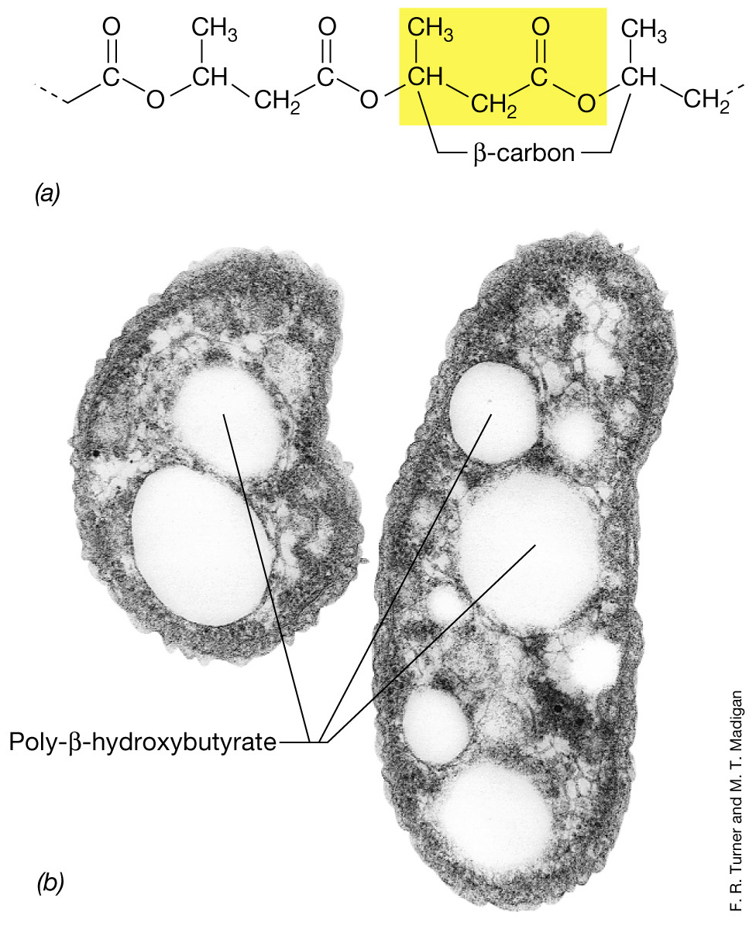
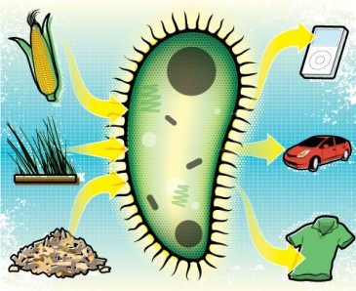
Bacterial PHB inclusions

Slide 12
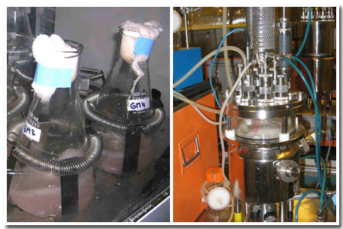
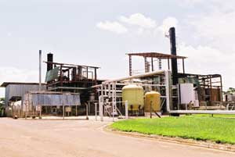
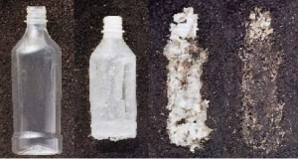
Properties of PHB
Water insoluble and relatively resistant to hydrolytic degradation. This differentiates PHB from most other currently available biodegradable plastics, which are either water soluble or moisture sensitive.
Good oxygen permeability.
Good ultra-violet resistance but poor resistance to acids and bases.
Soluble in chloroform and other chlorinated hydrocarbons.
Biocompatible and hence is suitable for medical applications.
Melting point 175°C., and glass transition temperature 15°C.
Tensile strength 40 MPa, close to that of polypropylene.
Sinks in water (while polypropylene floats), facilitating its anaerobic biodegradation in sediments.
Nontoxic.

Slide 13
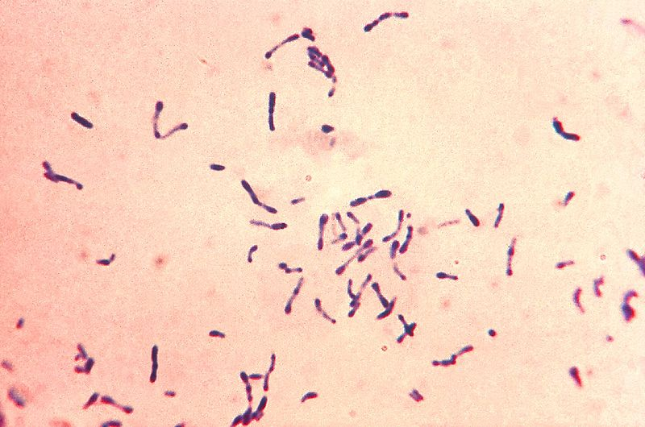
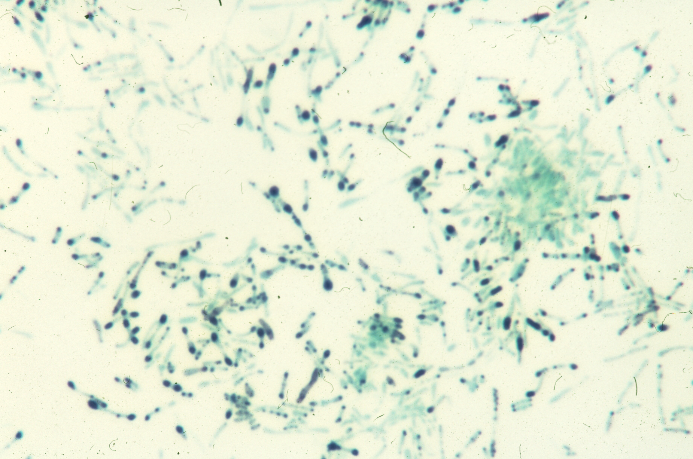
Bacterial polyphosphate inclusions (volutin granules)
Corynebacterium diphtheriae
stained using the methylene blue technique
Corynebacterium diphtheriae
stained using the Gram technique

Slide 14
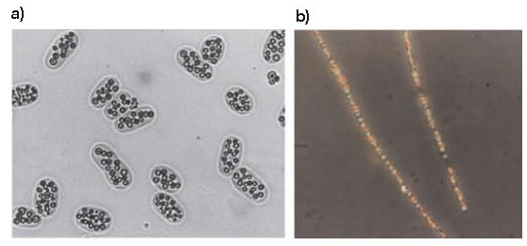
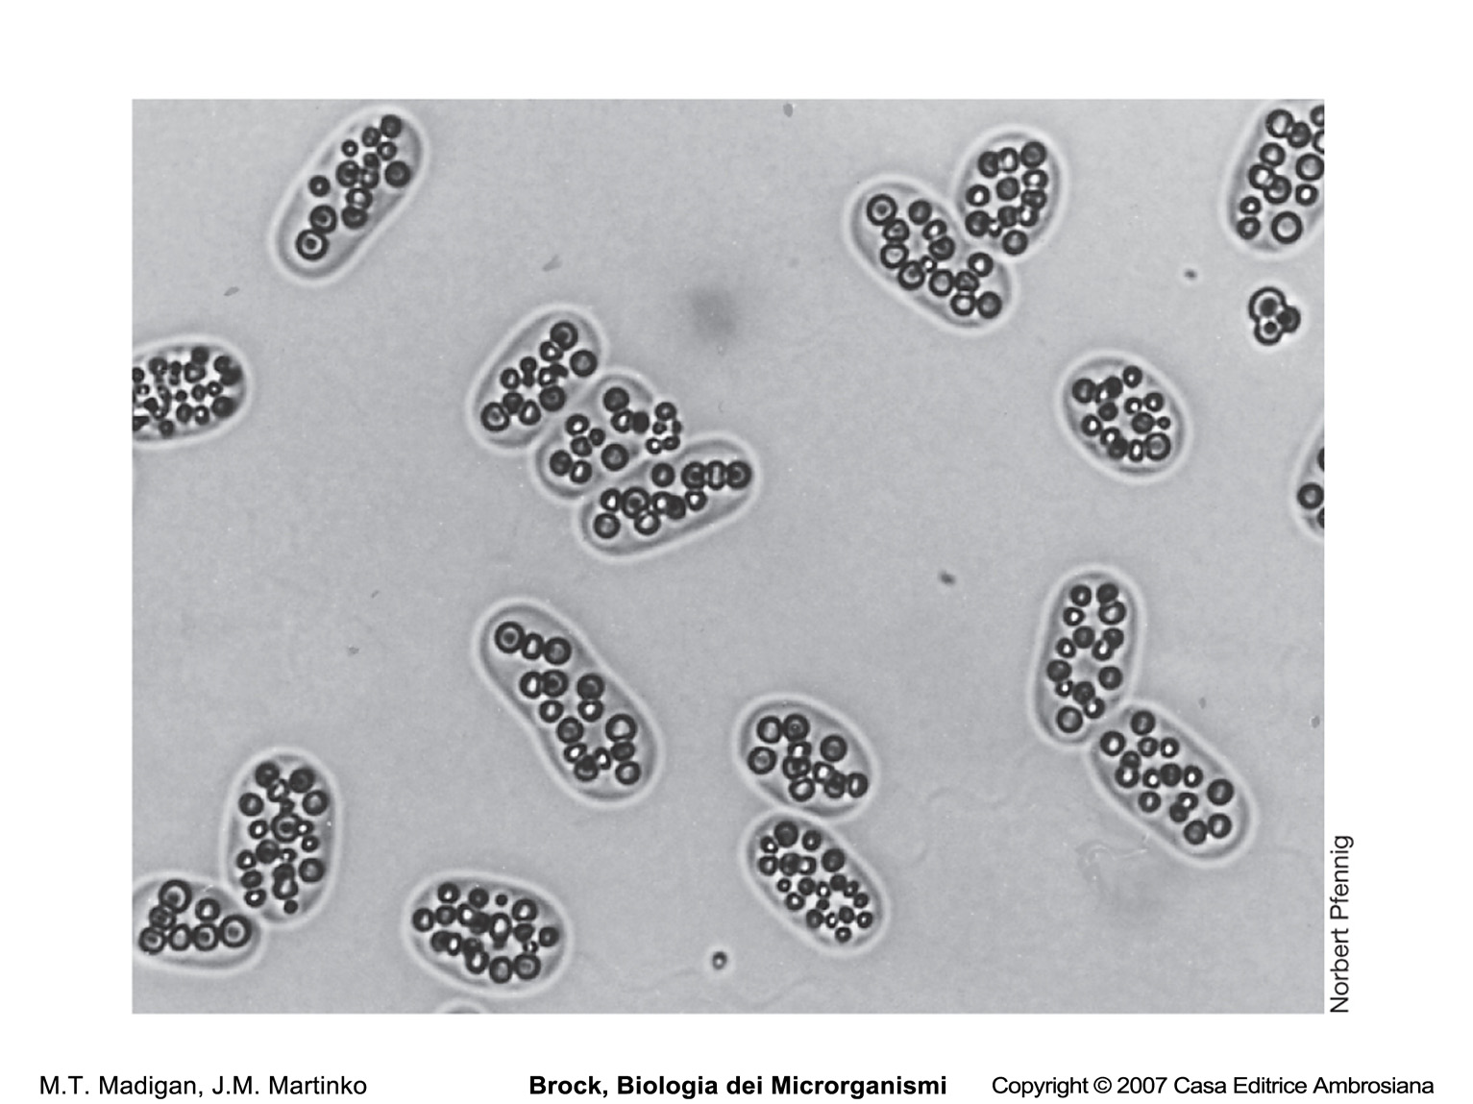
Sulphur globules in the cells of a purple sulfur bacterium

Slide 15
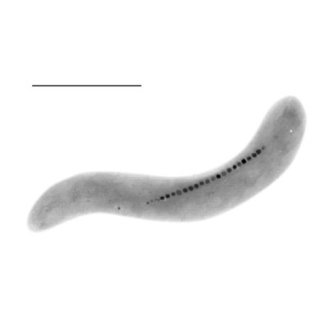
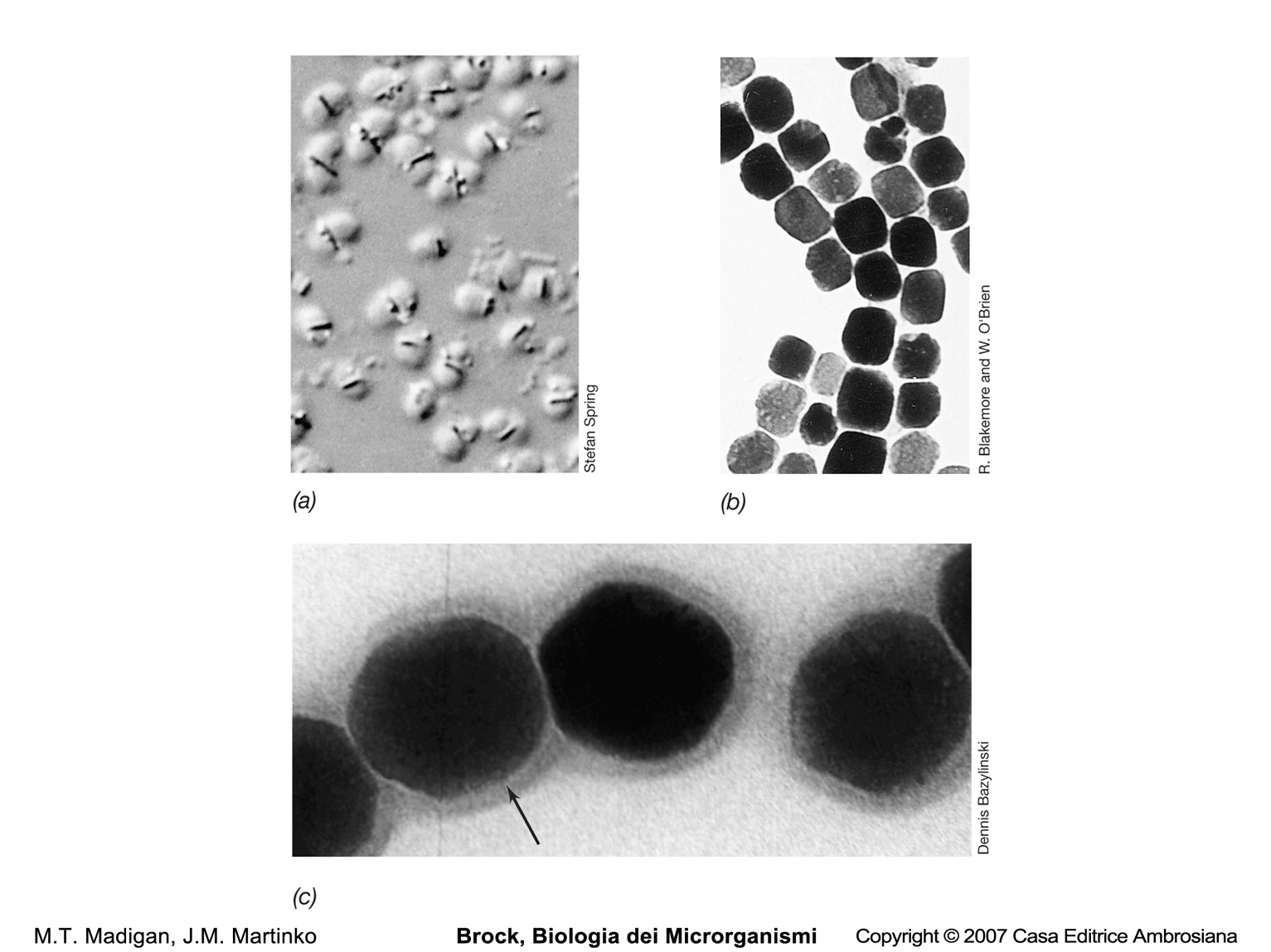
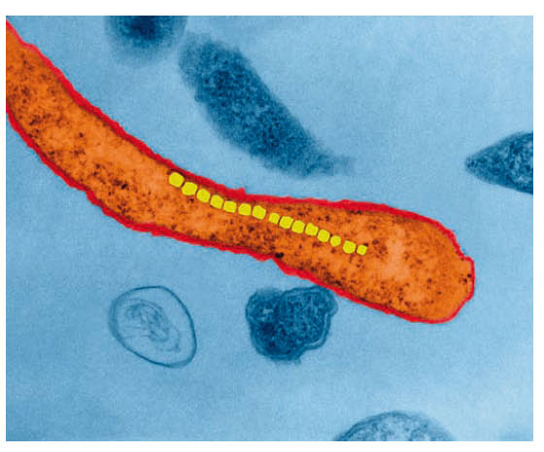
Magnetotactic bacteria and magnetosomes

Slide 16
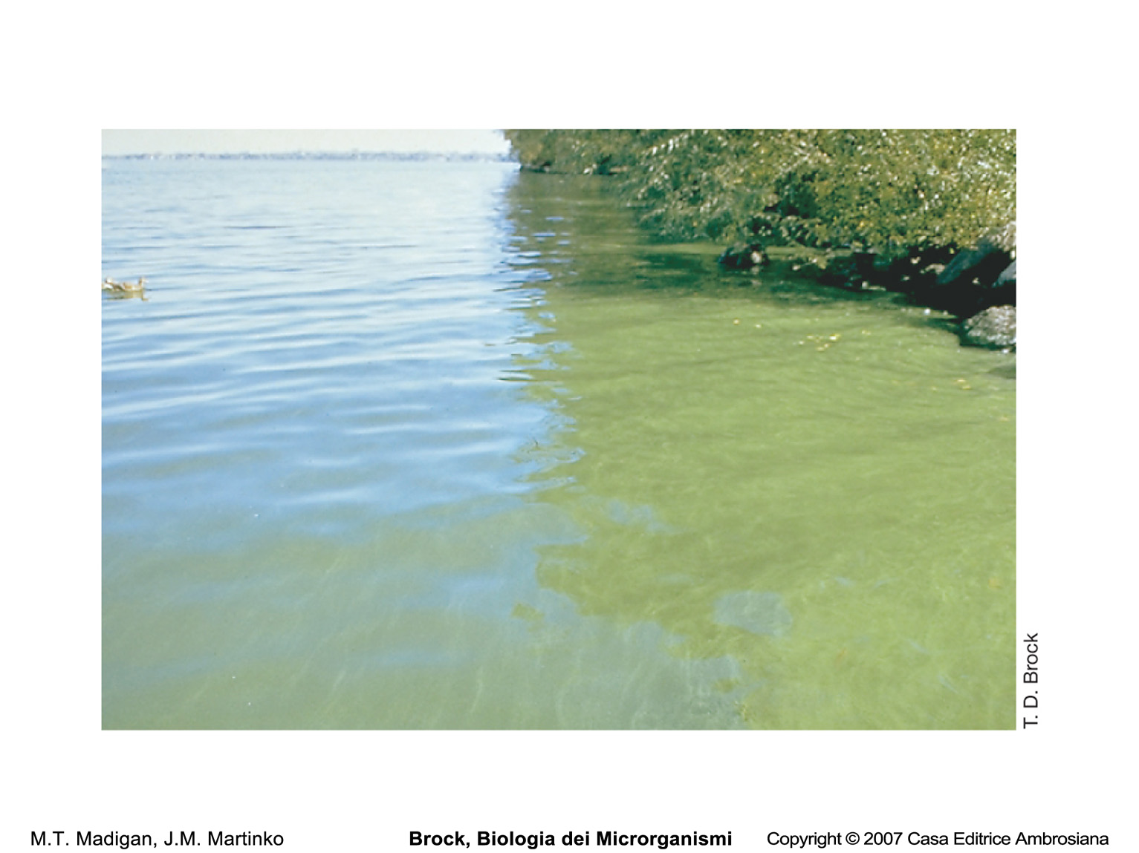
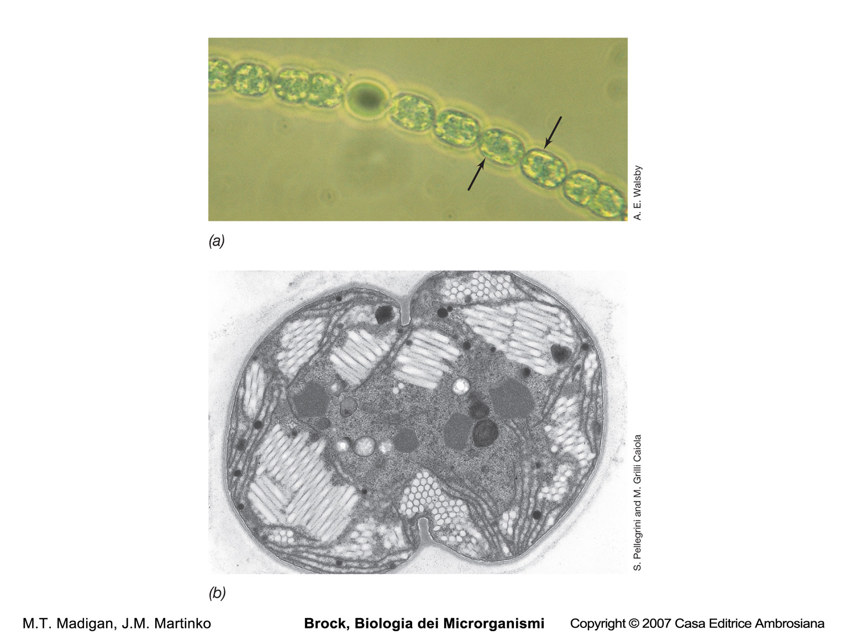
Gas vesiscles of the cyanobacteria Anabaena and Microcystis

Slide 17
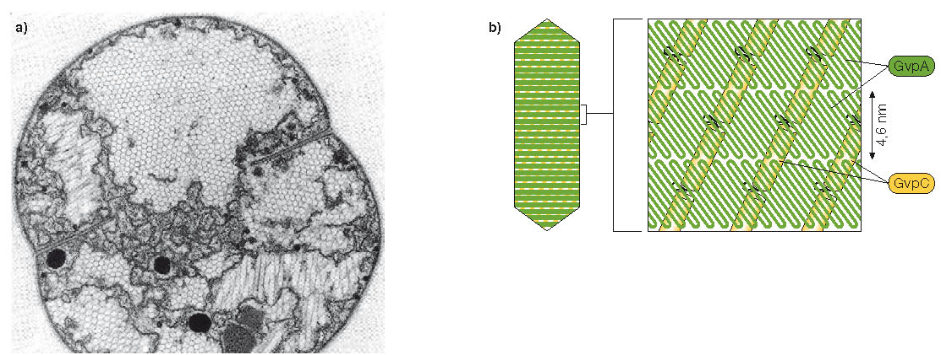
Isolated gas vesicles
Gas vesicles proteins
Model of how the two proteins that make up the gas vesicle, GvpA and GvpC,interact to form a watertight but gas-permeable structure. GvpA makes up the rib and is a rigid β-sheet. GvpC is the cross-linker and is of an α-helix structure

Slide 18
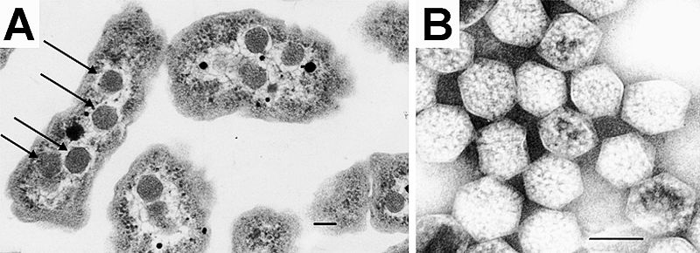
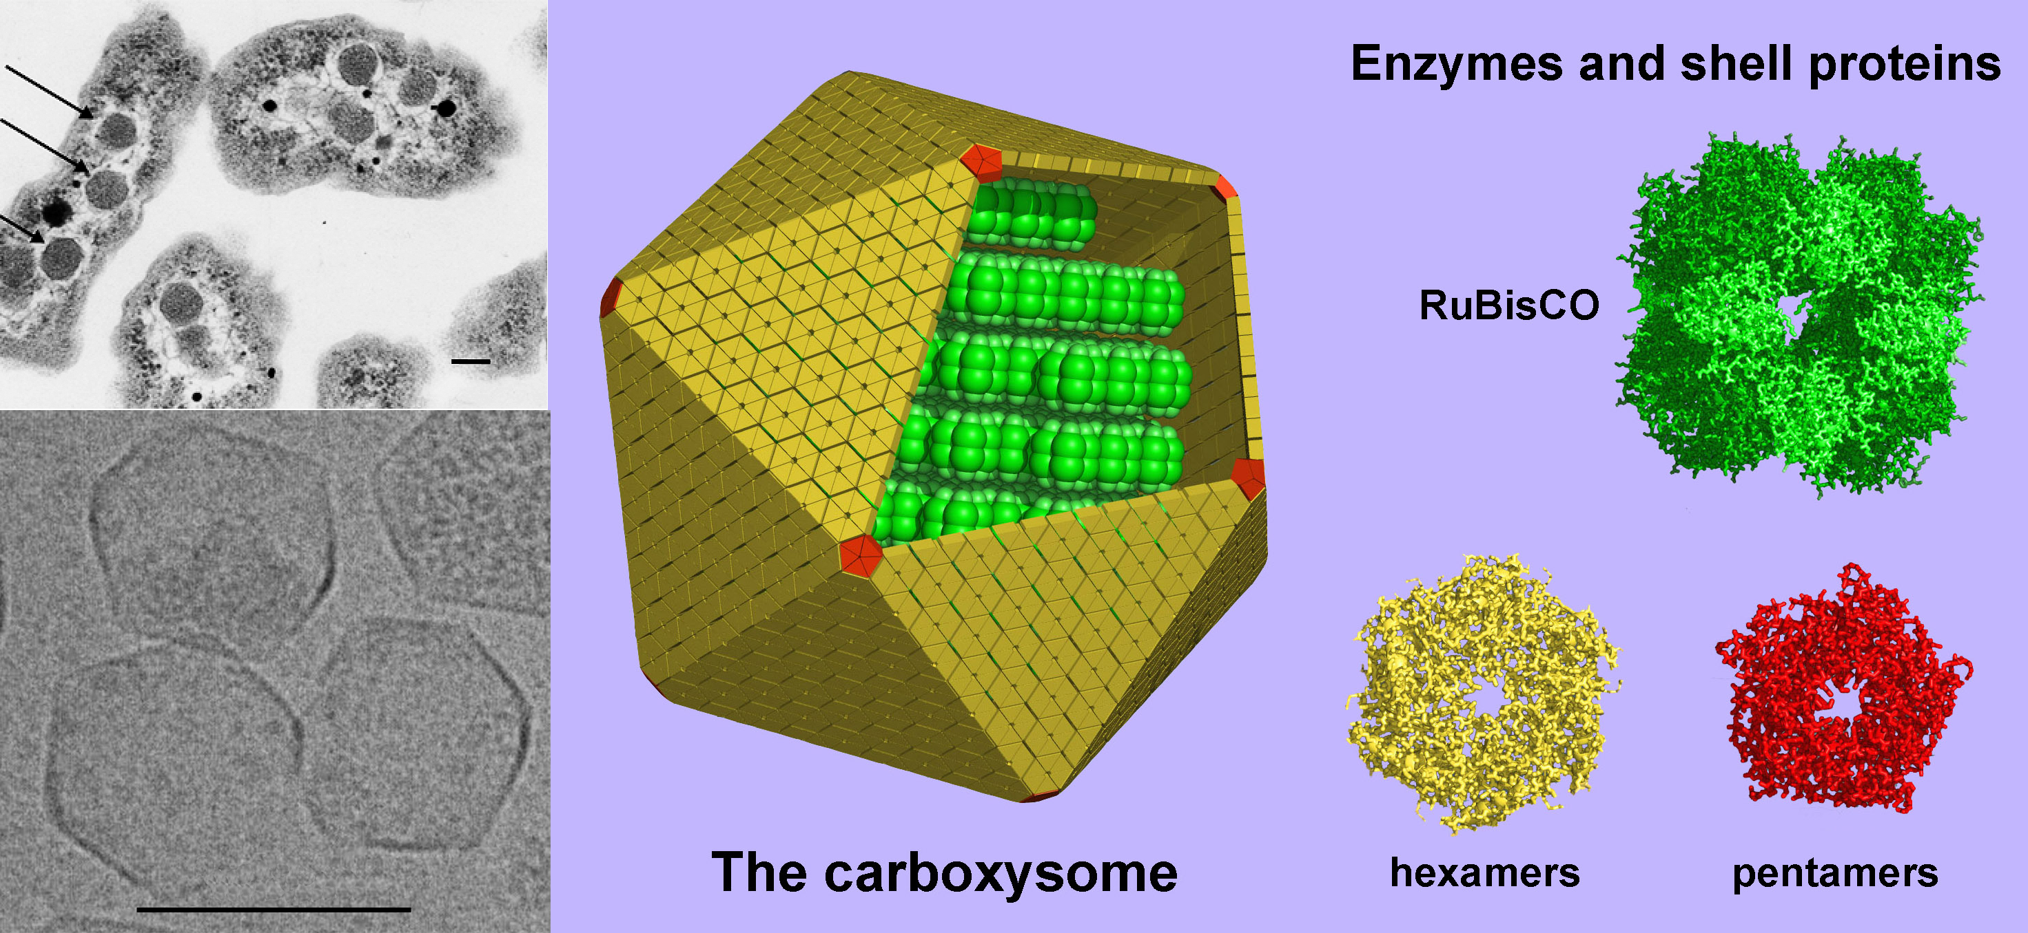
Carboxysomes
Electron micrograph of Halothiobacillus neapolitanus cells, arrows highlight carboxysomes.
Image of intact carboxysomes isolated from H. neapolitanus. Scale bars indicate 100 nm.

Slide 19
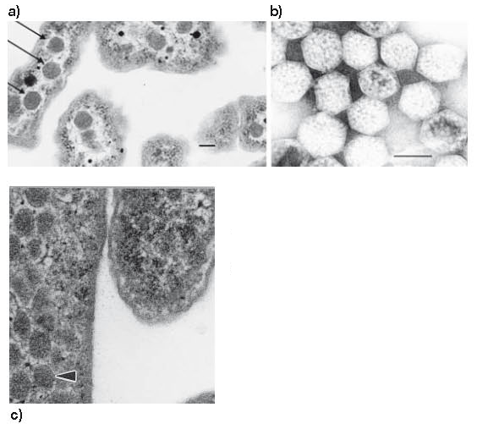

Slide 20
The bacterial chromosome is typically one large
circular molecule of DNA free in the cytoplasm
Prokaryotes sometimes possess smaller extrachromosomal pieces
of DNA called plasmids.The total DNA content of a prokaryote is
referred to as the cell genome

Slide 21
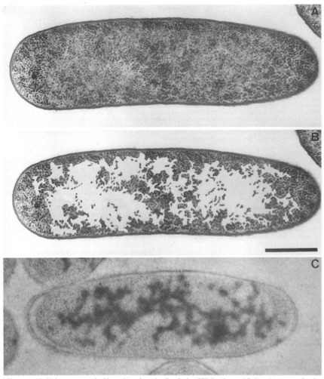
The Escherichia coli nucleoid

Slide 22
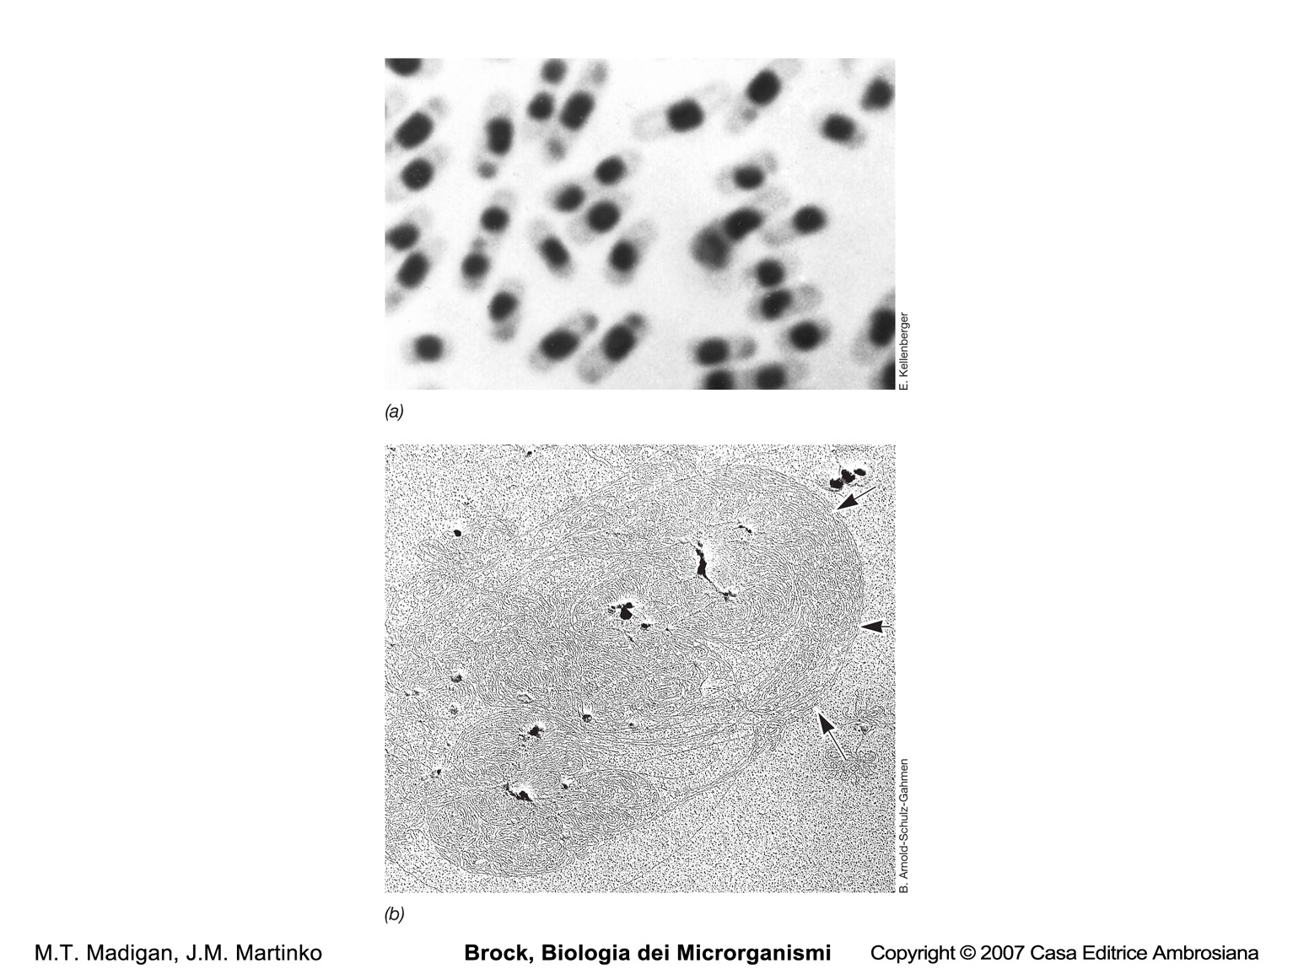
The prokaryotic nucleoid

Slide 23
Structure and function of prokaryotic cells:
Intracellular Compartmentation In Planctomycetes

Slide 24
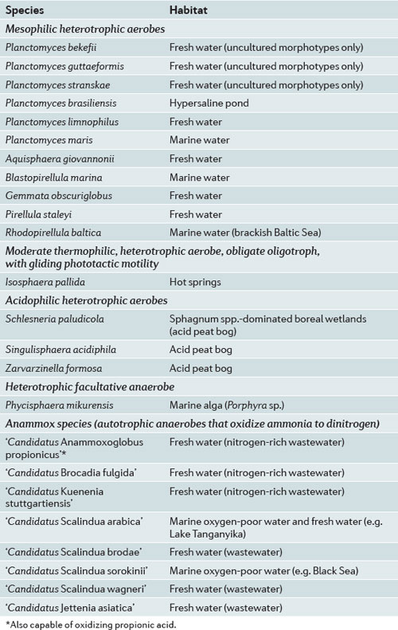
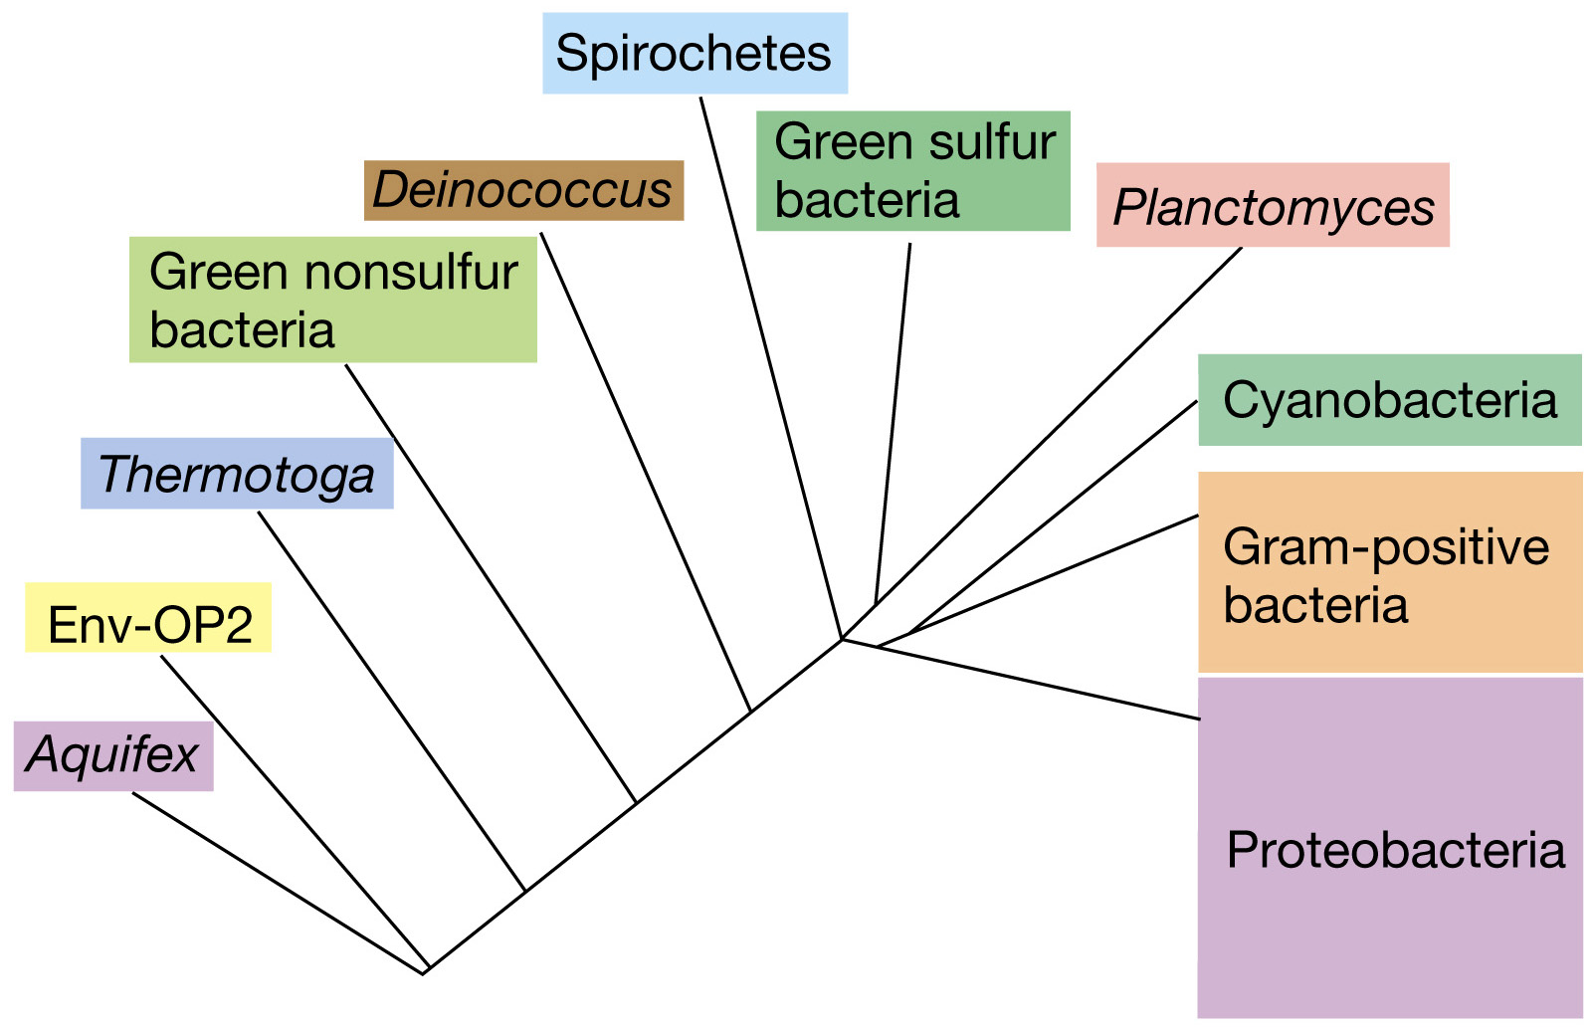
Planctomyces

Slide 25
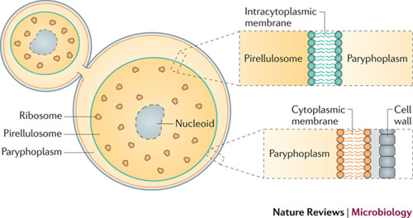
An idealized planctomycete in the process of cell division
The unusual compartmentalized cell structure of the planctomycetes is shown, detailing the protein cell wall, the cytoplasmic membrane lipid bilayer and the intracytoplasmic membrane lipid bilayer (ICM) in relation to the ribosome-free paryphoplasm and the ribosome-containing pirellulosome that contains condensed nucleoid DNA.

Slide 26
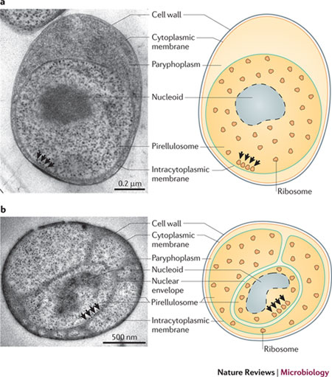
Cell structure of
planctomycetes.

Slide 27
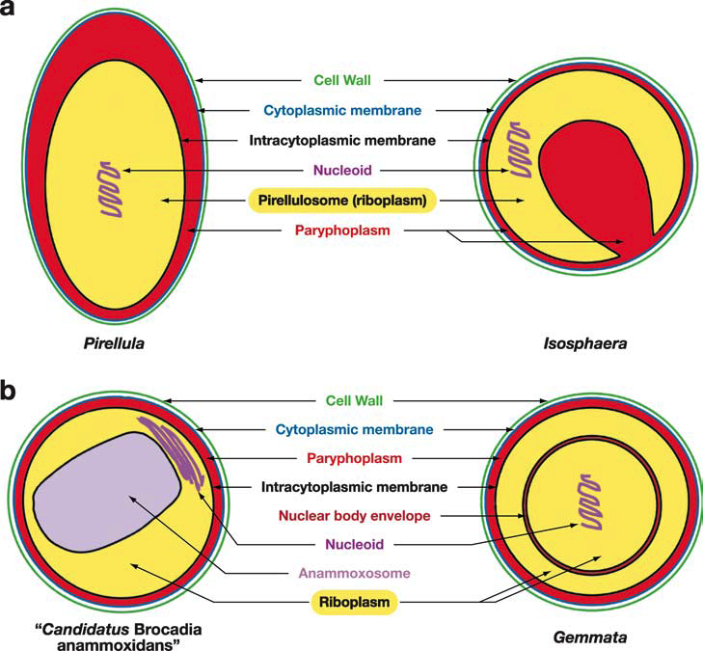
Diagrams of cell organization and compartmentalization in Planctomycetes

Slide 28
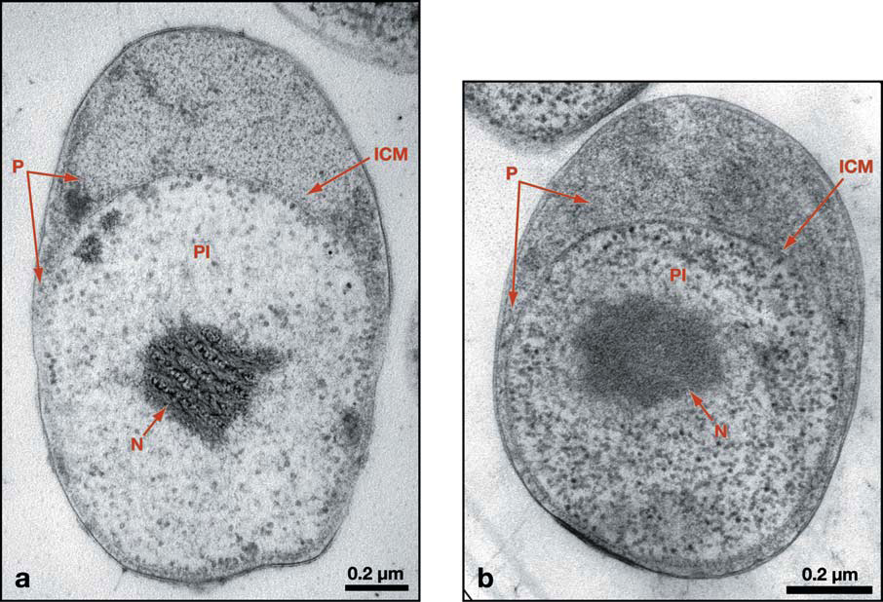
Transmission electron micrograph of thin section of of Blastopirellula marina displaying compartmentalization into pirellulosome (PI) and paryphoplasm (P) separated by the intracytoplasmic membrane (ICM). The nucleoid (N) is contained within the pirellulosome and thus compartmentalized and surrounded by the single ICM membrane.

Slide 29
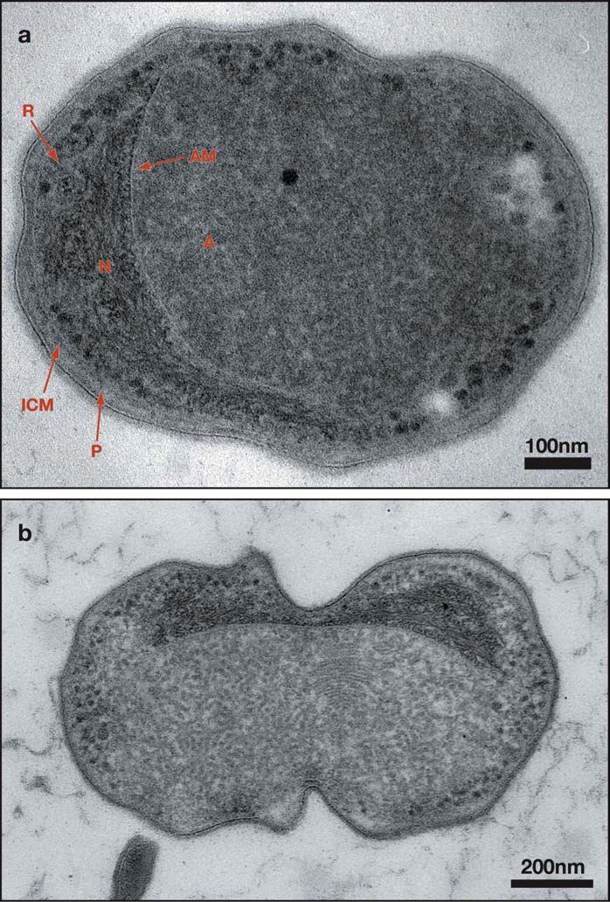
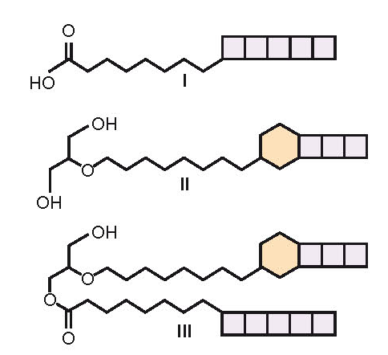
Transmission electron micrograph of thin section of cryosubstituted cell of “Candidatus Brocadia anammoxidans” from a bioreactor performing anaerobic ammonium oxidation.
Structures of characteristic ladderane lipids of
anammox planctomycetes.

Slide 30
The prototype of a prokaryotic cell

Slide 31
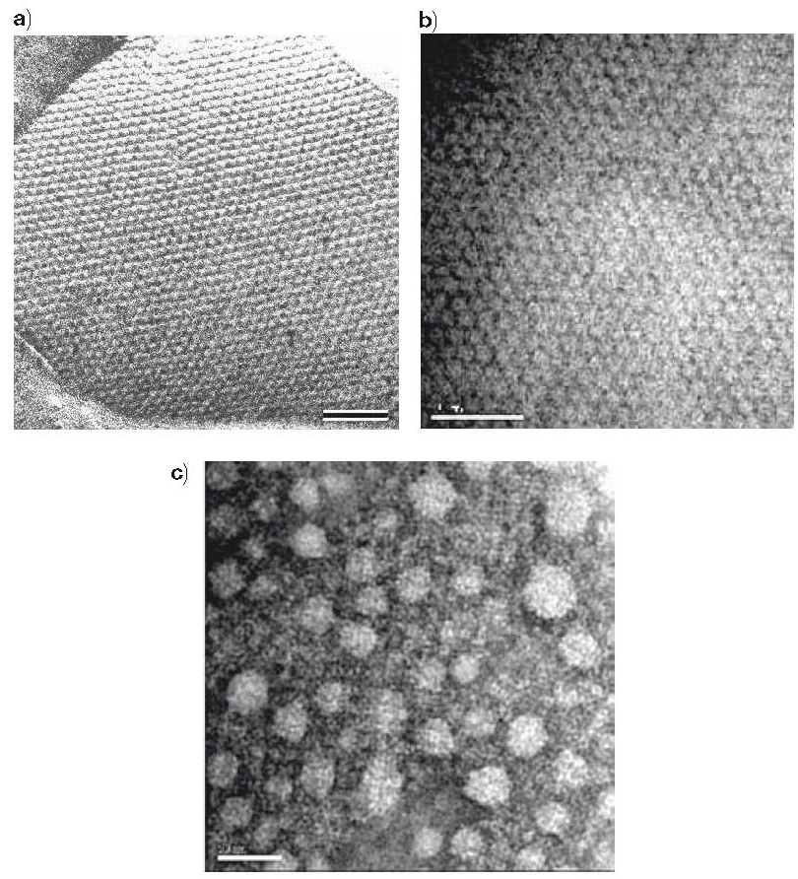
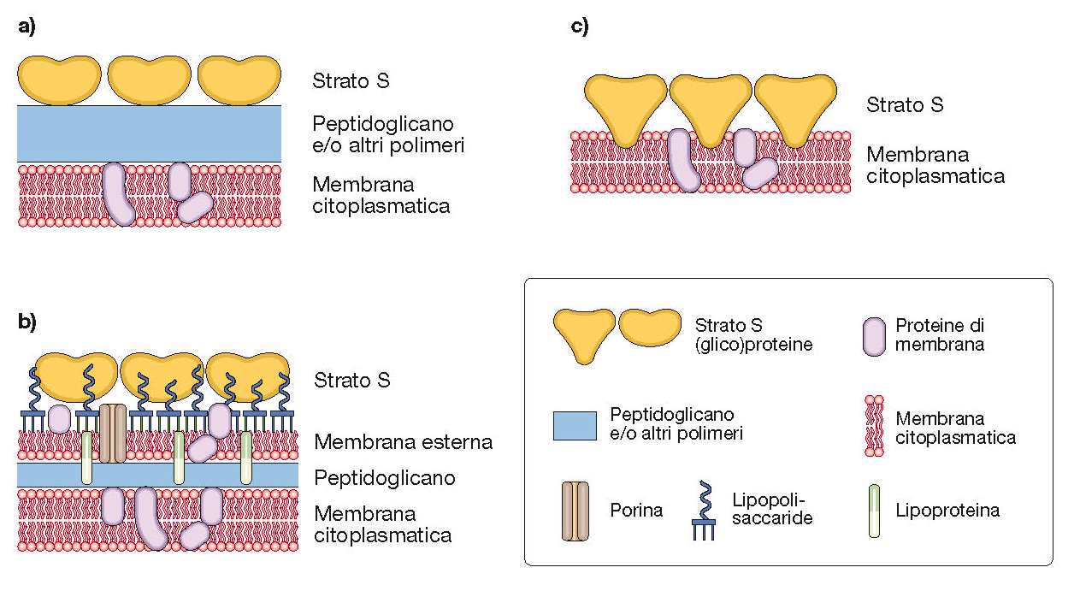
Prokaryotic S layers

Slide 32
Structure and function of prokaryotic cells:
the capsule

Slide 33
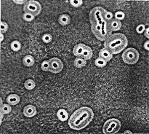
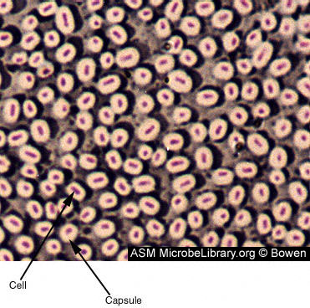
Bacterial capsule outlined by India ink stain

Slide 34
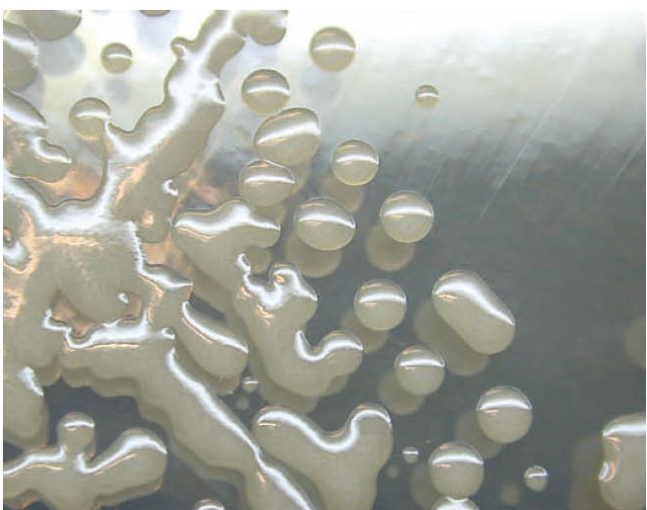
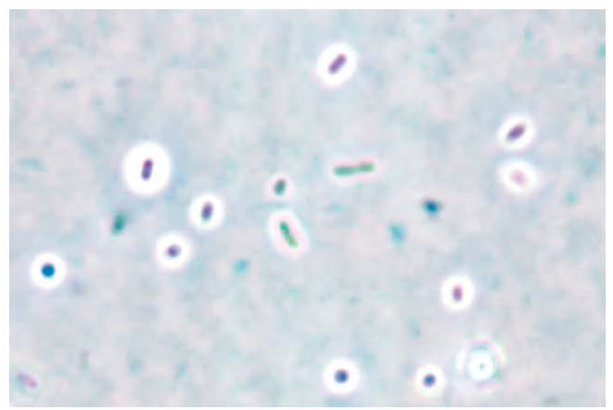
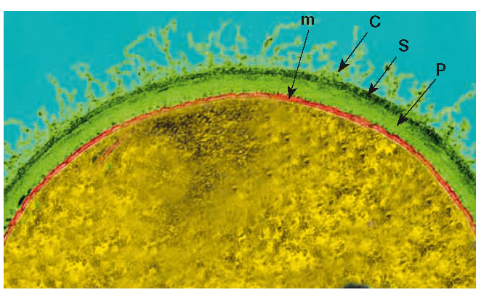
Bacterial capsules

Slide 35
The bacterial capsule

Slide 36
The bacterial capsule functions
A true capsule is a discrete detectable layer of polysaccharides or peptides deposited outside the cell wall
Like fimbriae, capsules mediate cell adherence to surfaces
Capsules protect bacteria from engulfment by predatory
protozoa or phagocytes, or from attack by antimicrobial
agents of plant or animal origin
Capsules in certain sole bacteria protect them from driyng
or desiccation
Capsular materials may be overproduced when bacteria
are fed with sugars to become reserve of carbohydrate

Slide 37
Chemical composition of some bacterial capsules
Bacterium | Capsule | Structural subunits
Gram-positive
Bacillus anthracis | polypeptide | D-glutamic acid
Streptococcus mutans | polysaccharyde | (dextran) glucose
Streptococcus pyogenes | polysaccharyde | NAG, glucuronic acid
Streptococcus pneumoniae | polysaccharyde | sugars, amino sugars, uronic acis
Gram-negative
Escherichia coli | polysaccharyde | glucose, galactose
Pseudomonas aeruginosa | polysaccharyde | mannuronic acid

Slide 38
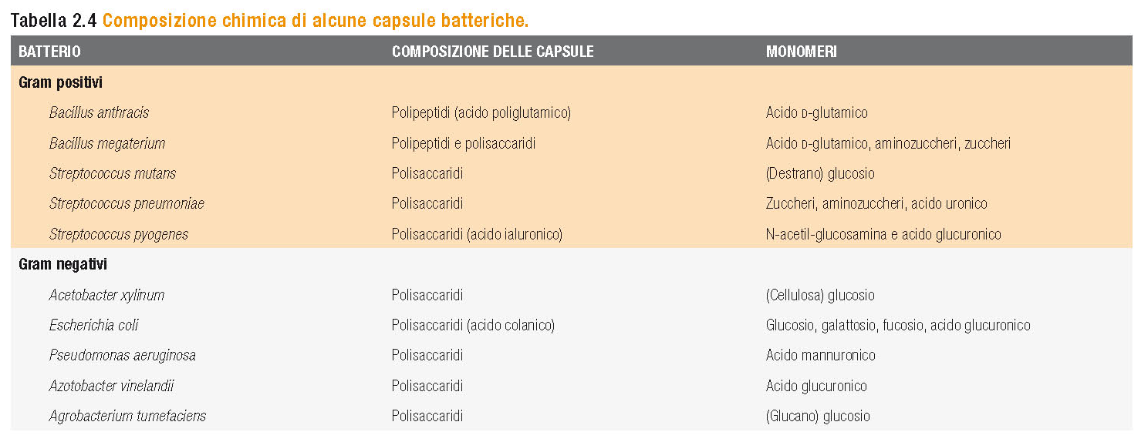

Slide 39
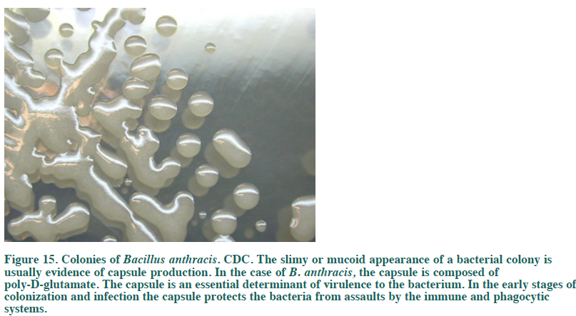
Colonies of Bacillus anthracis
The slimy or mucoid appearance of a bacterial colony is usually evidence of capsule production. The capsule of B. anthracis is composed of poly-D-glutamate.
The capsule is an essential determinant of virulence to the bacterium. In the early stages of colonization and infection the capsule protects the bacteria from assaults by the immune and phagocytic systems.

Slide 40
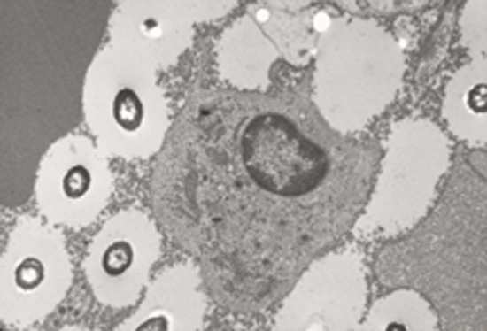
A macrophage surrounded by Bacillus anthracis. Clear spaces represent
capsule material that prevents uptake by the cell and killing of bacteria.

Slide 41
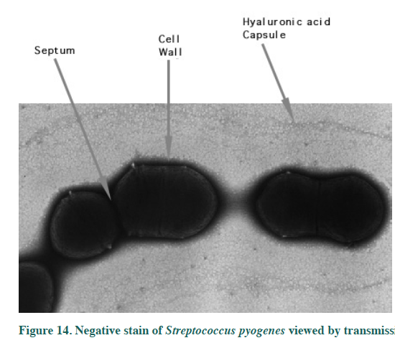
Negative stain of Streptococcus pyogenes viewed by E.M.: the halo around the chain of cells is the hyaluronic acid capsule athat surrounds the exterior of the bacteria

Slide 42
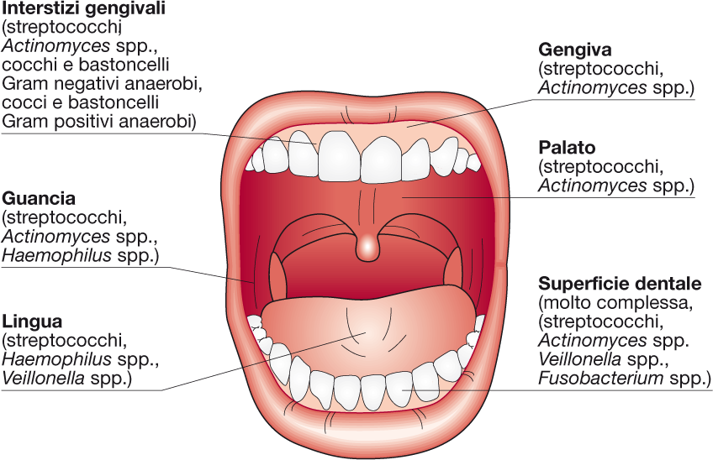

Slide 43
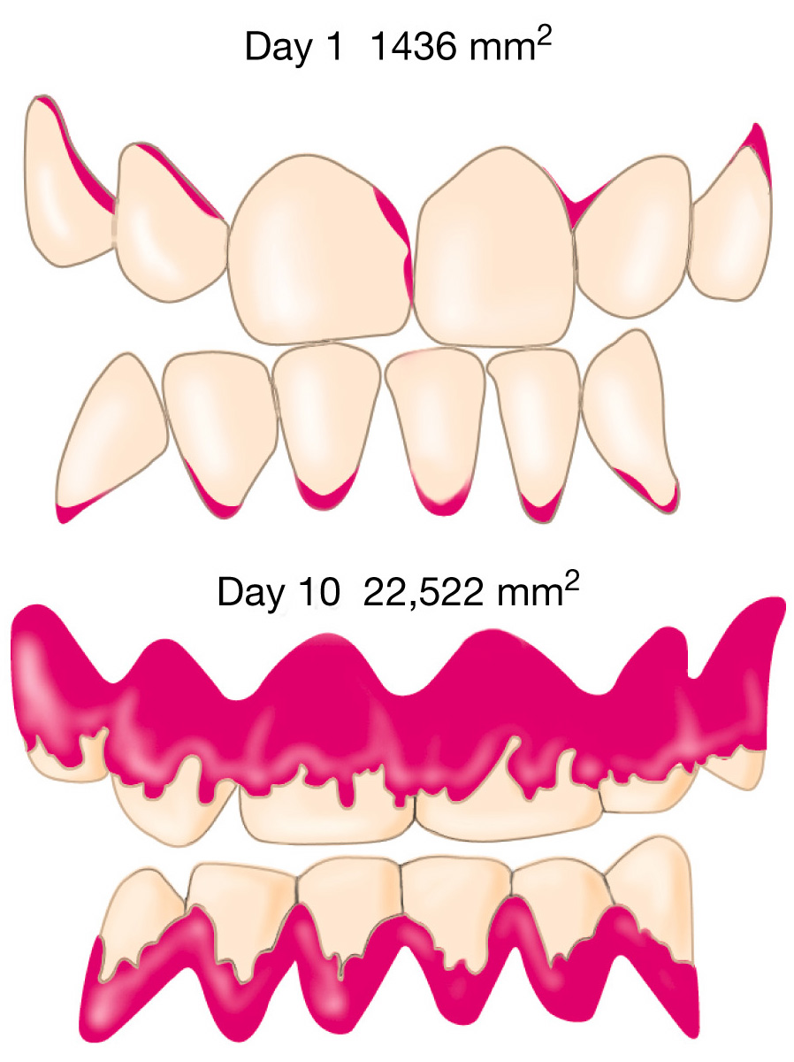
The dental plaque
Dental plaque revealed by red dye Human dental plaque.

Slide 44
The dental plaque
Dental plaque revealed by red dye Human dental plaque.

Slide 45
The dental plaque

Slide 46
The dental plaque and dental caries

Slide 47
Structure and function of prokaryotic cells:
flagella and mobility

Slide 48
The prototype of a prokaryotic cell

Slide 49
Bacterial flagella as observed in E. coli cells stained with the Leifson method

Slide 50
EM of a dividing Salmonella typhi showing flagella and fimbriae

Slide 52
Fine structure of bacterial flagella

Slide 53
Bacterial flagella as observed in living cells
Dark-field Phase contrast

Slide 54
Different flagellar arrangements
Peritrichous Polar Lophotrichous

Slide 55
Different flagellar arrangements

Slide 56
Flagellum structure

Slide 57
Structure of the bacterial flagellum and attachment to the cell wall and membrane in gram-negative Bacteria.

Slide 59
The bacterial flagellum consists over almost all of its length of a single protein, flagellin.
Thousands of flagellin molecules form a hollow tube
composed of 11 simple polymer threads, known as protofilaments.

Slide 60
Summary of steps in flagella biosynthesis.

Slide 61
Summary of steps in flagella biosynthesis.

Slide 62
Axial filaments of spirochetes

Slide 65
Flagellum of the Archea Methanococcus voltae

Slide 66
Manner of movement in peritrichously flagellated prokaryotes

Slide 67
Manner of movement in polarly flagellated prokaryotes

Slide 69
RELAX…… OUR STARS ARE PLAYING
http://www.rowland.harvard.edu/labs/bacteria/movies/index.php

Slide 70
Chemotaxis in a peritrichously flagellated bacterium
like Escherichia coli.

Slide 72
Chemotaxis

Slide 73
Schematic diagram of
the chemosensory
system of Escherichia coli

Slide 74
Schematic diagram of the chemosensory
system of Escherichia coli

Slide 75
Interactions of transducers(MCP), chemotaxis (Che) proteins,
and the flagellar motor in bacterial chemotaxis

Slide 76
Interactions of transducers(MCP), chemotaxis (Che) proteins,
and the flagellar motor in bacterial chemotaxis

Slide 77
Bacterial phototaxis
Thiospirillum jenense
(scotophobotaxis)
Rhodospirillum centenum
(true phototaxis)
time 0
light
time 2h

Slide 79
Proposed model for gliding motility

Slide 80
Proposed model for gliding motility

Slide 81
Structure and function of prokaryotic cells:
the fimbriae

Slide 82
The prototype of a prokaryotic cell

Slide 83
EM of a dividing Salmonella typhi showing flagella and fimbriae

Slide 84
The fimbriae functions
Common pili (fimbriae) are usually involved in specific adherence of prokaryotes to surfaces, cell-to-cell interactions, biofilm formation, conjugation (HGT), movement.
They are the major determinants of bacterial virulence because they allow pathogens to attach to (colonize) tissues and/or resist attack by phagocytes

Slide 85
Transmission electron micrograph of adherence of E. coli JR1 strain to mucosal surface of human foreskin.
B) Enlargement of A with attachment of E. coli to mucosal surface by fimbriae (arrowheads).
C) Enlargement of B with attachment of E. coli by fimbriae (arrowheads).

Slide 86
Type I pili assembly (chaperon/usher)

Slide 87
Type IV pili
Escherichia coli
Neisseria gonorrhoeae

Slide 88
Type IV pilus assembly

Slide 89
Type IV pili-dependent movement

Slide 90
Pili of E .coli

