Slide 1
MICROBIOLOGIA GENERALE
The Archaea

Slide 2
MICROBIOLOGIA GENERALE
Prokaryotic diversity:
The Archea

Slide 3
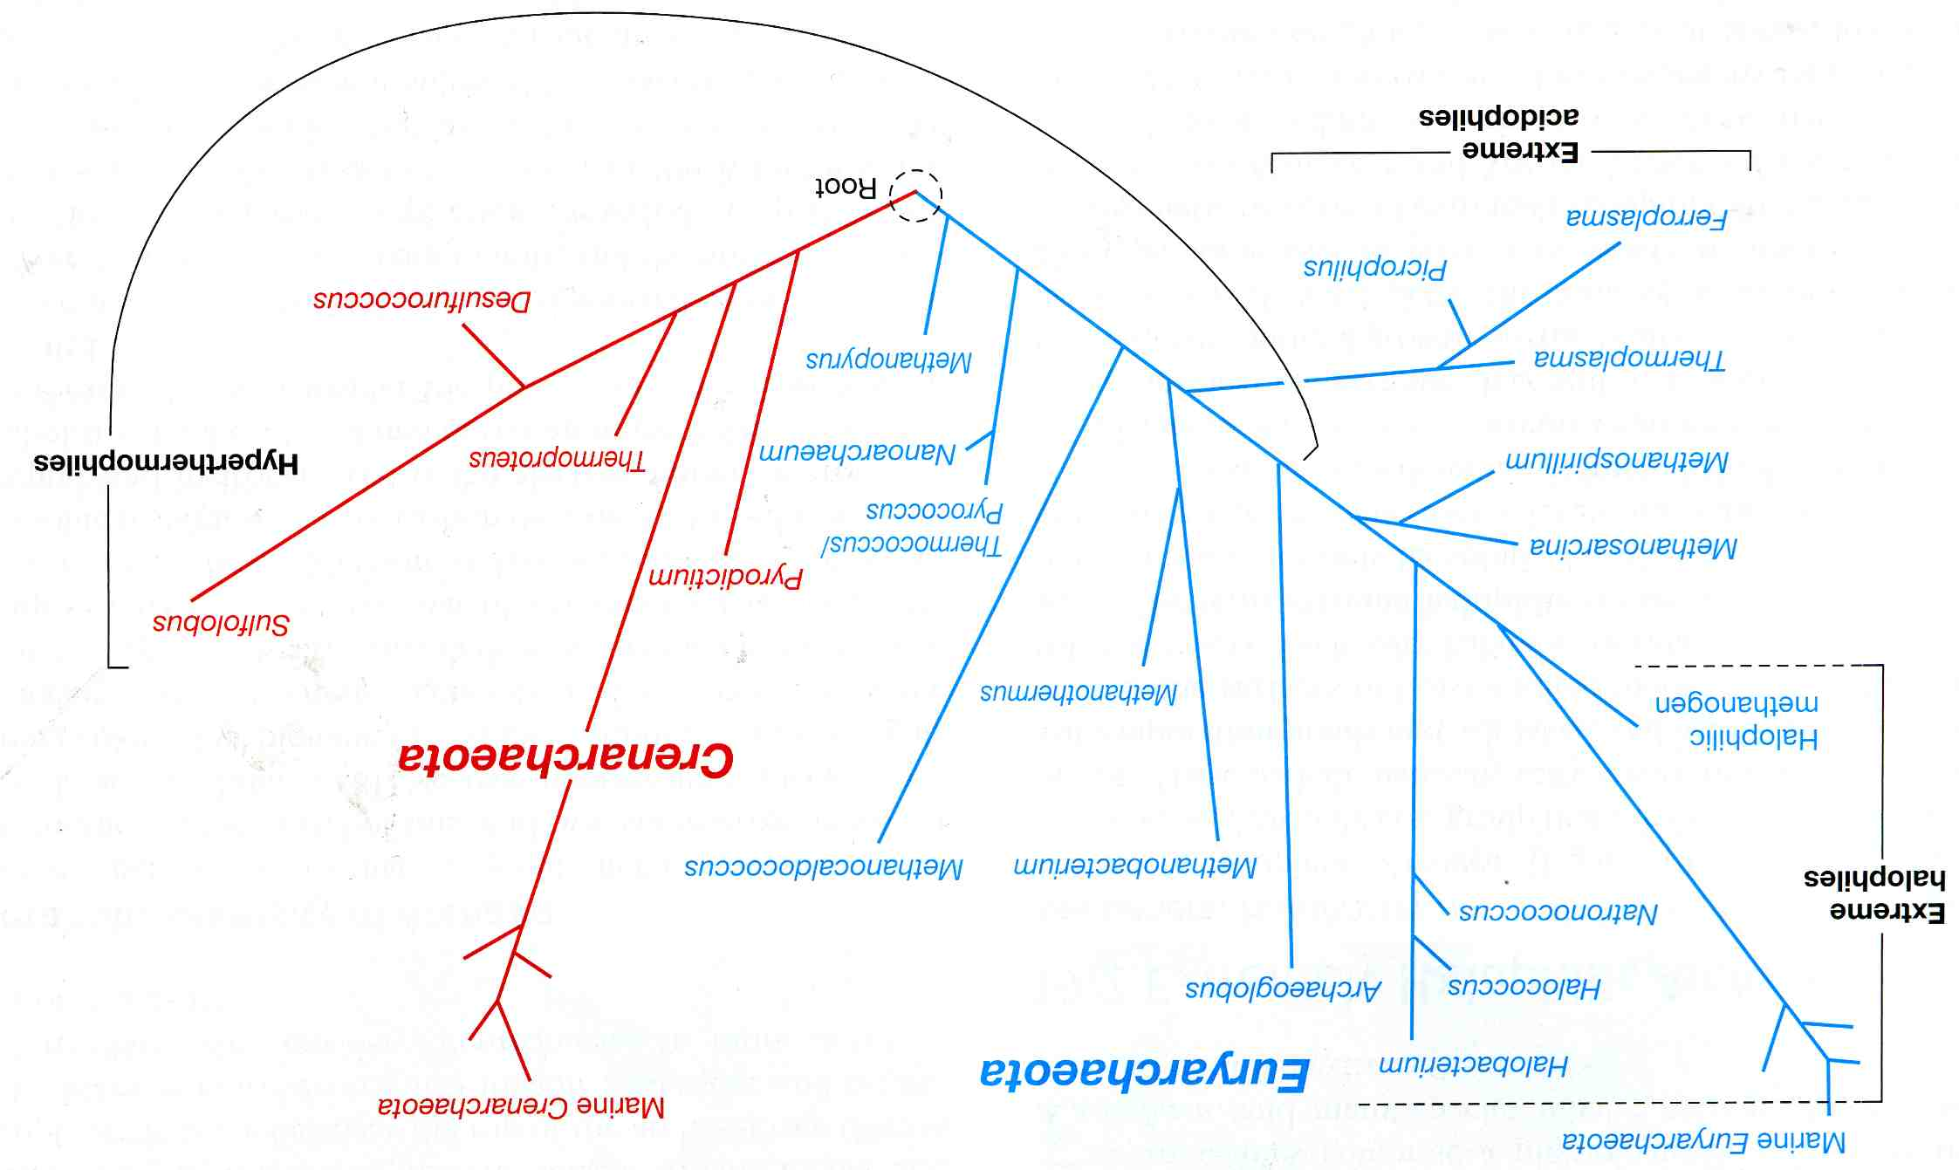
The phylogenetic tree of Archaea based on 16S rRNA gene sequence

Slide 4
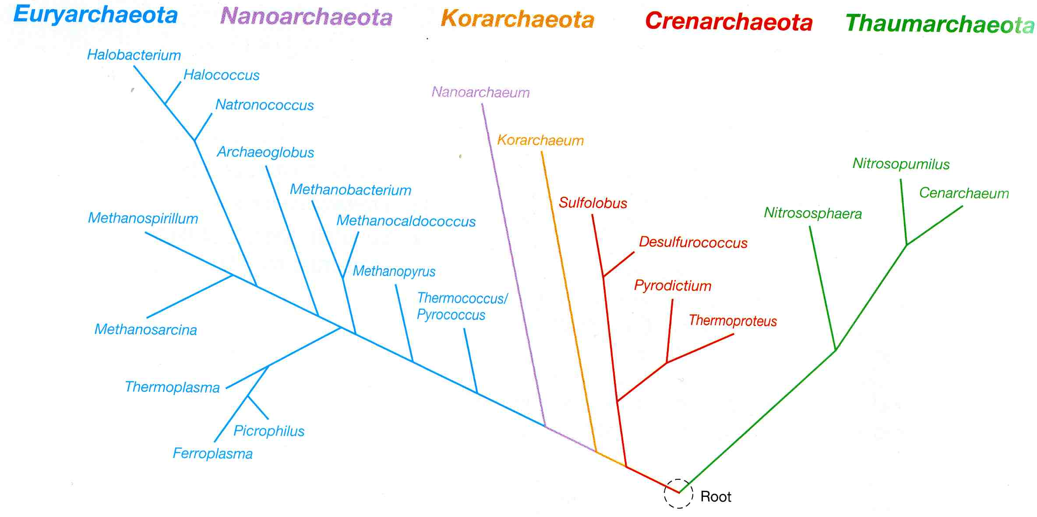
Detailed phylogenetic tree of Archaea based on comparison of
ribosomal proteins from sequenced genomes

Slide 5
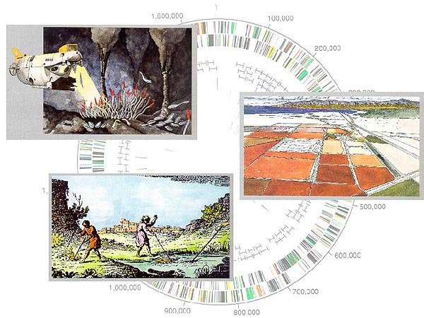

Slide 6
The Archaea’s traits
The cell wall of Archaea: pseudopeptidoglycan, polysaccharide, glycoprotein
2. The cytoplasmic membrane of Archaea: ether linkage, glycerol diethers and tetraethers
3. Transcription and translation in Archaea
4. Energy metabolism and metabolic pathways in Archaea

Slide 7
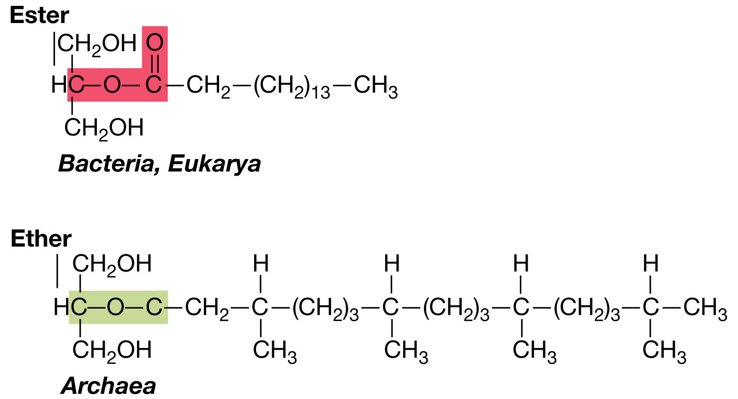
Lipids in Bacteria, Eukarya, and Archaea

Slide 8
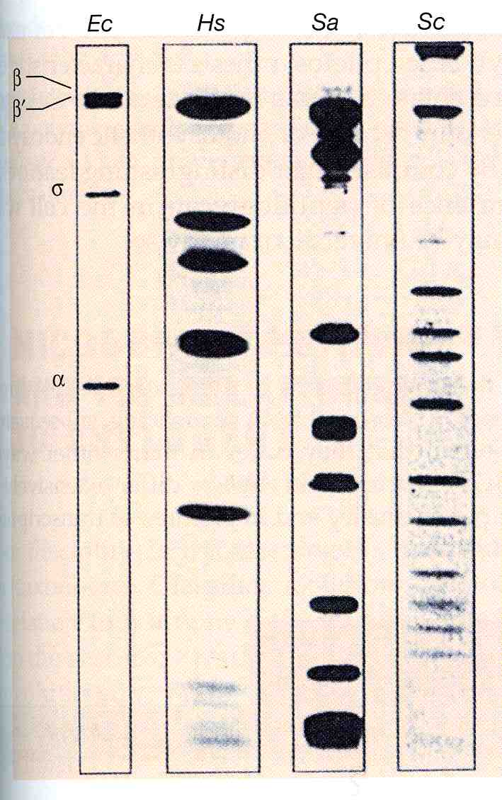
RNA polymerases from Bacteria, Eukarya, and Archaea

Slide 9
The Euryarchaeota:
extremely halophilic Archaea

Slide 10
Ionic composition of some highly saline environments
 | Concentration (g/l)
Ion | Great Salt Lake | Dead Sea | Soda lake | Seawater
Na⁺ | 105 | 401 | 142 | 10.6
K⁺ | 6.7 | 7.7 | 2.3 | 0.38
Mg²⁺ | 11 | 44 | <0.1 | 1.27
Ca²⁺ | 0.3 | 17.2 | <0.1 | 0.40
Cl⁻ | 181 | 225 | 155 | 18.9
SO₄²⁻ | 27 | 0.5 | 23 | 2.65
HCO3⁻ | 0.7 | 0.2 | 67 | 0.14
pH | 7.7 | 6.1 | 11 | 8.1

Slide 11
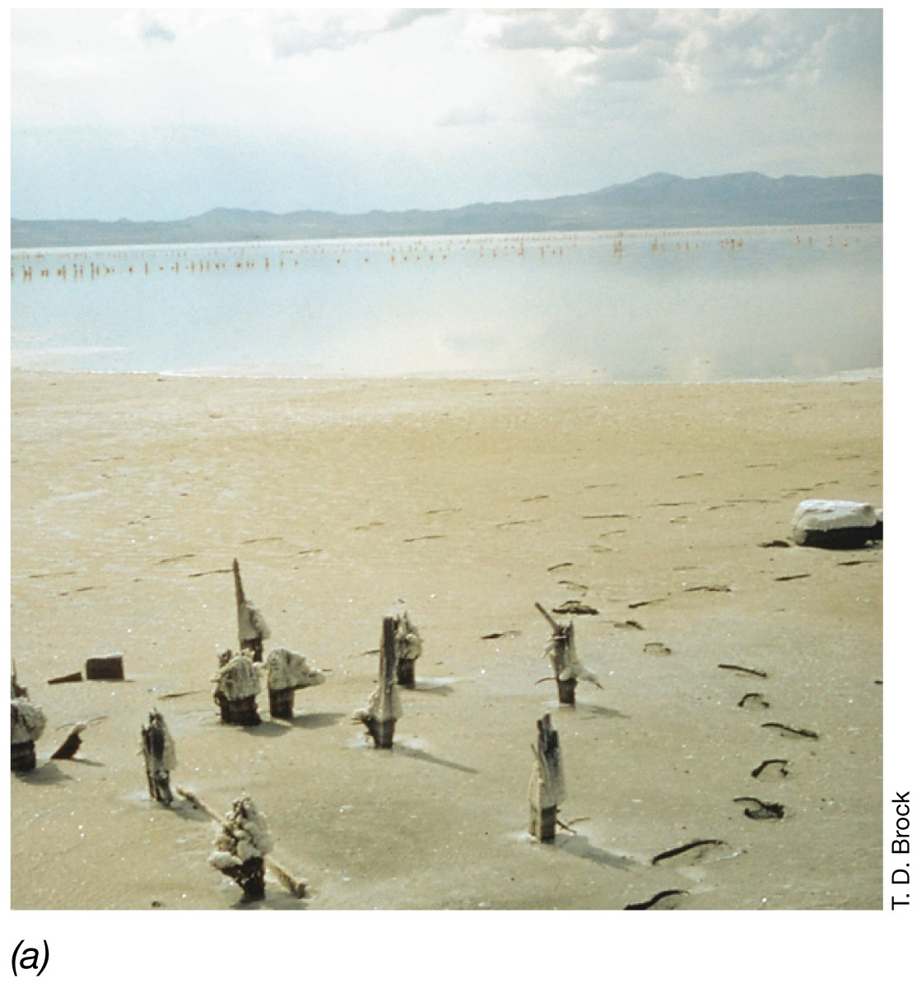
Hypersaline habitats for halophilic Archaea : the Great Salt Lake

Slide 12
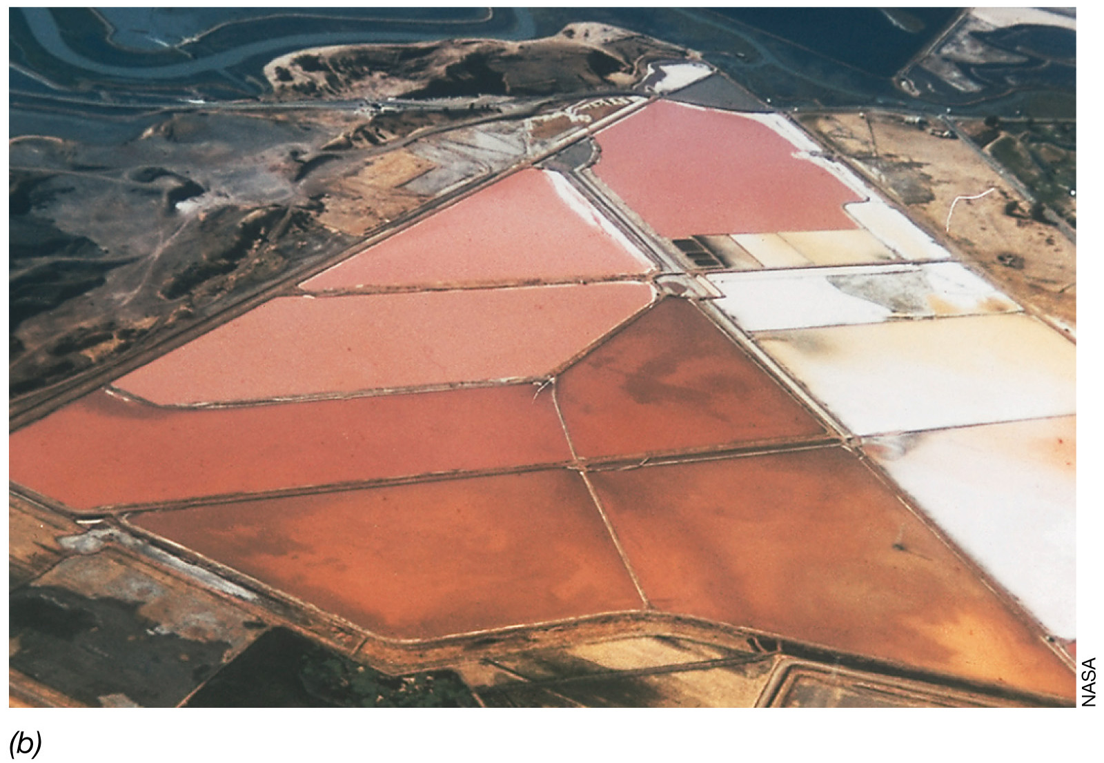
Hypersaline habitats for halophilic Archaea : the salter

Slide 13
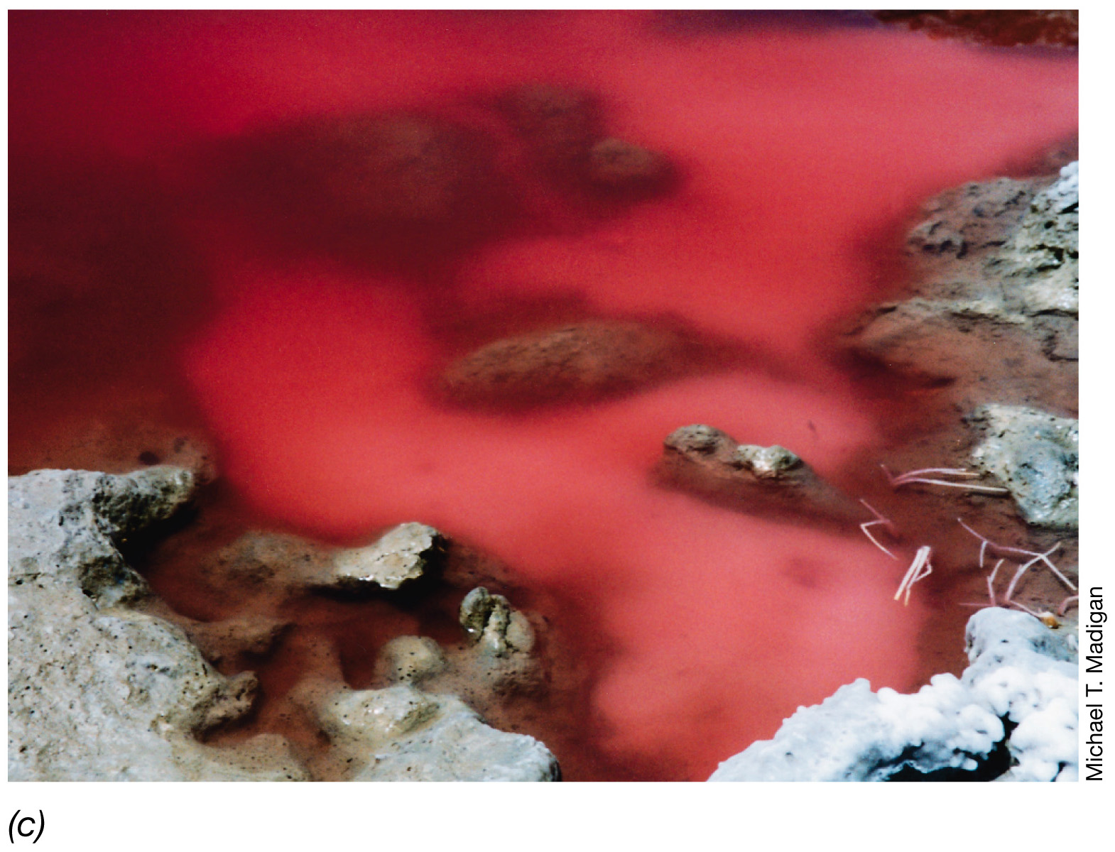
Hypersaline habitats for halophilic Archaea : Lake Hamara, Egypt

Slide 14
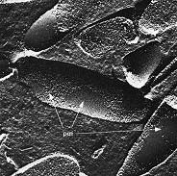
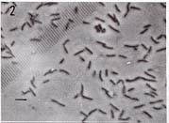
Halobacterium salinariumis an extreme halophile that grows at
4 to 5 M NaCl.
The freeze etched preparation shows the surface structure of the cell membrane and reveals smooth patches of"purple membrane" (bacteriorhodopsin).

Slide 15
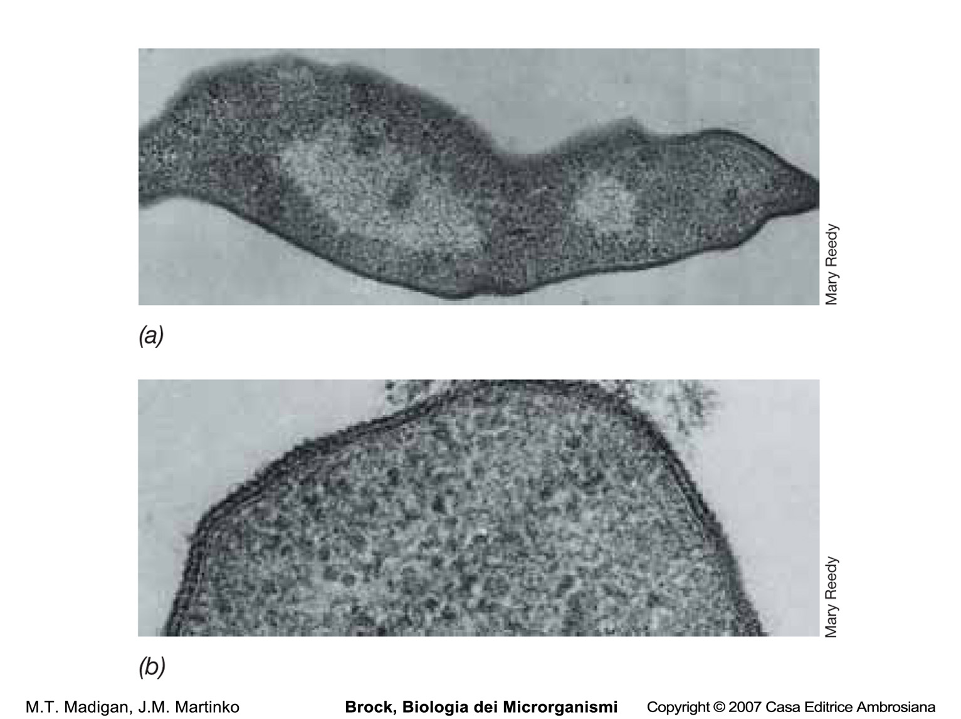
Halobacterium salinarum

Slide 16
Concentration of ions in cells of Halobacterium salinarum
Ion _{Concentration} Concentration
_{in medium (M)} in cells (M)
Na⁺ K⁺ Mg²⁺ Cl⁻ | _{3.3} _{0.05} _{0.13} _{3.3} | 0.8 5.3 0.12 3.3

Slide 18
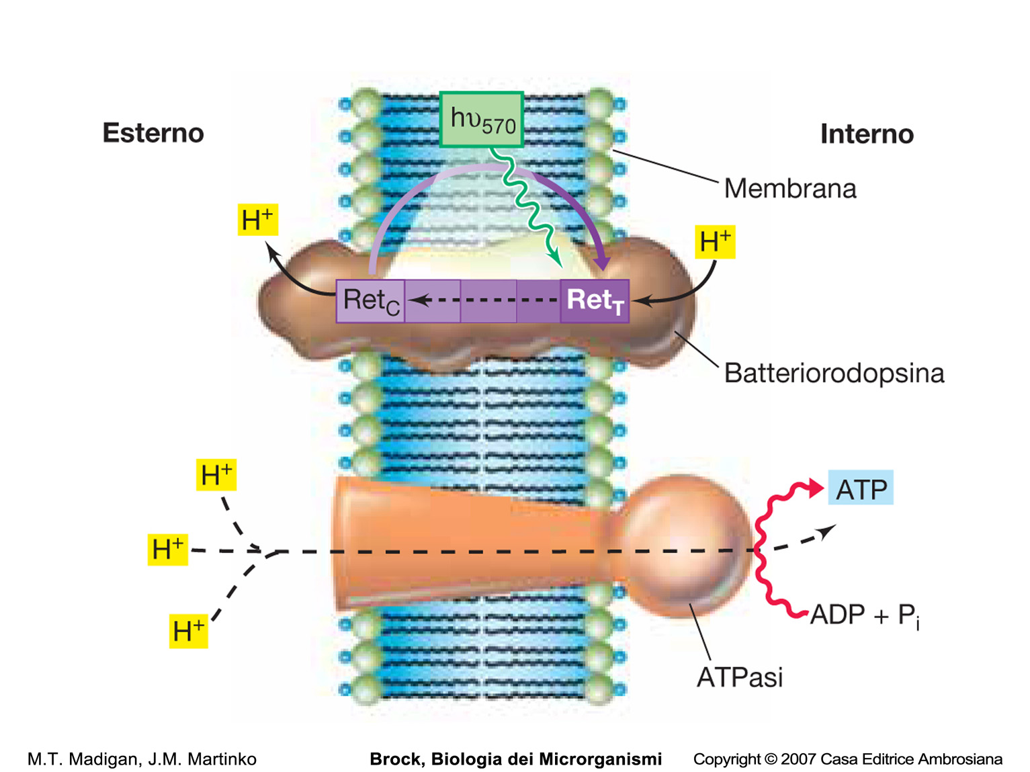
Mechanism of bacteriorhodopsin activity

Slide 19
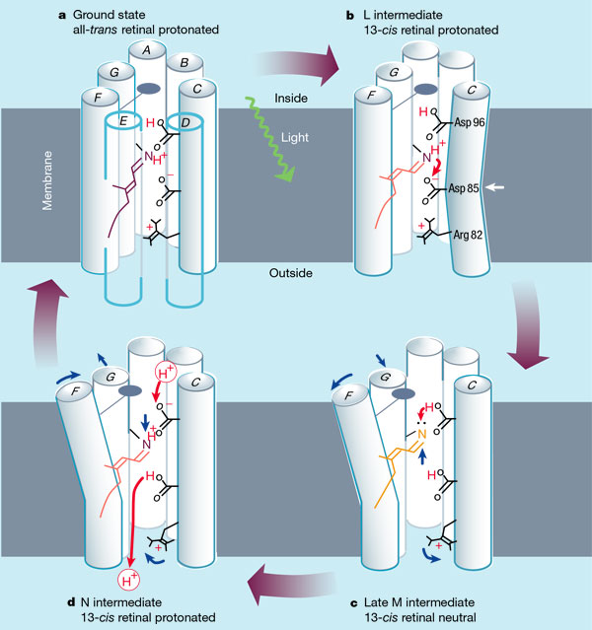

Slide 20
The Euryarchaeota:
methanogens

Slide 21
Habitats of Methanogens
Anoxic sediments: bogs, marshs, rice fields
2. Animal digestive tracts: rumen of ruminants, cecum of cecal animals (horse, rabbits), large intestine of monogastric animals (humans), hindgut of cellolytic insects (termites)
3. Geothermal sources of H₂ +CO₂: hydrothermal vents
4. Artificial biodegradation facilities: sewage sludge digestors
5. Endosymbionts of various anaerobic protozoa

Slide 22
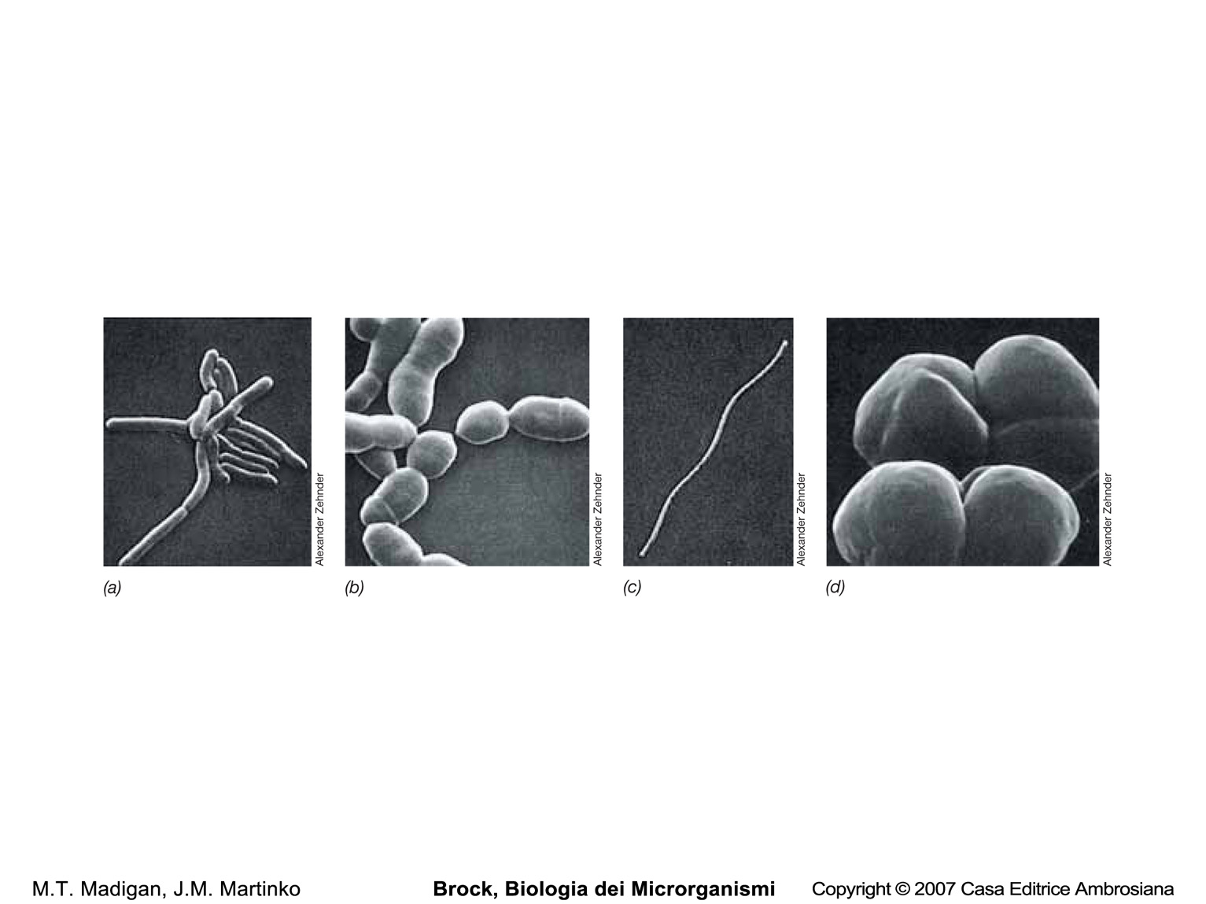
Methanogens

Slide 23
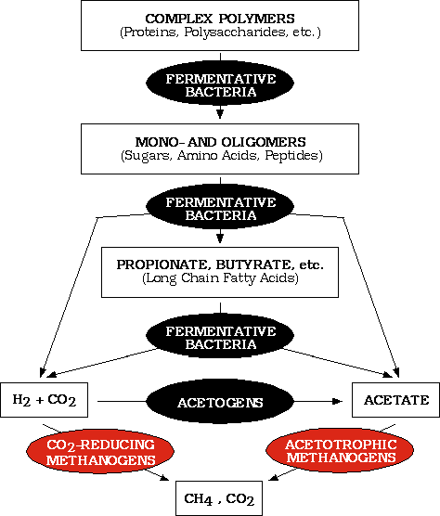
Methanogenesis is the terminal step in the biodegradation of the
organic matter in anoxic habitats

Slide 24
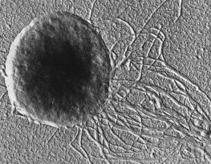
Methanococcus jannischii was originally isolated from a "white smoker" chimney at an oceanic depth of 2,600 meters on the East Pacific Rise.
It can be grown in a mineral medium containing only H2 and CO2 as sources of energy and carbon for growth

Slide 25
Substrates converted to methane by various
methanogenic Archaea
CO₂-type substrates
CO₂ (with electrons derived from H₂, alcohols or pyruvate)
Formate, HCOO⁻
Carbon monoxide, CO
2. Methyl-substrates
Methanol, CH₃OH
Methylamine, CH₃NH₃⁺
Dimethylamine, (CH₃)₂NH₂⁺
Methylmercaptan, CH₃SH
Dimethylsulfide, (CH₃)₂S
3. Acetotrophic substrates
Acetate, CH₃COO⁻
Pyruvate, CH₃COCOO⁻

Slide 26
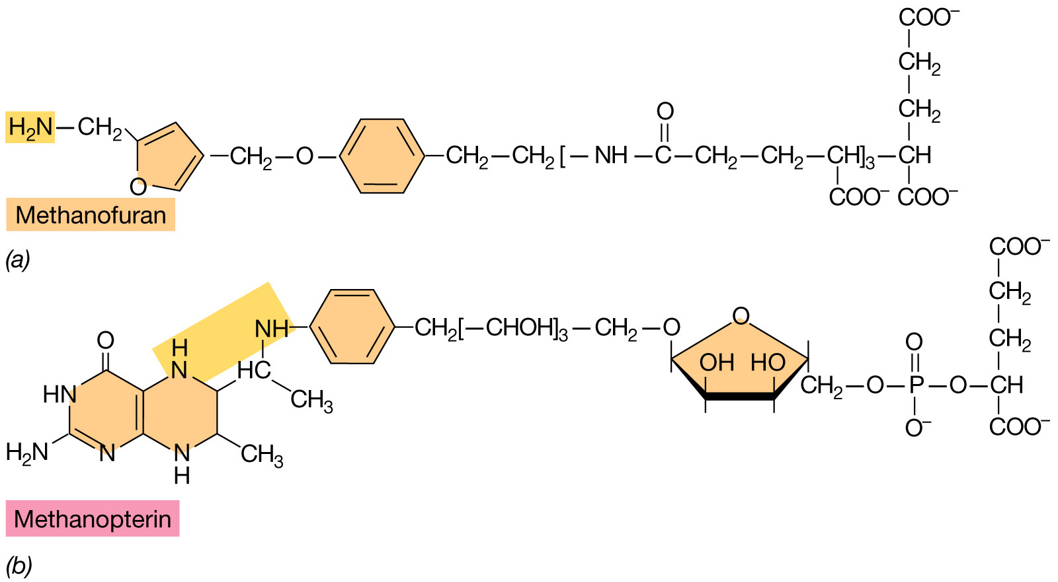
Coenzymes of methanogenic Archaea: C1 carriers in methanogenesis

Slide 27
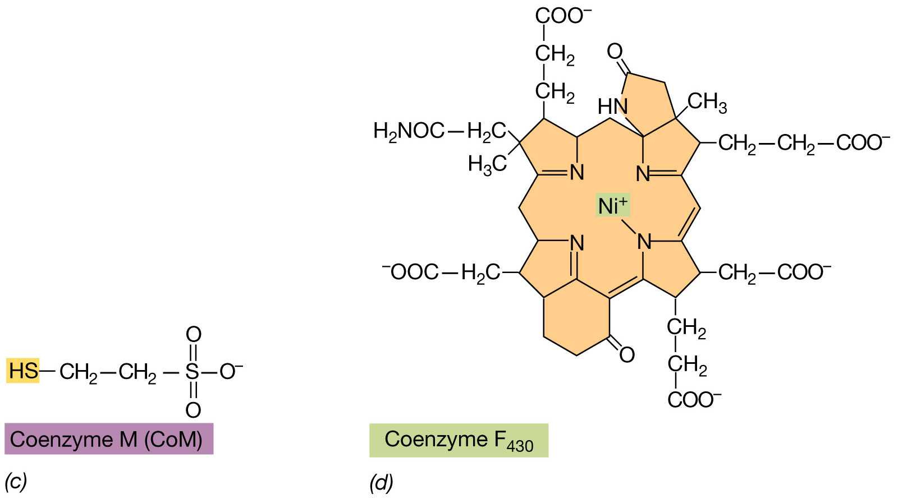
Coenzymes of methanogenic Archaea: C1 carriers in methanogenesis

Slide 28
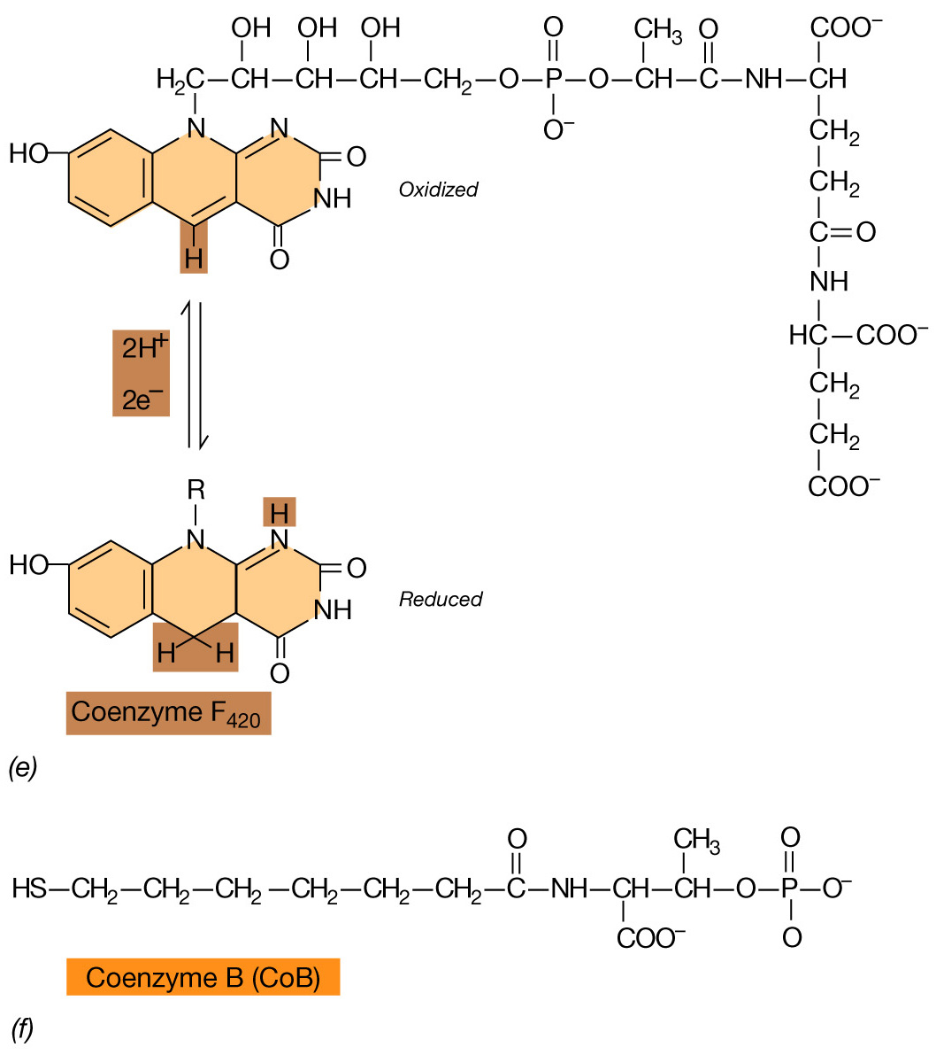
Coenzymes of methanogenic Archaea:
electron donors in methanogenesis

Slide 29
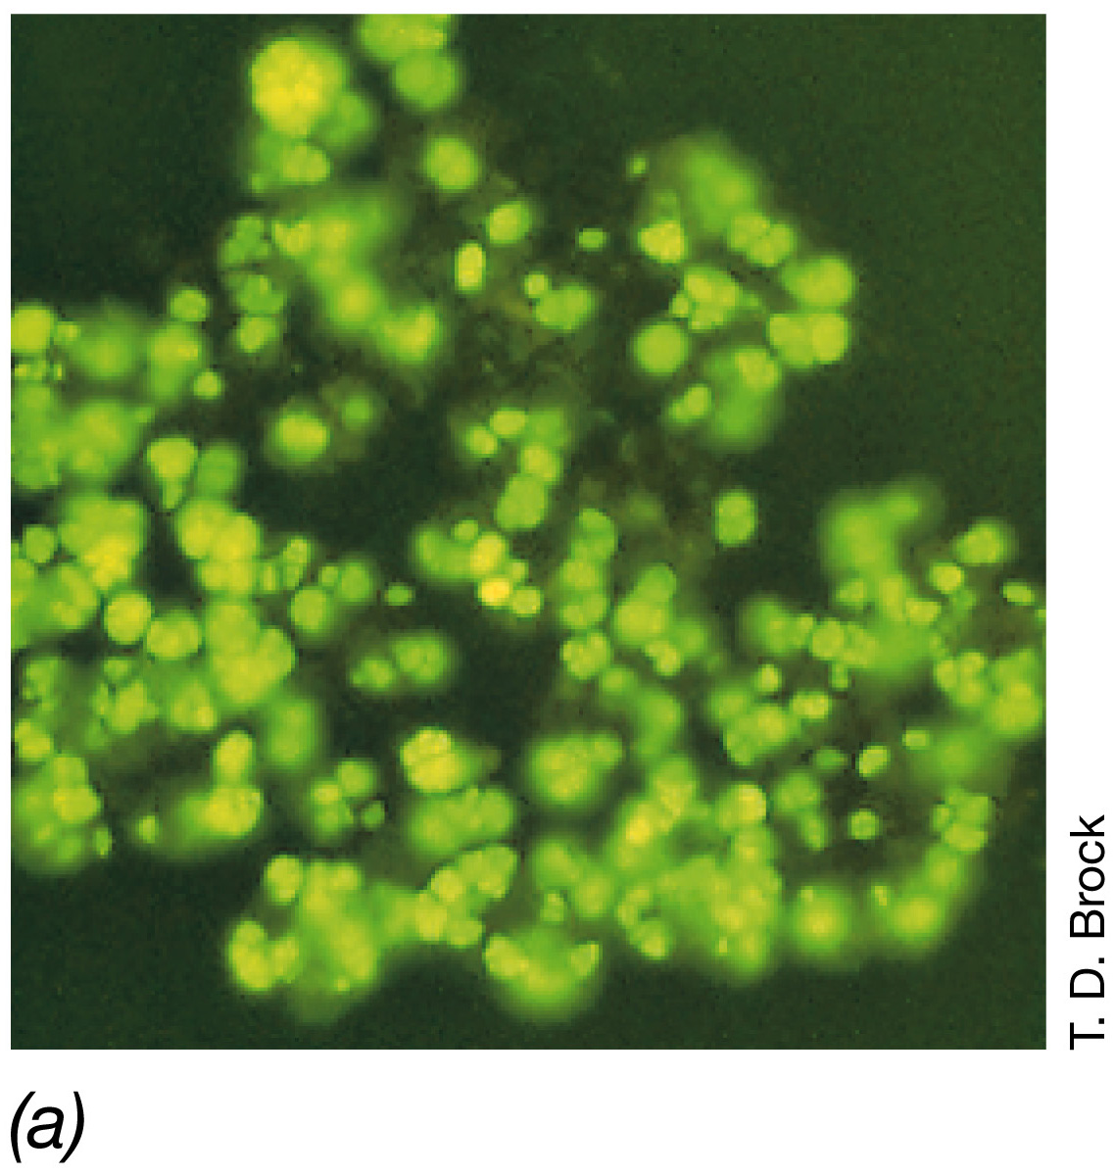
Autofluorescence in cells of the methanogen Methanosarcina barkeri
due to the presence of the unique electron carrier F₄₂₀

Slide 30
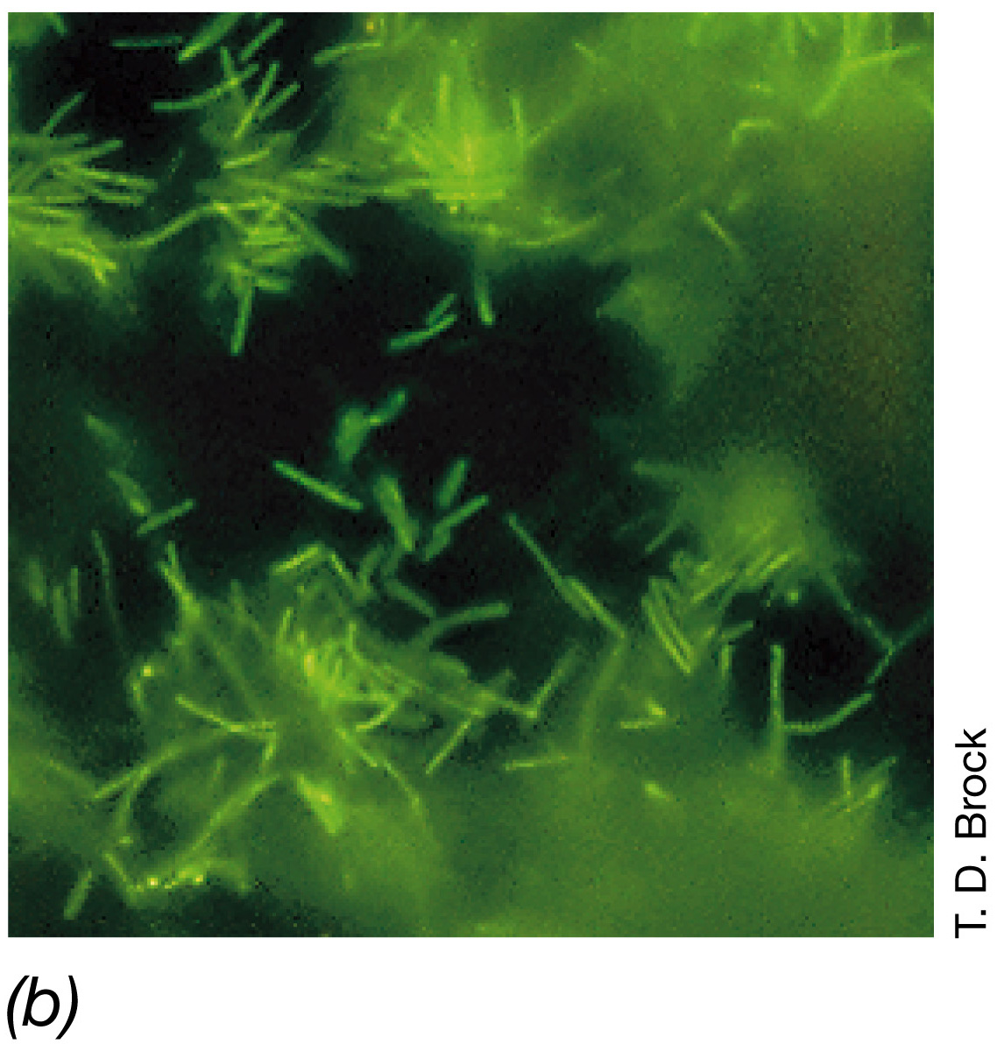
F₄₂₀ fluorescence in cells of the methanogen
Methanobacterium formicum

Slide 31
Pathway of methanogenesis from CO₂
1
2

Slide 32
Pathway of methanogenesis from CO₂
3

Slide 33
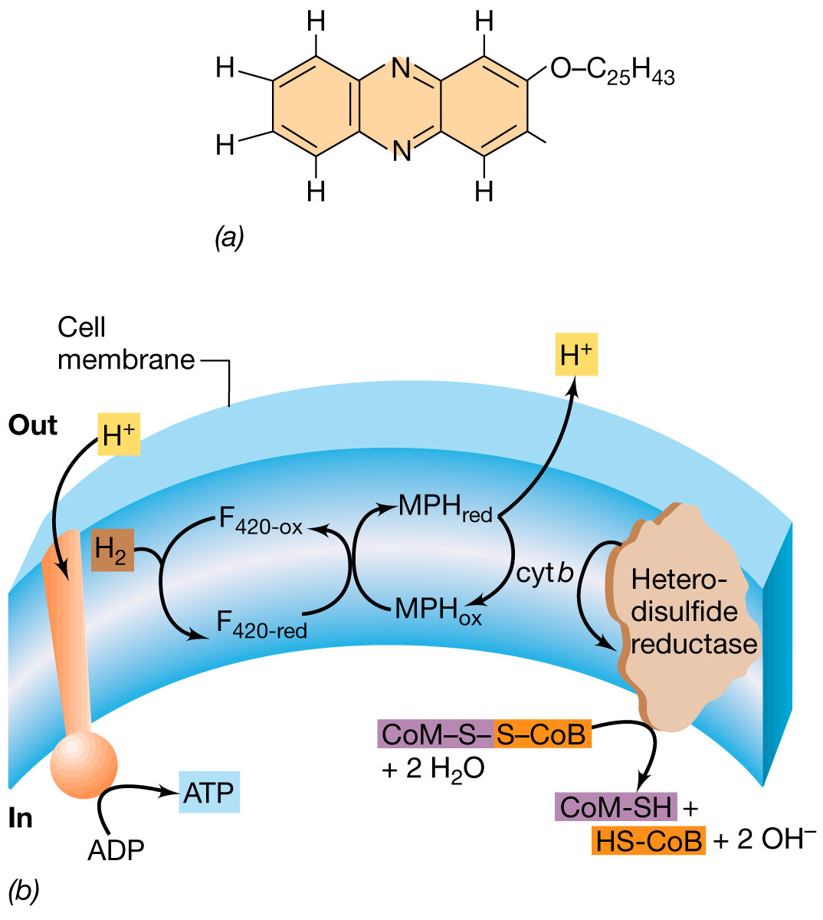
Energy conservation
in methanogenesis

Slide 34
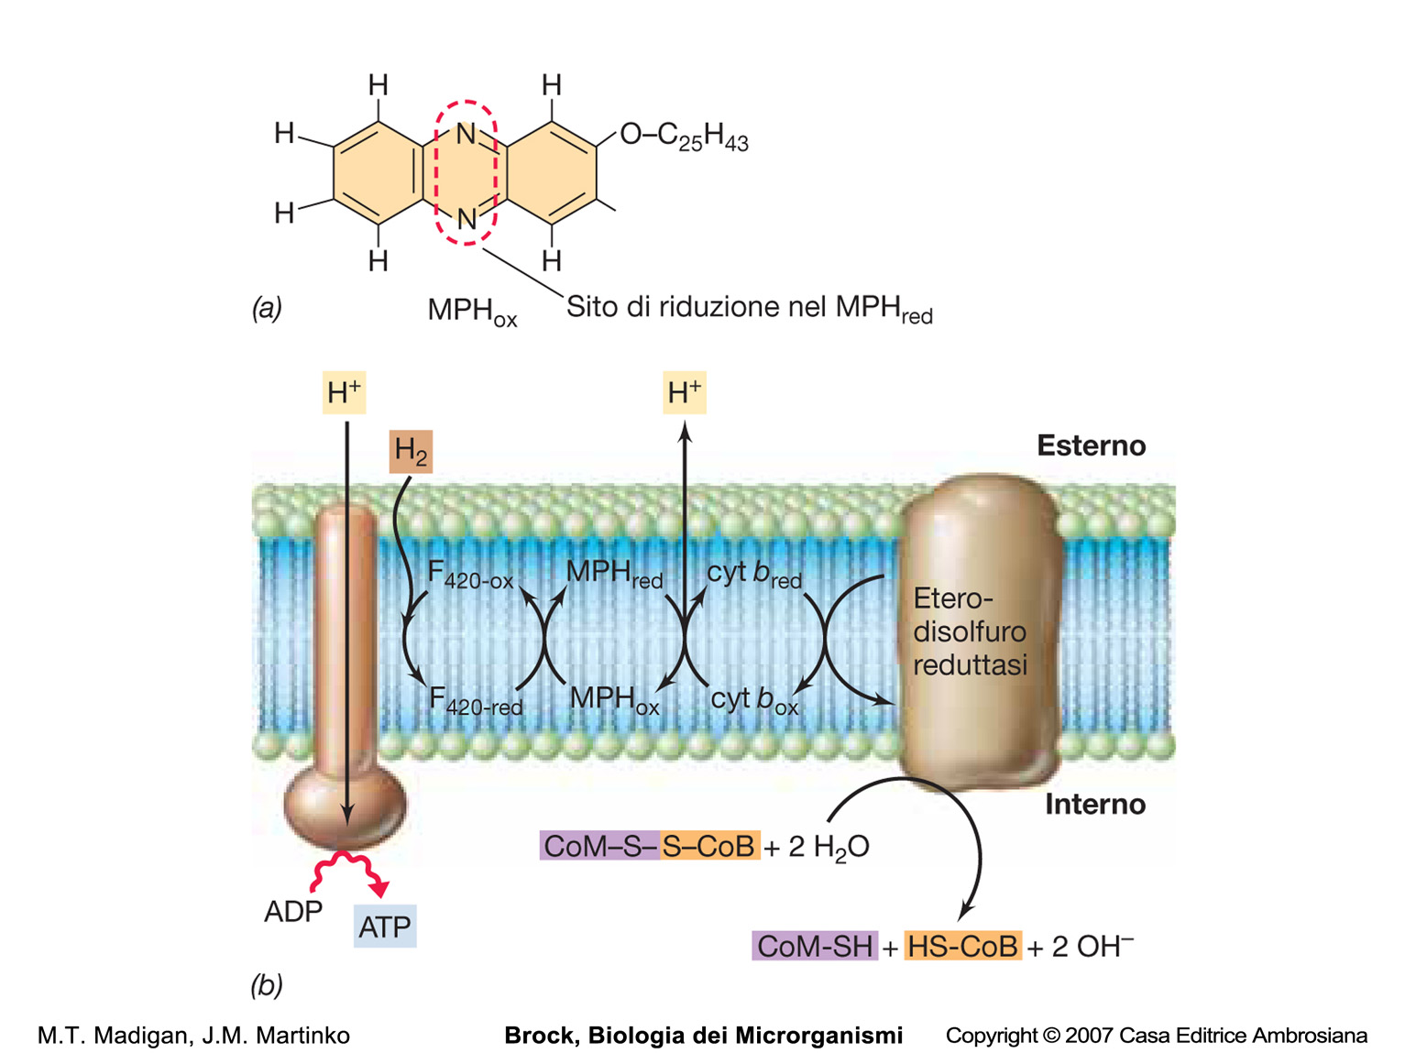

Slide 35
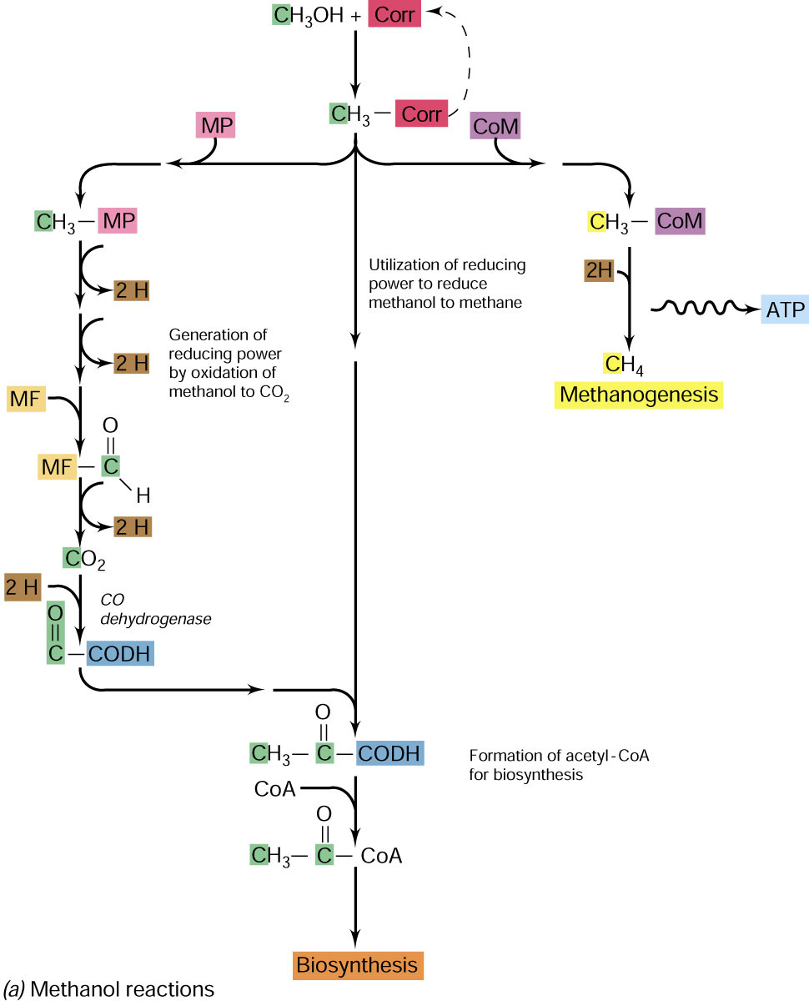
Utilization of reactions of the acetyl-CoA pathway during growth on methanol by methanogenic Archaea

Slide 36
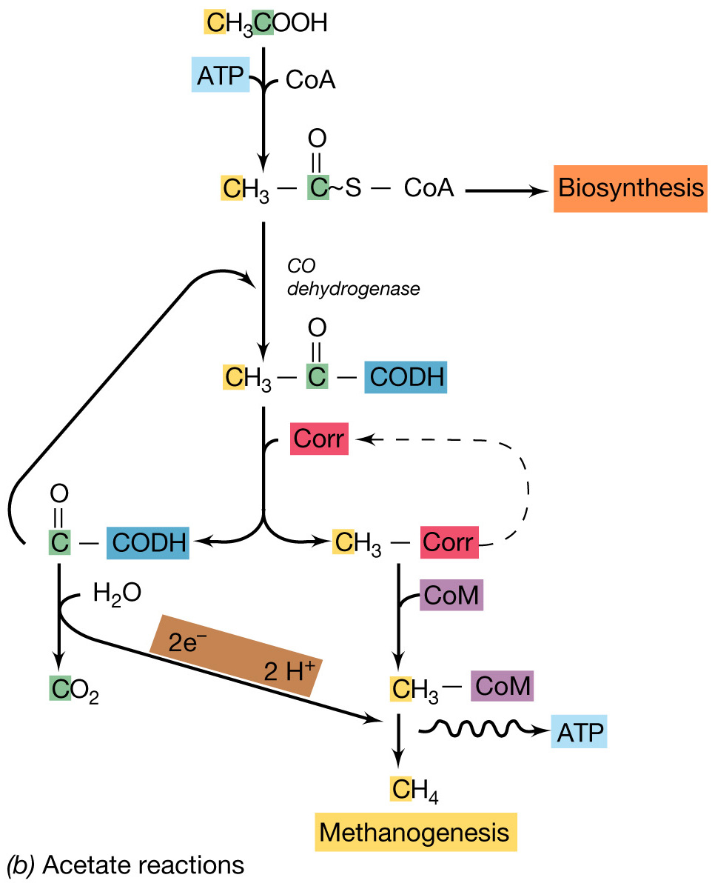
Utilization of reactions of the acetyl-CoA pathway during growth on acetate by methanogenic Archaea

Slide 37
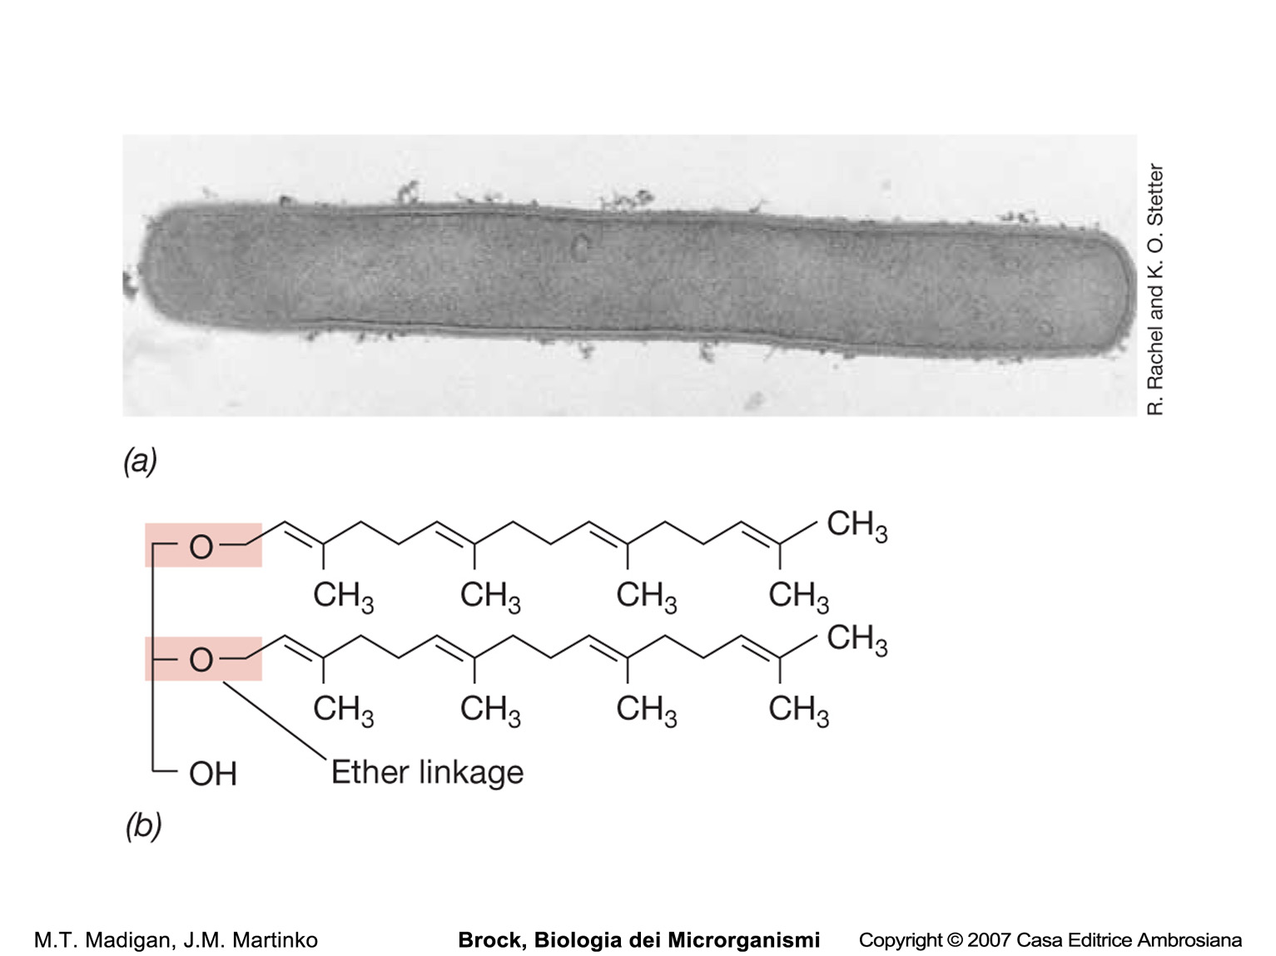
Methanopyrus grows optimally at 100°C and can make CH₄ only from CO₂ + H₂. Here is shown the structure of the lipid of M. kandleri.

Slide 38
The Euryarchaeota:
Thermoplasma

Slide 39
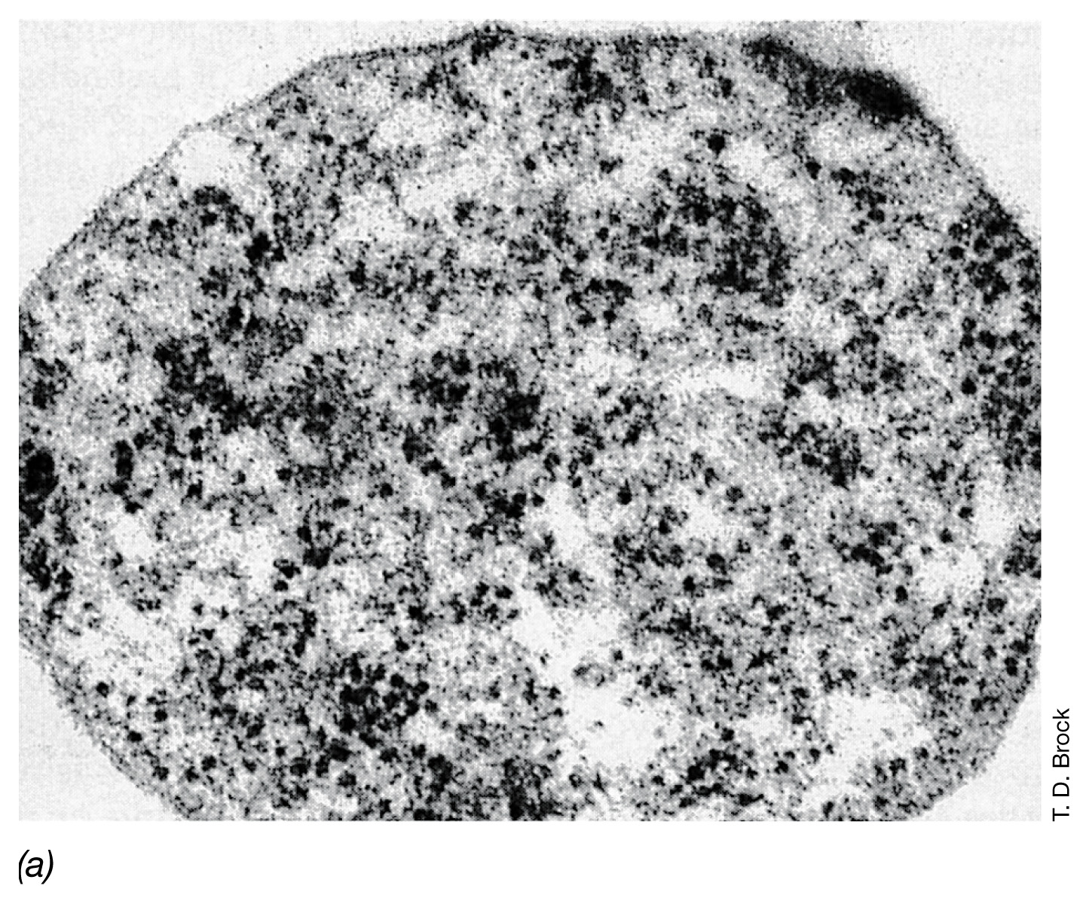
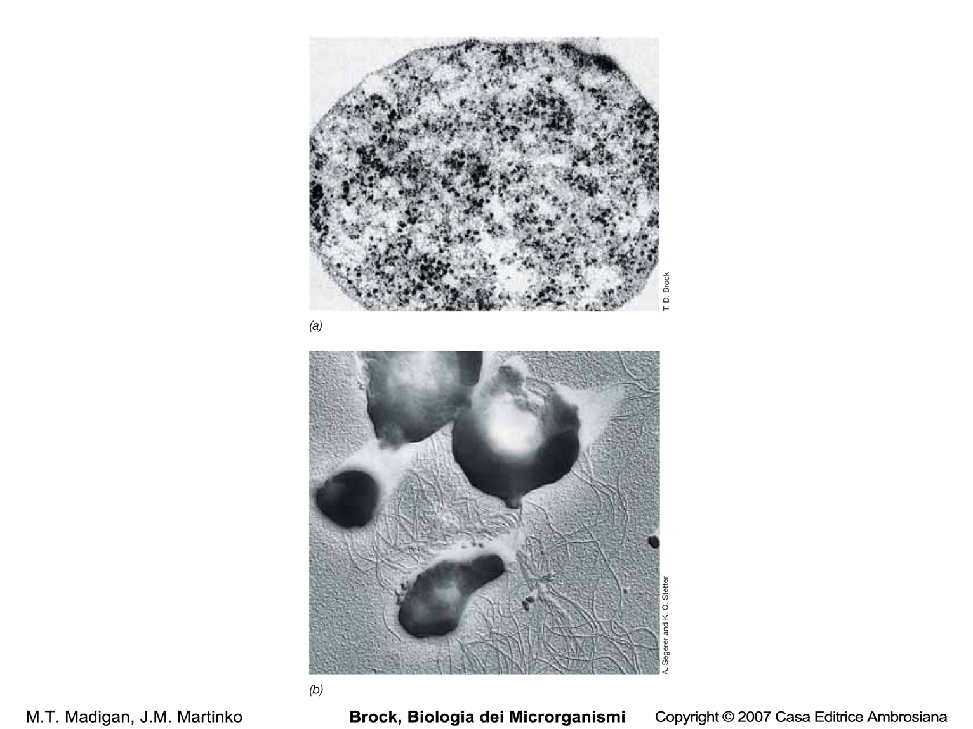
Thermoplasma acidophilum, an acidophilic, thermophilic
mycoplasma-like archaeon

Slide 40
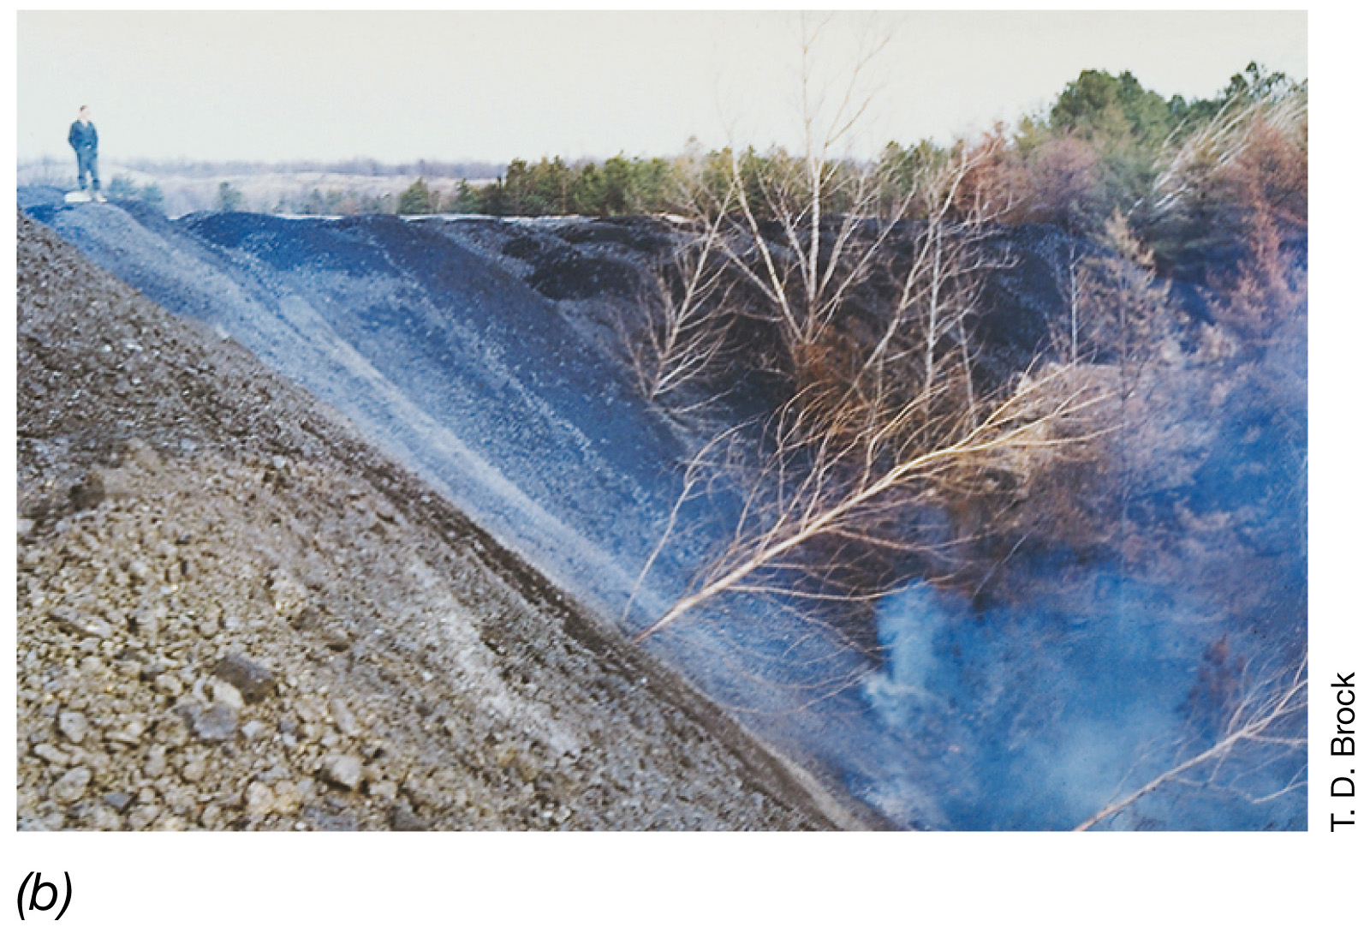
A typical self-heating coal refuse pile, habitat of Thermoplasma

Slide 41
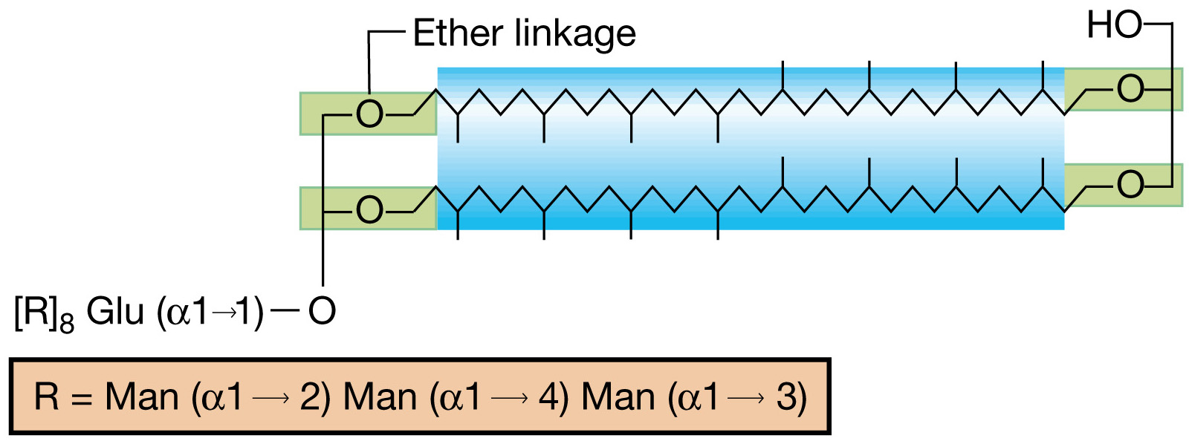
Structure of the tetraether lipoglycan of Thermoplasma acidophilum

Slide 42
The Crenarcaeota:
hyperthermophilic Archaea

Slide 43
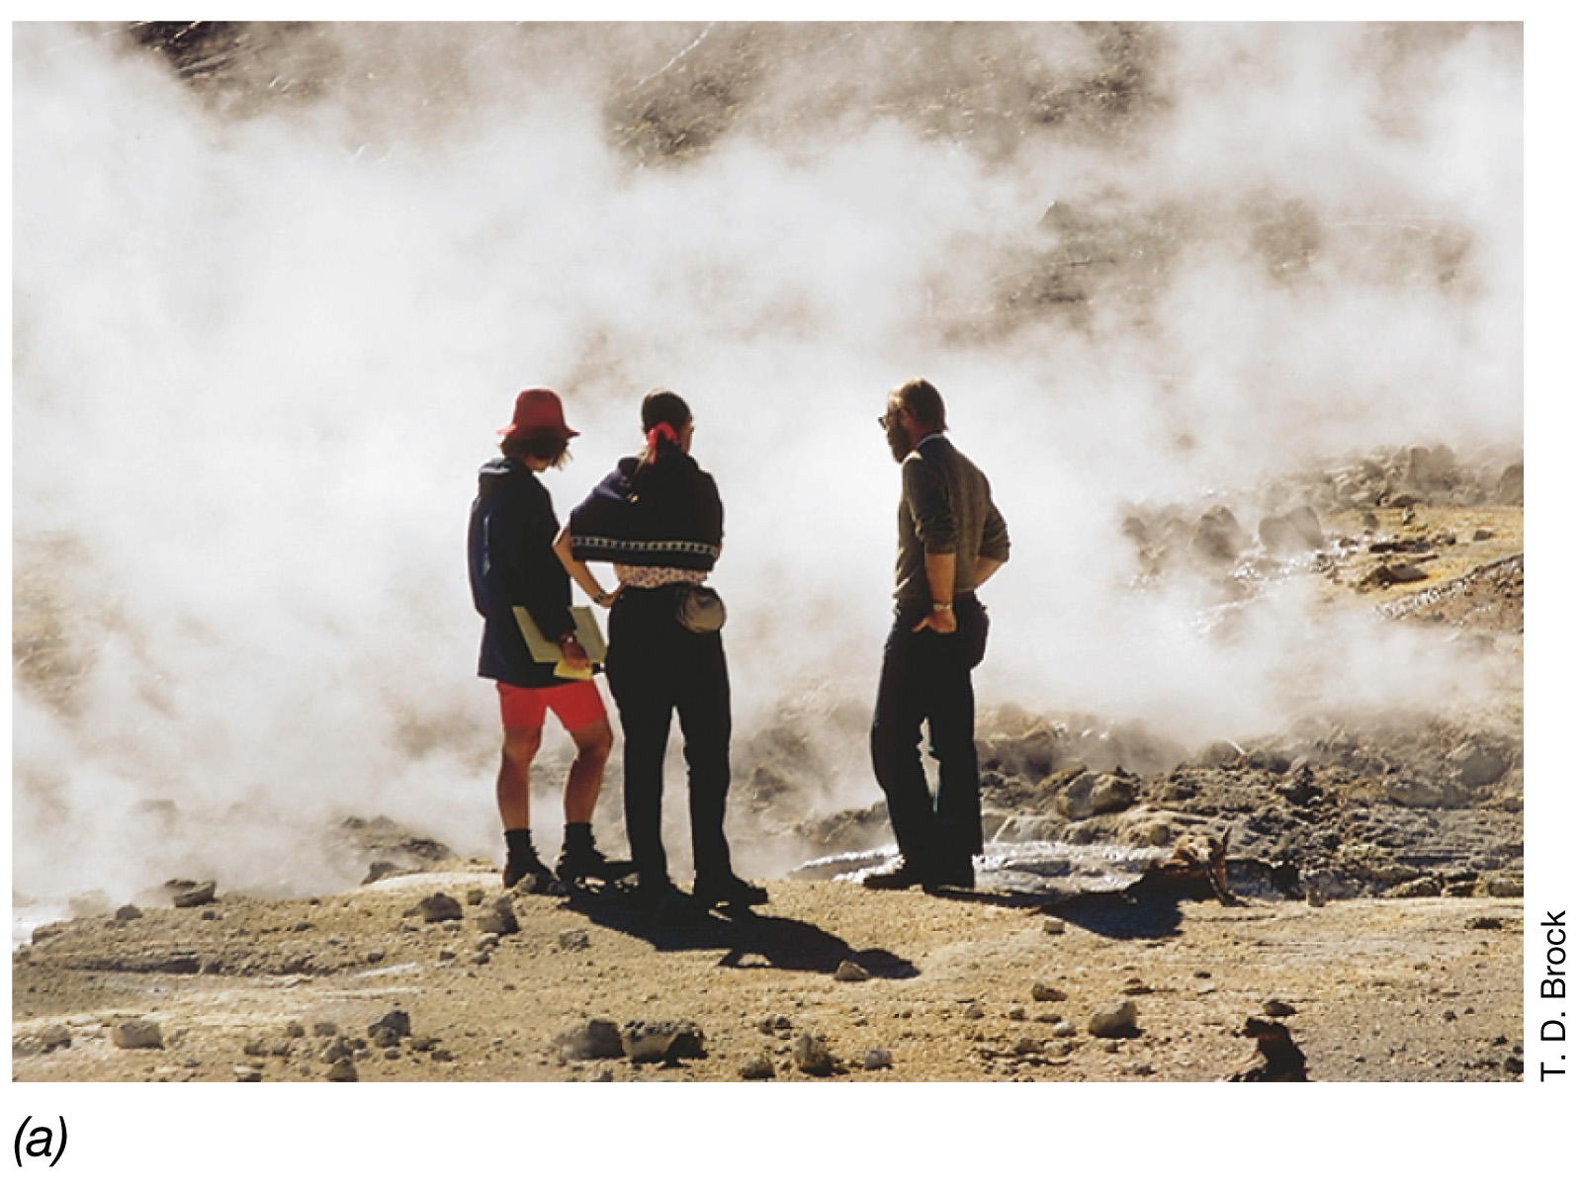
Habitats of hyperthermophilic Archaea: A typical solfatara in
Yellowstone National Park

Slide 44
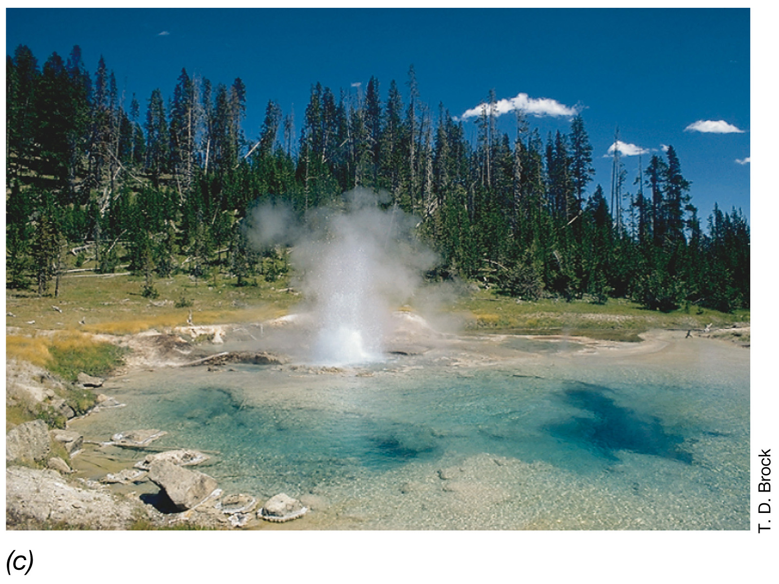
Habitats of hyperthermophilic Archaea: A typical boiling spring of neutral pH in Yellowstone Park; Imperial Geyser

Slide 45
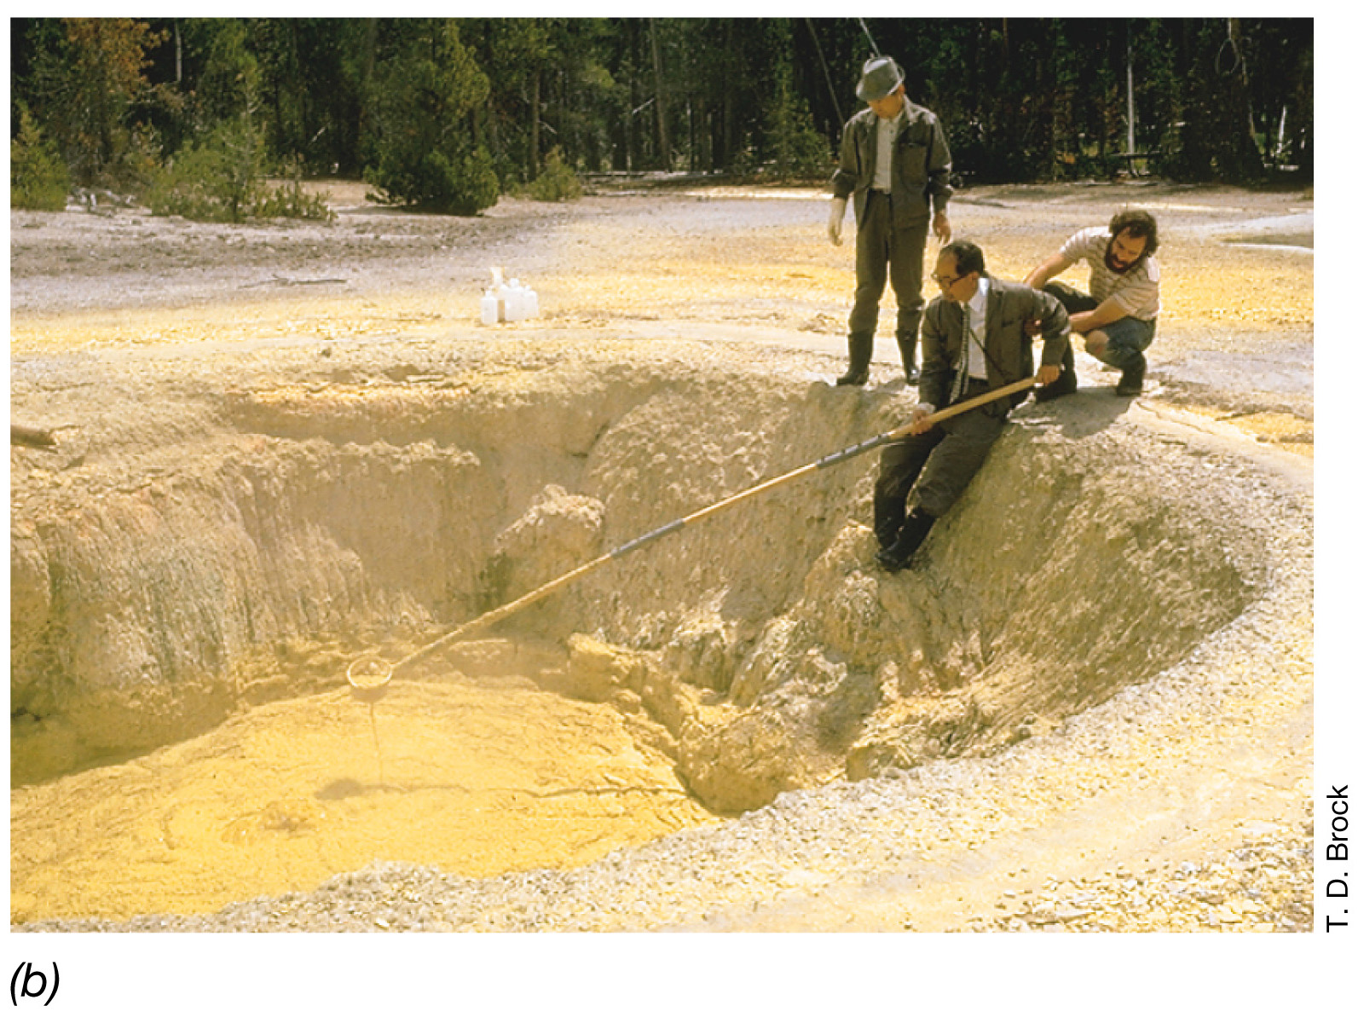
Habitats of hyperthermophilic Archaea: Sulfur-rich hot spring, a habitat containing dense populations of Sulfolobus.
The acidity in solfataras and sulfur springs comes from the oxidation of H₂S and S0
to H₂SO₄ by Sulfolobus and related prokaryotes

Slide 46
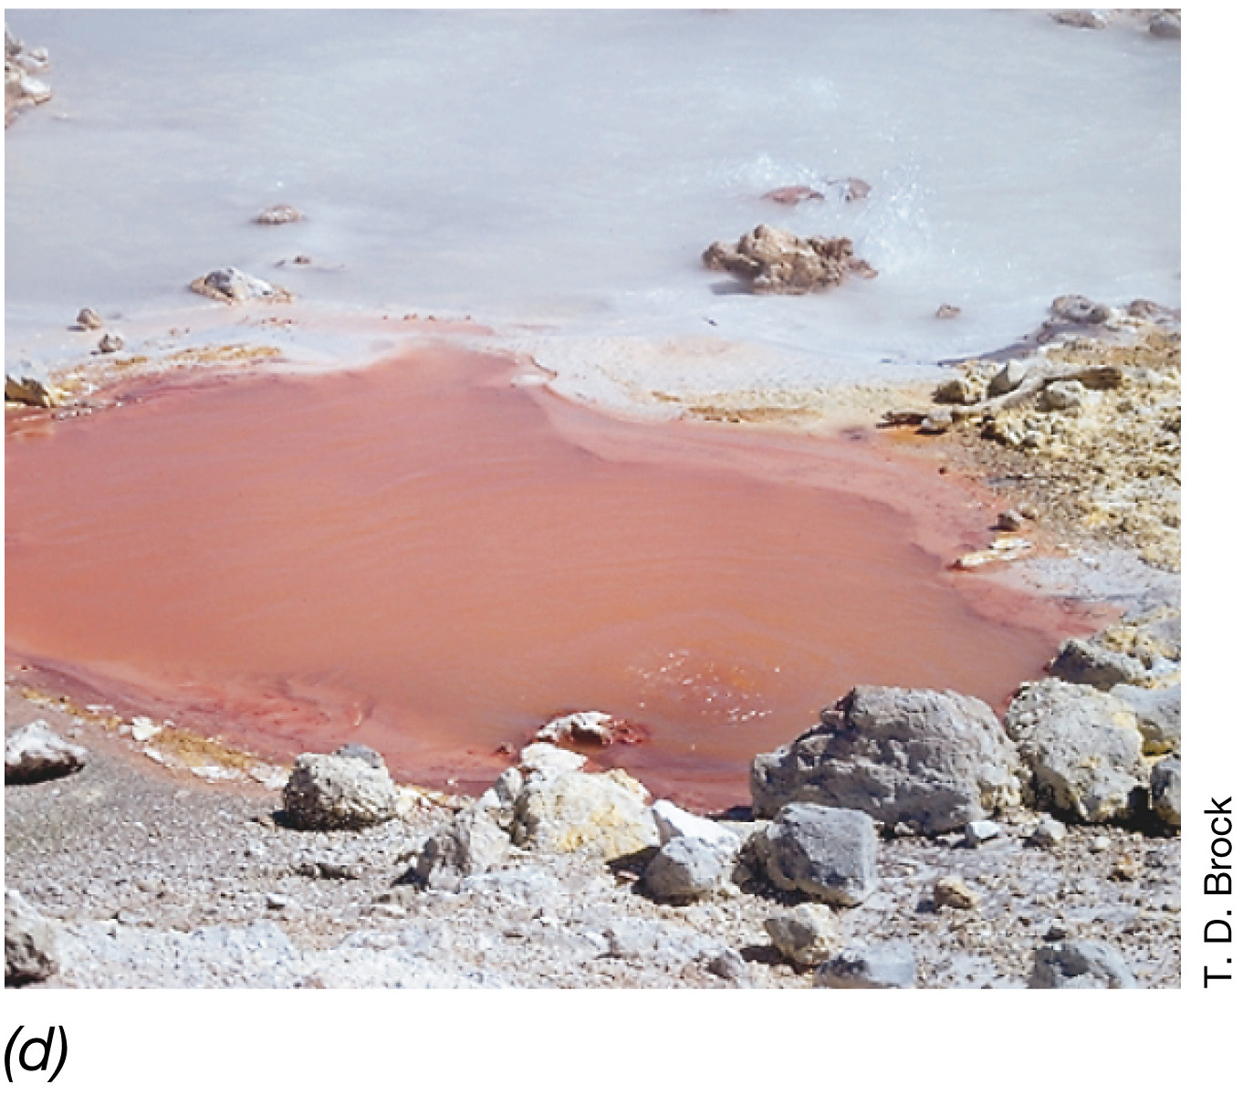
Habitats of hyperthermophilic Archaea: An acidic iron-rich geothermal spring, another Sulfolobus habitat

Slide 47
Energy yielding reactions of hyperthermophilic Archaea
Nutritional class | Energy-yielding reaction | Metabolic type | Example
Chemoorganotrophic | Organic+ S⁰= H₂S+CO₂ | AnRespir | Thermoproteus
 | Organic+SO₄²⁻= H₂S+CO₂ | AnRespir | Archaeoglobus
 | Organic+O₂= H₂O+CO₂ | AeRespir | Sulfolobus
 | Pyruvate= CO₂+H₂+FA | Ferment | Pyrococcus
Chemolithotrophic | H₂+S⁰= H₂S | AnRespir | Pyrodyctium
 | H₂+2Fe³⁺= 2Fe²⁺+2H⁺ | AnRespir | Pyrodyctium
 | 2H₂+O₂= 2H₂O | AeRespir | Sulfolobus
 | 2S⁰+3O₂+2H₂O= 2H₂SO₄ | AeRespir | Sulfolobus

Slide 48
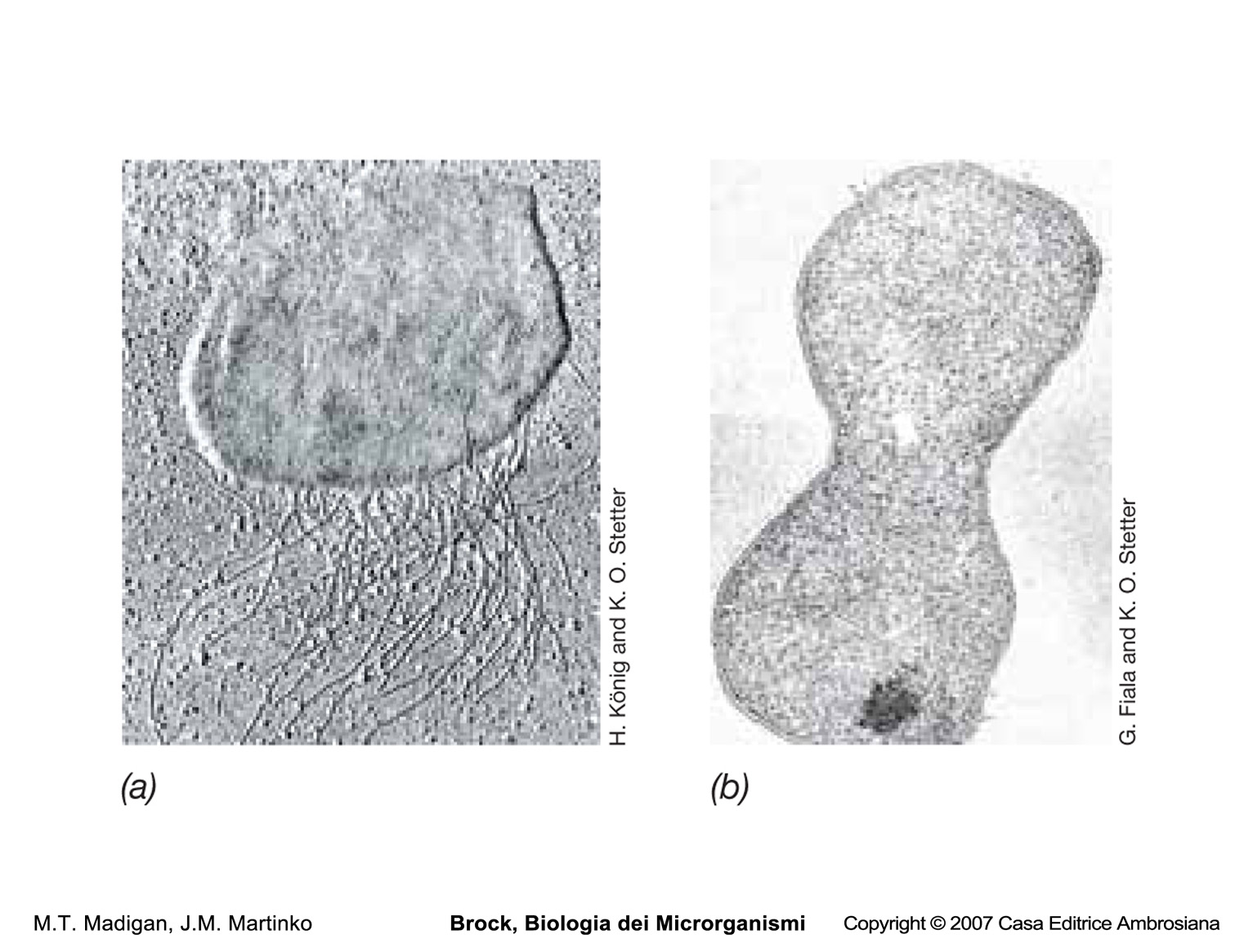
Thermococcus celer
Pyrococcus furiosus

Slide 49
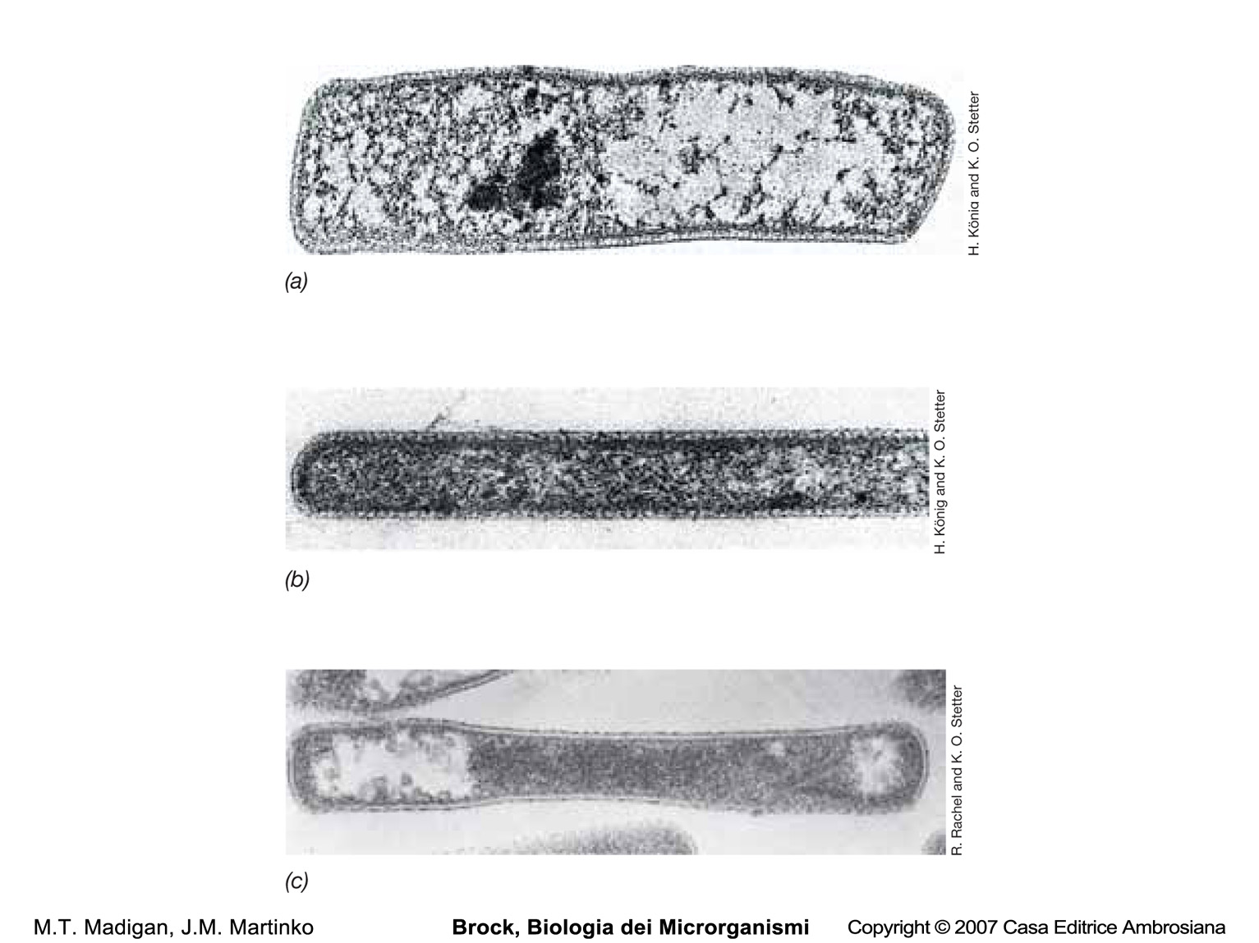

Slide 50
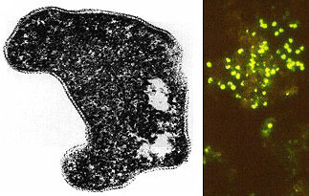
Sulfolobus acidocaldarius is an extreme thermophile that has
been found in geothermally-heated acid springs, mud pots
and surface soils 60 to 95 degrees C, and a pH of 1 to 5.
Fluorescent photomicrograph of cells attached to a sulfur crystal

Slide 51
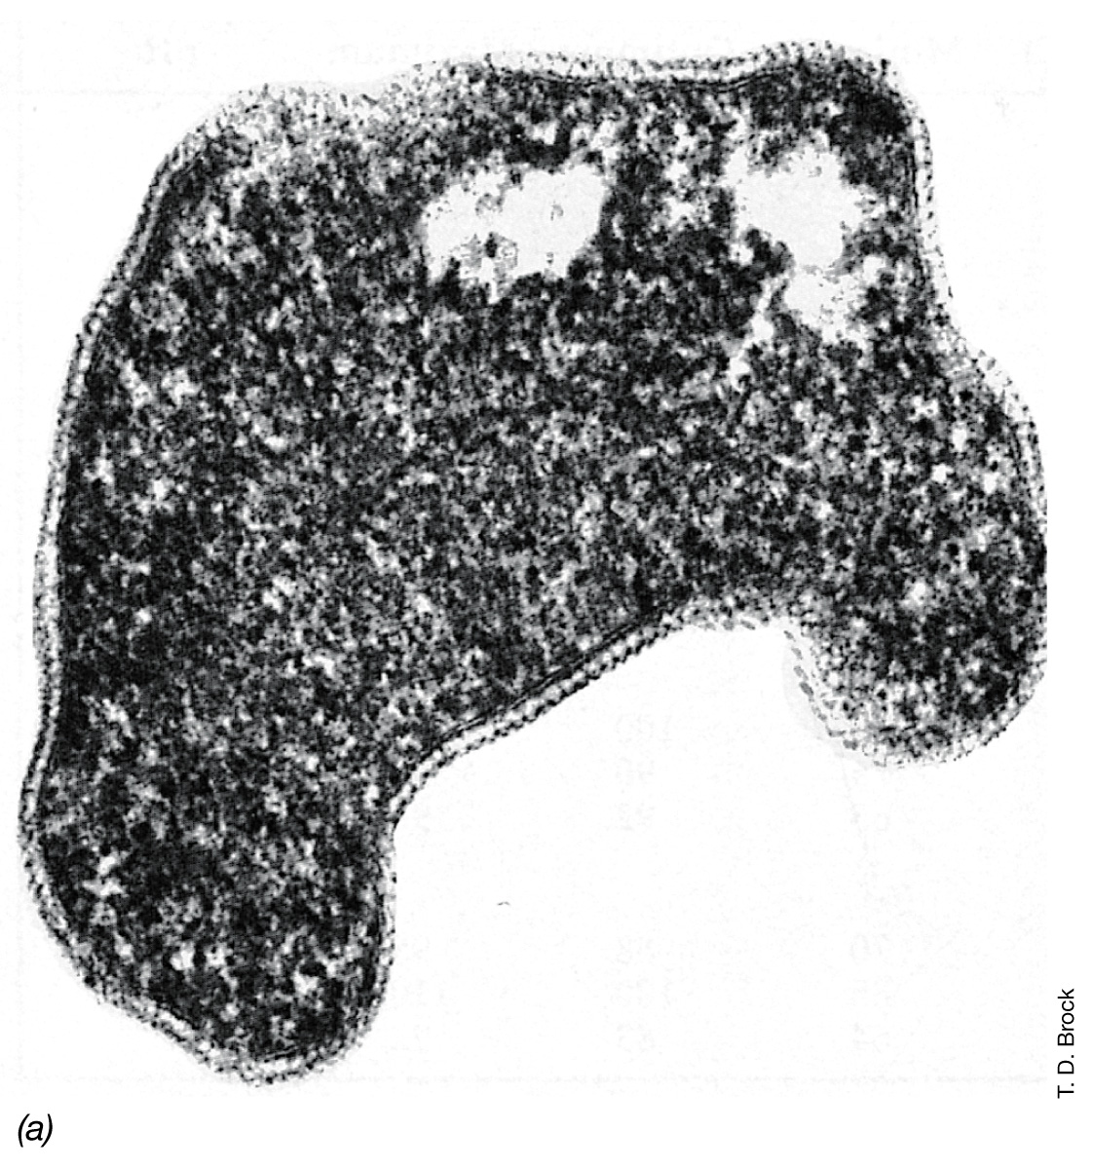
Acidophilic hyperthermophilic Archaea,
the Sulfolobales: Sulfolobus acidocaldarius
Notes:
Figure: 13-17
Caption:
Electron micrograph of a thin section.

Slide 52
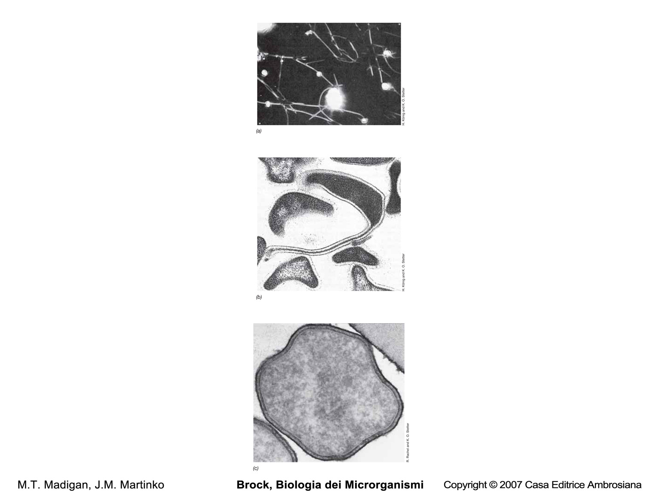
Pyrodictium occultum
Pyrolobus fumarii

Slide 53
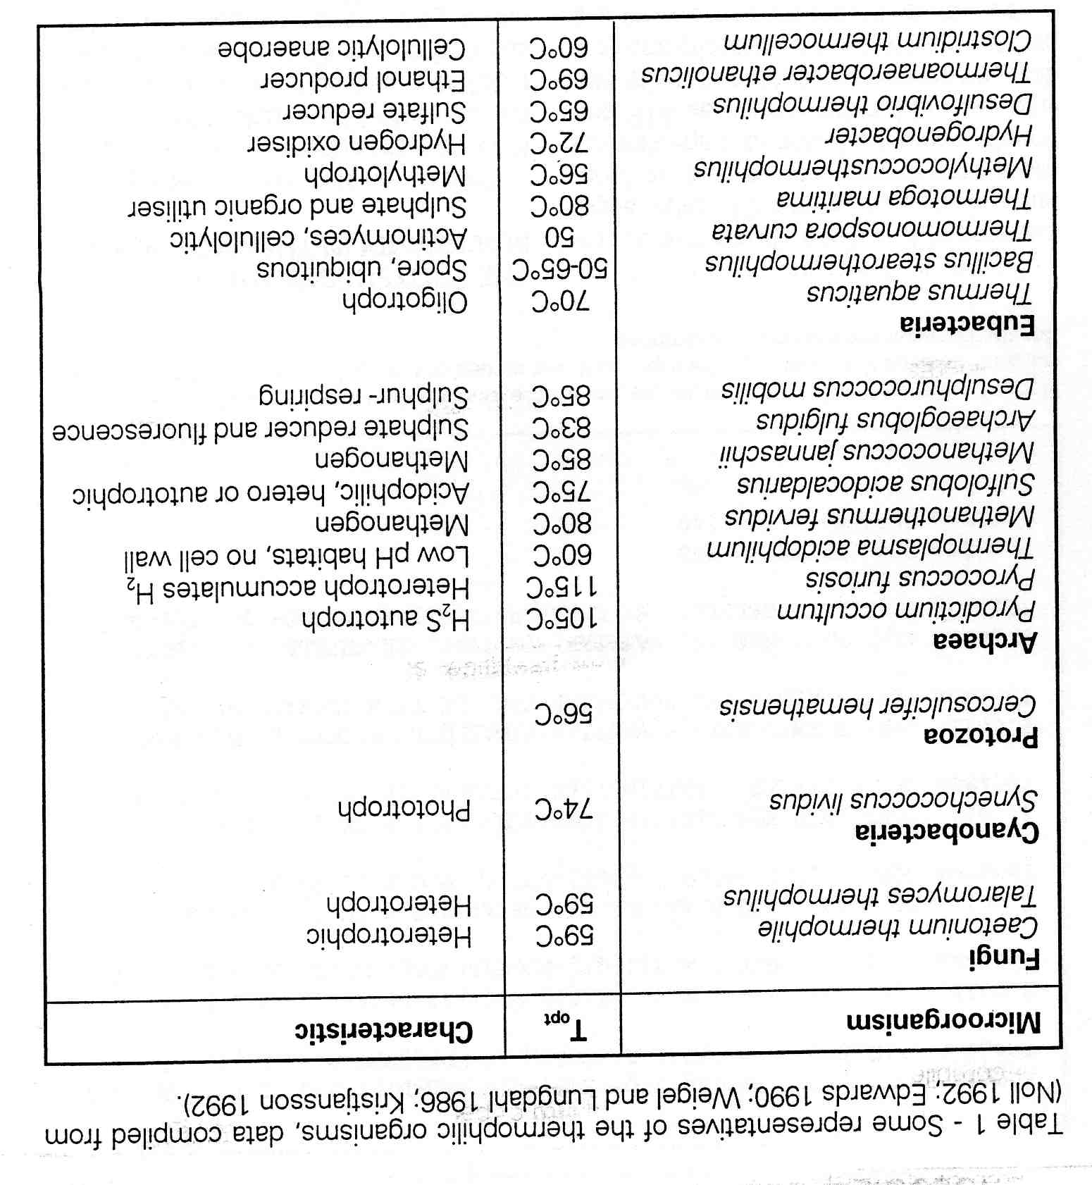
Some representatives thermophilic organisms

Slide 54
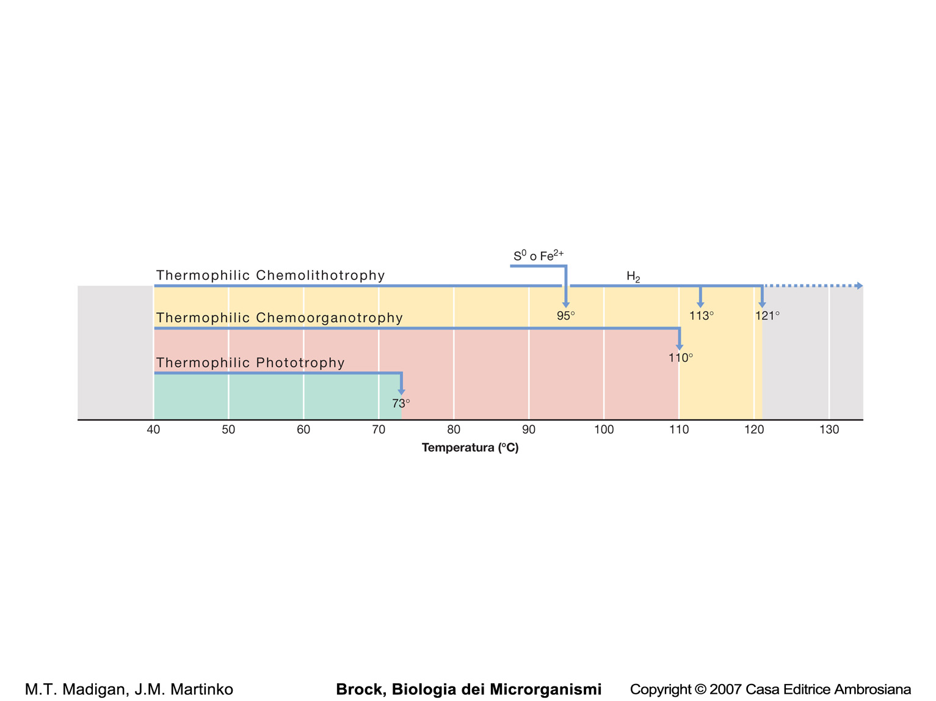
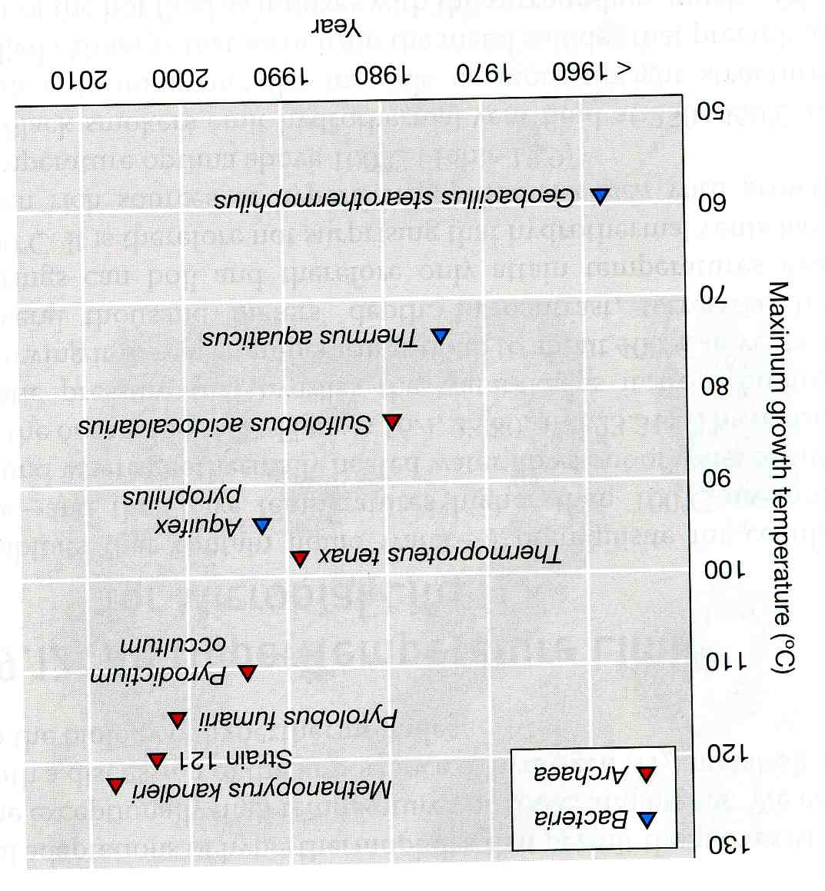

Slide 55
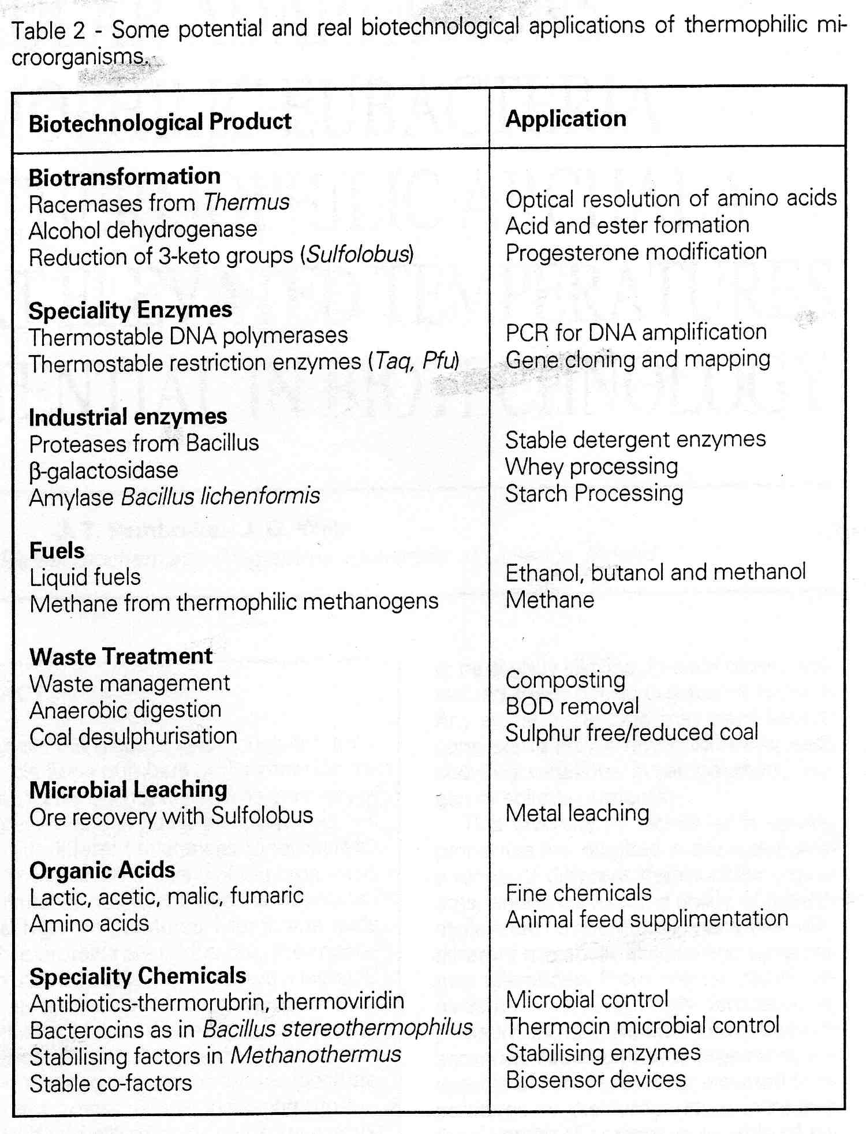
Some potentail and real biotechnological applications of thermophilic microorganisms

