Slide 1
MICROBIOLOGIA GENERALE
Microbial genetics 1

Slide 2
Microbial genetics:
the horizontal gene transfer

Slide 3
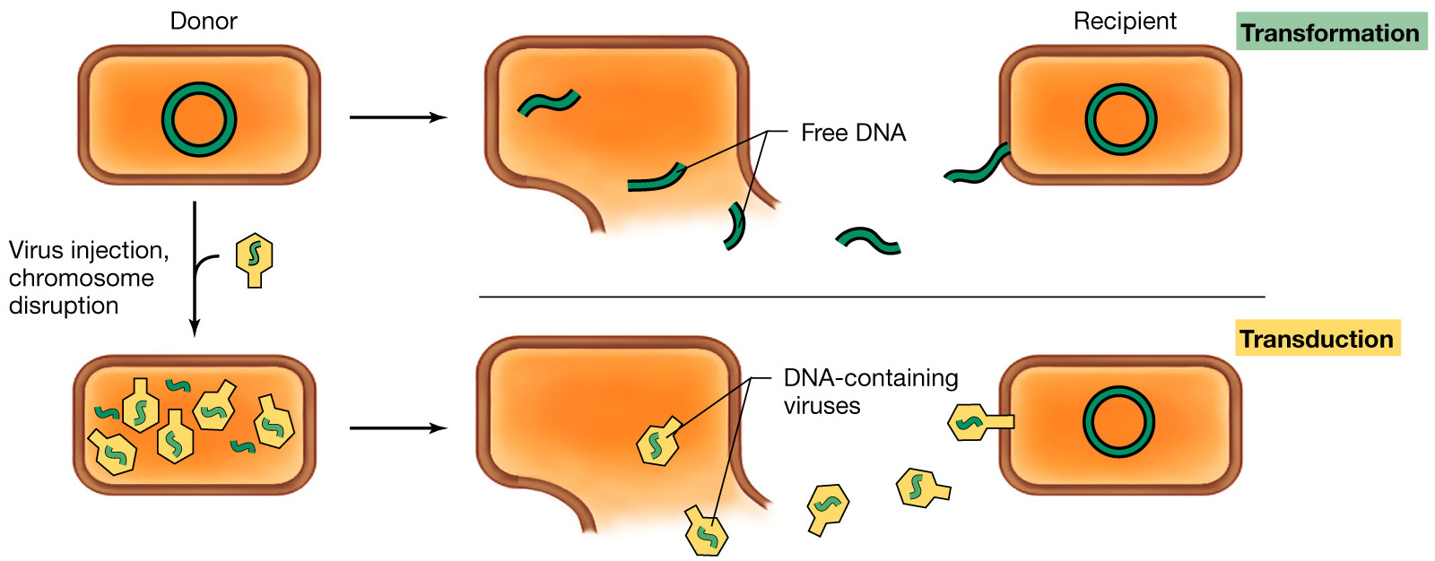
Overview of the processes by which DNA is transferred from donor to recipient bacterial cell:
transformation and transduction

Slide 4
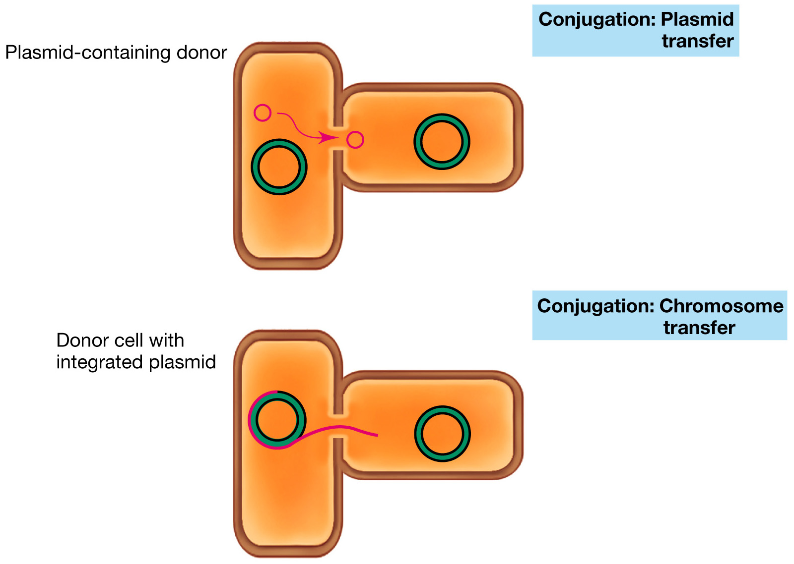
Overview of the processes by which DNA is transferred from donor to recipient bacterial cell: conjugation

Slide 5
Microbial genetics:
transformation

Slide 6
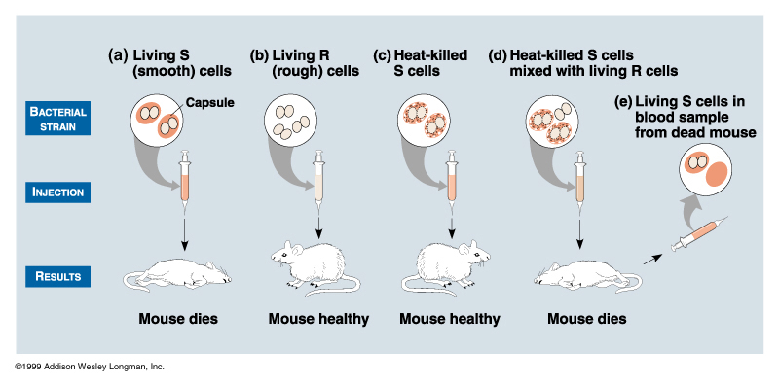
1928: Frederick Griffith discovered phenomenon of
transformation in Streptococcus pneumoniae

Slide 7
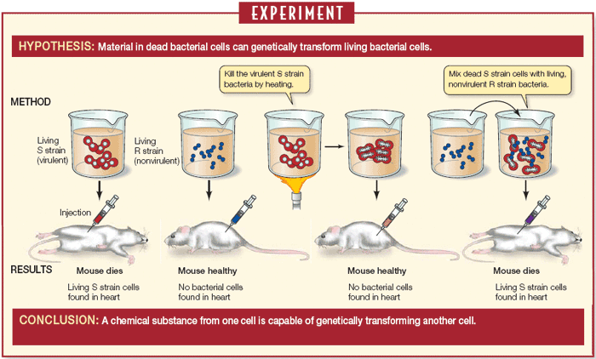
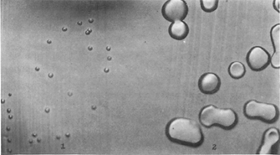
Frederick Griffith Discovers Bacterial Transformation (1928)
R S

Slide 8
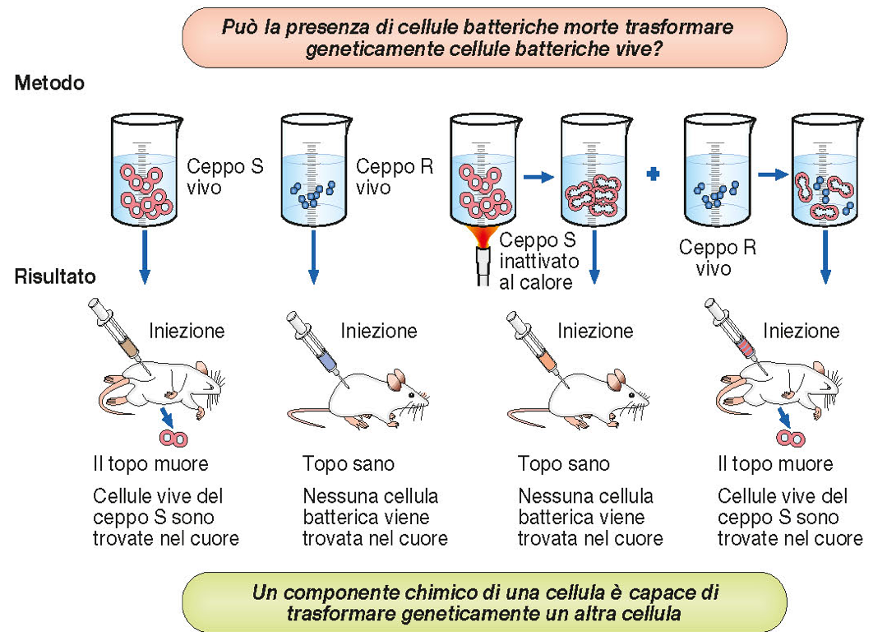

Slide 9
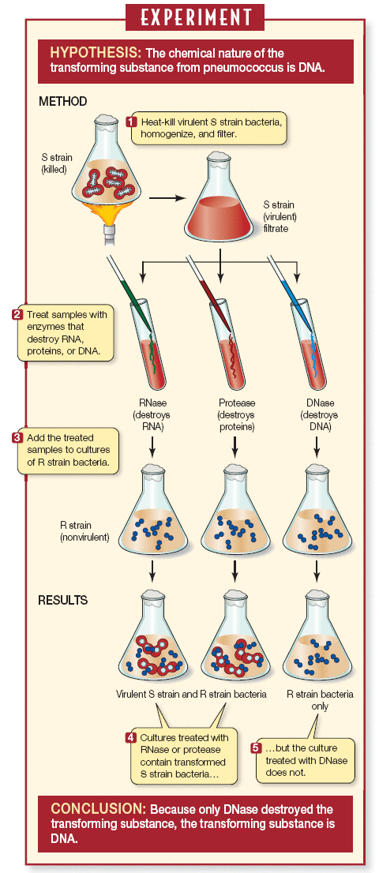
Avery et al. Identify DNA as the “Transforming Principle” (1944)

Slide 10
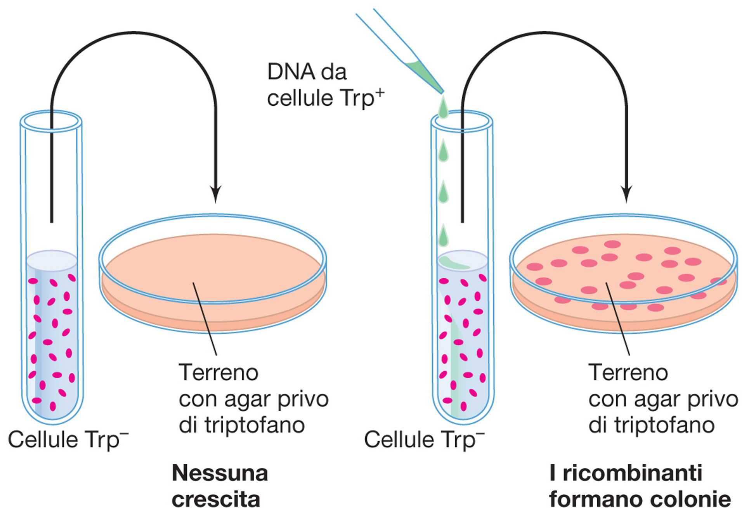
Using a selective medium to detect rare genetic recombinants

Slide 11
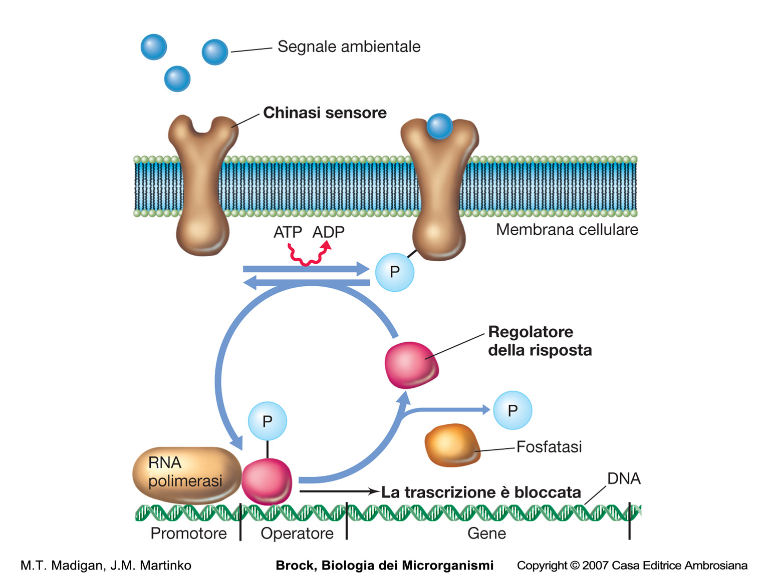
The control of gene expression by a two-component regulatory system
ComP
ComA
mRNA

Slide 12
Regulation of competence development in Bacillus subtilis

Slide 13
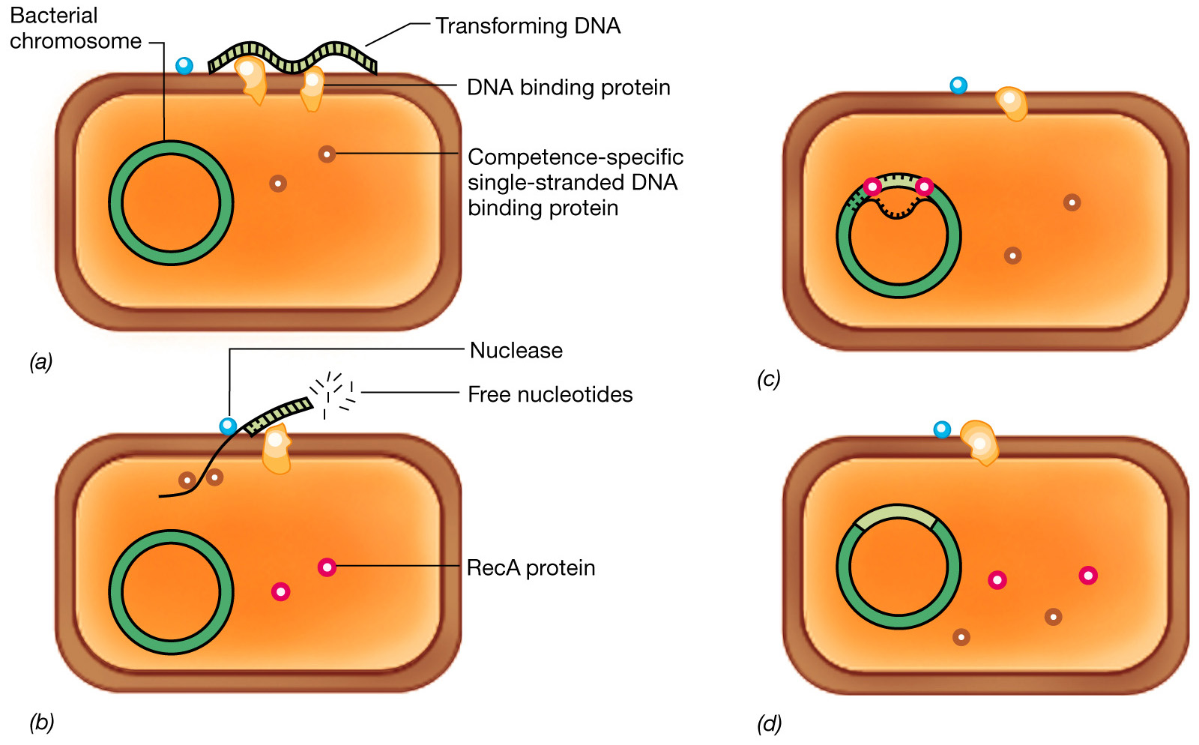
Mechanism of transformation in a Gram-positive bacterium

Slide 14
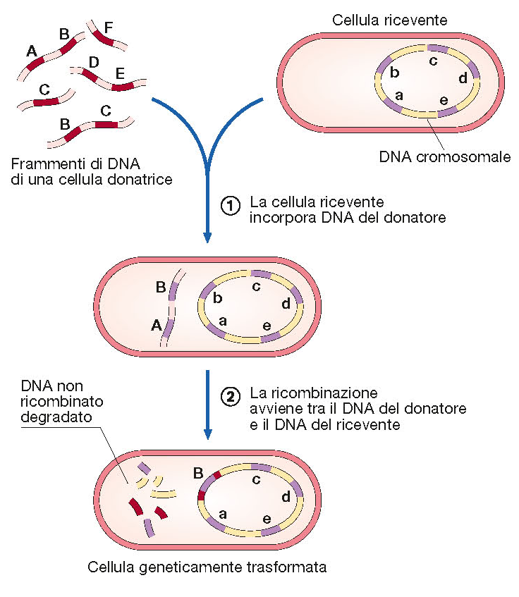

Slide 15
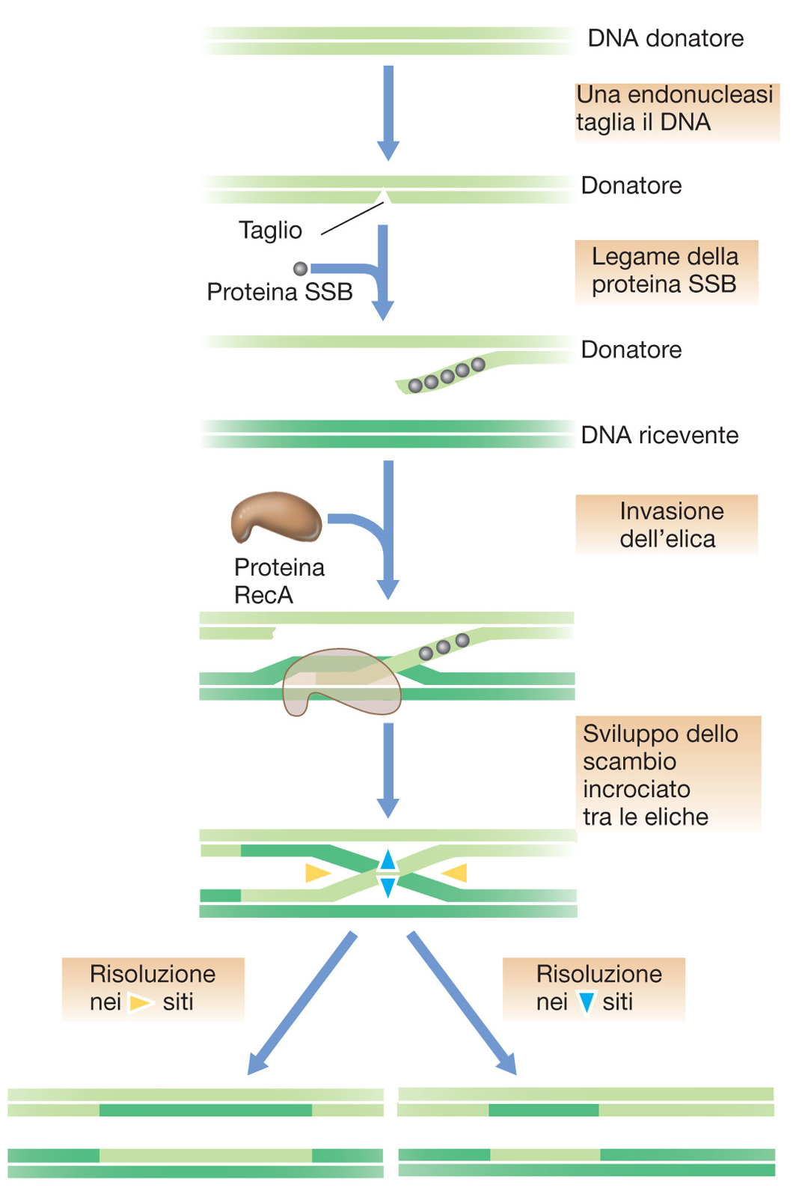
Molecular Events in Homologous Recombinantion

Slide 16
Trasformation in the Gram negative
Haemophilus influenzae

Slide 17
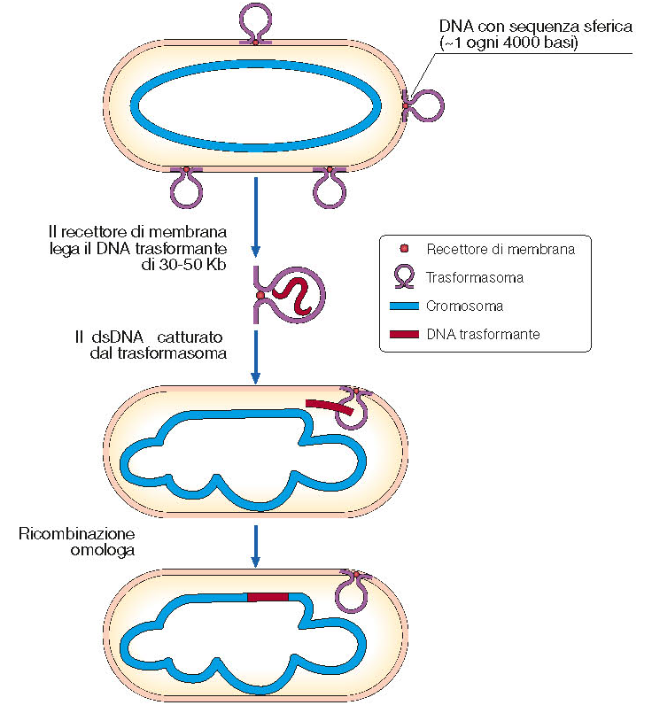

Slide 18
DNA uptake
GRAM +
GRAM -

Slide 20
The role of natural transformation
NUTRITION ?
2. DNA REPAIR ?
3. RECOMBINATION ?

Slide 21
Microbial genetics:
conjugation

Slide 22
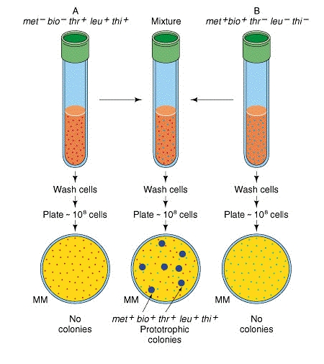
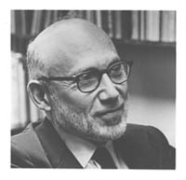
The discovery of bacterial
conjugation (1946)
E.L. Tatum J. Lederberg

Slide 23
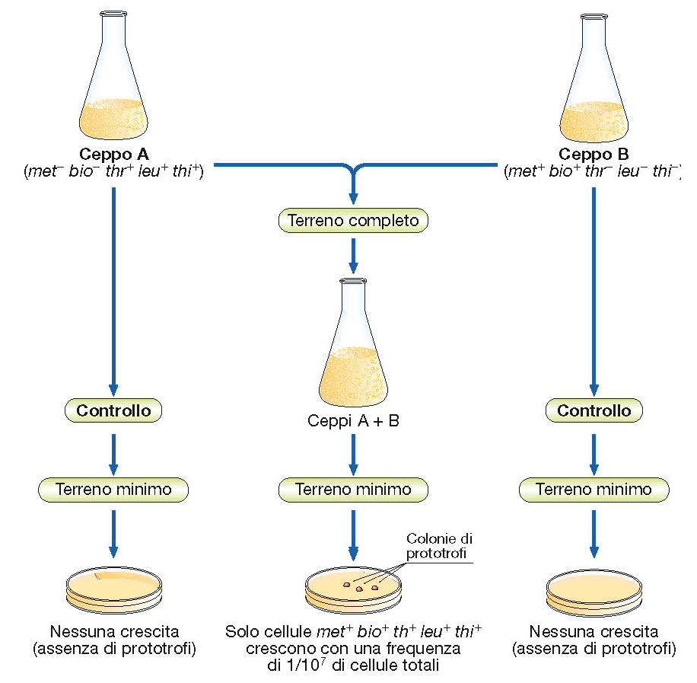

Slide 24
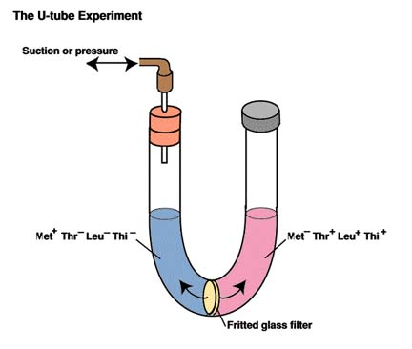
The unusual properties of conjugation in Escherichia coli

Slide 25
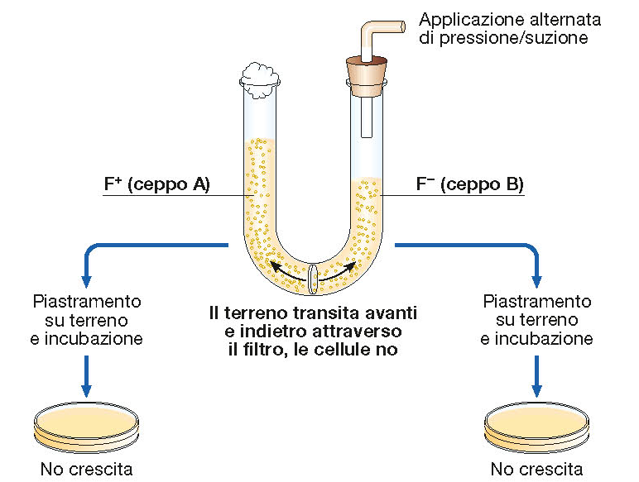

Slide 26
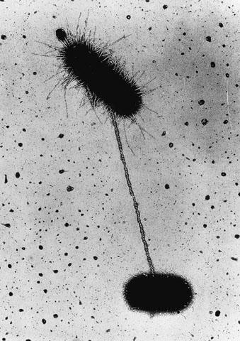

Slide 27
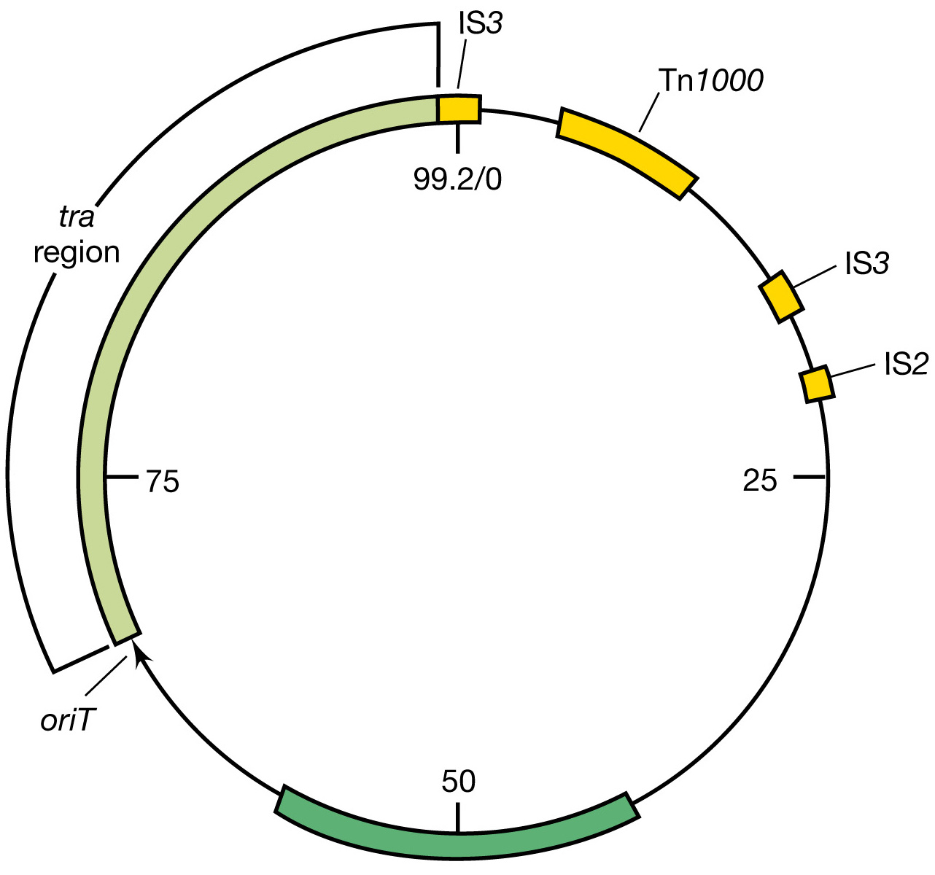
Genetic map of the F (fertility) plasmid of Escherichia coli.
99, 159 bp

Slide 28
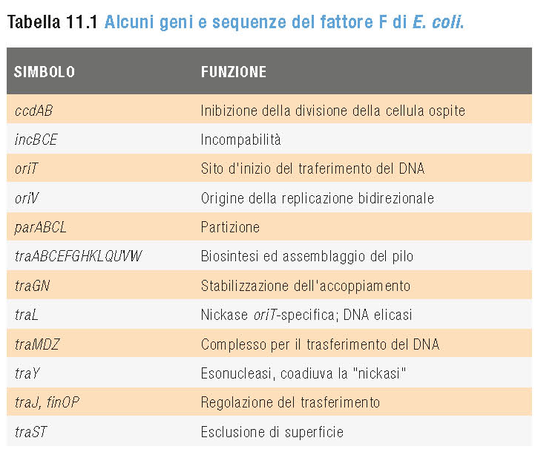

Slide 29
Plasmid transfer from cell to cell during conjugation
Notes:
.

Slide 30
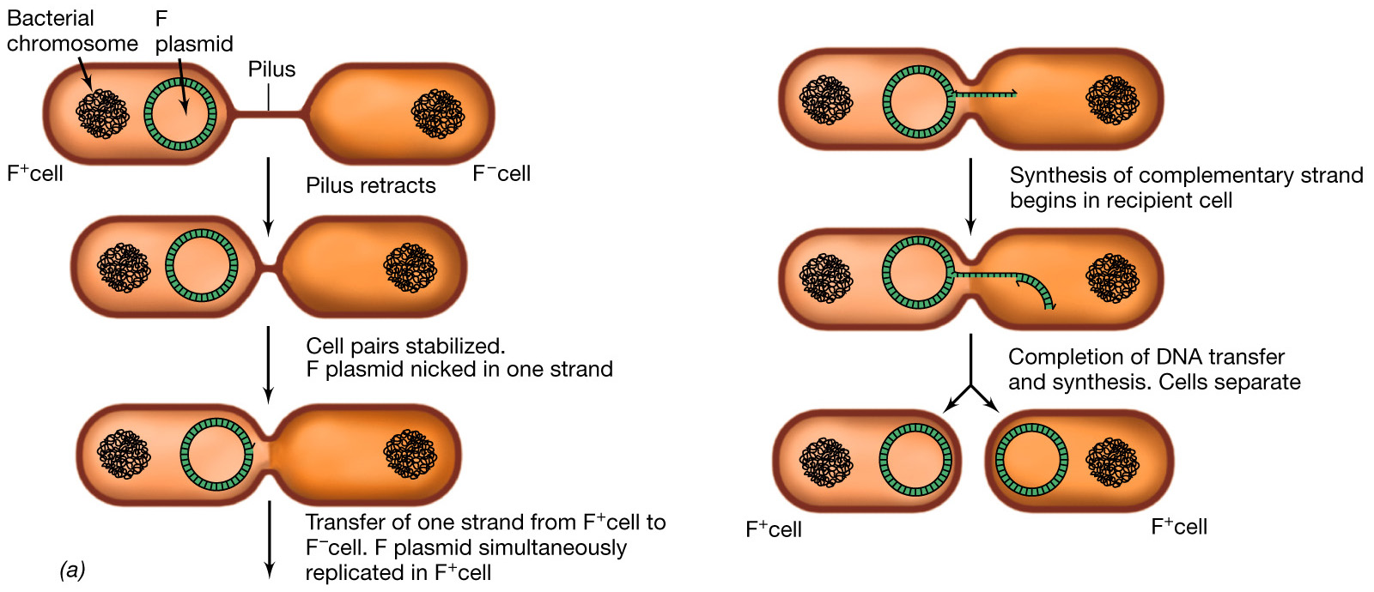
Transfer of plasmid DNA by conjugation.
In this example, the F plasmid of an F⁺ cell is being transferred to an F⁻ recipient cell

Slide 31
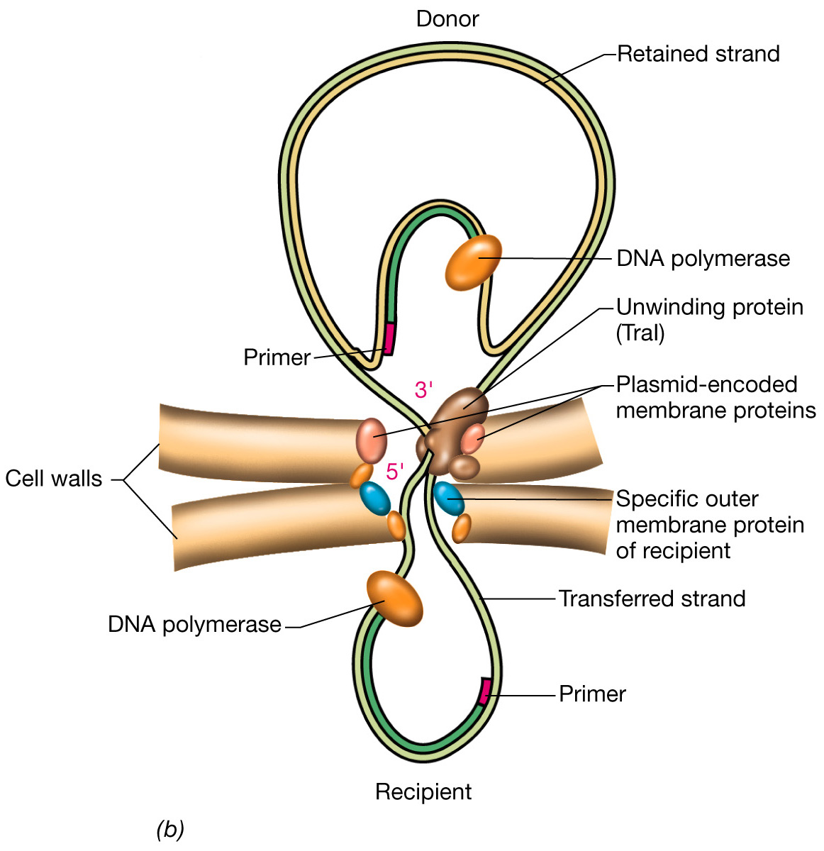
Transfer of plasmid DNA by conjugation

Slide 32
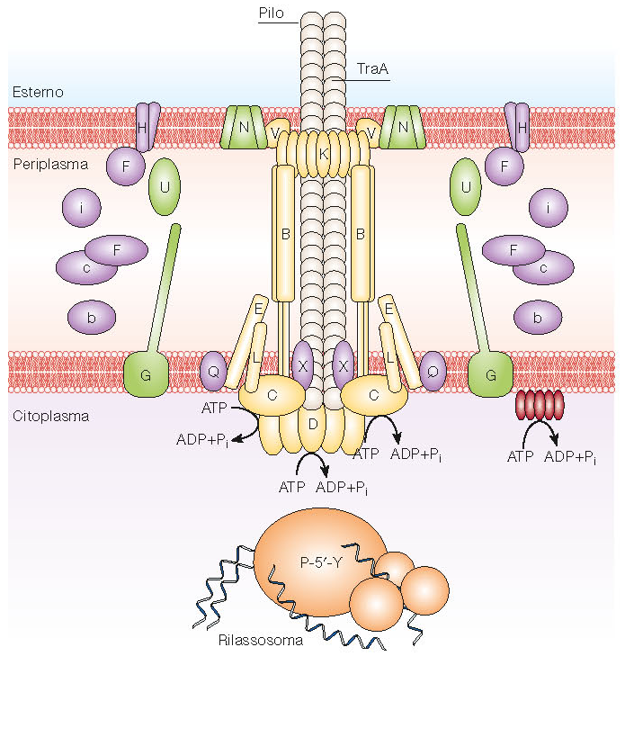
The Mating-Pair Formation (Mpf) components in conjugation

Slide 33
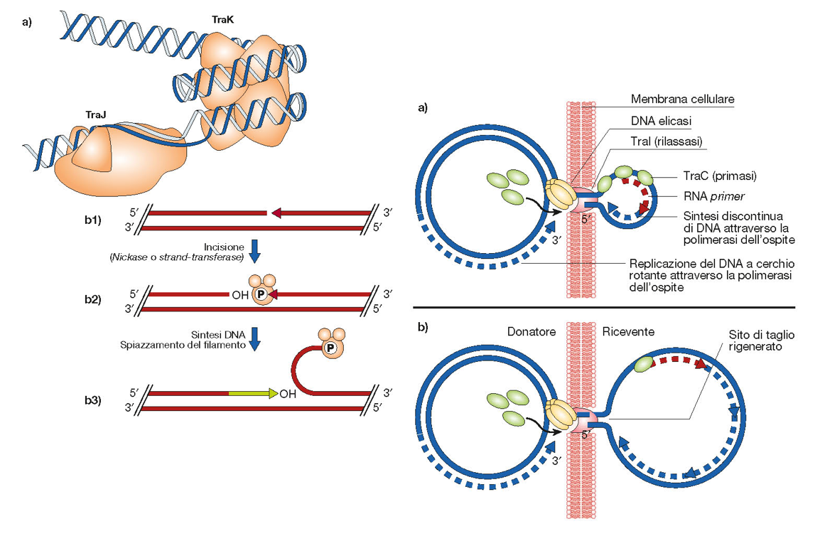
The DNA Transfer and Replication (Dtr) components and the DNA transfer during conjugation

Slide 34
The MpF and Dtr components and the DNA transfer during conjugation

Slide 35
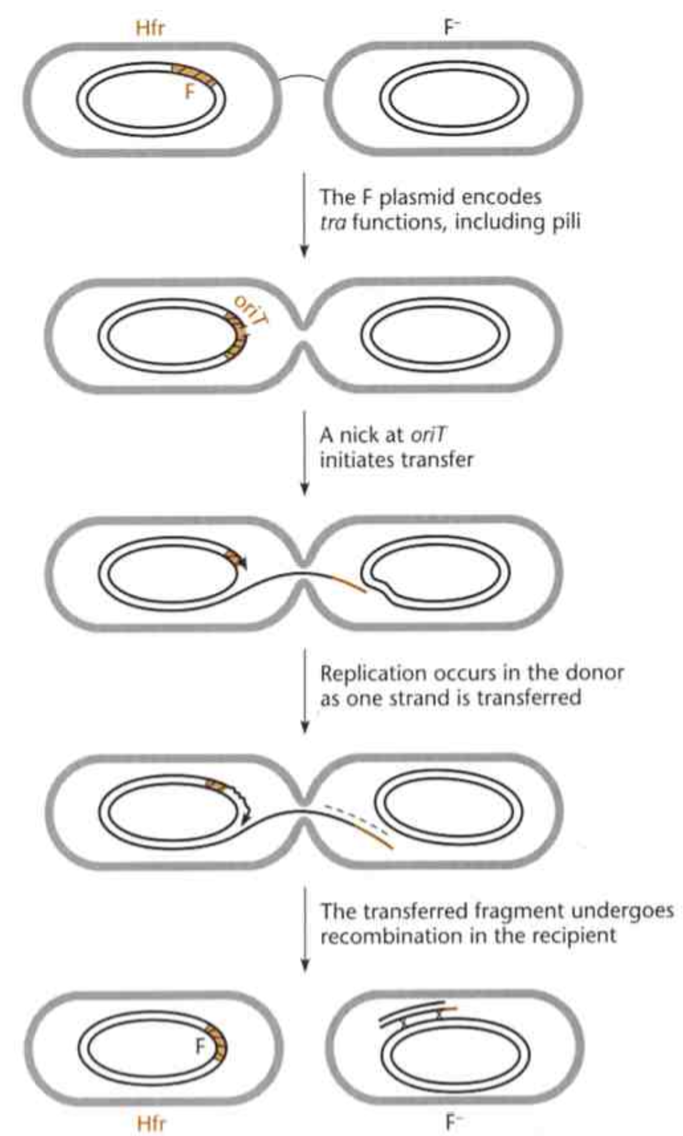
Transfer of chromosomal DNA by an integrated plasmid

Slide 36
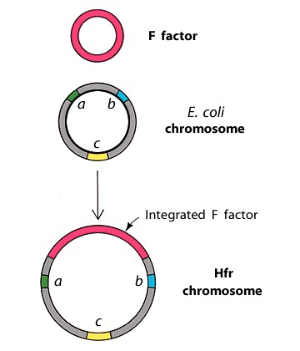
Integration of F plasmid in the bacterial chromosome

Slide 37
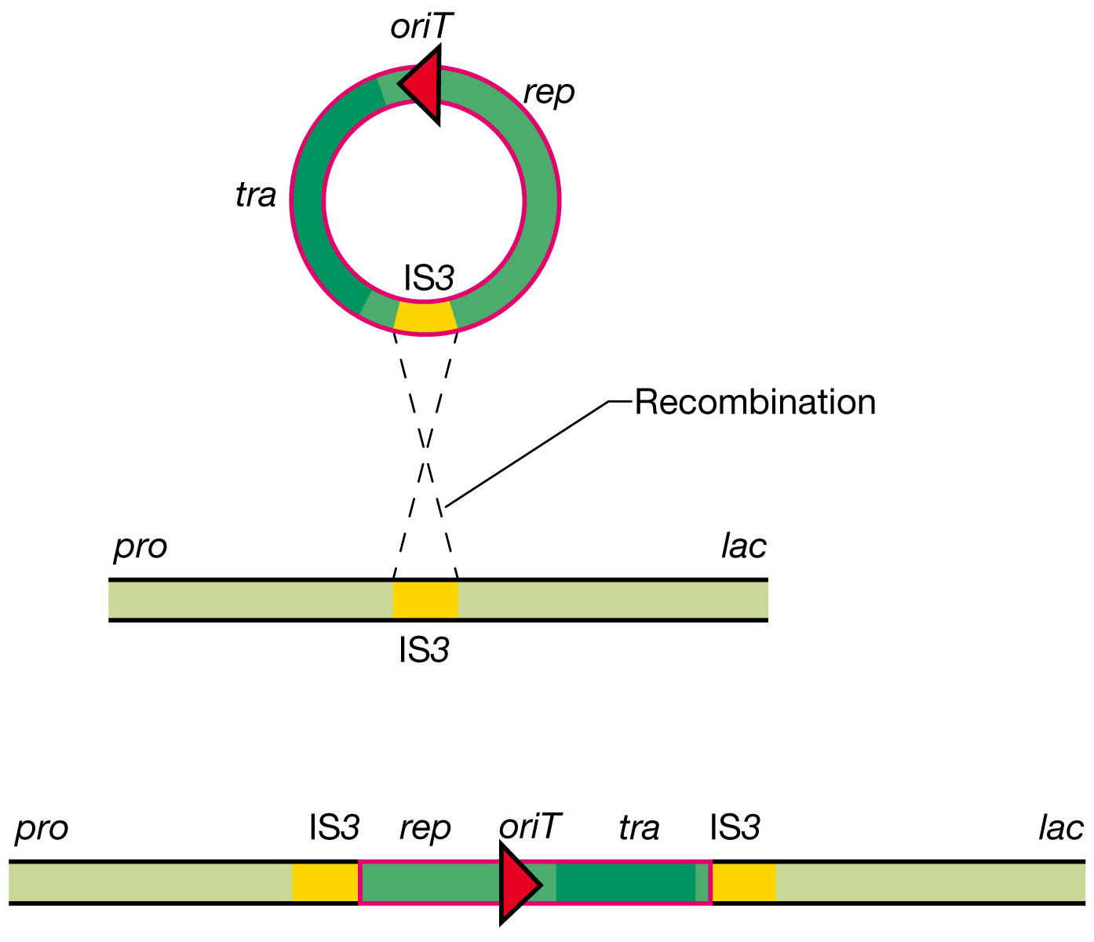
Integration of F plasmid in the bacterial chromosome

Slide 38
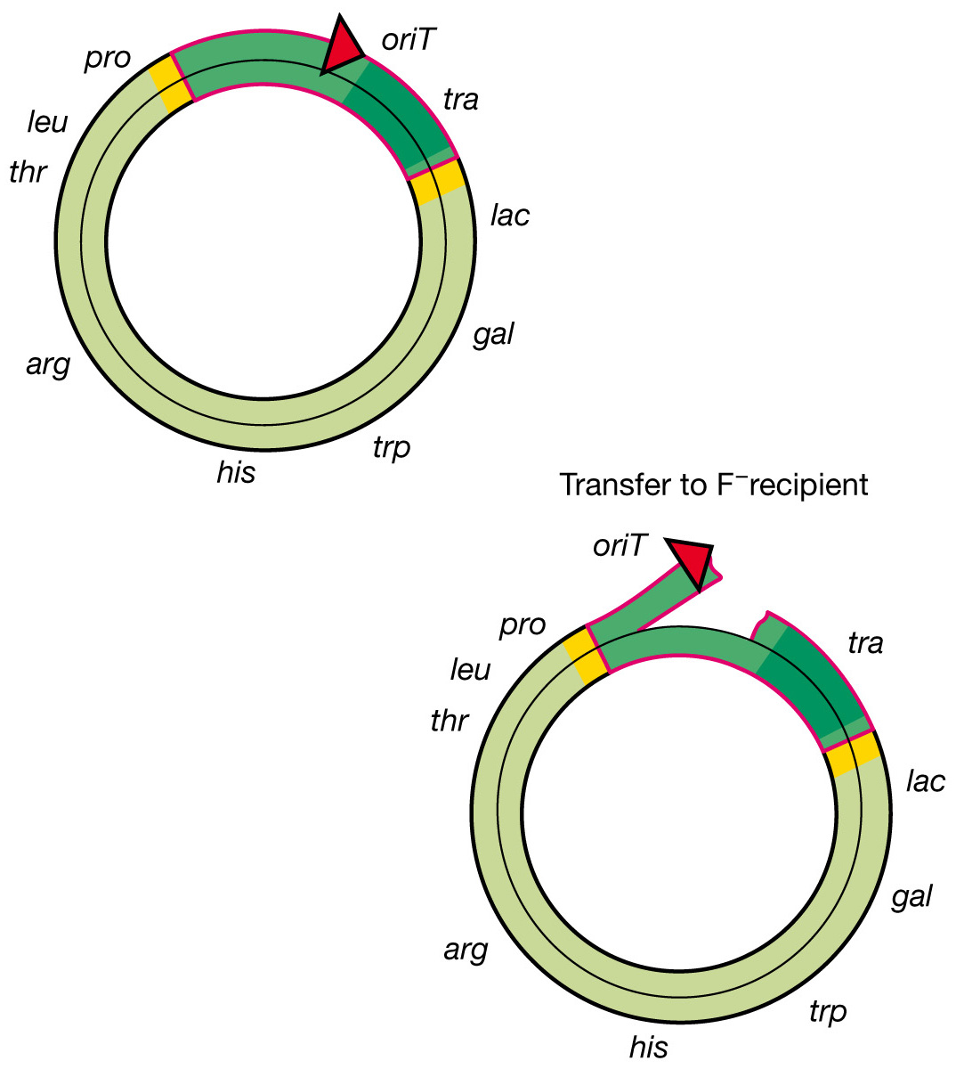
Integration of F plasmid in the bacterial chromosome

Slide 39
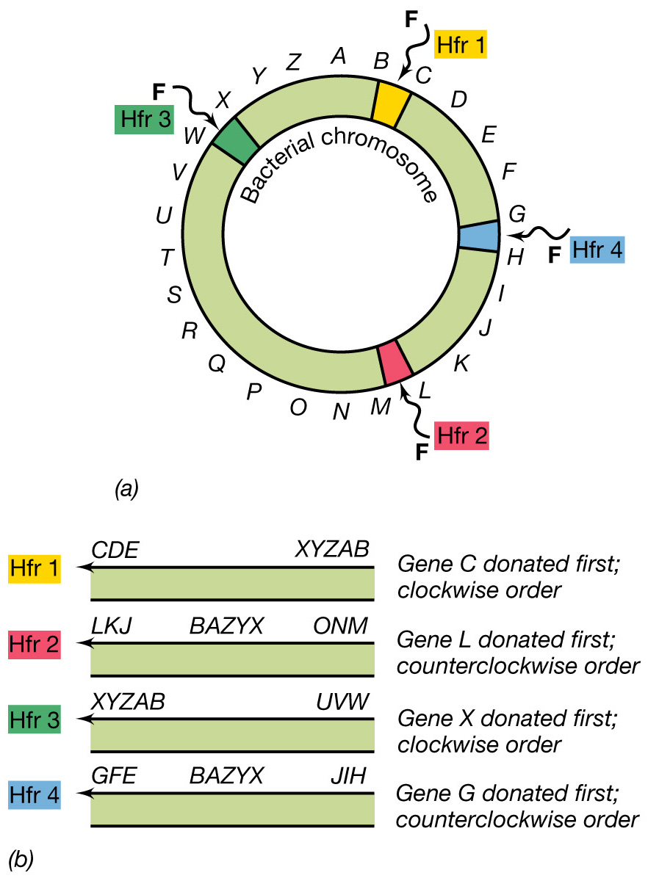
Hfr strains

Slide 40
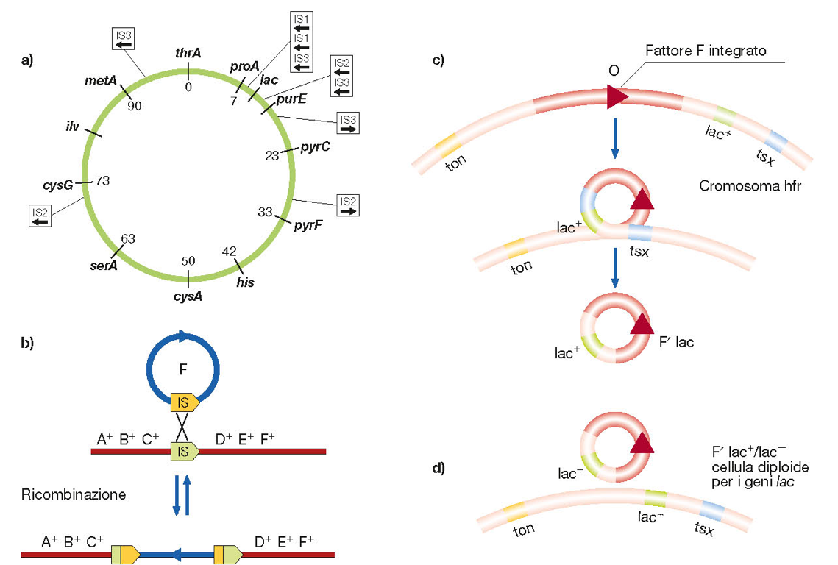

Slide 41
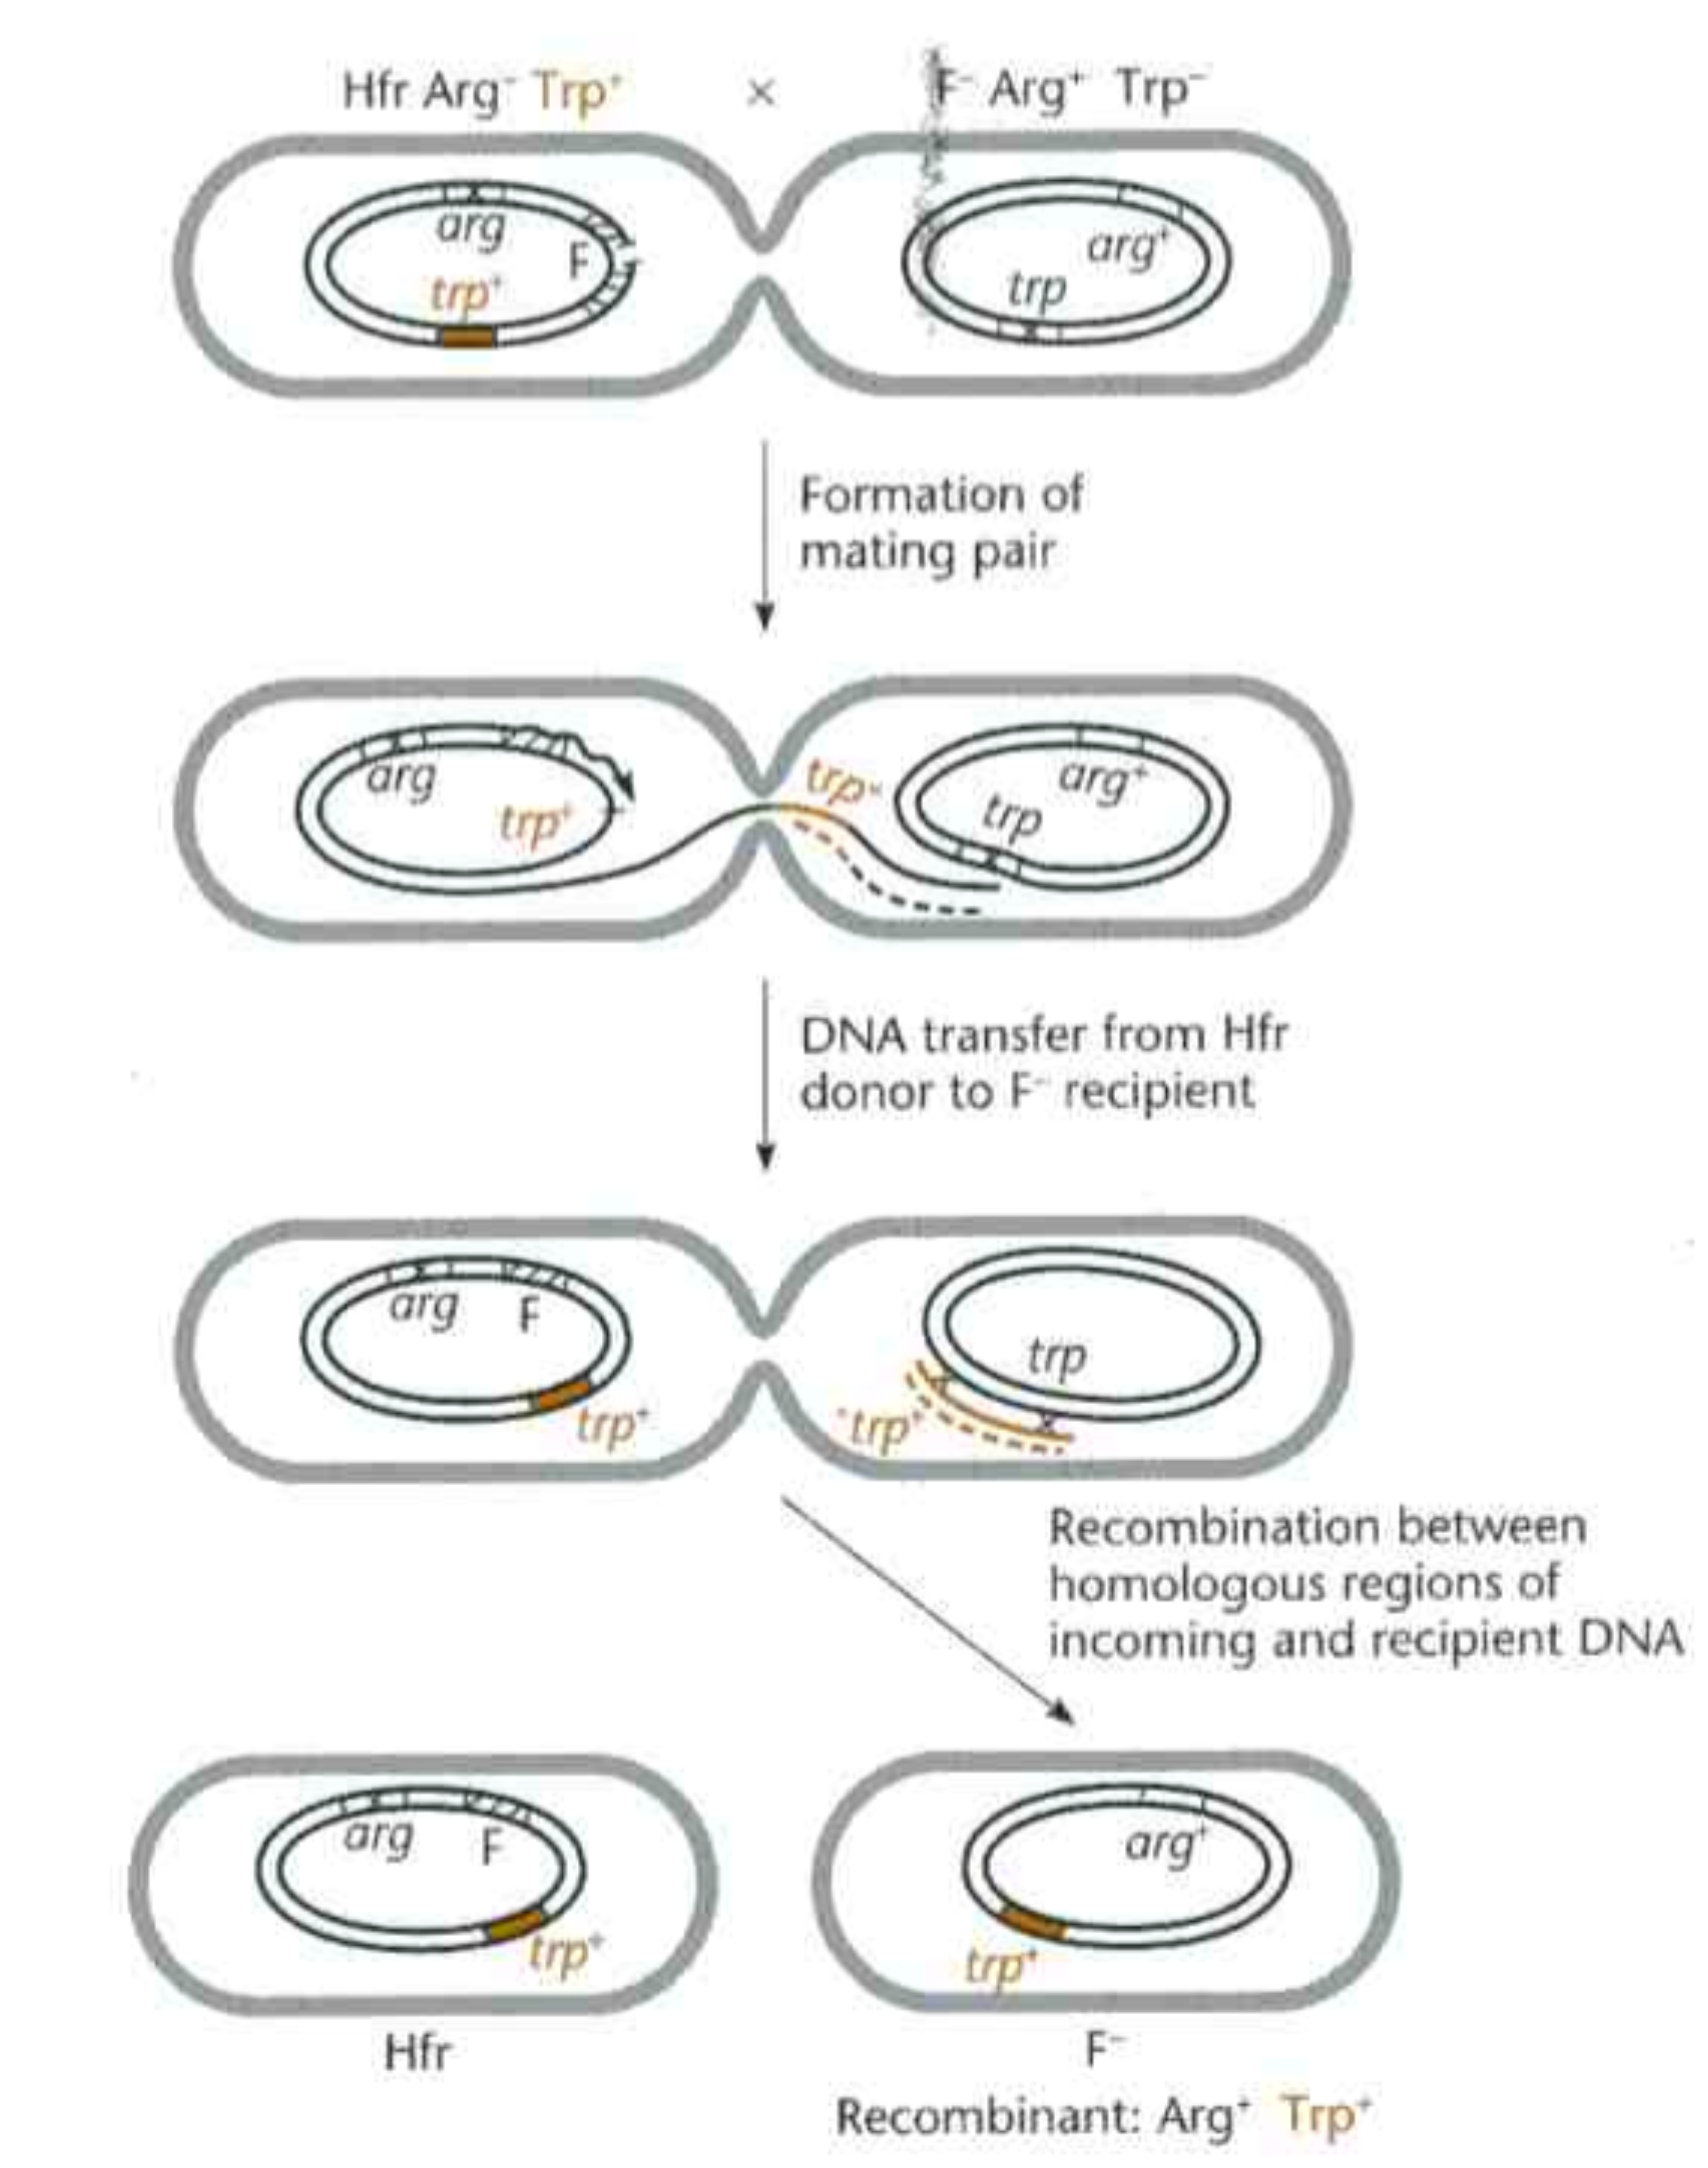
Formation of recombinant types after DNA transfer by an Hfr strain

Slide 42
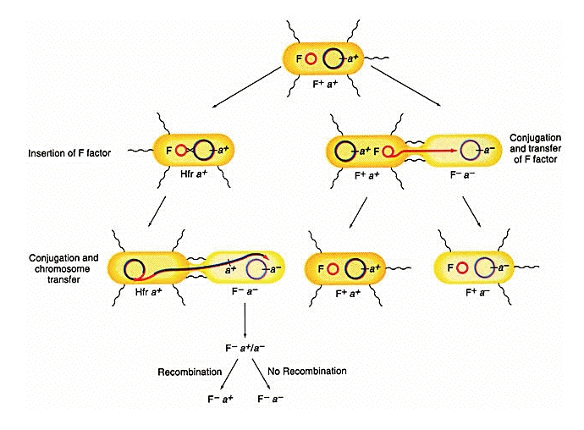

Slide 43
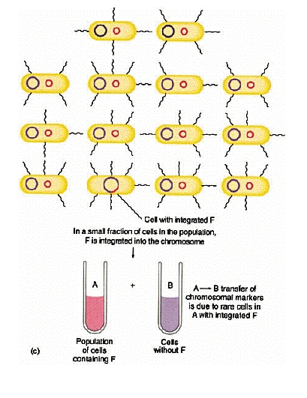

Slide 44
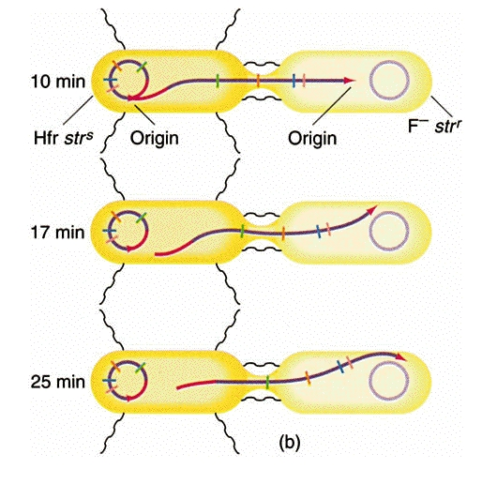

Slide 45
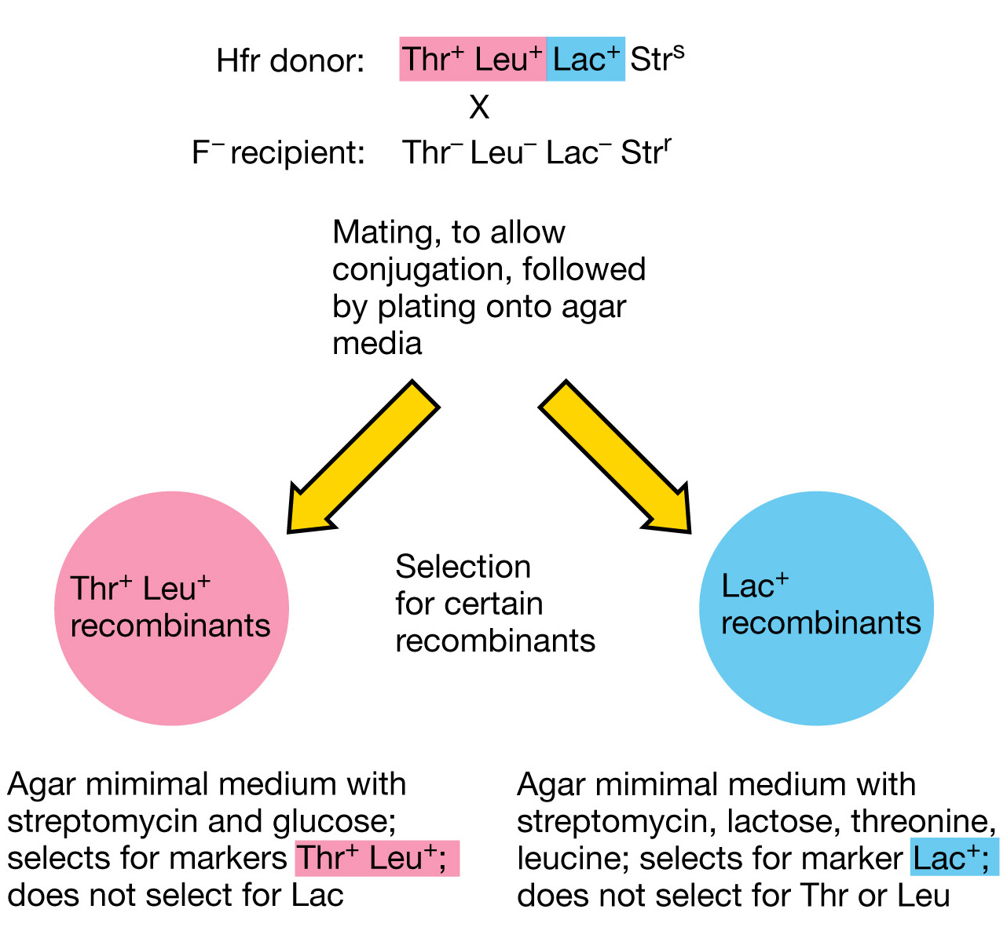

Slide 46
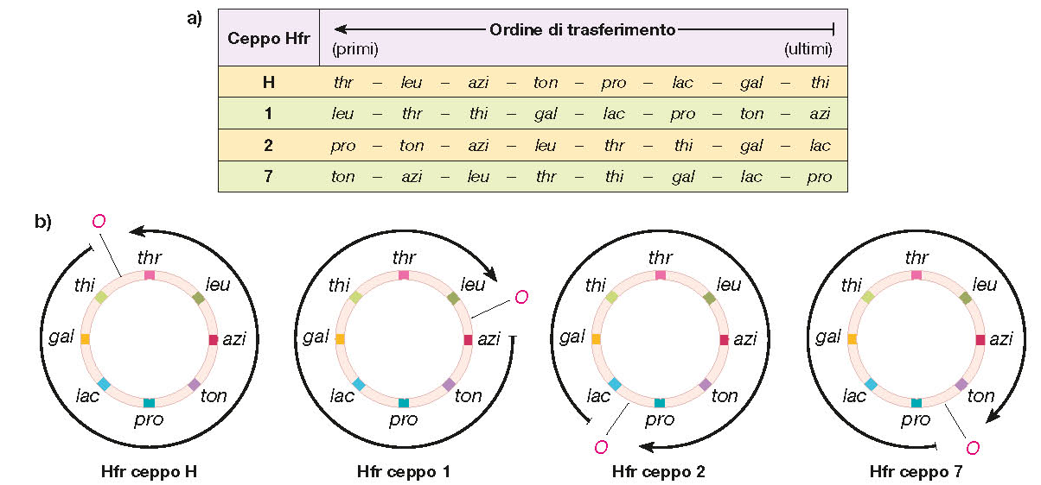

Slide 47
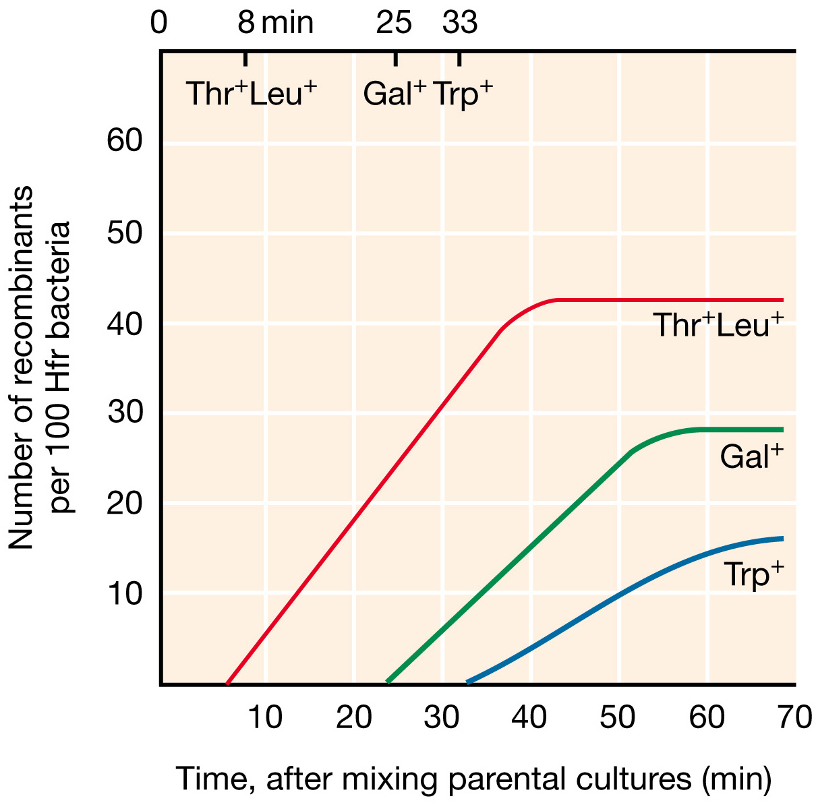

Slide 48
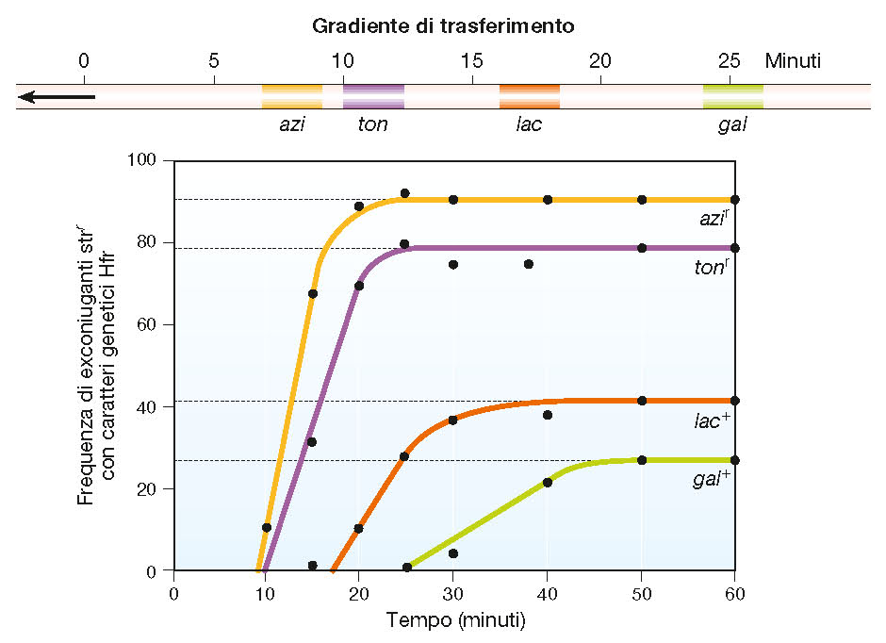

Slide 49
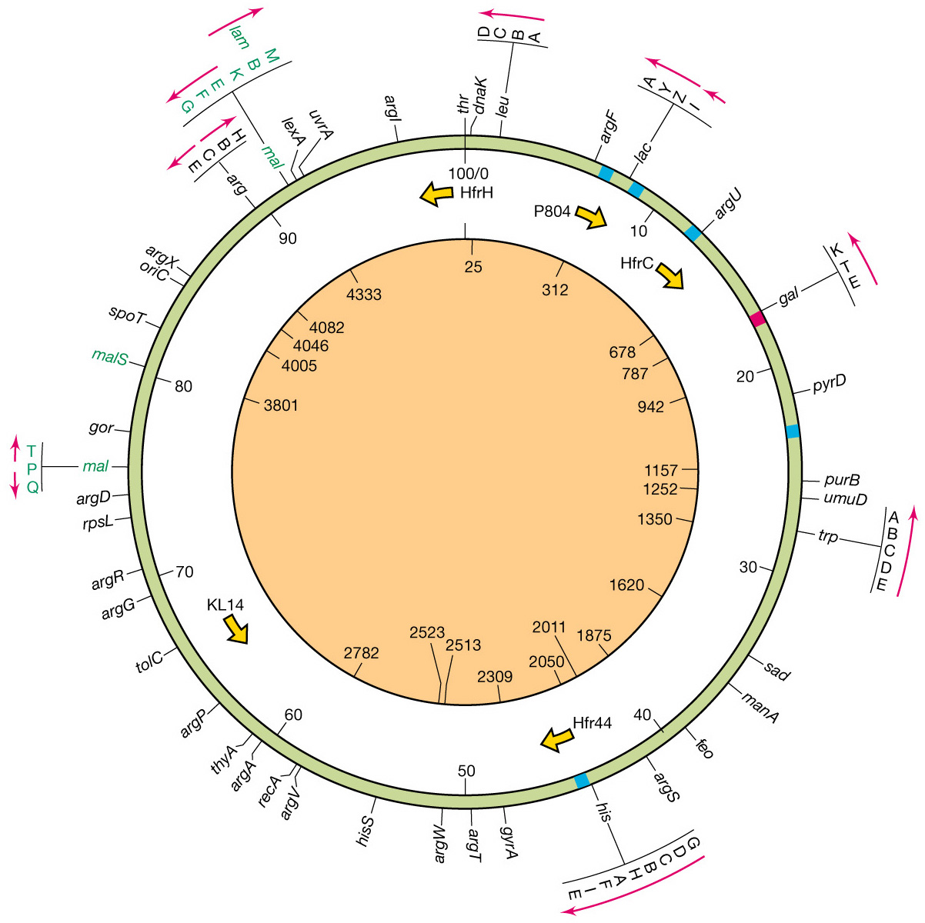
E.coli map in minutes

Slide 50
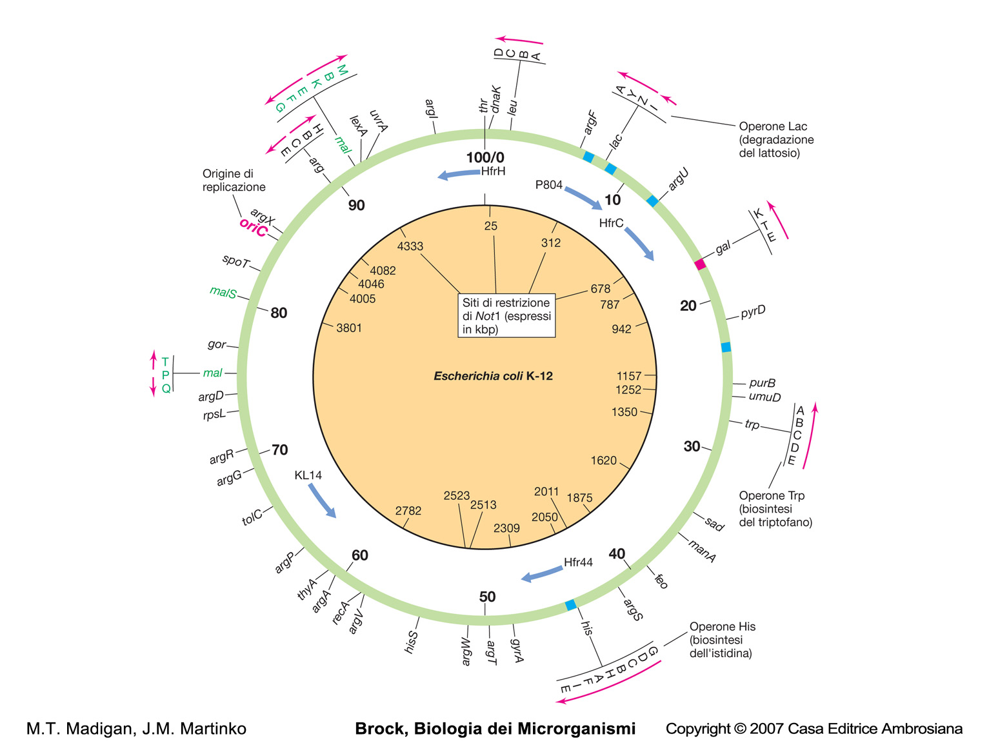
E.coli map in minutes

Slide 51
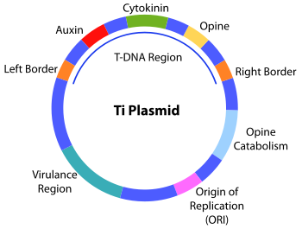
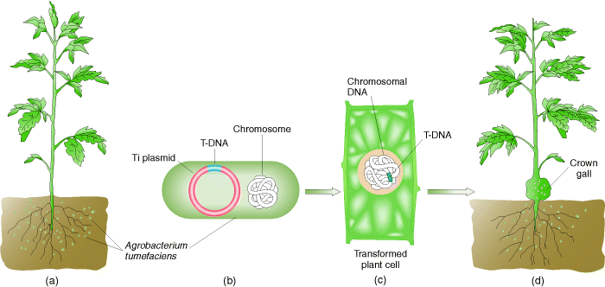
Transfer of a bacterial plasmid into eukaryotes

Slide 52
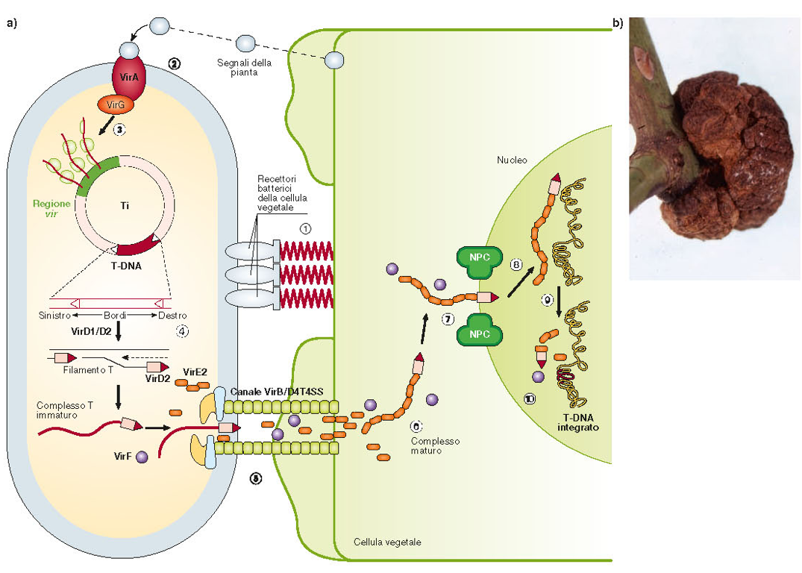
Gene transfer between Agrobacterium and a host plant

Slide 53
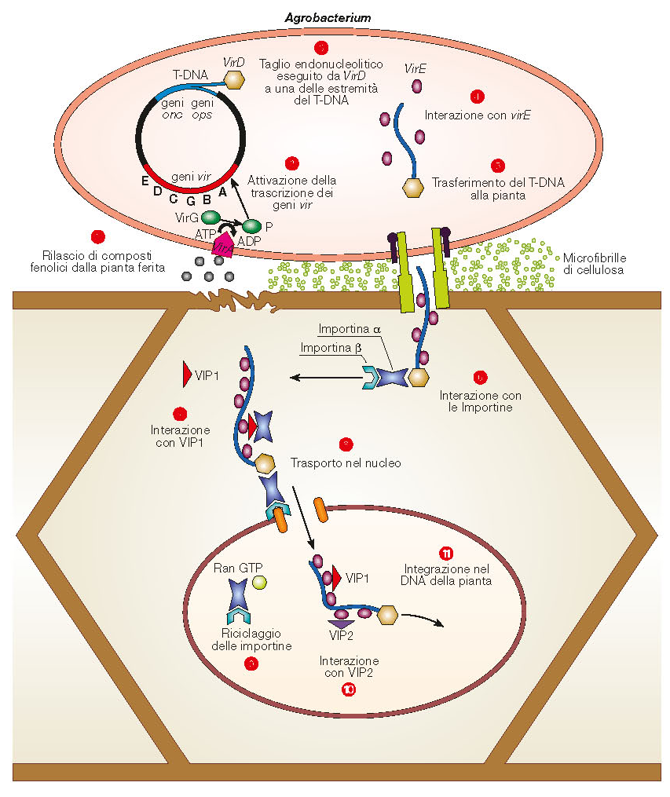
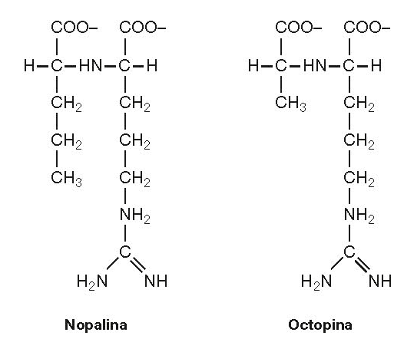
Gene transfer between Agrobacterium and a host plant

Slide 54
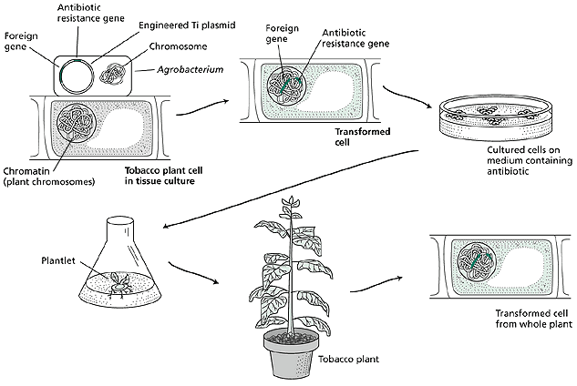
Use of Agrobacterium to genetically engineer plants

Slide 55
Microbial genetics:
plasmids

Slide 58
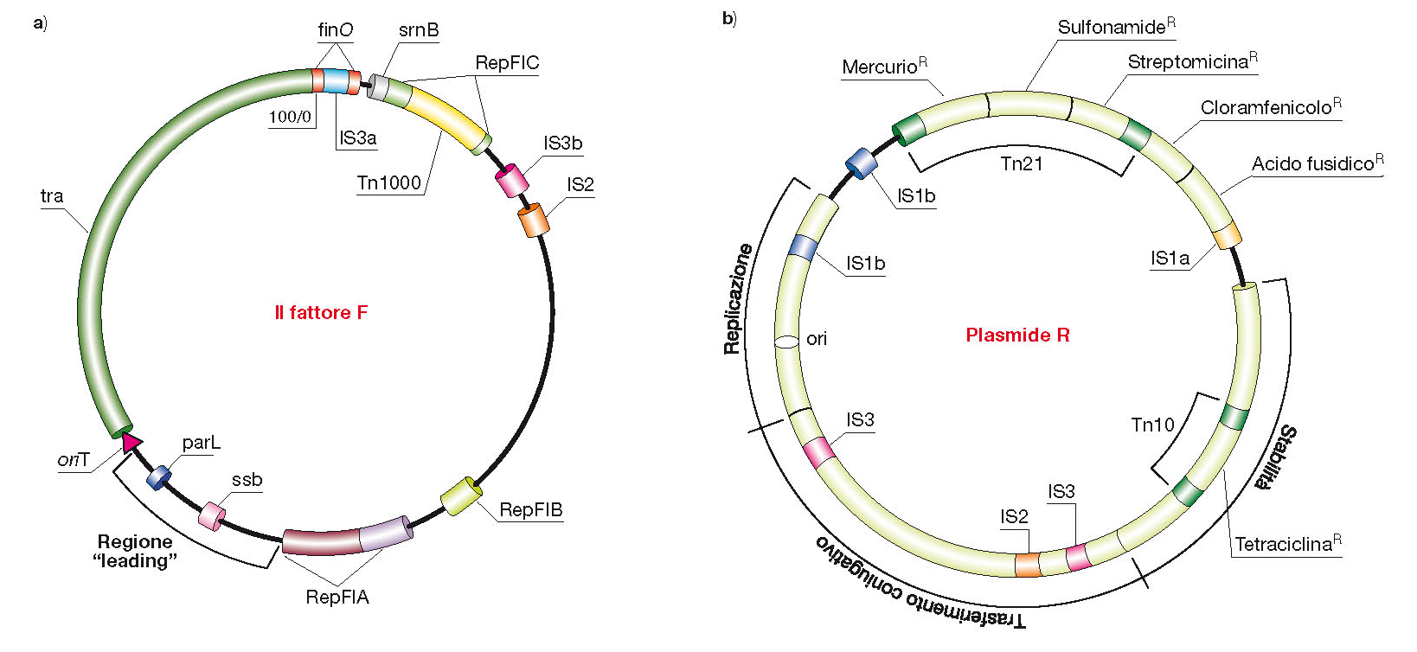

Slide 59
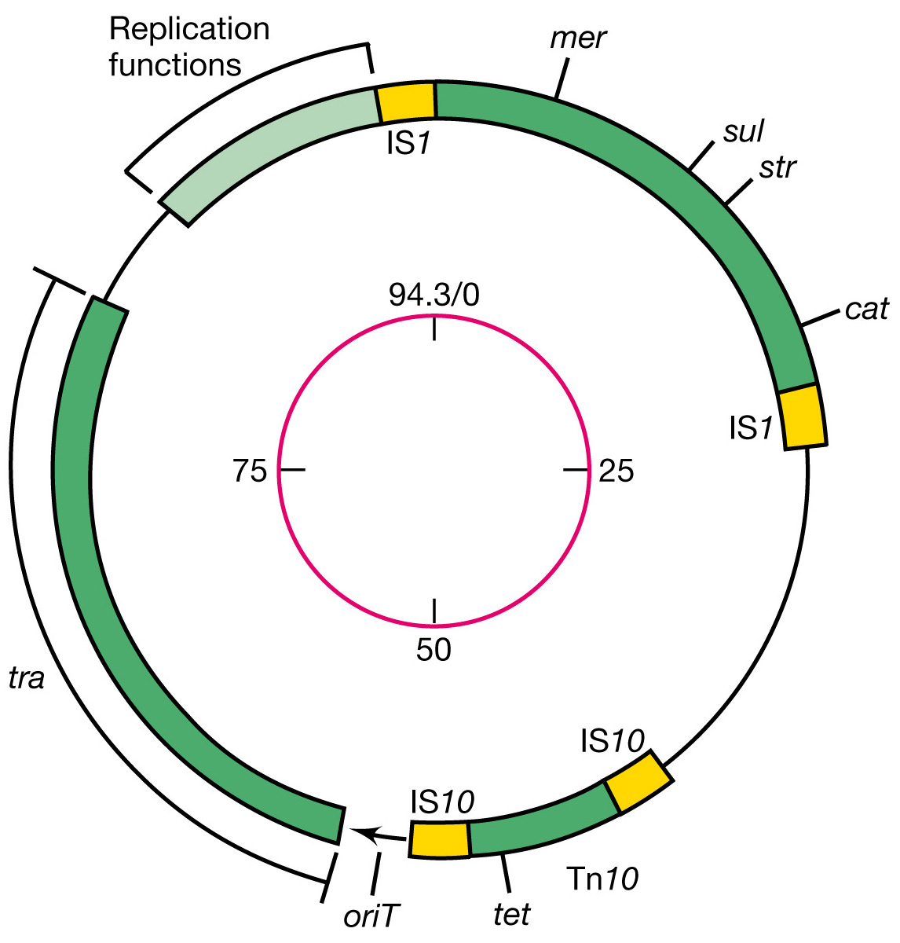
Genetic map of
the resistance
plasmid R100

Slide 60
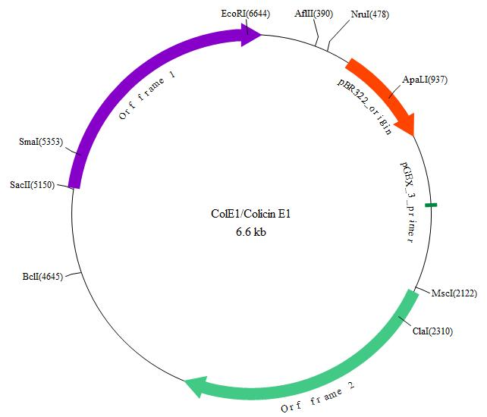
Plasmid map of ColE1/Colicin E1

Slide 61
The structure of
plasmid pBR322

Slide 62
Molecular cloning of a DNA segment into pBR322 plasmid vector

