Slide 1
MICROBIOLOGIA GENERALE
Microbial evolution and systematics

Slide 2
Systematics is the study of the diversity of microorganisms and their relationships.
It links together taxonomy with phylogeny.
The science of taxomomy: how Bacteria and Archea are classified and named.
Taxomomy characterizes (identification), names (nomenclature) and places (classification) microorganims in groups according to several defined criteria.
Polyphasic taxonomy is based on phenotypic, genotypic and phylogenetic information.
Phenotypic traits useful in taxomony include morphology, motility, metabolism, cell chemistry, lipid analyses.
Genotypic anlysis examines traits of the genome. Prokaryotic species can be distinguished genotypically on the basis of DNA-DNA hybridization, DNA profiling, MLST, GC content of their DNA.

Slide 3
Microbial evolution and systematics:
Phenotypic and genotypic taxonomy

Slide 5
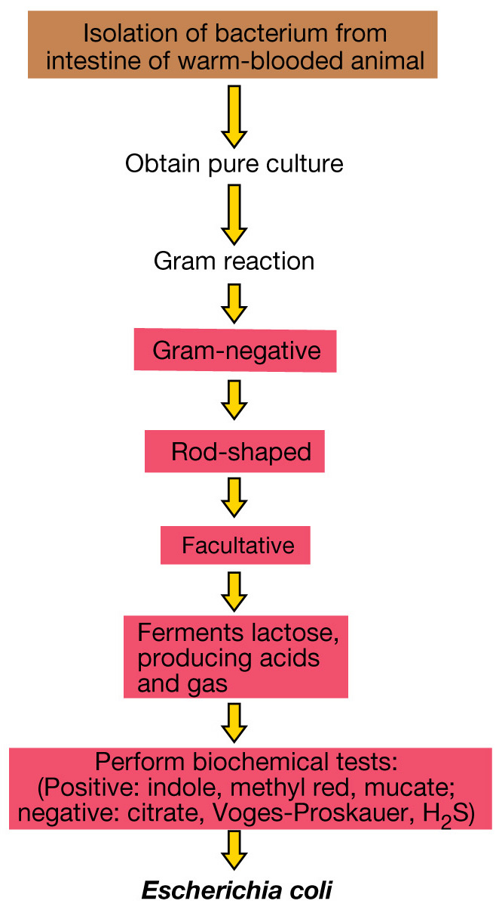
Conventional taxonomy
Example of methods that would
be used for identification of a
newly isolated enteric bacterium, using classic microbiological methods

Slide 7
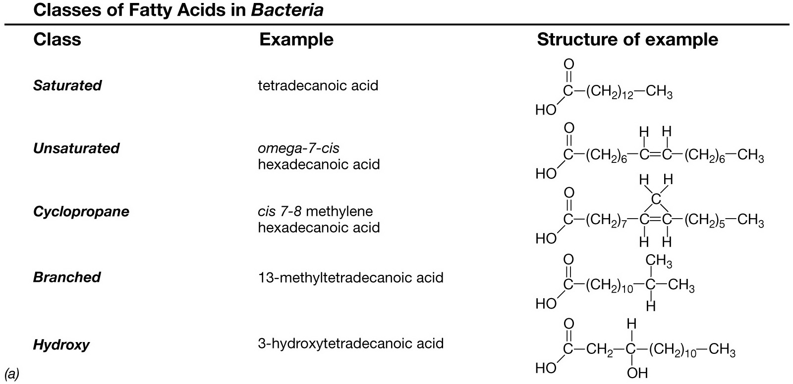
Fatty acid methyl ester (FAME) analysis in bacterial identification:
classes of fatty acids in Bacteria.

Slide 8
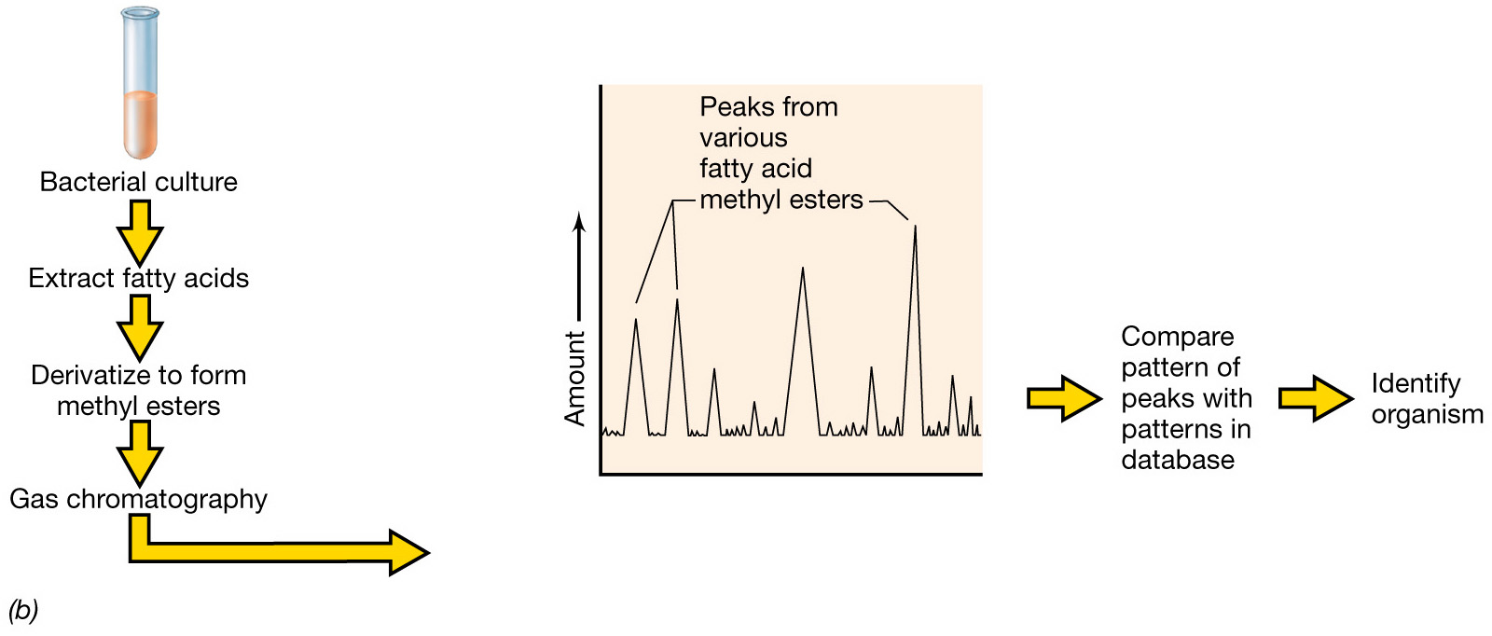
Fatty acid methyl ester (FAME) analysis in bacterial identification
Each peak from the gas chromatograph is due to one particular fatty acid methyl ester and the peak height is proportional to the amount.
Notes:
Figure: 11-21b
Caption:

Slide 9
Genotypic methods used in bacterial taxomomy

Slide 10
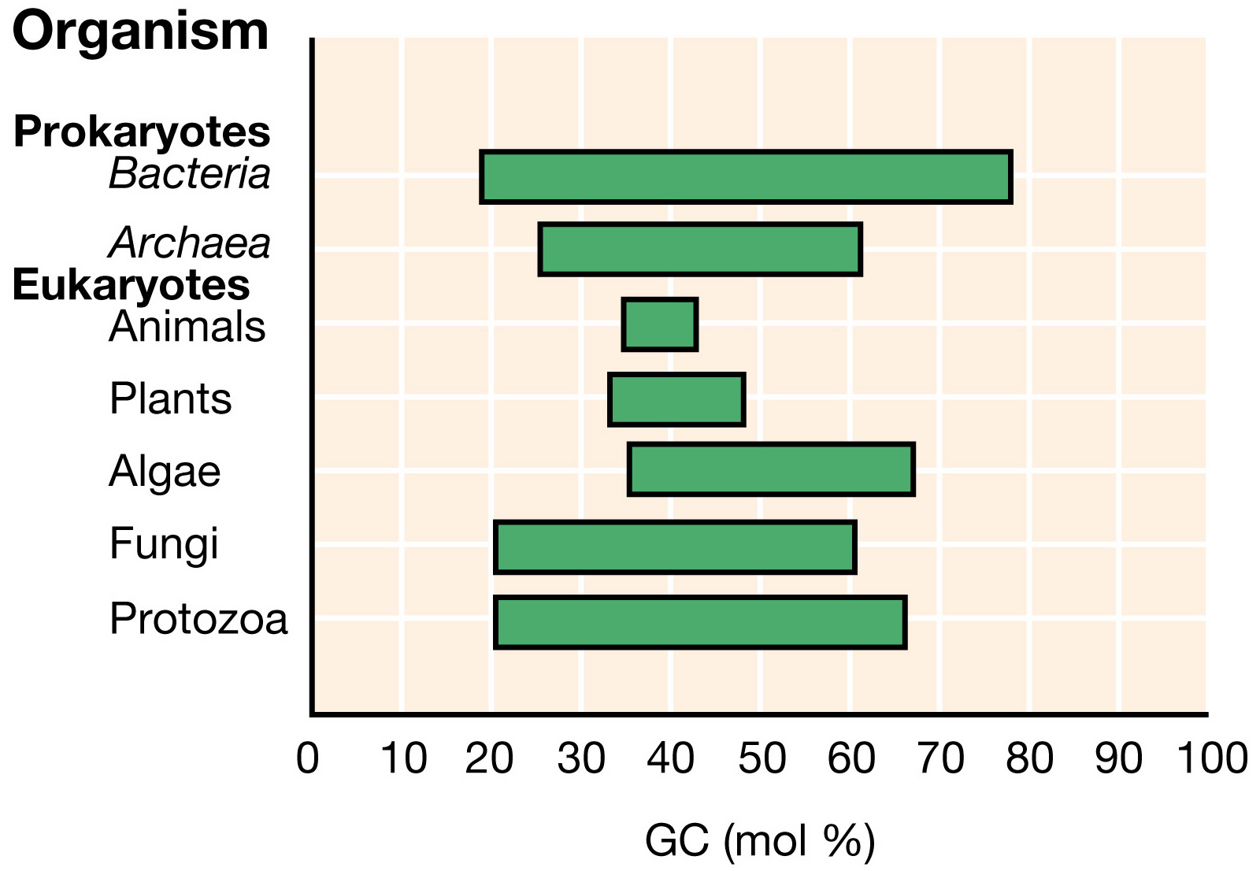
Ranges of GC ratios of various organisms

Slide 11
DNA-DNA hybridization as a taxonomic tool

Slide 12
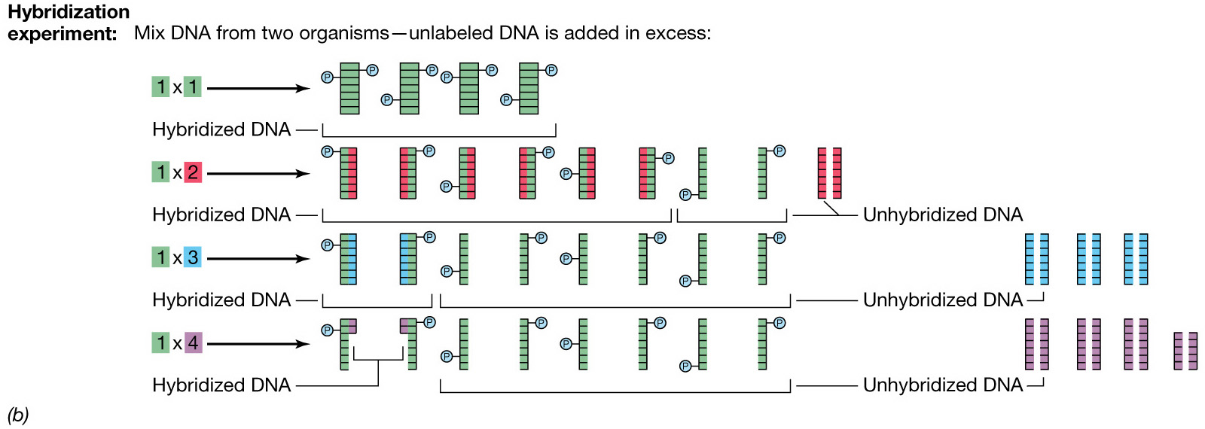
Genomic hybridization as a taxonomic tool

Slide 13
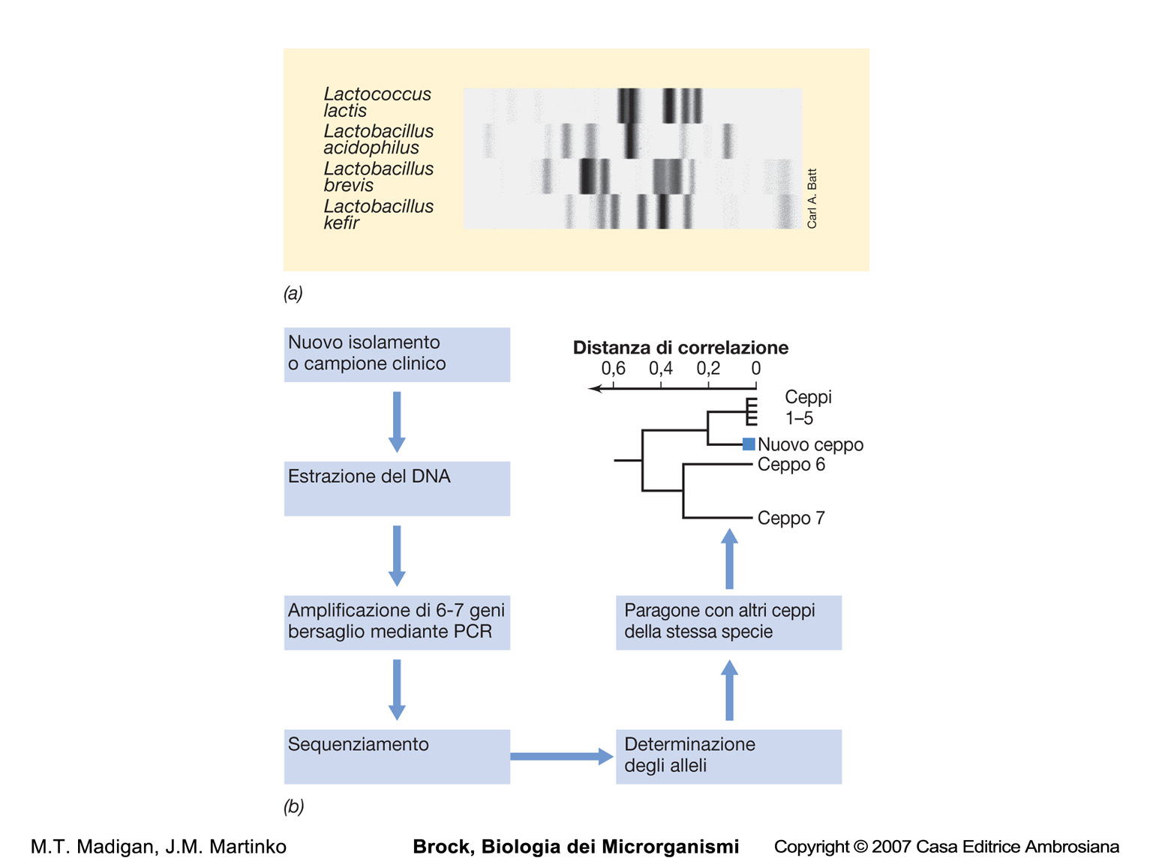
Ribotyping
Multilocus sequence typing (MLST)

Slide 14
Microbial evolution and systematics:
evolutionary chronometers and microbial philogeny

Slide 15
Escherichia coli
16S RNA

Slide 16
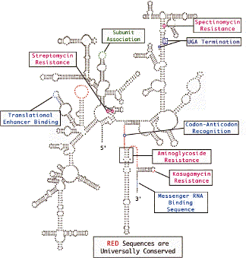
Escherichia coli 16S RNA

Slide 17
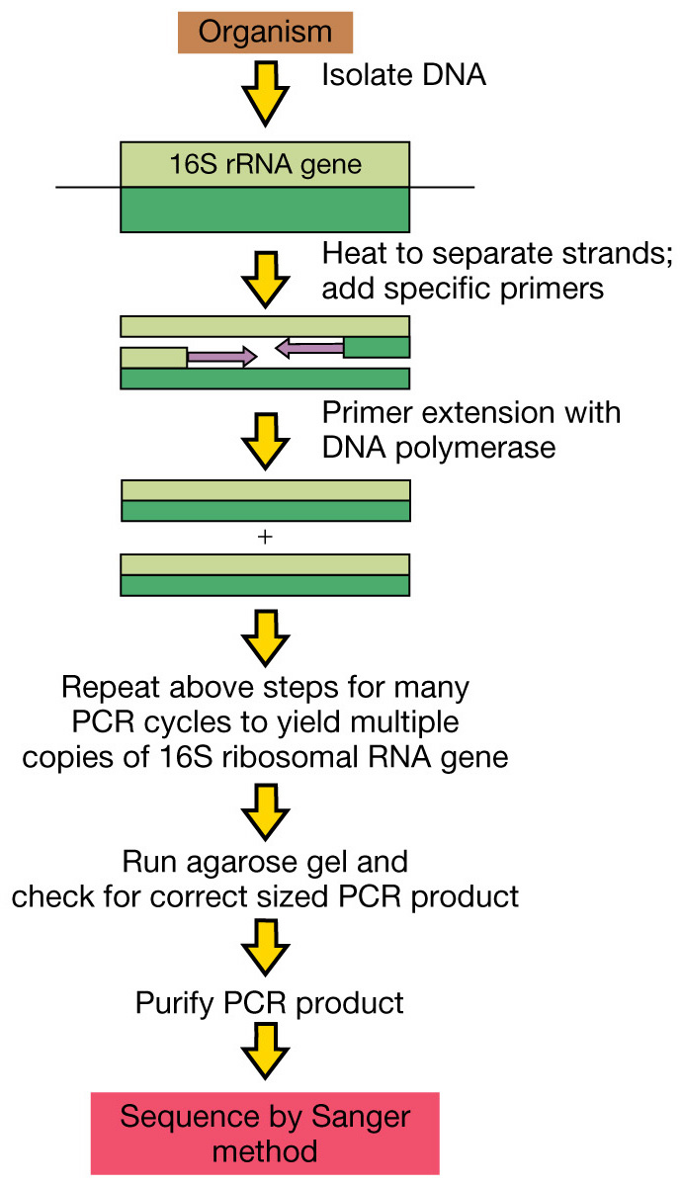
Ribosomal RNA sequencing of a pure culture of a microorganism using PCR

Slide 18
Sanger ddNTP chain terminator sequencing
G A T C

Slide 19
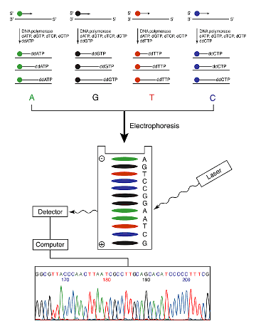

Slide 20
Preparing a phylogenetic
distance tree
rom 16S
rRNA sequences

Slide 21
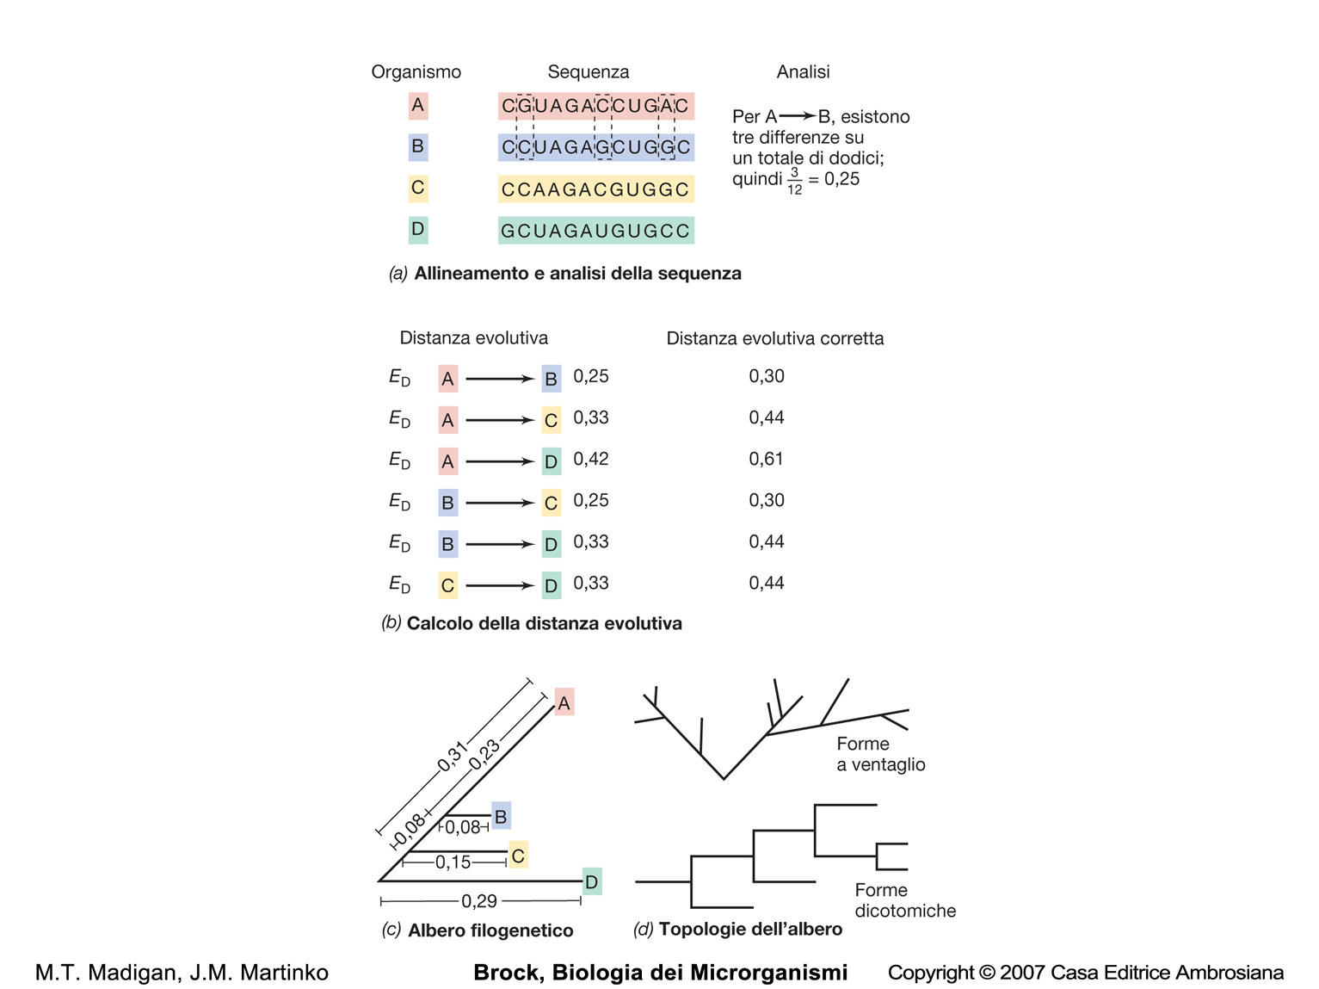

Slide 22
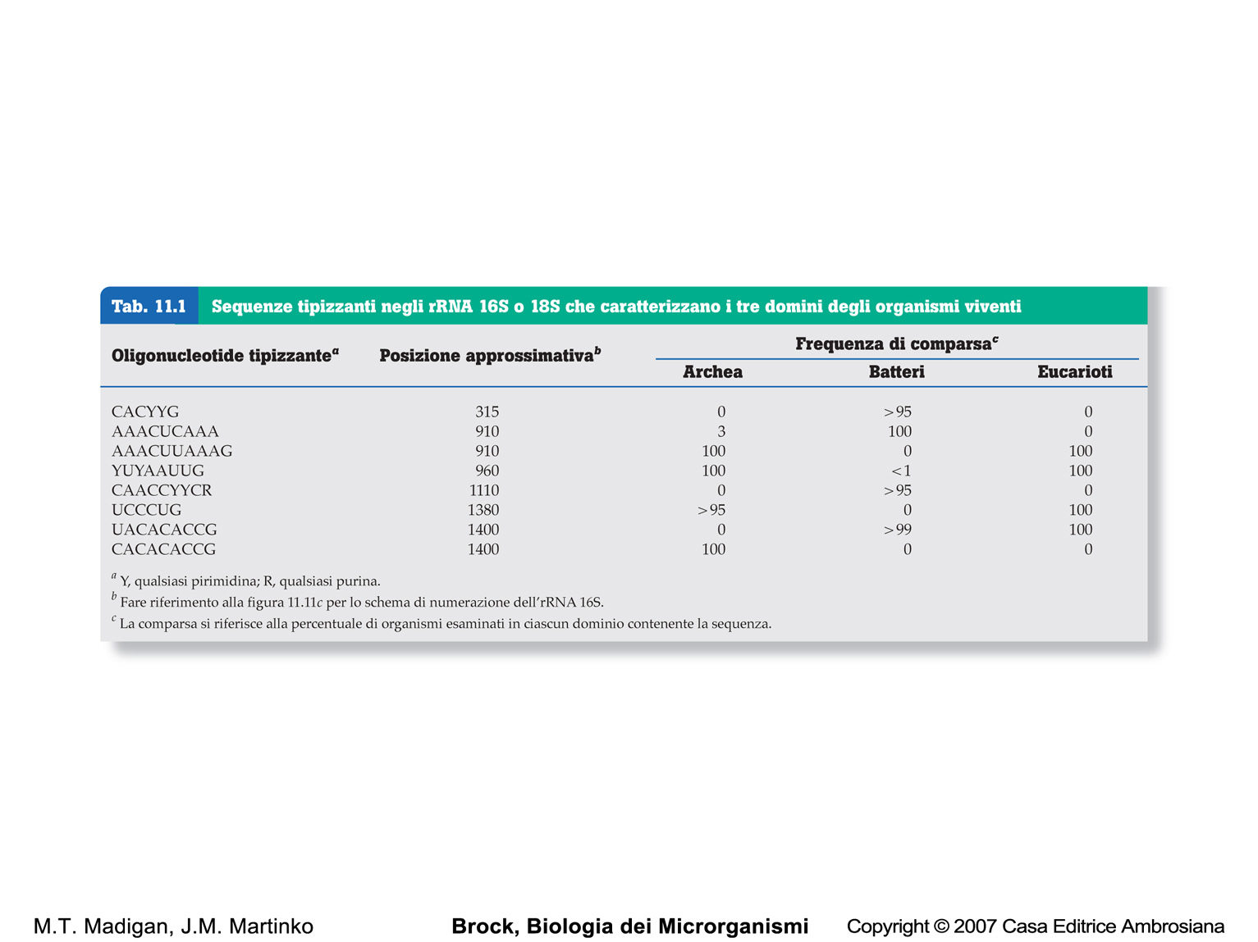
SSU RNA signature sequences

Slide 23
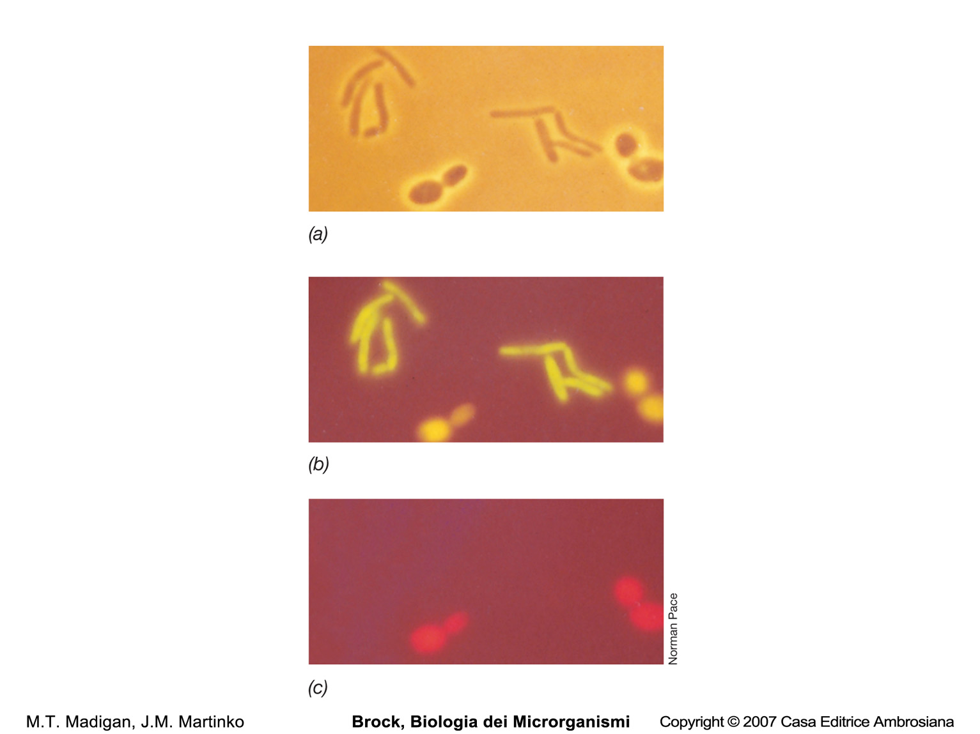
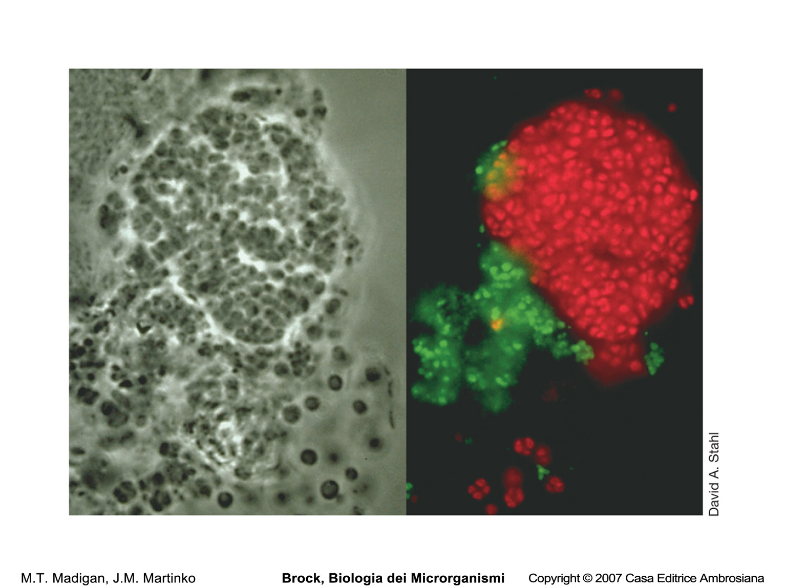
Fluorescently labeled RNA probes:
Phylogenetic stains
Bacillus megaterium
Nitrosomonas spp.
Saccharomyces cerevisiae
Nitrobacter spp.

Slide 24
Steps in biodiversity analysis
of a microbial community
using phylogenetic trees

Slide 25
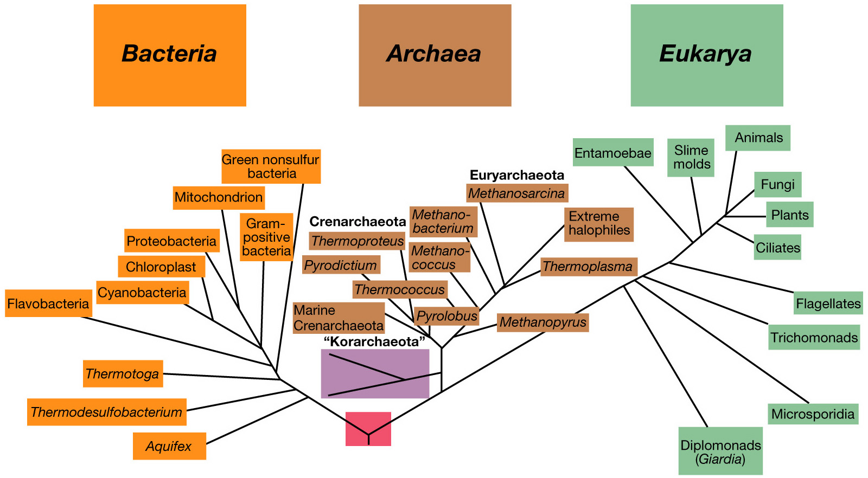
Universal phylogenetic tree as determined from comparative rRNA sequencing

Slide 26
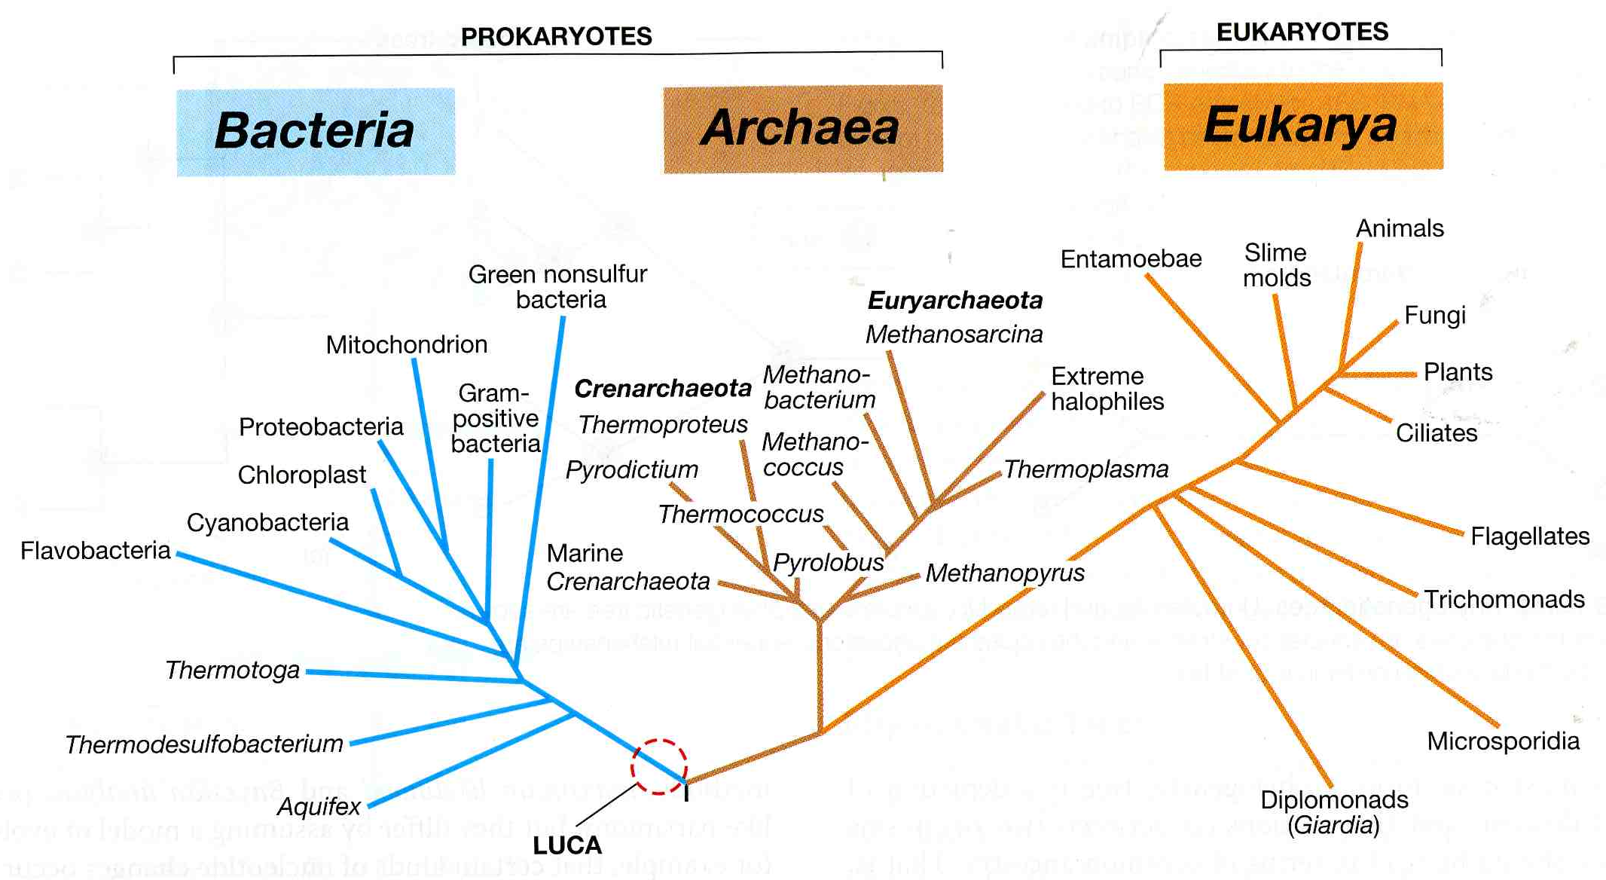
Universal phylogenetic tree as determined from comparative SSU rRNA gene sequence anlysis

Slide 27
Microbial evolution and systematics:
unique phenotypic characteristics of the primary domains

Slide 28
1: Cell walls
Virtually all Bacteria have cell walls containing peptidoglycan.
Peptidoglygan can thus be considered a signature for Bacteria
Eukarya and Archaea lack peptidoglycan.
In Archaea various cell wall types exist: pseudopeptidoglycan, polysaccharide, protein, or glycoprotein
In Eukarya when present cell walls are made of cellulose or chitin

Slide 29
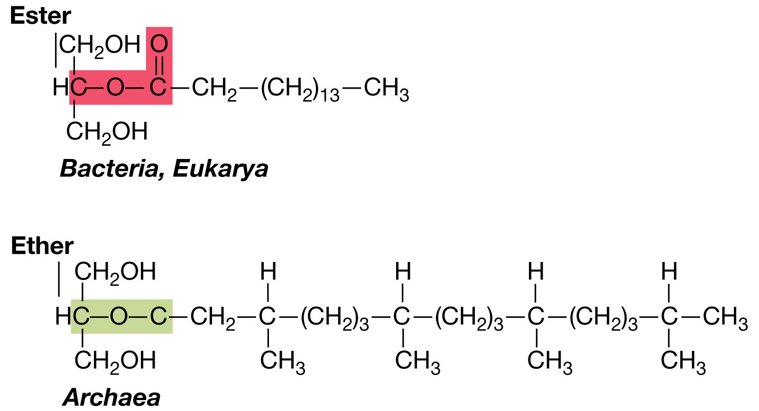
2: Plasma membrane lipids

Slide 30
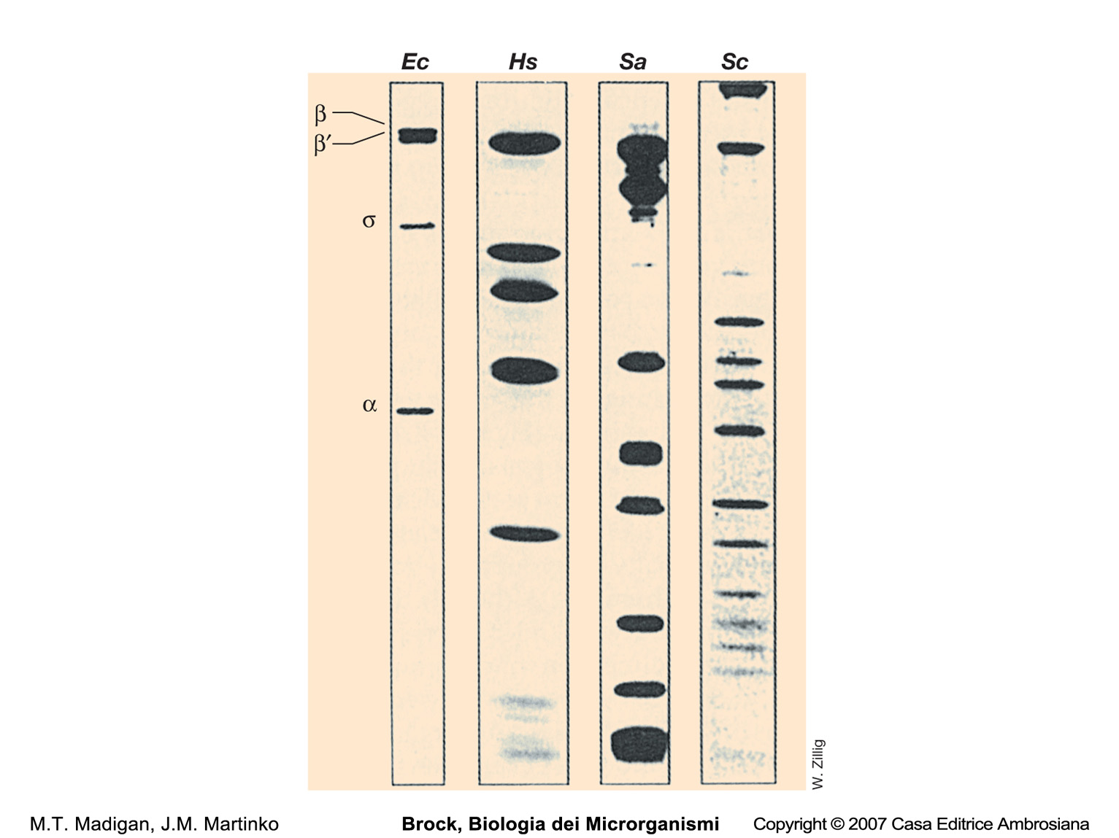
3: RNA polymerases

Slide 31
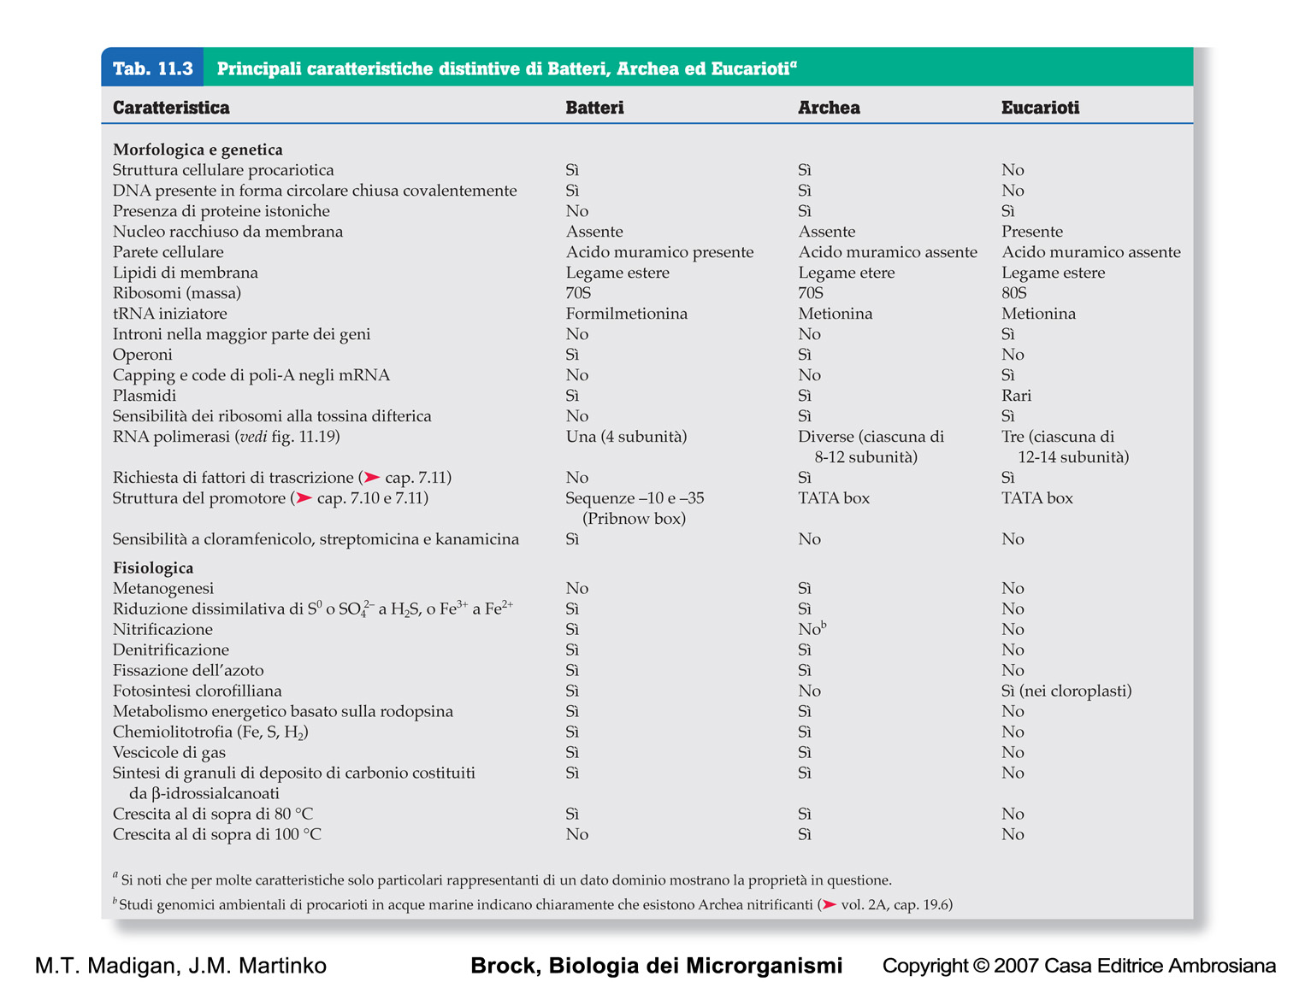

Slide 32
Microbial evolution and systematics:
the specie concept in microbiology and nomenclature

Slide 33
Current definition of prokaryotic species
At the present, there is no universally accepted concept of species
for prokaryotes
A prokaryotic species is defined operationally as a group of strains sharing a high degree of similarity in several independent traits.
Traits currently considered most important for grouping strains together as a species include:
70% or greater genomic DNA-DNA hybridization;
97% or greater identity (<3% difference) in 16 S RNA sequence

Slide 34
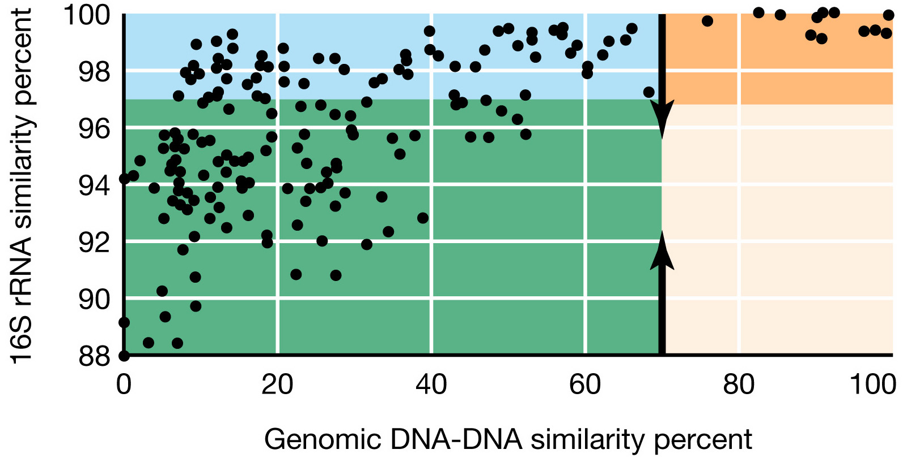
Relationship between 16S ribosomal RNA sequence similarity and
genomic DNA hybridization between different pairs of organisms

Slide 35
Prokaryotic nomenclature:
the taxonomic hierarchy
DOMAIN
KINGDOM
PHYLUM
CLASS
ORDER
FAMILY
GENUS
Escherichia coli
SPECIES

Slide 36
Possible mechanism of bacterial speciation

Slide 37
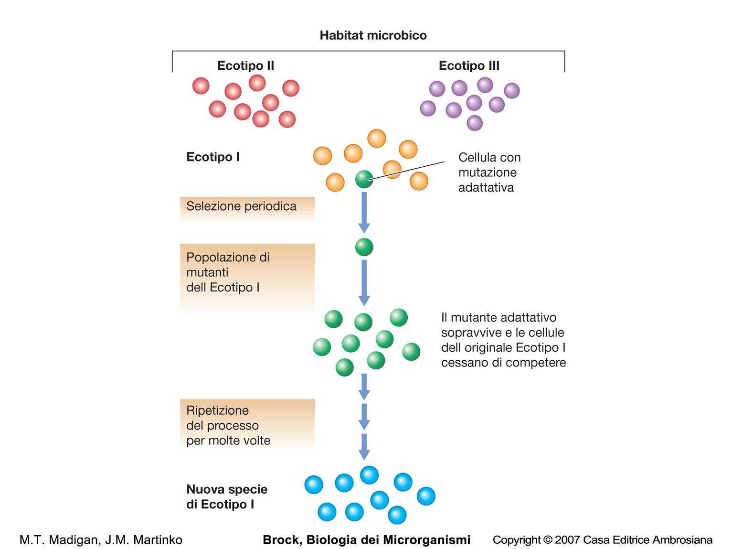

Slide 39
Microbial evolution and systematics:
primitive microorganisms

Slide 40
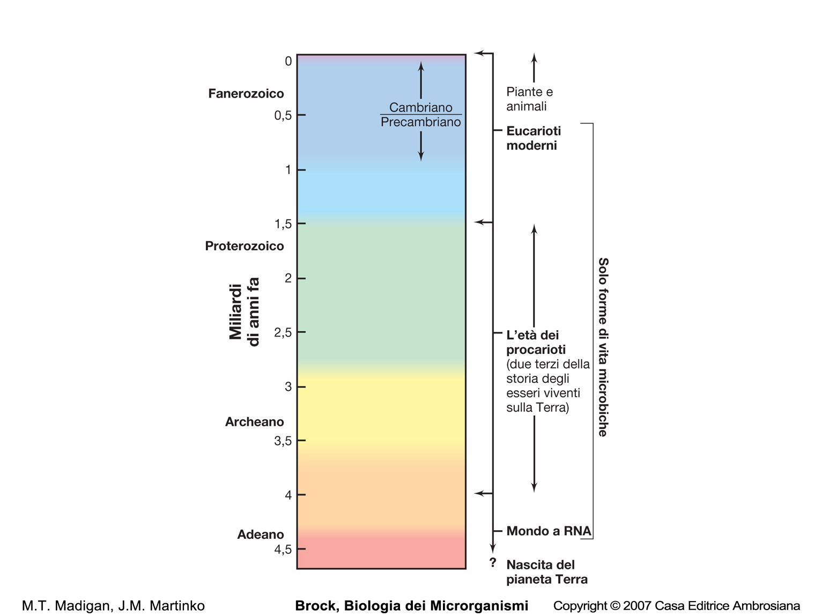
Major landmarks in
biological evolution

Slide 41
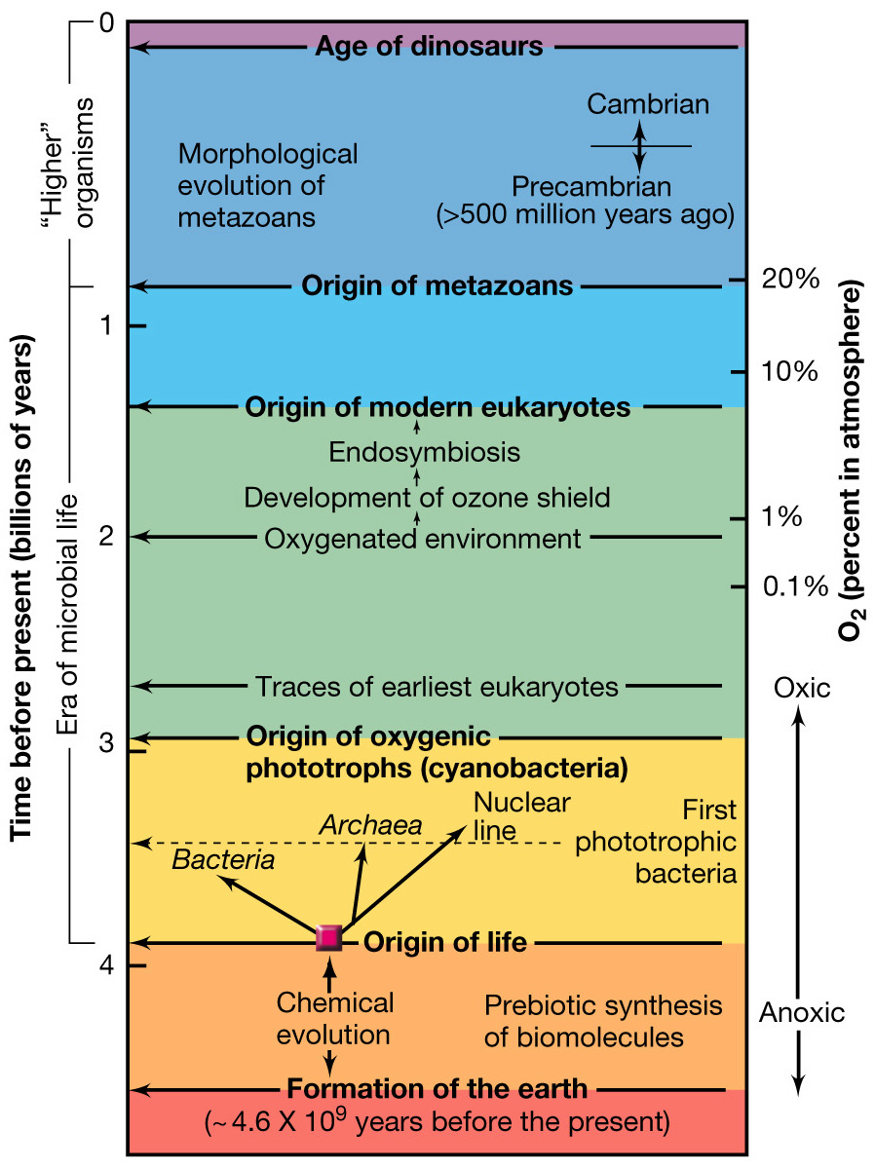
Major landmarks in
biological evolution

Slide 42
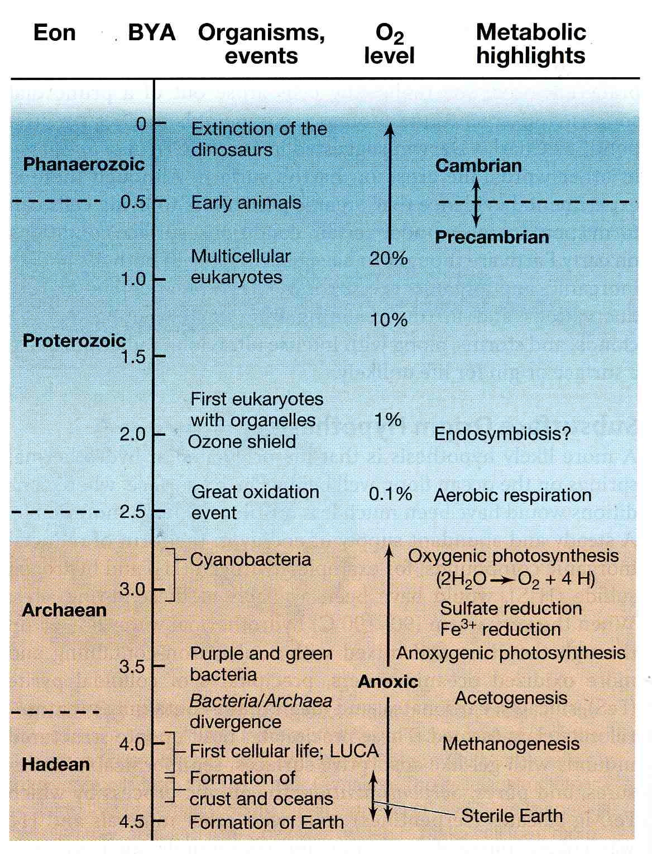
Major landmarks in
biological evolution

Slide 43
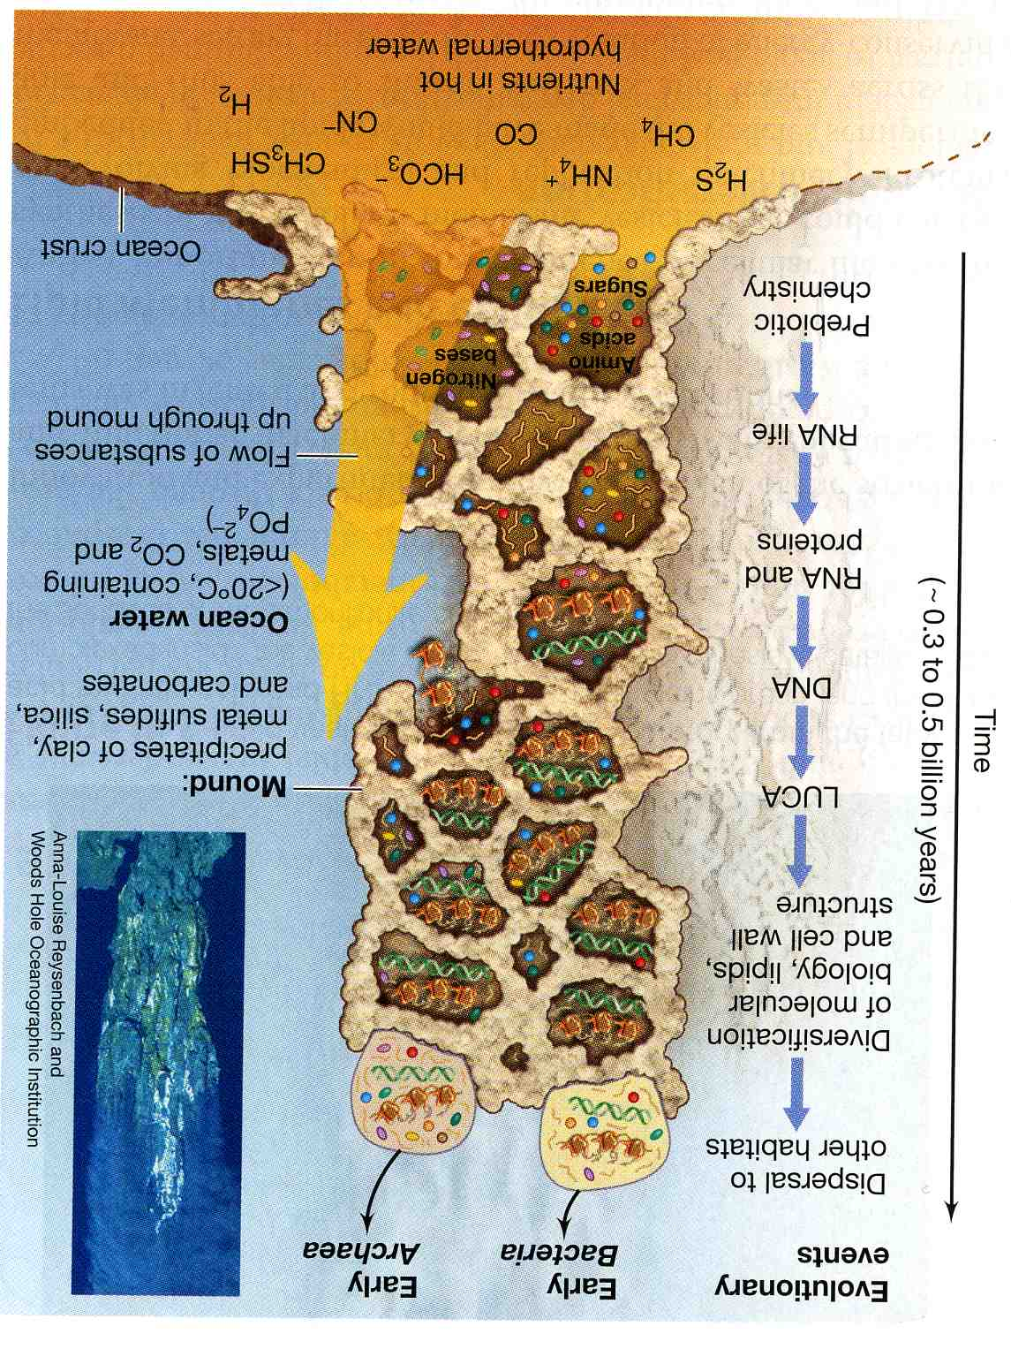
Submarine mounds and their possible link to the origin of life

Slide 44
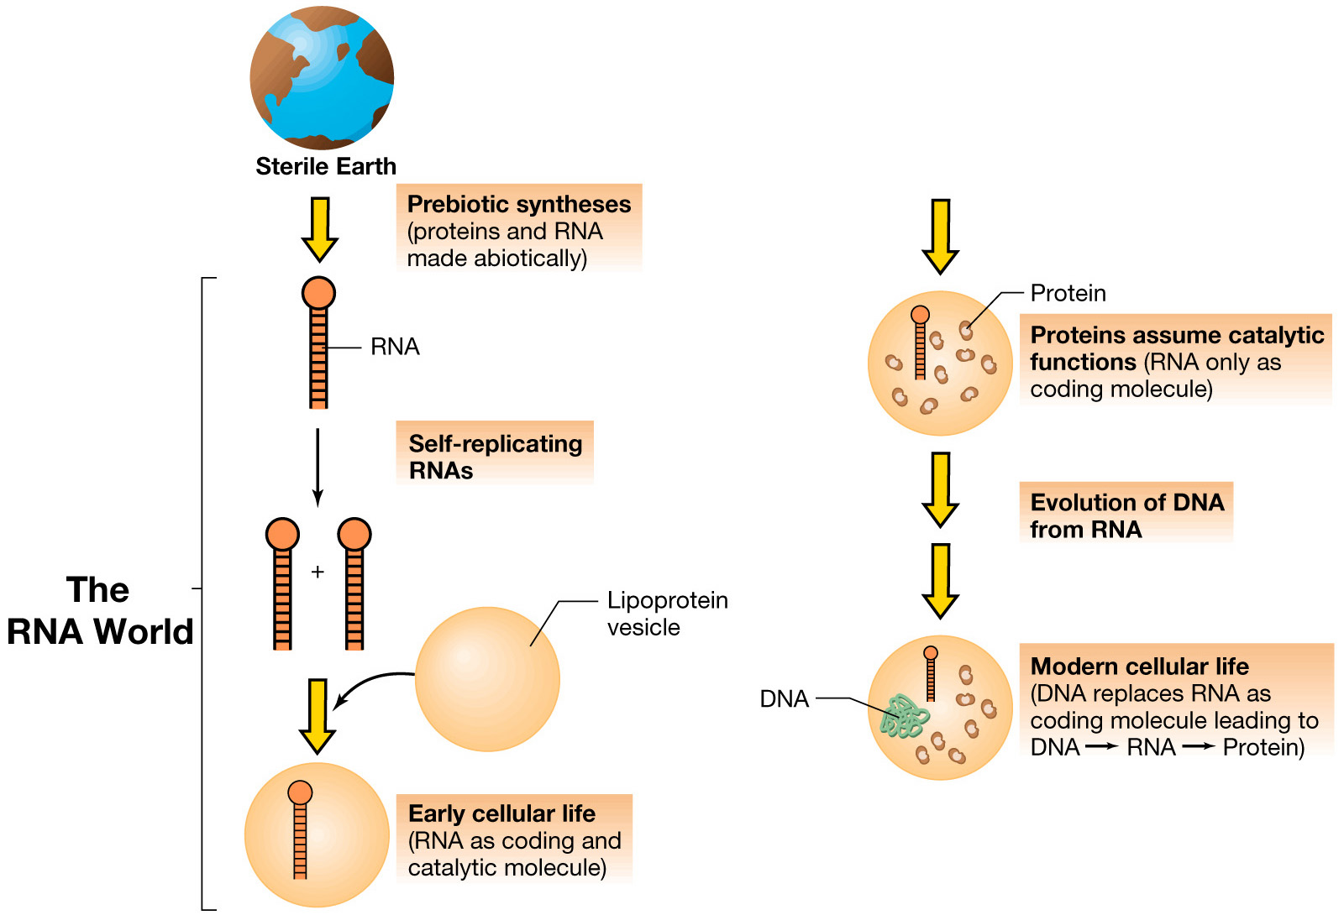
Possible scenario for the evolution of
cellular life forms from RNA life forms

Slide 45
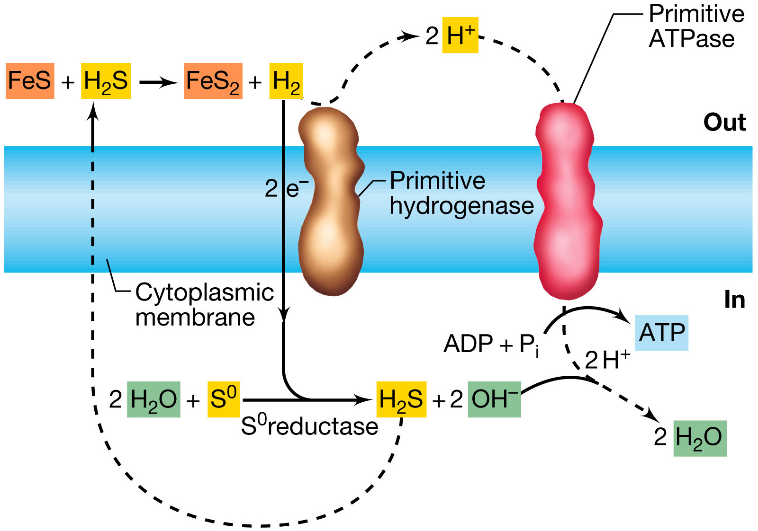
A hypothetical energy-generating scheme for primitive cells

Slide 46
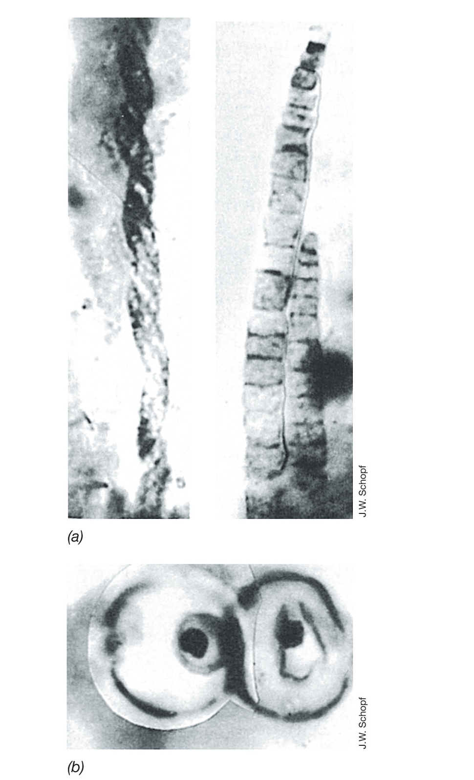
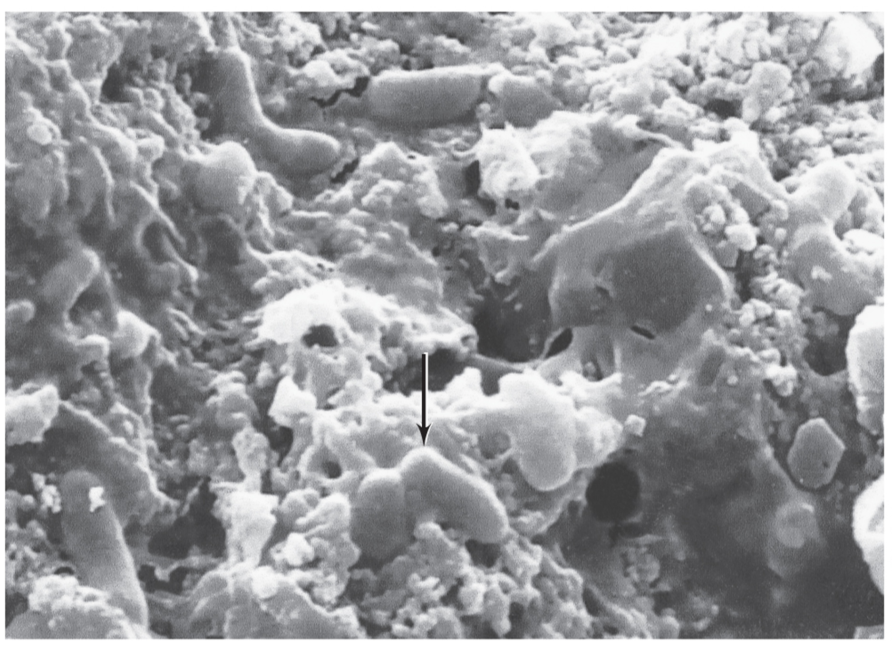
Ancient microbial life: microfossil bacteria
1 BYA
3.45 BYA

Slide 47
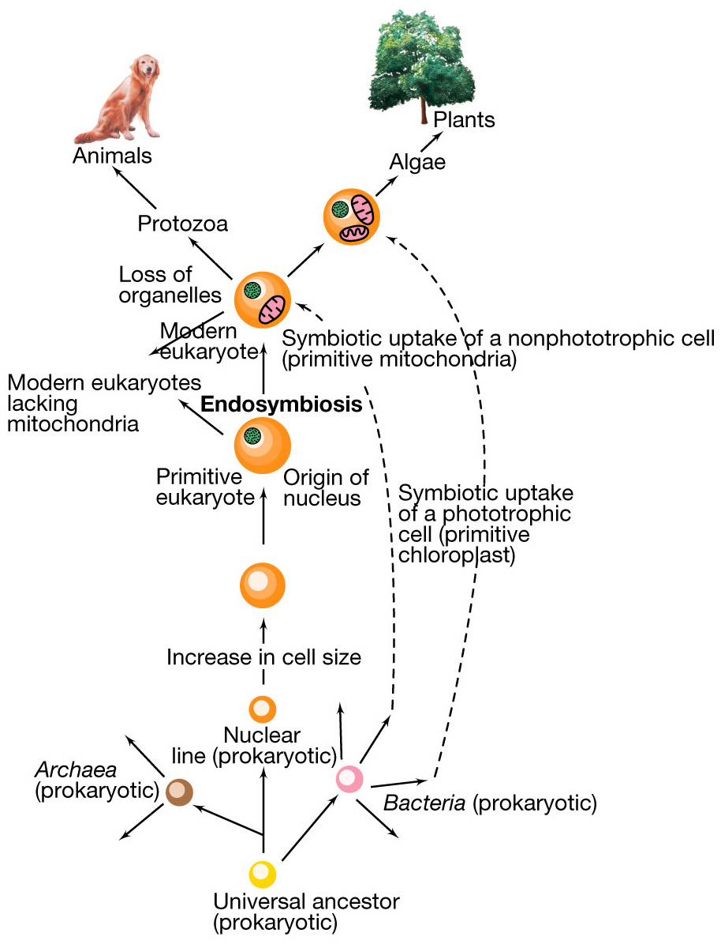
Origin of modern eukaryotes
by endosymbiotic events

