Slide 1
MICROBIOLOGIA GENERALE
Microbial genetics 2

Slide 2
Microbial genetics:
transduction

Slide 3
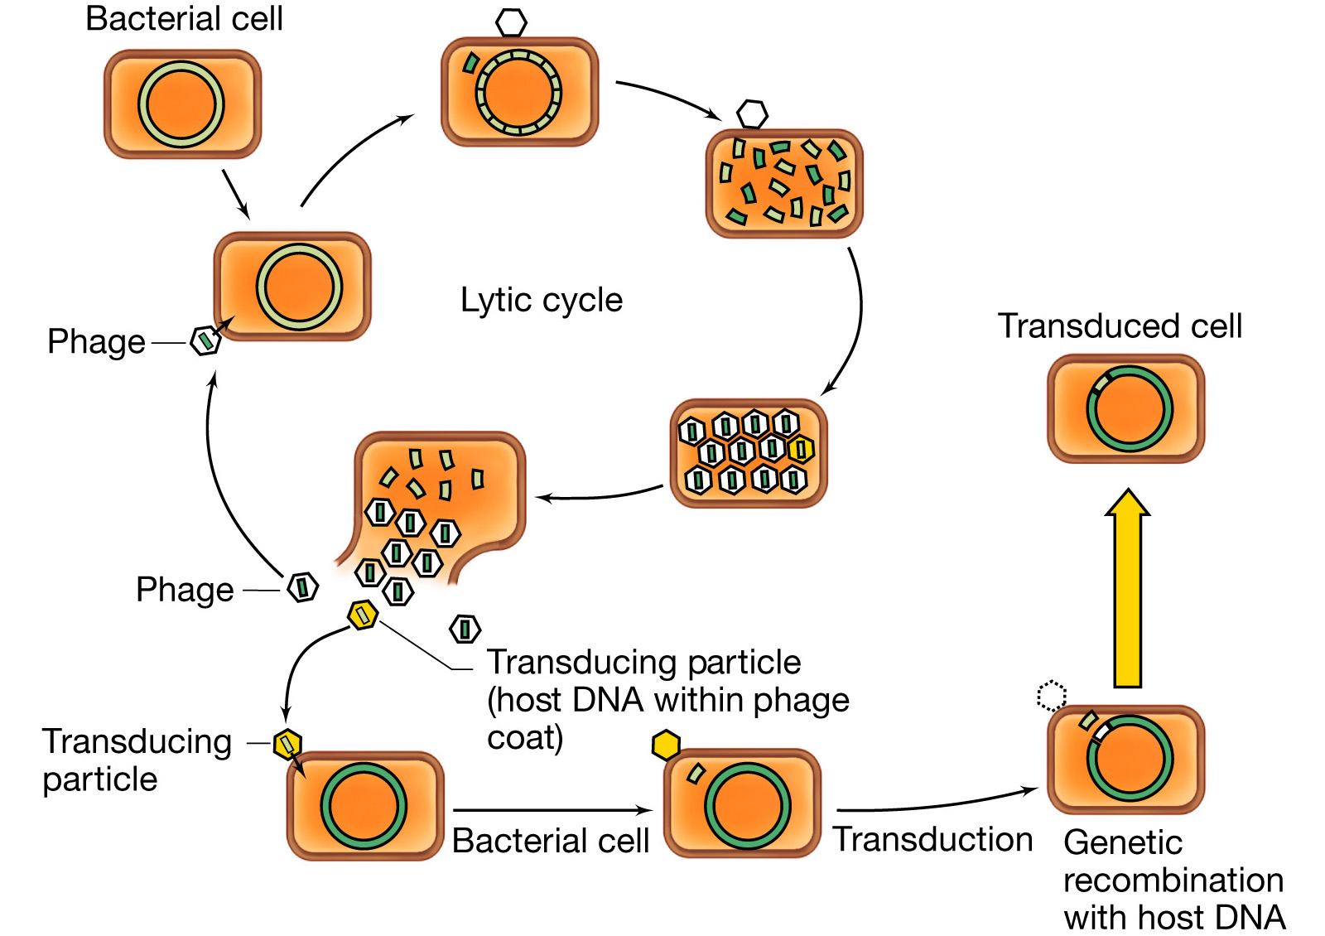
Generalized transduction

Slide 4
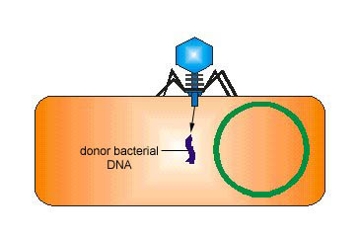
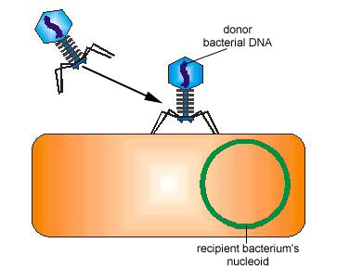
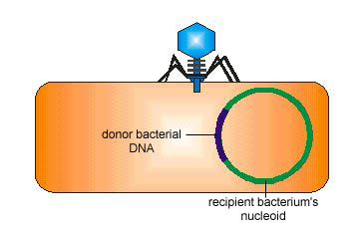
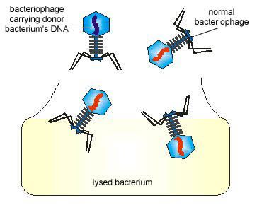
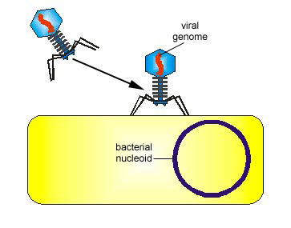
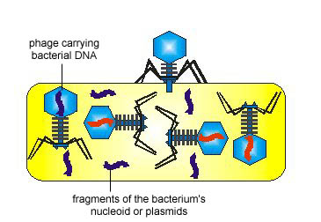
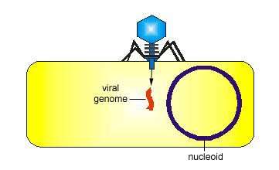
Mechanism of generalized transduction

Slide 5
An example of generalized
transduction

Slide 7
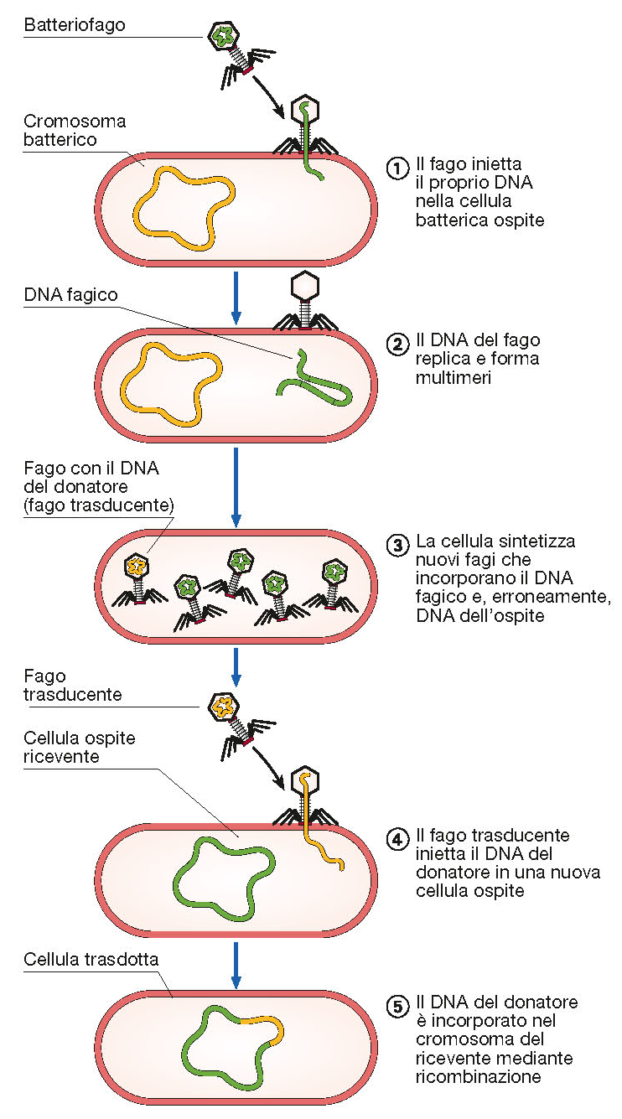

Slide 8
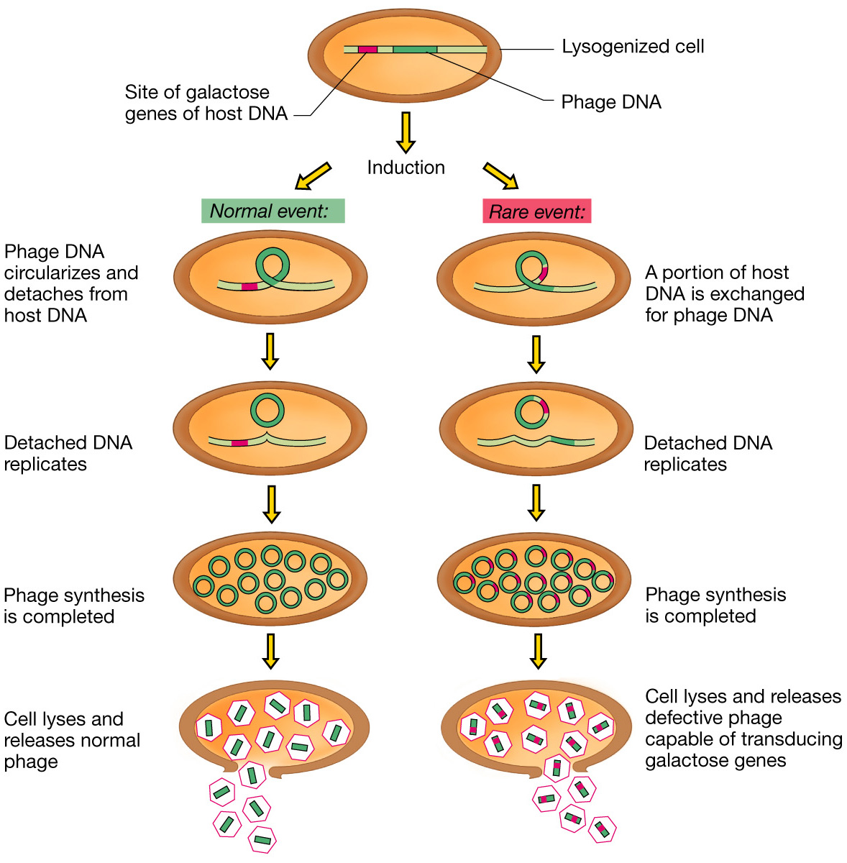
Specialized transduction

Slide 9
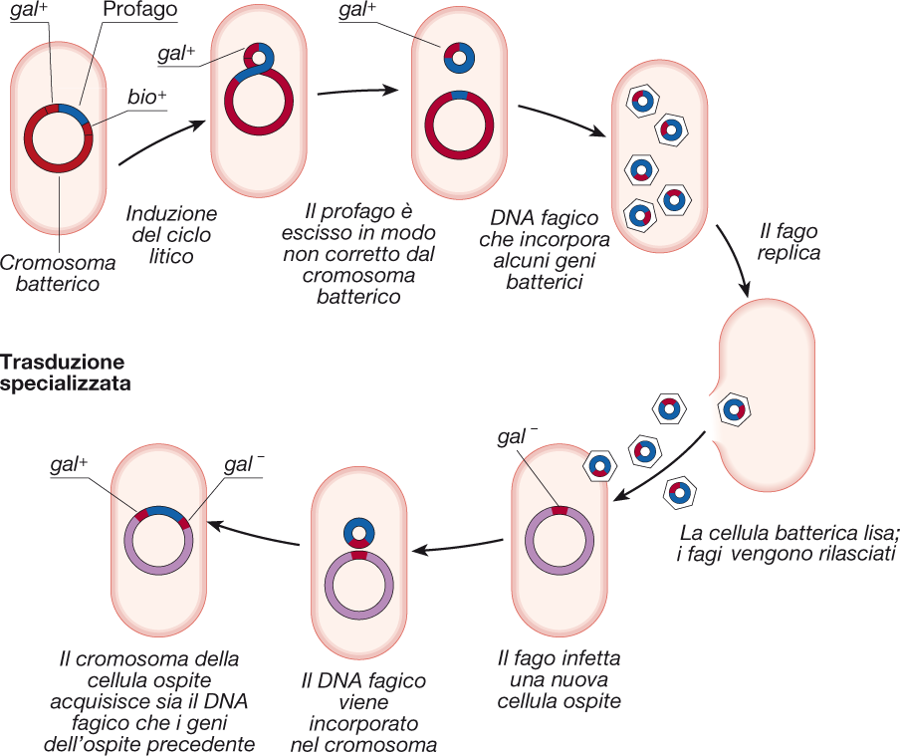

Slide 10
Formation of a λdgal transducing particle

Slide 11
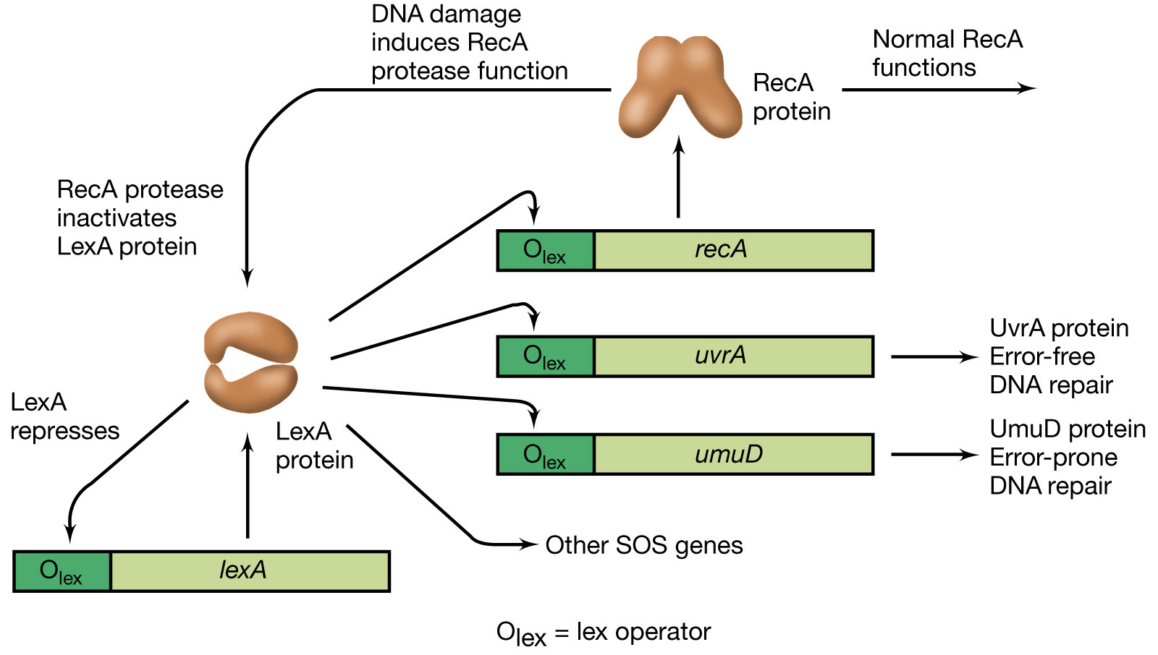

Slide 12
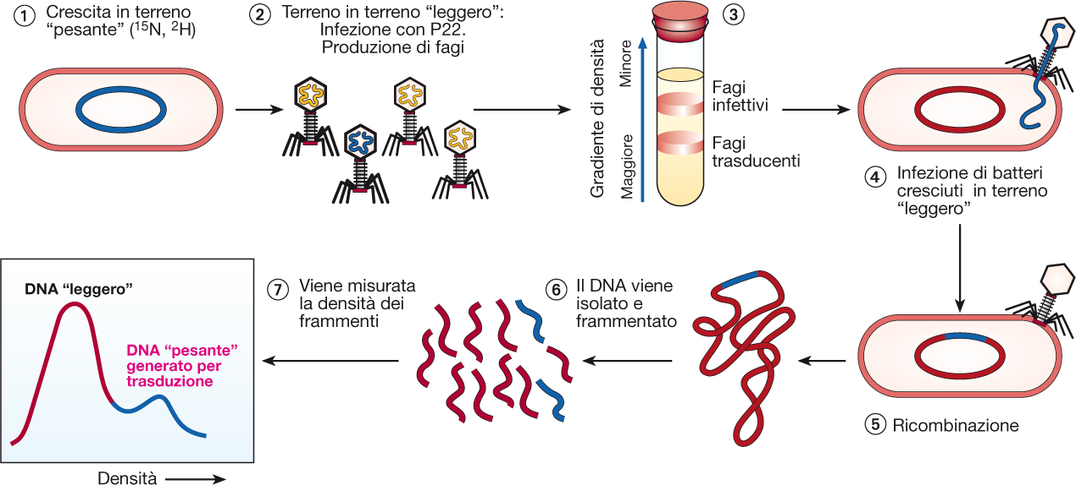

Slide 13
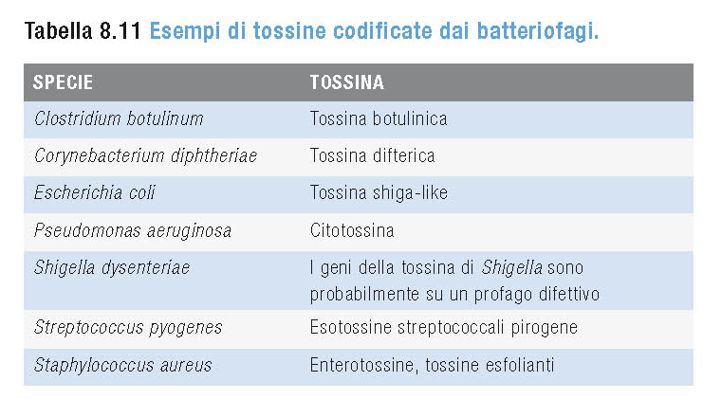
Lysogenic conversion
A temperate phage induces a change in the phenotype of the infected bacteria. Changes can often involve the external membrane of the cell by making it impervious to other phages or even by increasing the pathogenic capability of the bacteria for a host. In this way, temperate bacteriophages also play a role in the spread of virulence factors, such as exotoxins and exoenzymes, amongst bacteria.

Slide 14
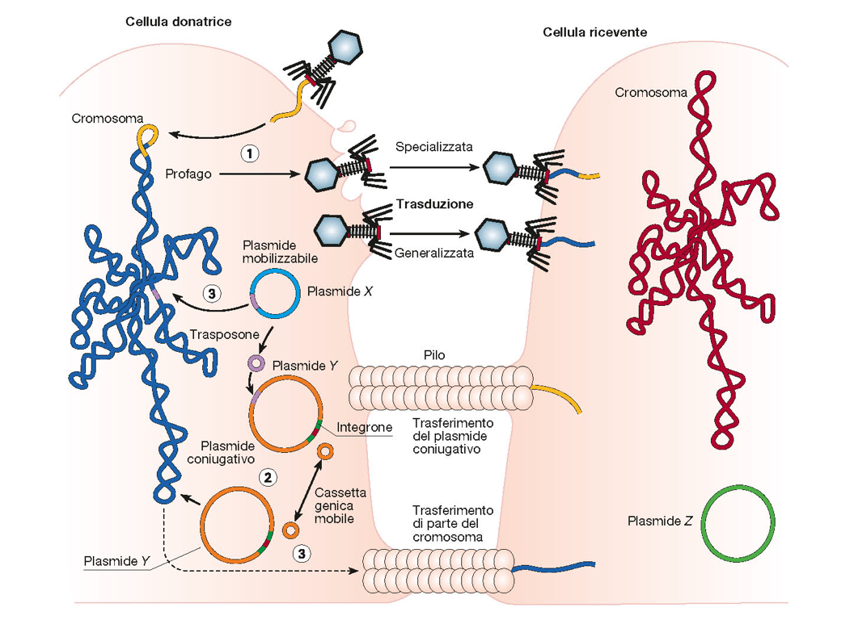
Overview of the horizontal gene transfer processes

Slide 15
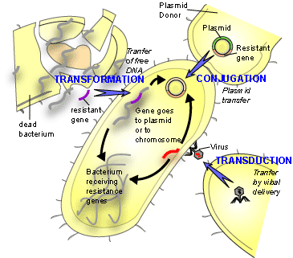
Overview of the horizontal gene transfer processes

Slide 16
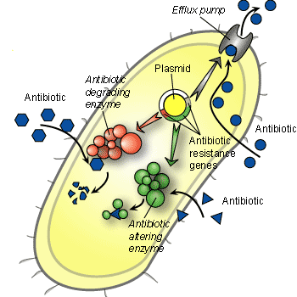
Horizontal gene transfer and antibiotic resistance

Slide 17
Suggested reading
Robert V. Miller
Scambio di geni tra batteri in natura
Le Scienze 355, 68-73,1998

Slide 18
Microbial genetics:
transposons

Slide 19
Bacterial Transposons
Transposable elements (“Jumping genes”)
Mobile DNA
- able to move from one place to another within a cell’genome
- sometimes a copy is made and teh copy moves
- insertion requires target DNA sequences
In Bacteria, transposons can jump from chromosomal DNA to plasmid DNA and back
In the process of transposition, they may:
- cause mutations
- increase (or decrease) the amount of DNA in the genome
- promote genome rearrangements (inversions, deletions, duplications)
- regulate gene expression
- induce chromosome breakage and rearrangements
Bacterial Transposon types:
1. Insertion Sequences (IS)
2. Simple Tranposons
3. Composite transposons
4. Transposable phages (Mu phage)

Slide 20
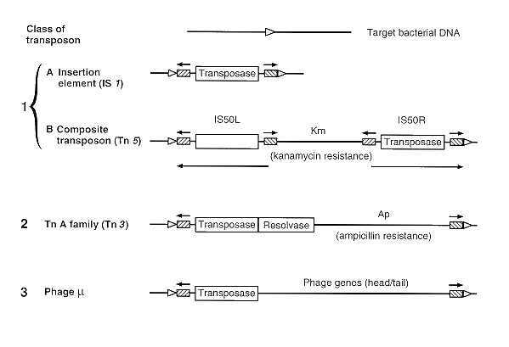
Structure of bacterial transposons
1
3
2
4

Slide 21
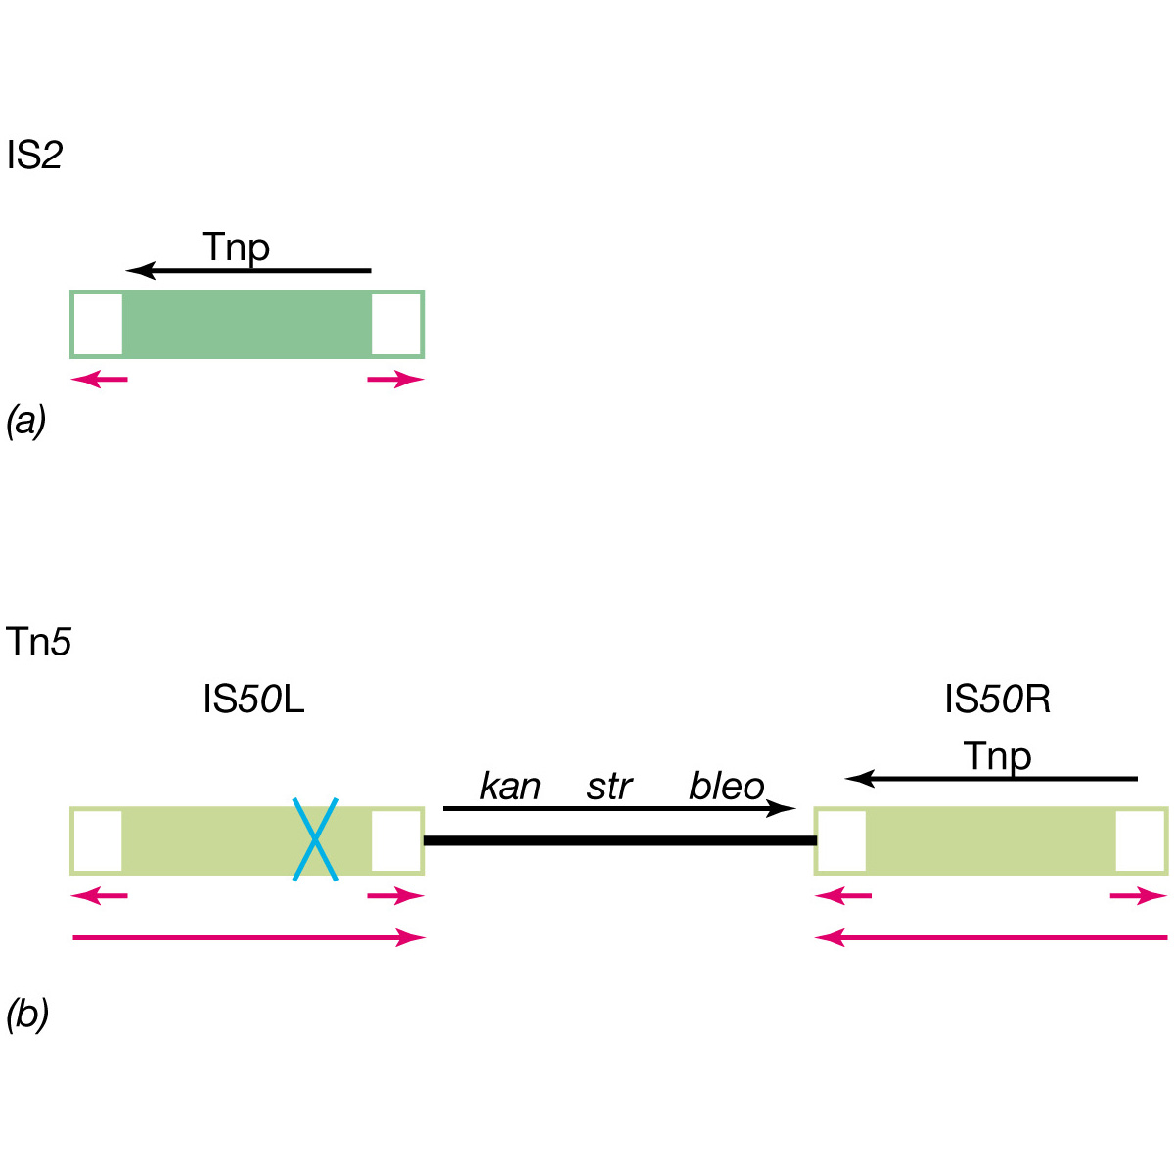
Structure of bacterial transposons

Slide 22
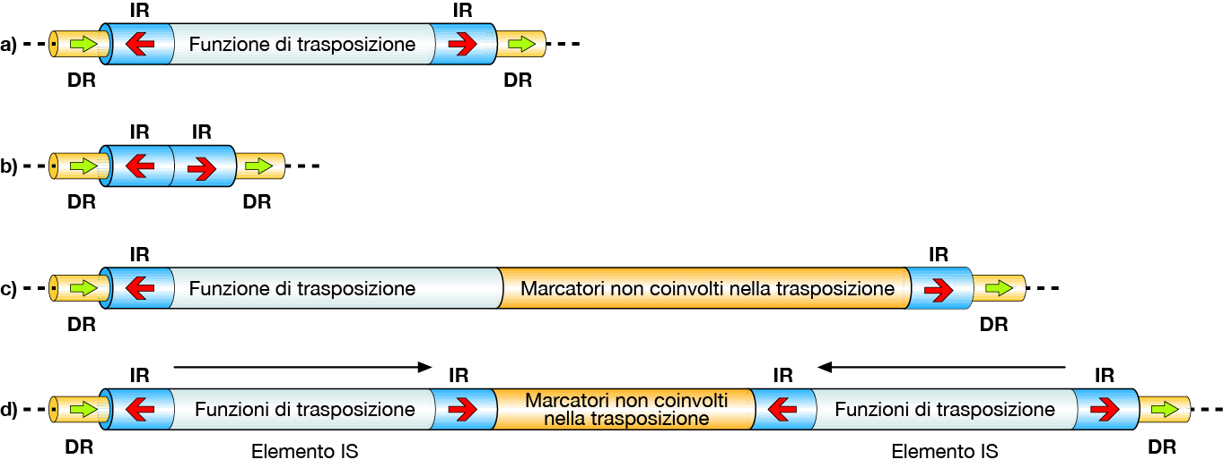
Structure of bacterial transposons

Slide 23
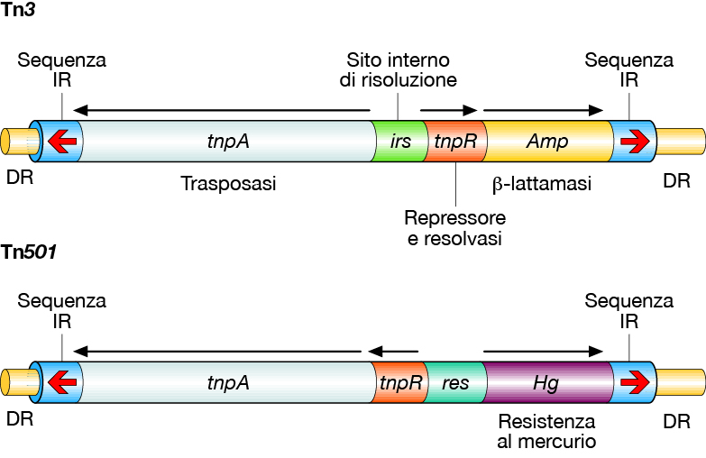
Structure of simple bacterial transposons

Slide 24
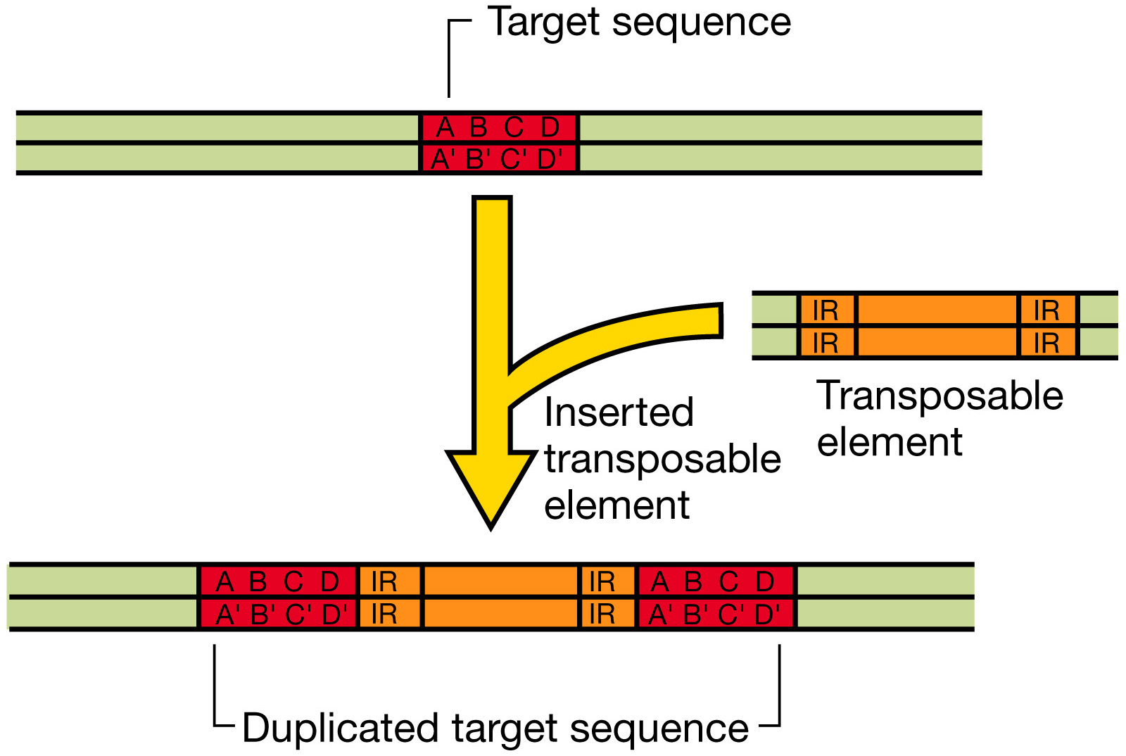

Slide 25
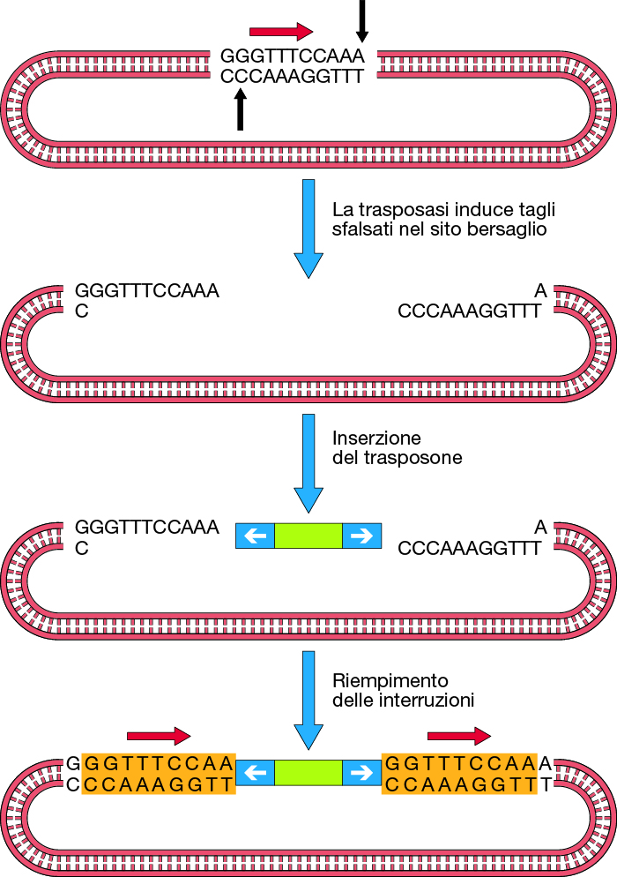
Transposition: generation of DR sequences

Slide 26
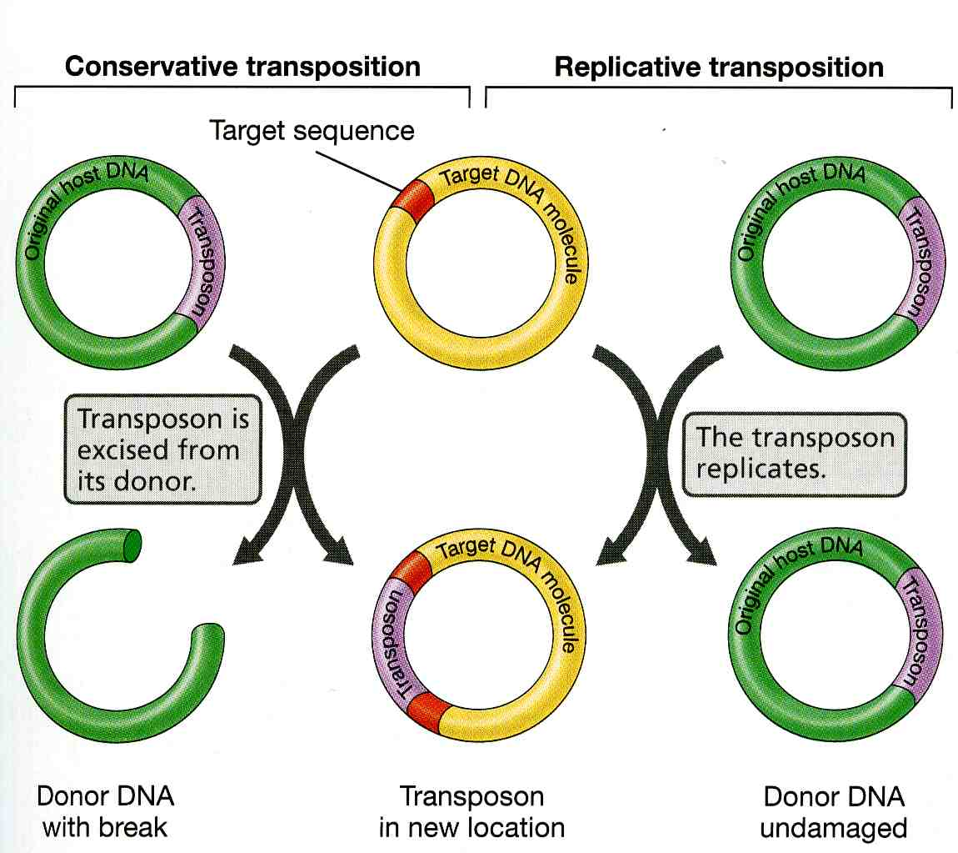
Two mechanisms of transposition
Replicative: Tn3
Conservative: Tn5, Tn7, Tn9

Slide 27
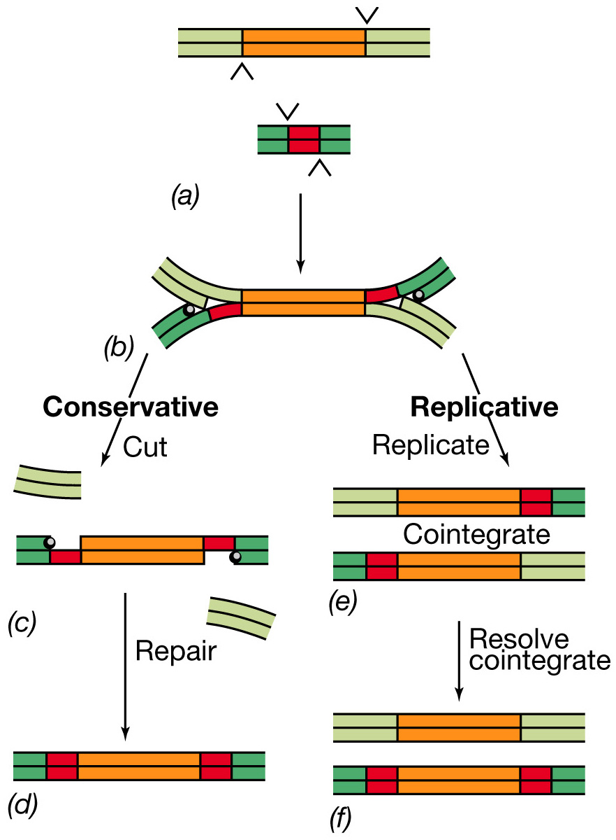
Transposition

Slide 28
Conservative transposition

Slide 29
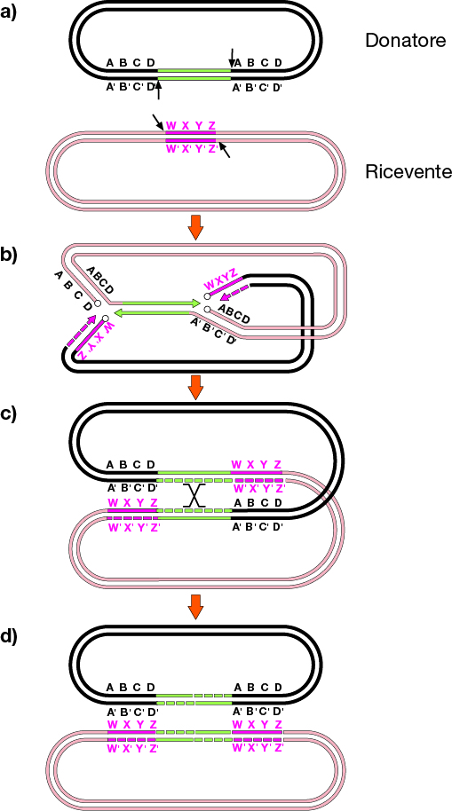
Replicative transposition

Slide 30
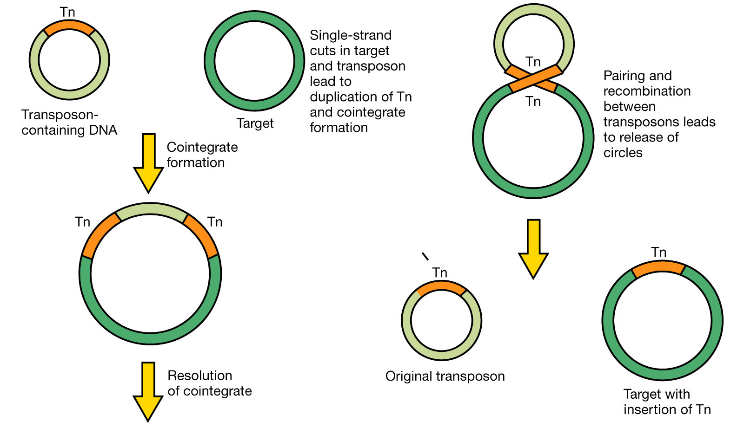

Slide 31
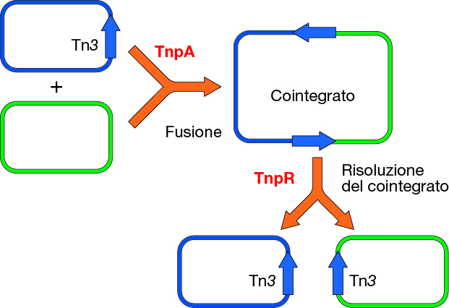
Tn3 transposition

Slide 32
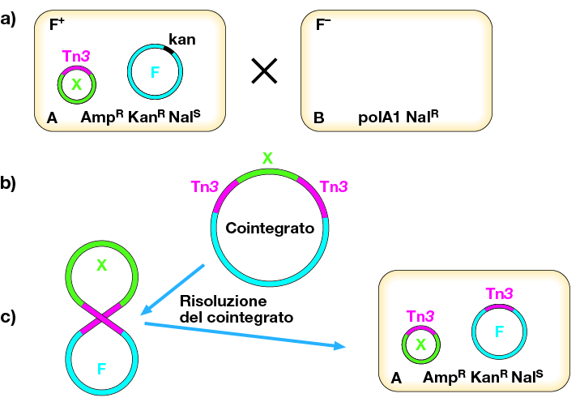

Slide 33
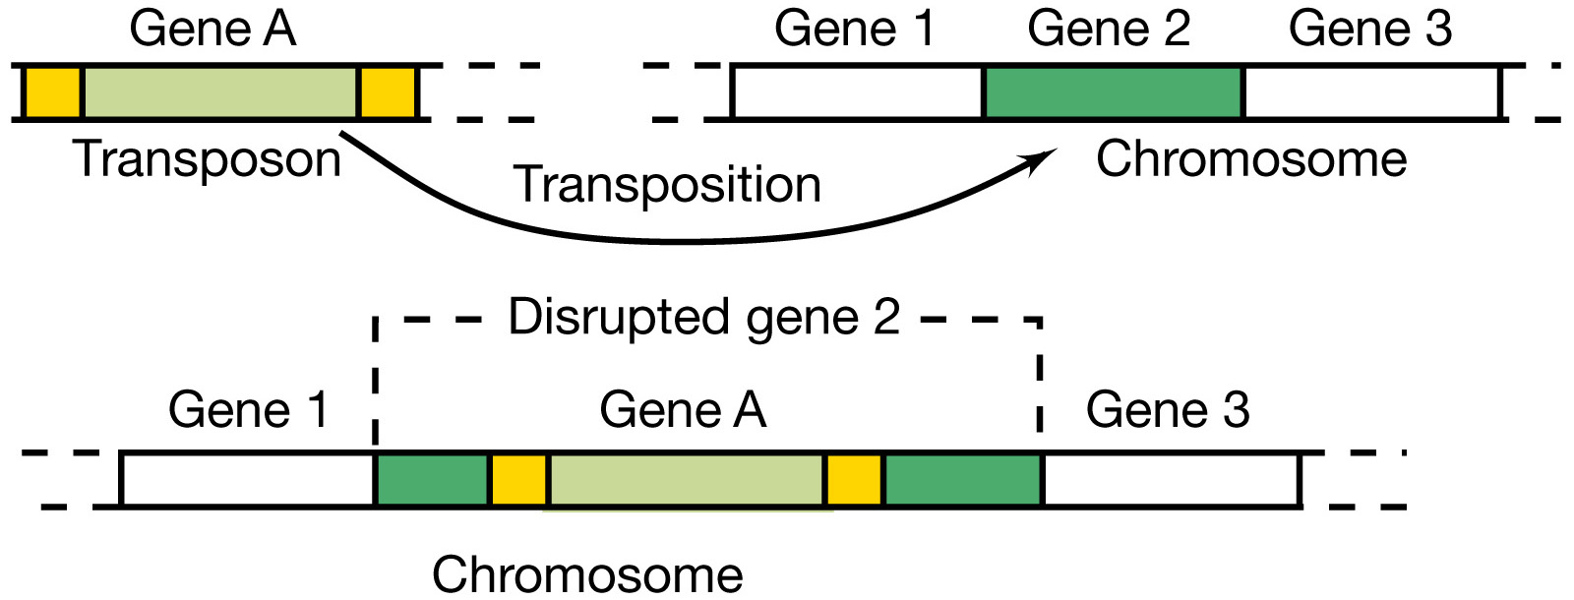
Transposition and mutagenesis

Slide 34
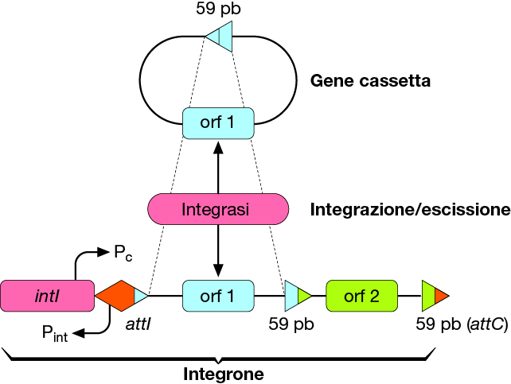

Slide 35
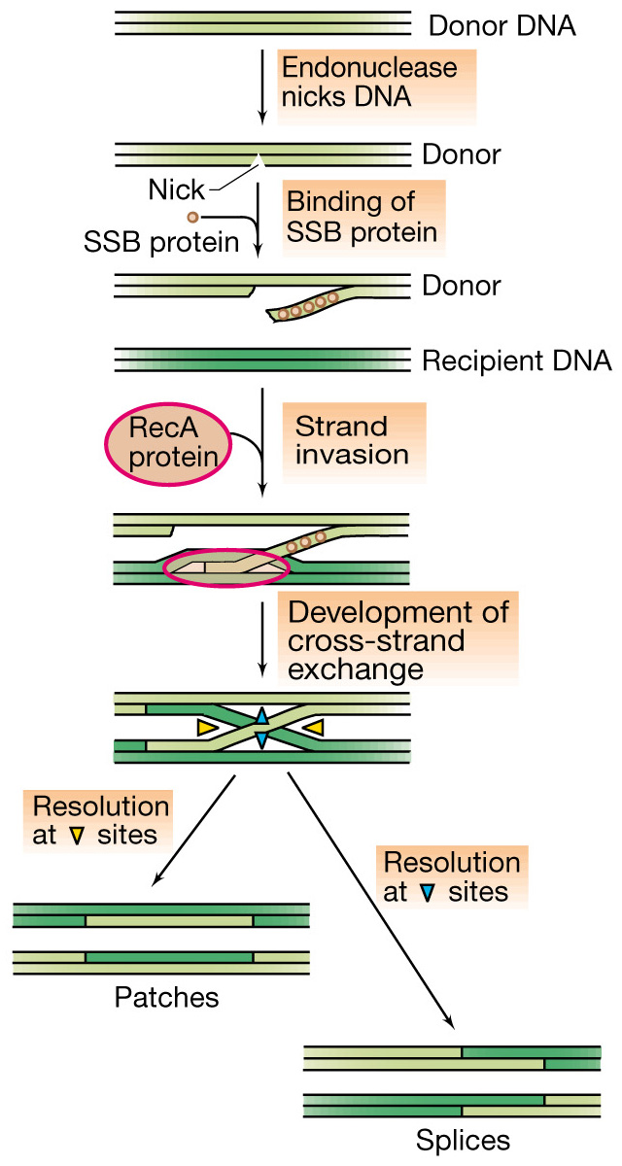
Notes:
Figure: 10-09
Caption:
A simplified version of one molecular mechanism of genetic recombination. Homologous DNA molecules pair and exchange DNA segments. The mechanism involves breakage and reunion of paired segments. Two of the proteins involved, a single-stranded binding (SSB) protein and the RecA protein, are shown. The other proteins involved are not shown. The diagram is not to scale: Pairing can occur over hundreds or thousands of bases. Resolution occurs by cutting and ligating the cross-linked DNA molecules. Note that there are two possible outcomes, depending on which strands are cut during the resolution process. In one outcome the recombinant molecules have patches, whereas in the other the two parental molecules appear to have been cut and then spliced together.

